Slide 1
Famous people from
POLAND

Slide 2
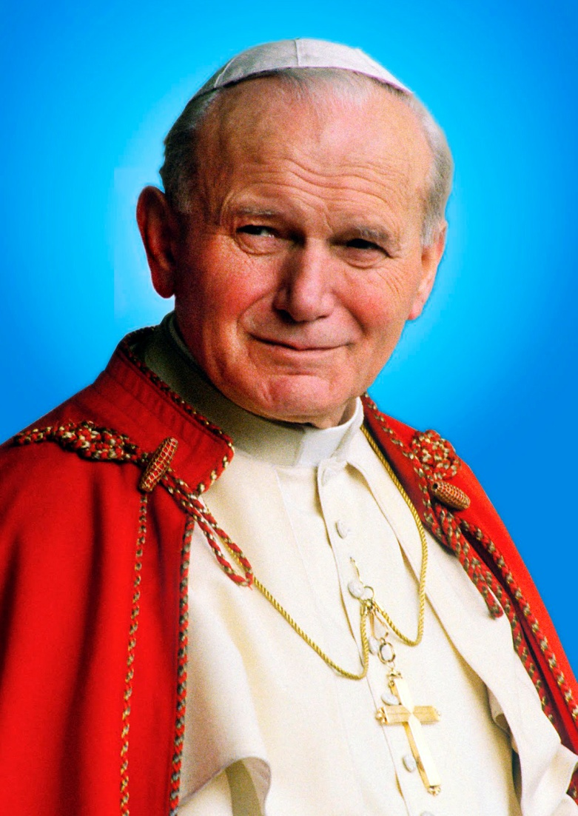
Jan Paweł II (Karol Wojtyła)
born in 1920, died in 2005
the Pope of Catholic Church

Slide 3
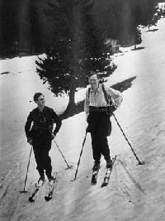

Slide 4
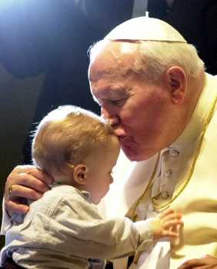

Slide 5
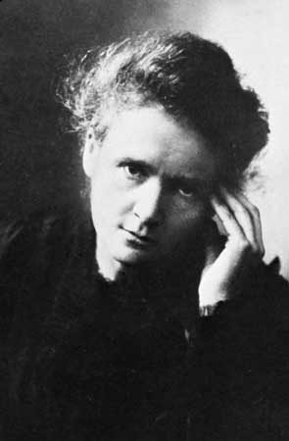
Maria Skłodowska - Curie
1867 – 1934
lived in Paris with her husband
discovered two chemical elements
won a Nobel Prize twice

Slide 6
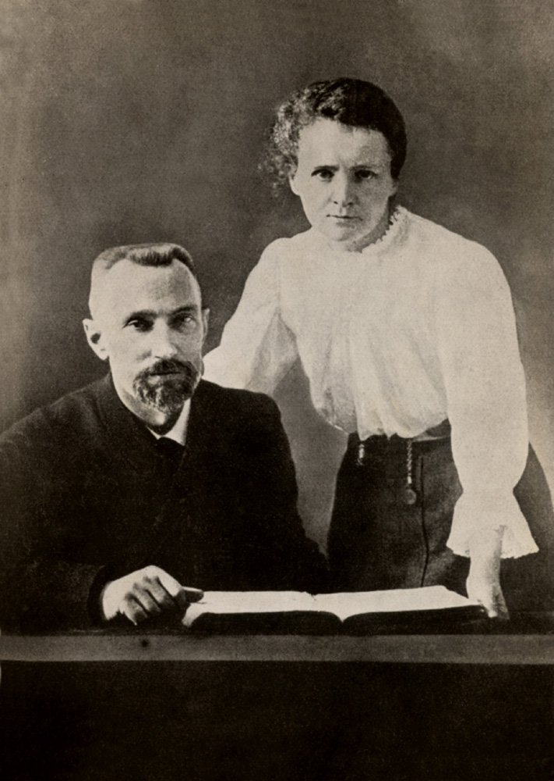

Slide 7
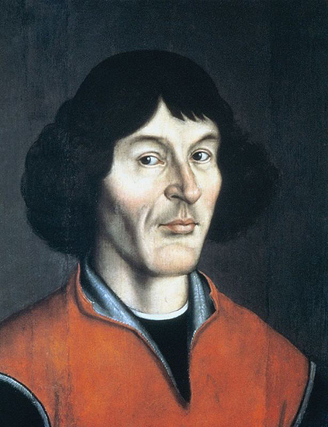
Mikołaj Kopernik
born in 1473 in Toruń
heliocentric theory

Slide 8
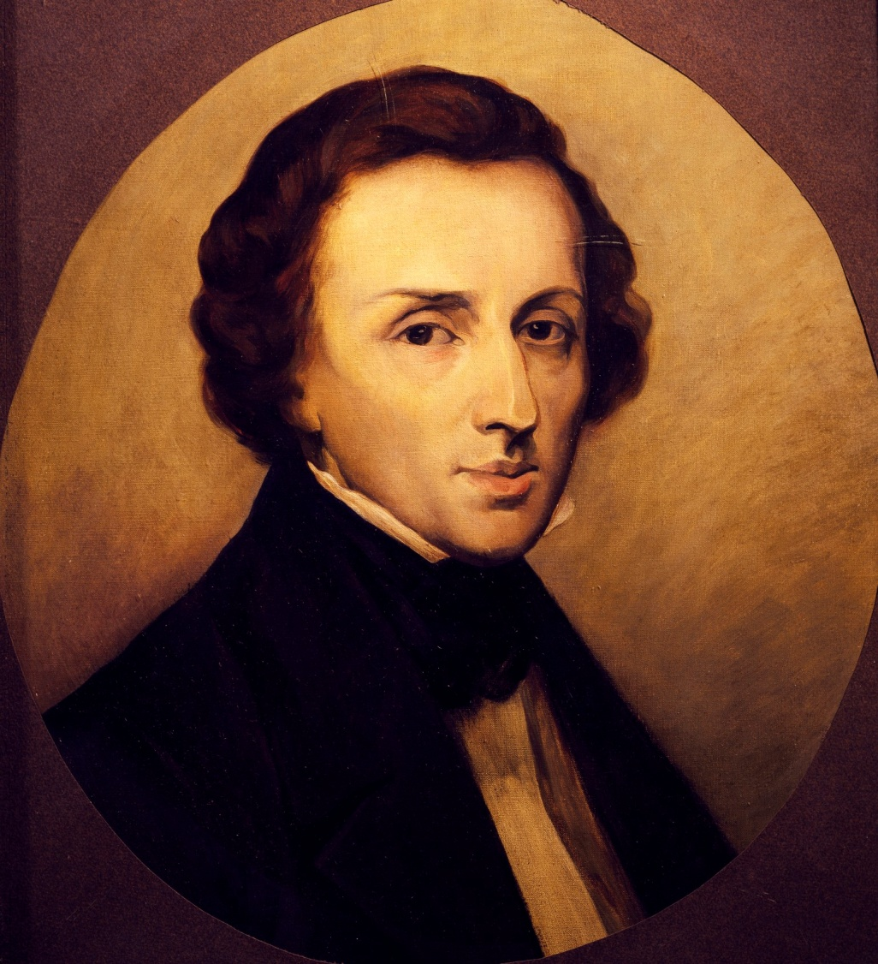
Fryderyk Chopin
1810 (Żelazowa Wola) – 1849 (Paris)
great composer and pianist

Slide 9
