Slide 1
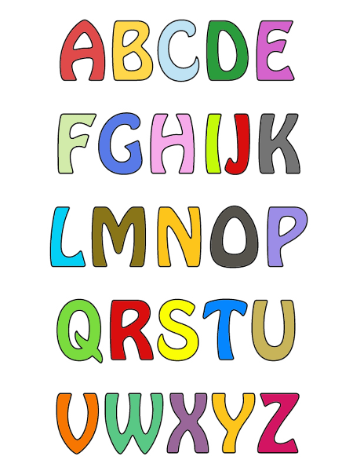
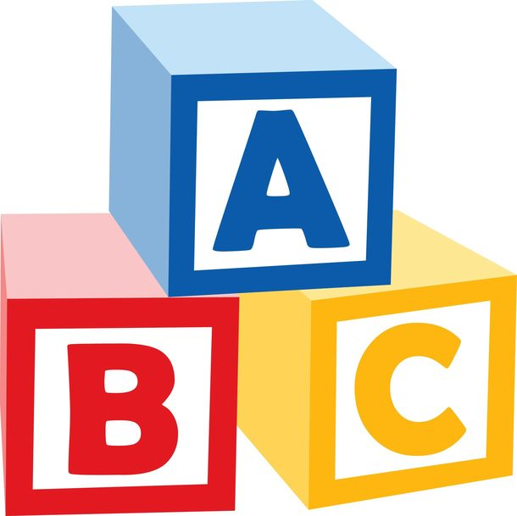
JULIAN TUWIM: ”THE ALPHABET”

Slide 3
The text in english is:
The alphabet fell off the bed,
And thumped onto the floor,
Scattered all around the room,
And got really score:
I-misplaced its little dot,
H-was bridge-like,now its not
B-two tummies got all bruised,
A-got both its legs confused,
O-just burst like a balloon,
Making P roll eyes and swoon,
T-cant find its little hat,
L-jumped inside U at that,
S-got straighter than a die,
R-right leg snapped at the thigh,
W-landed on its head
And pretends its M instead.

Slide 4
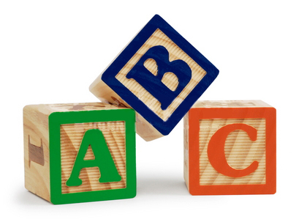
a short interpretation of the poem…
The alphabet,as you know,fell on the floor and broke,the history of broken alphabet is a very good way to learn the letters.A poet wants to help us to secern the letters.This fairy-tale teaches us reading and writting letters in very funny and comfortable way

Slide 5
something about the author…
Julian Tuwim Julian Tuwim (1894-1953) was polish poet of jewish orgin. He was born in Łódź. In 1916 he moved to Warsaw to study law and philosophy at the University of Warsaw. Julian got married and adopted doughter. He wrote many poems, for example: - Juwenilia - Czyhanie na Boga - Sokrates tańczący - Siódma jesień - Rzepka

Slide 6
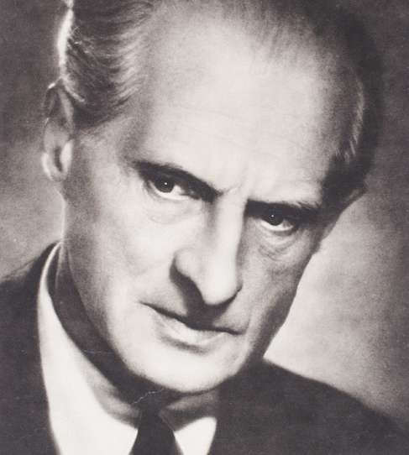
The author of this poem-Julian Tuwim

Slide 7
THIS PRESENTATION WAS MADE BY:
KLAUDIA KONDRACIUK
WERONIKA KOSZAŁKA
MAGDALENA KOTOWSKA
3F

