Slide 1
True Love Wislawa Szymborska

Slide 2
True Love True love. Is it normal is it serious, is it practical? What does the world get from two people who exist in a world of their own?

Slide 3
Placed on the same pedestal for no good reason, drawn randomly from millions but convinced it had to happen this way - in reward for what? For nothing. The light descends from nowhere. Why on these two and not on others? Doesnt this outrage justice? Yes it does. Doesnt it disrupt our painstakingly erected principles, and cast the moral from the peak? Yes on both accounts.

Slide 4
Look at the happy couple. Couldnt they at least try to hide it, fake a little depression for their friends sake? Listen to them laughing - its an insult. The language they use - deceptively clear. And their little celebrations, rituals, the elaborate mutual routines - its obviously a plot behind the human races back!

Slide 5
Its hard even to guess how far things might go if people start to follow their example. What could religion and poetry count on? What would be remembered? What renounced? Whod want to stay within bounds?

Slide 6
True love. Is it really necessary? Tact and common sense tell us to pass over it in silence, like a scandal in Lifes highest circles. Perfectly good children are born without its help. It couldnt populate the planet in a million years, it comes along so rarely.

Slide 7
Let the people who never find true love keep saying that theres no such thing. Their faith will make it easier for them to live and die. Translated from the Polish by Stanislaw Baranczak and Clare Cavanagh

Slide 8
Wislawa Szymborska was born on second July, 1923 in Prowent. Polish poet, winner of the Nobel Prize in literature. Its important work is "the cat in an empty apartment." She died on first February, 2012 in Krakow.

Slide 9
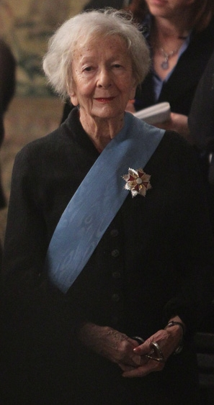
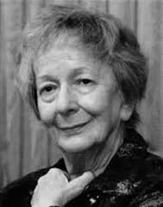
Maria Wislawa Anna Szymborska

Slide 10
„True love" in a rather ironic way discredit the phenomenon of unrequited love. However, it seems obvious that the discrediting is not actual - noticeable is the fact that this verse would rather be written by someone who has a love never experienced. Even more, it seems appropriate to establish that the song is written from the perspective of an absolutely objective observer, who can spend a cool judgment about reality.

Slide 11
Presentations prepared: Natalia Margol Magdalena Paździor Agnieszka Rogala With 1G-class, high school number 10 in Lublin.

