Slide 1
Sándor Weöres The brambleberry
Made : Ungvári Gyöngyike
Decsi Kíra
Orosz Kitti
Pósán Petra

Slide 2
Contents
The blambleberry
Sándor Weöres
Weöres family

Slide 3
Sándor Weörös The brambleberry
The brambleberry
Eves of autumn
Gleam with the brambleberry’s
Gleam with the brambleberry’s
Shimm’ring dress. Thorns a-rustling,
Winds scurry hither-thither,
Trembles the brambleberry
Comfortless
Should but the moon left lower her veil Bush turns maiden, starts to wail…
Eves of autumn
Gleam with the brambleberry’s
Gleam with the brambleberry’s
Shimm’ring dress. Translated by Adam Makkai
The poem in hungarian
Őszi éjjel izzik a galagonya izzik a galagonya ruhája. Zúg a tüske, szél szalad ide-oda, reszket a galagonya magába. Hogyha a Hold rá fátylat ereszt: lánnyá válik, sírni kezd. Őszi éjjel izzik a galagonya izzik a galagonya ruhája.

Slide 4
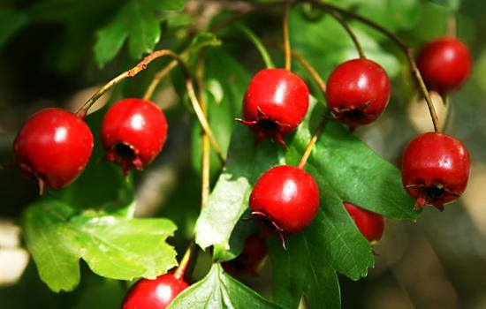
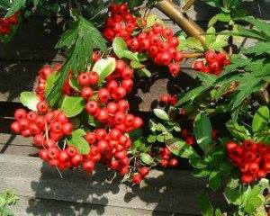
The brambleberry form the poem

Slide 5
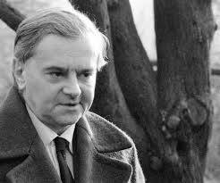
Sándor Weöres
He lived in the 20th century. He was a Hungarian poet and also an author. His wife was a poet too, her name was Amy Károlyi. He wrote poets for children and adults too.

Slide 6
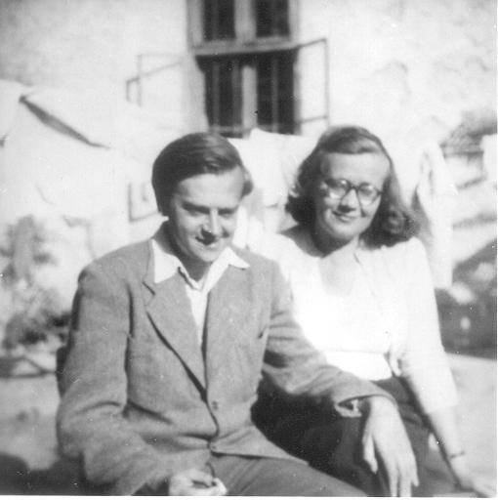
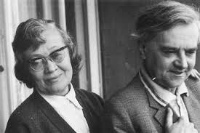
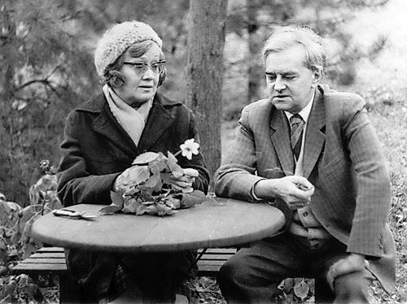
Weöres family
He and his wife

Slide 7
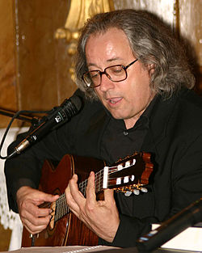
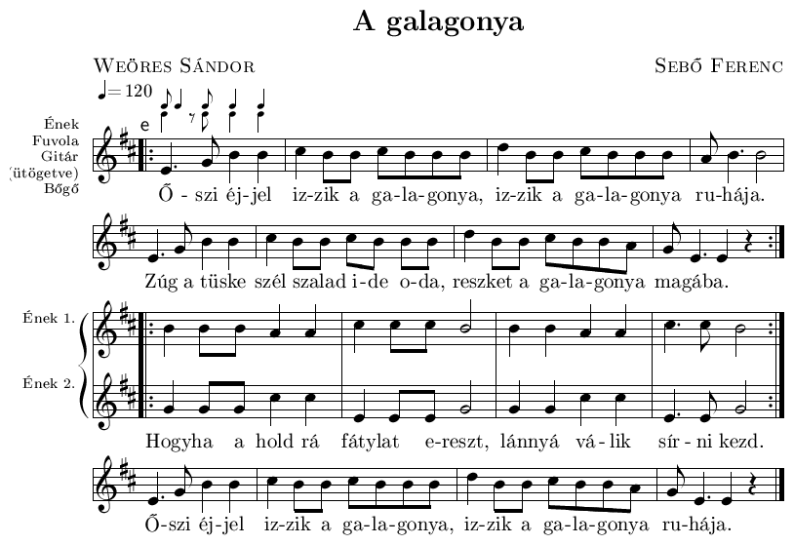
The brambleberry as a song
Ferenc Sebők set this poet to music. He and his band did it with lots of poest from Weöres

Slide 8
Thanks for your attention! ☺

