Slide 1
Attila József: Mama
Made:
Patrik Kocsis
Vince Márk Balla
László Tulipánt
Bence Dros

Slide 2
Contents
Attila József ’s Biography
About His Poems
The Poem

Slide 3
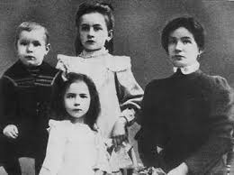
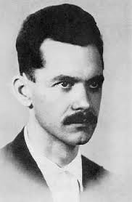
Attila József ’s Biography
Attila József was born 11th April, 1905 He had two elder sisters: Eta and Jolán. Attila József is the best known of the modern Hungarian poets internationally. Ödön Makai, his brother-in-law could pay for Attilla József's secondary education.He continued his studying in the Franz Joseph University. He wanted to be a secondary school teacher. He didn’t get married. He died 3rd December in 1937.
Attila József with his mother and his sisters.
Attila József when his older.

Slide 4
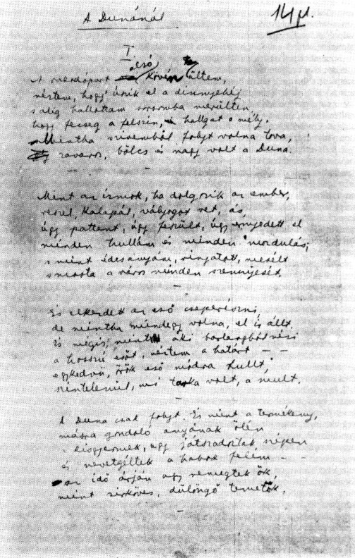
About His Poems
His first volume of poetry was A szépség koldusa (1922) (Beauty's beggar).In 1925 József published his second poem: Nem én kiáltok(It's not me who shouts).
This is his mauscript about a famous poem.
These are books of his poetry

Slide 5
The Poem
On Mama now my thoughts have dawdled all of a week. Clothes-basket cradled creaked on her hip; shed climb the stairway up to the drying-attics airway.
Then, for I was an honest fellow, how I would shriek and stamp and bellow! That swollen laundry needs no mother. Take me, and leave it to another.
But still she drudged so quietly, nor scolded me nor looked upon me, and the hung clothes would glow and billow high up above, with swoop and wallow.
Its too late now to still my bother; what a giant was my mother over the sky her grey hair flutters, her bluing tints the heavens waters.

Slide 6
Thank you for your attention

