Slide 1
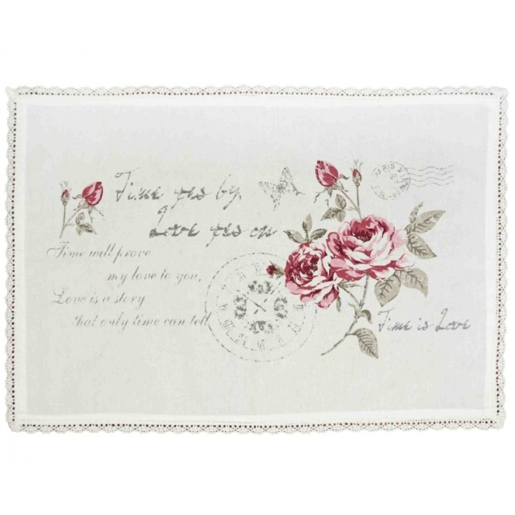
ADAM MICKIEWICZ
”GOODNIGHT”
„Dobranoc”

Slide 2
Goodnight! No more merriment for us today, May angels enfold you in blue wings of cheer, Goodnight! May your eyes ease after bitter tears, Goodnight! May your heart's passion slumber away. Goodnight! to moments of intimate replies, May a charming and soothing music surround, May it play in your ears, and whilst sleeping sound, Let my image so delight your sleepy eyes. Goodnight. Turn around! Place your gaze in my keep, Permit a cheek-Goodnight!-For your butler you've clapped? Give me your bosom to kiss-Goodnight-so strapped. Goodnight. You have run off and you want no more. Goodnight through the keyhole-sadly-a locked door! Repeating 'goodnight!' I'd never let you sleep.

Slide 3
Adam Mickiewicz is probably most Poland's celebrated poet. He was born in the town of Nowogródek, in present-day Belarus, where his father was a lawyer. He went to Vilnius University to study literature and became active in a student literary group. Mickiewicz was arrested along with his student comrades by the Russian authorities for their "patriotic activities."
In Russia he enjoyed relative freedom, but his movements were closely monitored by the police. He received a Russian passport in 1829, to left Russia and traveled through Germany and Italy. Mickiewicz soon settled permanently in Paris, and in 1834 he married Celina Szymanowska, daughter of a famous composer with whom Mickiewicz had become acquainted in Russia. Celina would bear him six children.
In 1848 he unsuccessfully sought the Pope's blessing to form a Polish legion, and in 1855 he set off to Constantinople with his son and personal secretary to fight for France against the Russians in the Crimean War. He died suddenly upon reaching Constantinople, overcome by the strain of the journey. His remains were brought to Paris and some years later were moved to Poland and interred in Cracow's Wawel Cathedral.

Slide 4
His poetry could not be published in his homeland and was never translated in his lifetime. Mickiewicz wrote poetry almost throughout his life. His literary works range from long poems and ballads to simple love sonnets. His most famous works are the epic poem ”Pan Tadeusz”. He wrote a love sonnet – ”Goodnight” during his younger days in Russia

Slide 5
Sonnet of Adam Mickiewicz ”Goodnight” is about lovers which cannot say goodbye.
The mood of the sonnet is sentimental, tender, calm, emotional. A man which wishes is a saying person one's beloved of calm dream, entrusts the care of the angel of the dream with it. He is calm, gently asks come to love so that she doesn't diverge, wants from every together spent moment sound to remain in her memory some quiet and charming.
He is demanding than one's beloved so that with him longer she stays a bit longer, doesn't want to wind up even though repeating still goodnight it would seem that he is already saying goodbye. The girl is escaping from the romantic lover and is closing the door.

Slide 6
Karolina Glimasińska 3F

