Slide 1
Love poetry
Made by: Szabina Vig, Petra Szima, Bori Varga, Zsófi Beke, Lilla Lakatos
2016.02.12

Slide 2
Title
The poem
About the writer
About the poem

Slide 3
Endre Ady: I guard your eyes
With my old man's wrinkled hand,
with my old man's squinting eyes,
let me hold your lovely hand,
let me guard your lovely eyes.
Worlds have tumbled, through their fall
like a wild beast chased by fright
I came, and I on you did call
scared, I wait with you inside.
With my old man's wrinkled hand,
with my old man's squinting eyes,
let me hold your lovely hand,
let me guard your lovely eyes.
I do not know why, how long
can I thus remain for you -
but I hold your lovely hand
and I guard your lovely eyes.

Slide 4
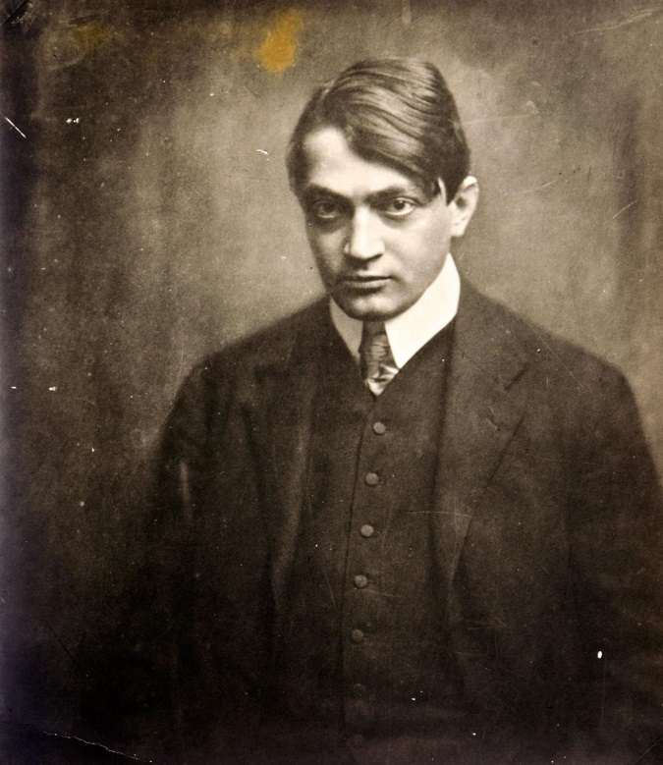
About Endre Ady
Endre Ady , 1877-1919, Hungarian poet. He abandoned his studies in law for a career in journalism and literature. His first volume of poetry, Versek, appeared in 1899. After 1903 he spent most of his time in Paris, where he fell in love with a woman who became the subject of many poems. A lyric poet noted for an original and creative use of language, Ady was influenced by the French symbolists. He became a leader of the politically and artistically radical Hungarian writers who attacked the complacent materialism of Hungary’s upper classes and founded the literary magazine, Nyugat at the New York Café. He died in Budapest on 27 January 1919.

Slide 5
About the poem
Date of publishing: January 1916. Title of the volume Halottak élén (Leading the Dead 1918).
Genre of the poem is elegiac chanson.
The elegy means disappointment, mourning.
In this poem Endre Ady expresses his own pain, mourning
Historical background: Transylvania where he and his lover, Csinszka live is attecked by the Roumanian troop in the 1st World War.
Ady fears of the war, the disaster, his health and the death.
Csinszka is his only supporter in his fears. The poet considers himself old and turns to the young and strong woman for love and affection.

Slide 6
Thank you for your kind attention!

