Slide 1

Turkey Meal
Çiğköfte
Baklava
Kebab
Iskender
Winding
Şırdan
Tantuni

Slide 2
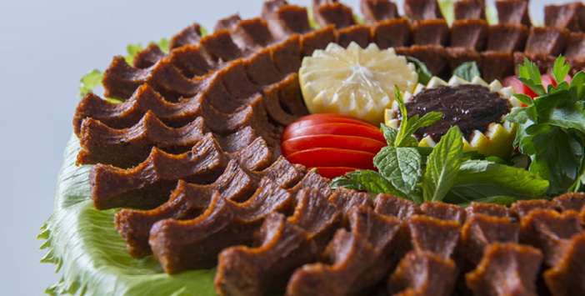
Çiğköfte

Slide 3
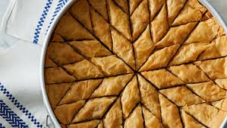
Baklava

Slide 4
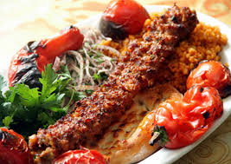
Kebab

Slide 5
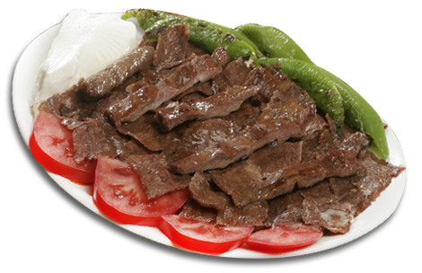
Iskender

Slide 6
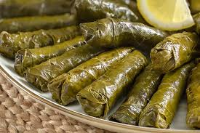
Winding

Slide 7
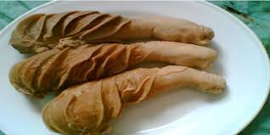
Şırdan

Slide 8
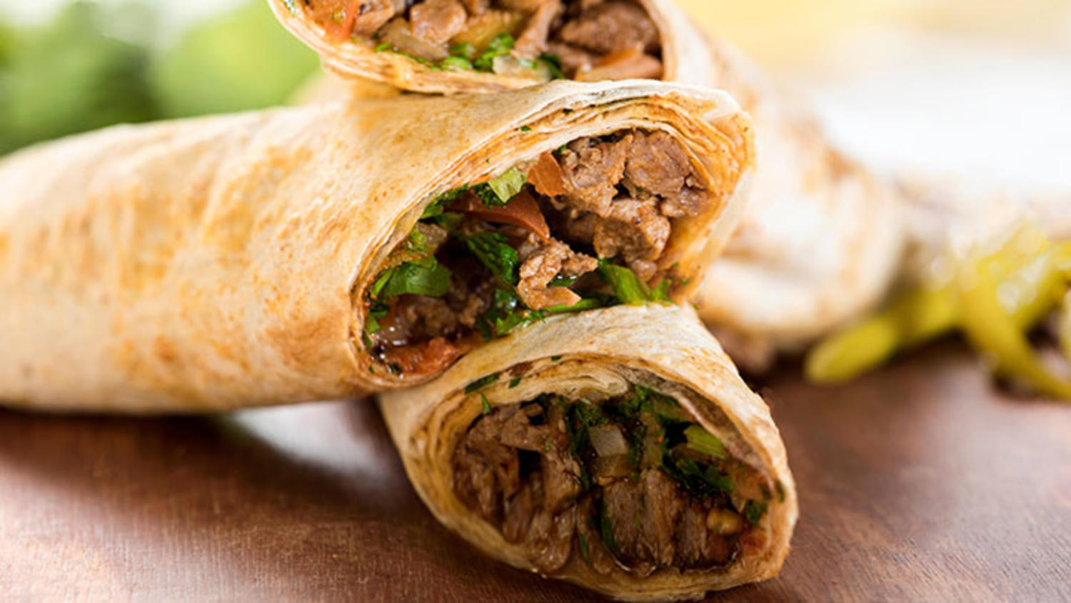
Tantuni

Slide 9
Natural beauties
Fairy chimneys
Ancient City of Ephesus
Kız Kulesi
Sümela Monastery
Pamuk Kale
Taş Köprü
Ihlara Valley
Cennet-Cehennem
Anadolu Hisarı

Slide 10
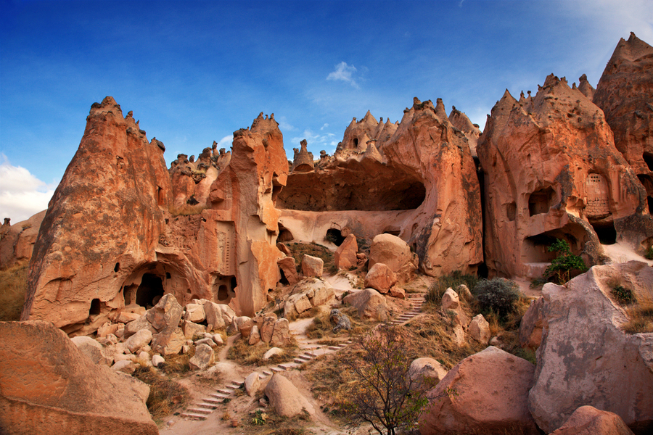
Fairy chimneys
Cappadocia's famous touristic place of Cappadocia, the natural value of the Fairy Chimneys were found here. Cappadocia, a region that has existed millions of years ago, erupted by Erciyes, Hasandağı and Güllüdağı and eroded by rain and wind in places made of lava and ashes.

Slide 11
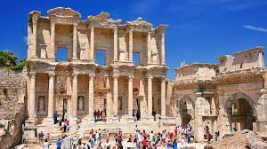
Ancient City of Ephesus
The ancient city of Ephesus is located in the Selçuk district of İzmir. Excavations of the ancient city of Ephesus have been continuing for 100 years. The magnifceint architectural masterpiece, the Celcus Library, the Hillside Houses, the Antique Theater, the King's Road and the many archaeological sites of the city, are the most attractive structures of Ephesus.

Slide 12
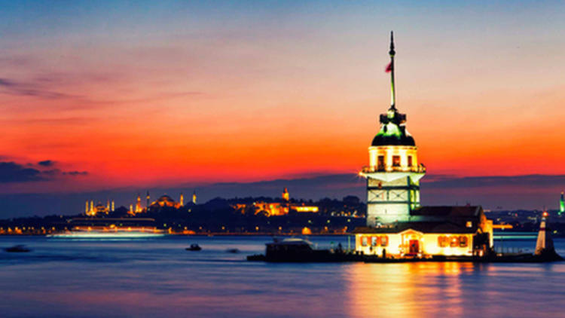
Kız Kulesi(Maiden's Tower)
This unique structure, which dates back to 2500 years ago, had a history which is equal to the history of Istanbul and witnessed the experiences of this city. From ancient Greece to Byzantine Empire, from Byzantine to Ottoman Empire, it has existed in all historical periods until today.

Slide 13
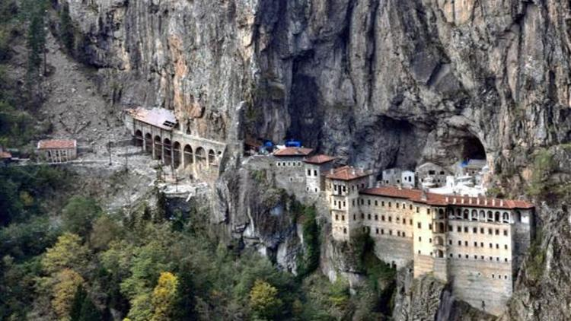
Sümela Monastery
The Sumela Monastery is thought to have been founded by two priests named Barnabas and Sophronios from Athens during the time of the Byzantine Emperor Theodosius I (375dan395). The monastery continued until 1923.

Slide 14
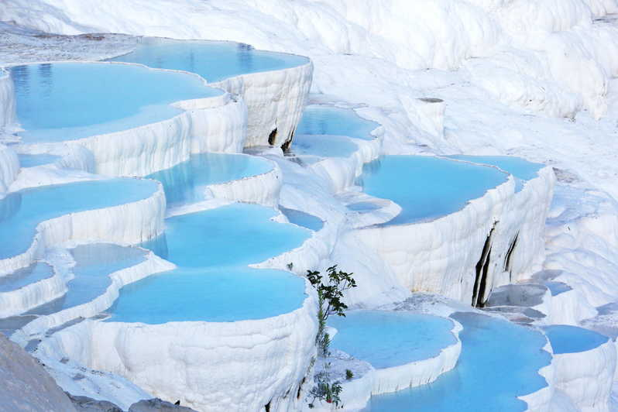
Pamuk Kale
Pamukkale, Turkey's most popular tourist centers. The place where the most local and foreign visitors take place in our country. The Menderes River Valley, Pamukkale, a natural archaeological site, with its white travertines, welcomes visitors as a bride. Pamukkale, which is a rare masterpiece, is located in the province of Denizli and takes place over 20 kilometers of the city.

Slide 15
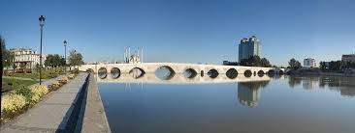
Taş Köprü

Slide 16
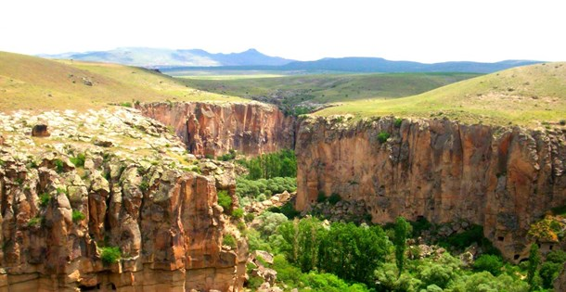
Ihlara Valley

Slide 17
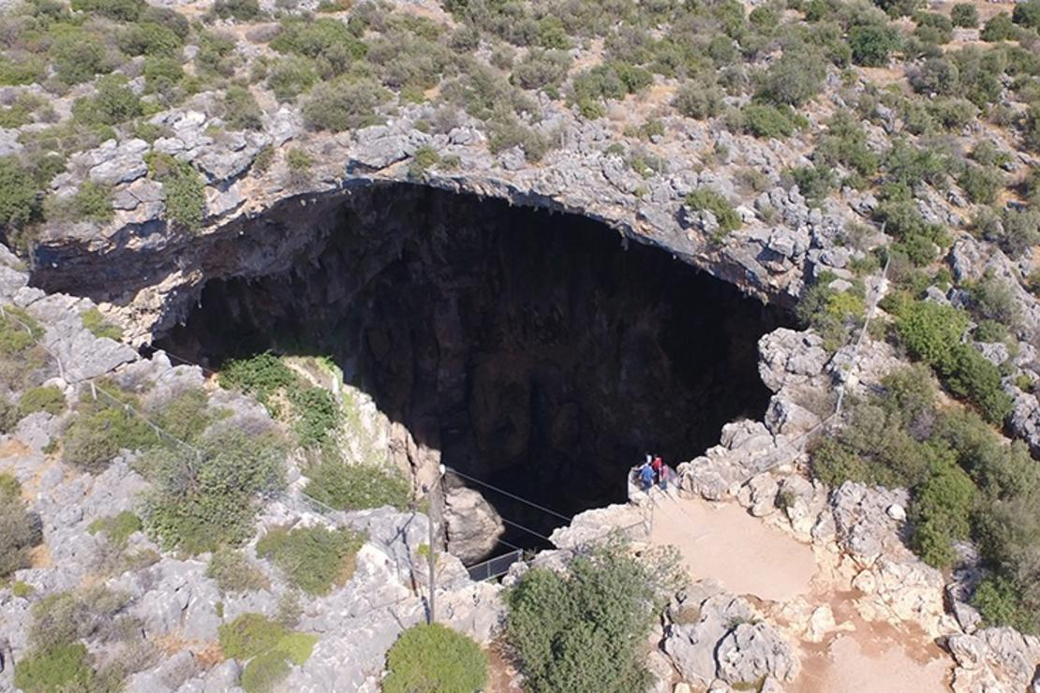
Cennet-Cehennem

Slide 18
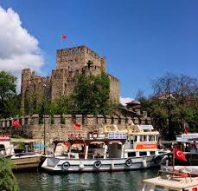
Anadolu Hisarı

