Slide 1
PIZZA
Milica Pejatović V-2
Source: my mom’s kitchen

Slide 2
INGREDIENTS
2 dl yoghurt
4 teaspoons of salt
1 packet of baking powder
1 teaspoon of salt
300 gr of flour

Slide 3
Mix the ingredients to form a dough

Slide 4
Roll out the dough to form a shape that fits a pan

Slide 5
Beat the eggs

Slide 6
Chop the cucumber and bacon

Slide 7
Grate the cheese

Slide 8
Coat the dough with eggs

Slide 9
Add the bacon and cucumber

Slide 10
Add the cheese and parsley

Slide 11
Add ketchup on top

Slide 12
Before and after baking

Slide 13
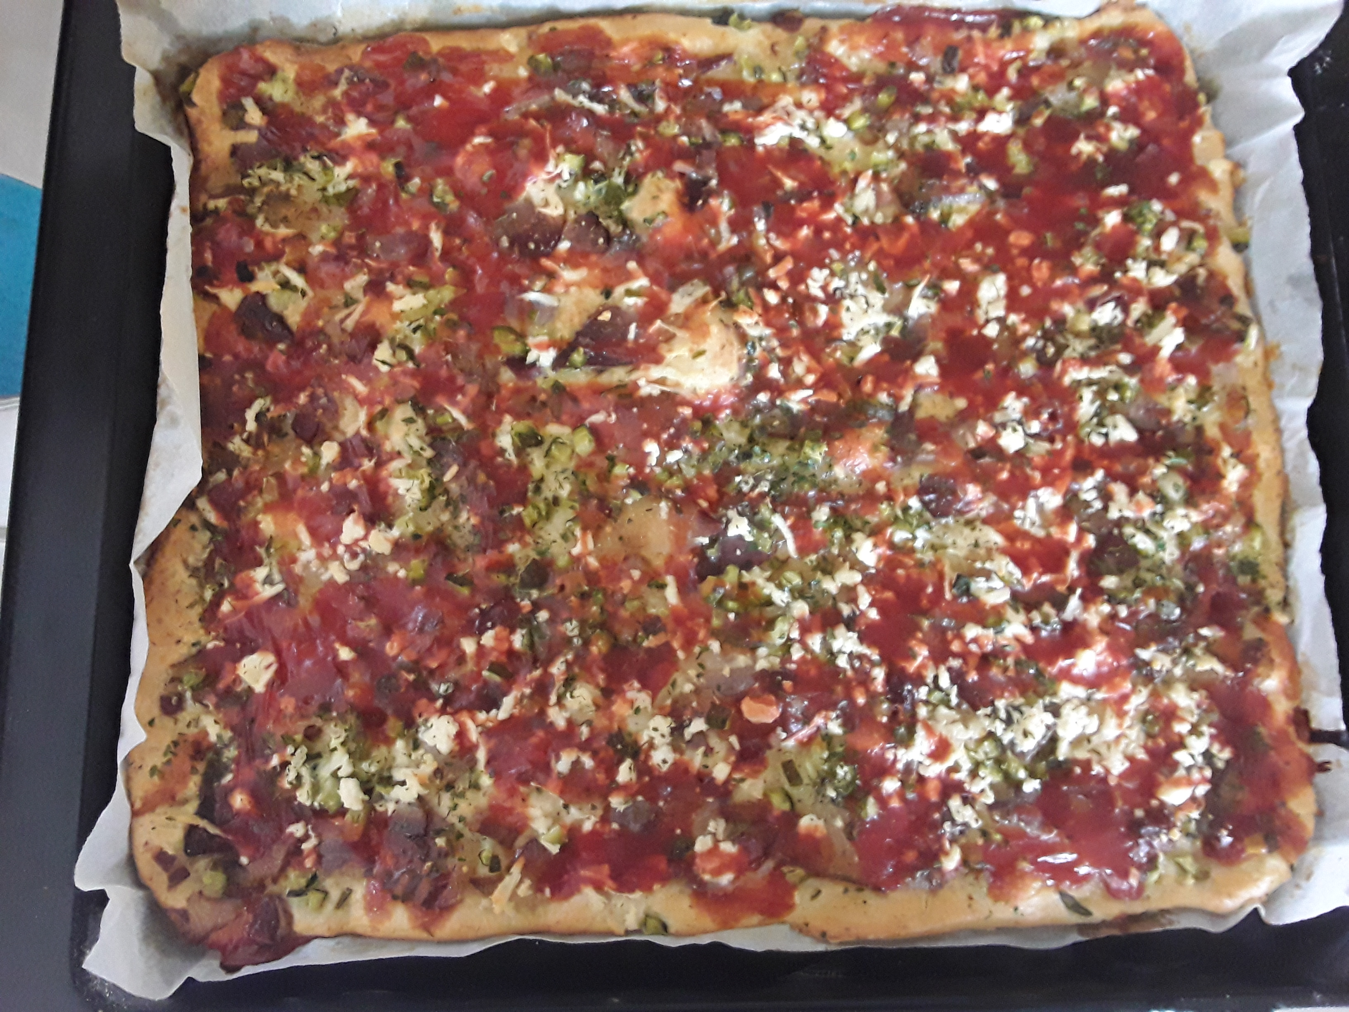
ENJOY!

