Slide 1
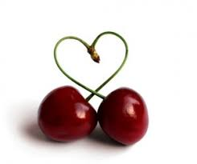
CHERRY CAKE
Đurđija Stevanković

Slide 2
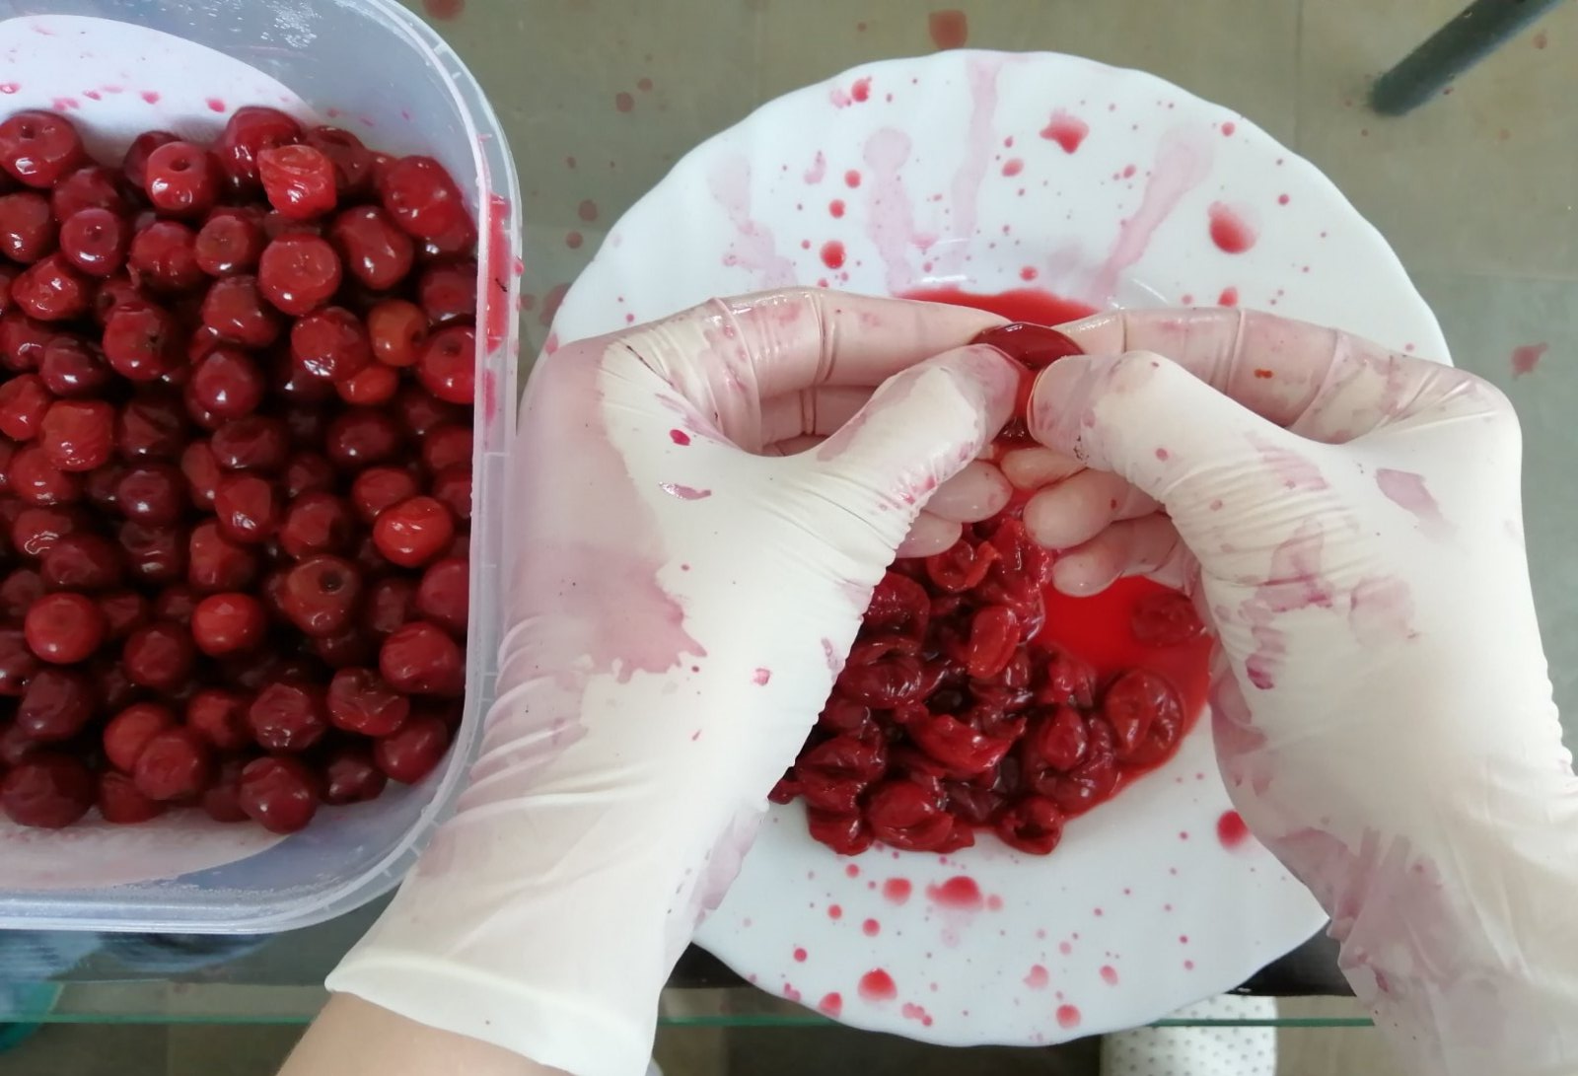
1. Heat the oven to 200°C 2. Prepare 300 g of chеrries, without bones.

Slide 3
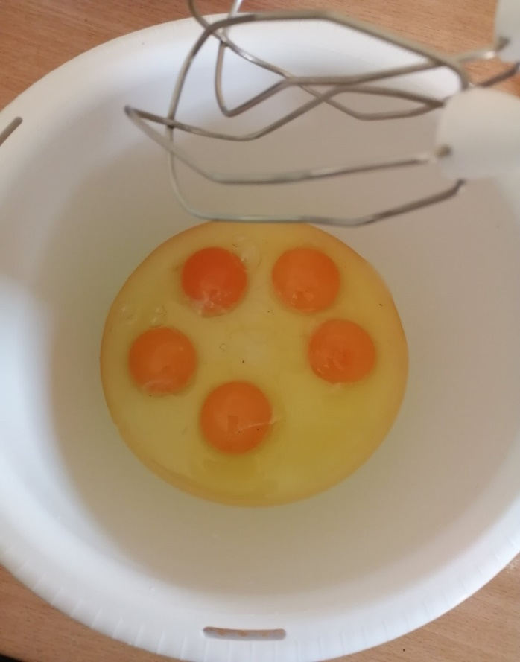
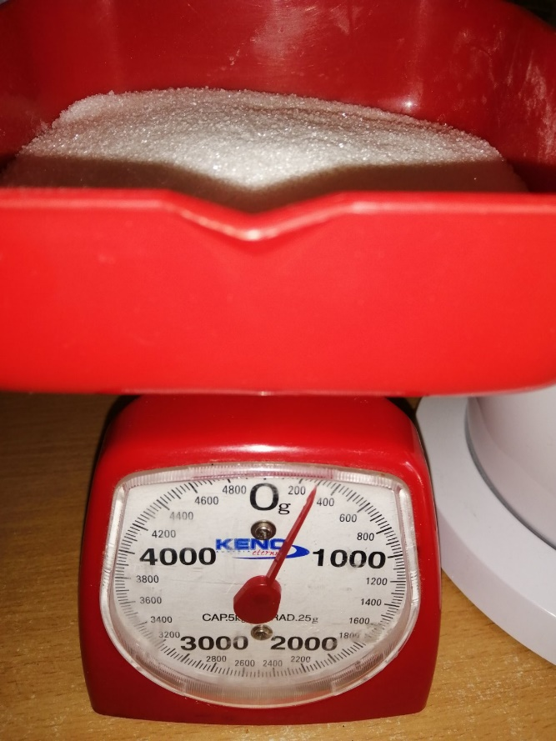
3. Mix 5 eggs with 300 g of sugar

Slide 4
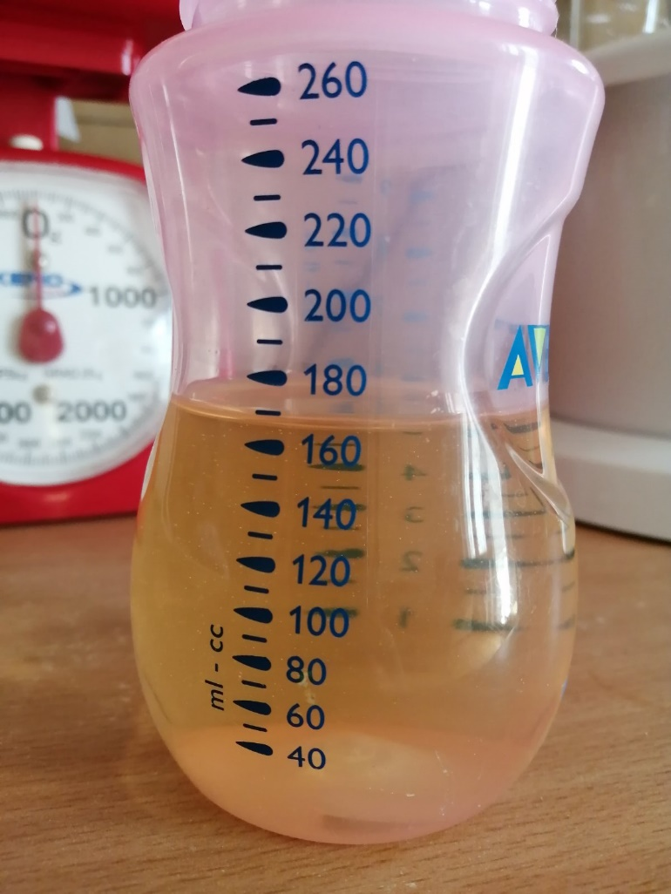
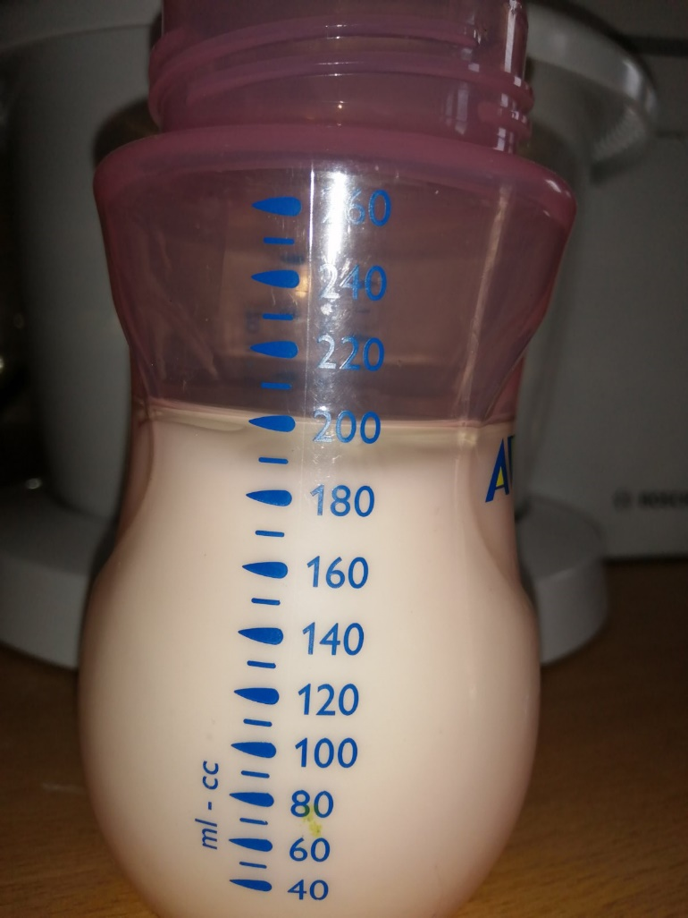
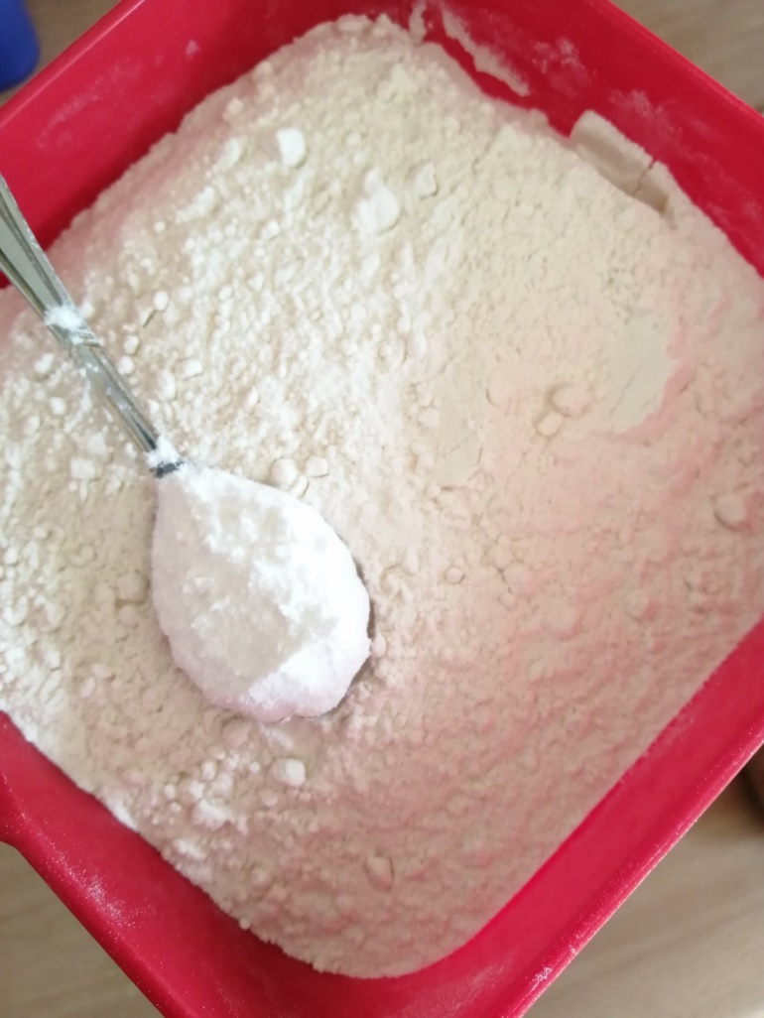
4. Add 170 ml of oil, 2 dl of yogurt, 270 g of flour and 1 teaspoon of baking powder, then mix it all together

Slide 5
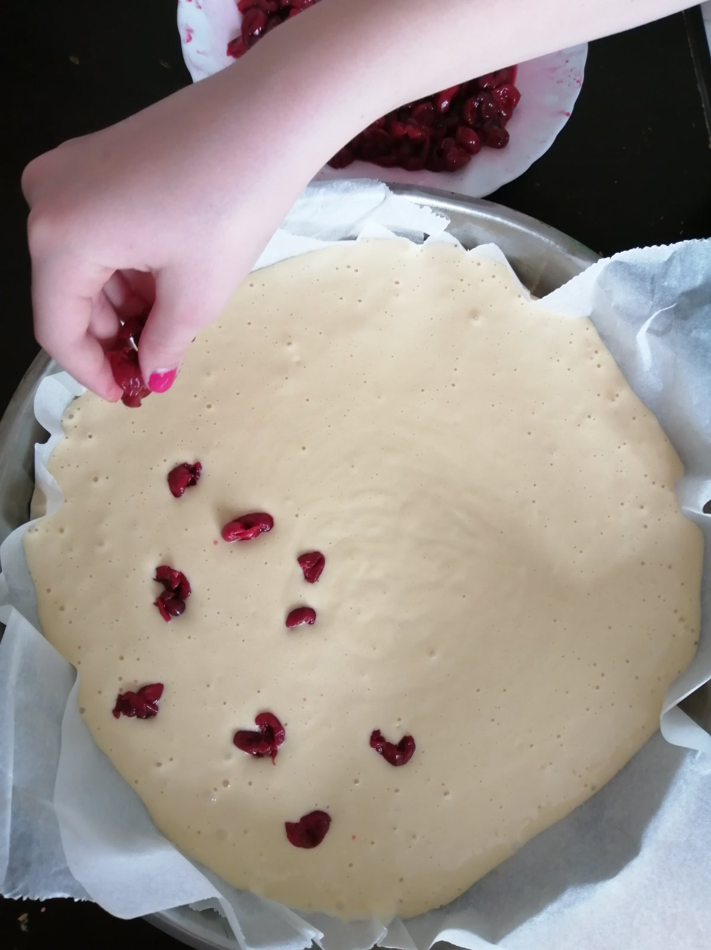
5. Pour the batter into the prepared pan and put cherries on top

Slide 6
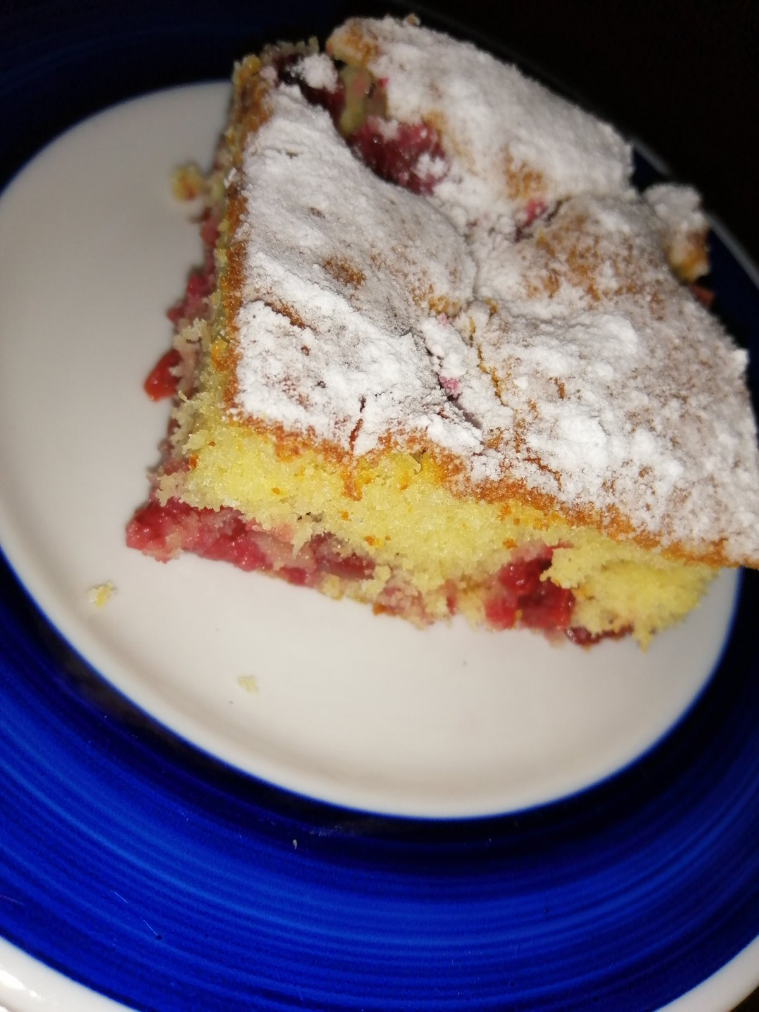
6. Place in the heated oven and bake for 40 minutes 7. When cooled, sprinkle the cake with powdered sugar and enjoy!!!
Yum, yum...

Slide 7
CHERRY CAKE
Photos from the private collection of the author

