Slide 1
AMERICAN PANCAKES
By Ana Gavrilovic 5/1
March 2020

Slide 2
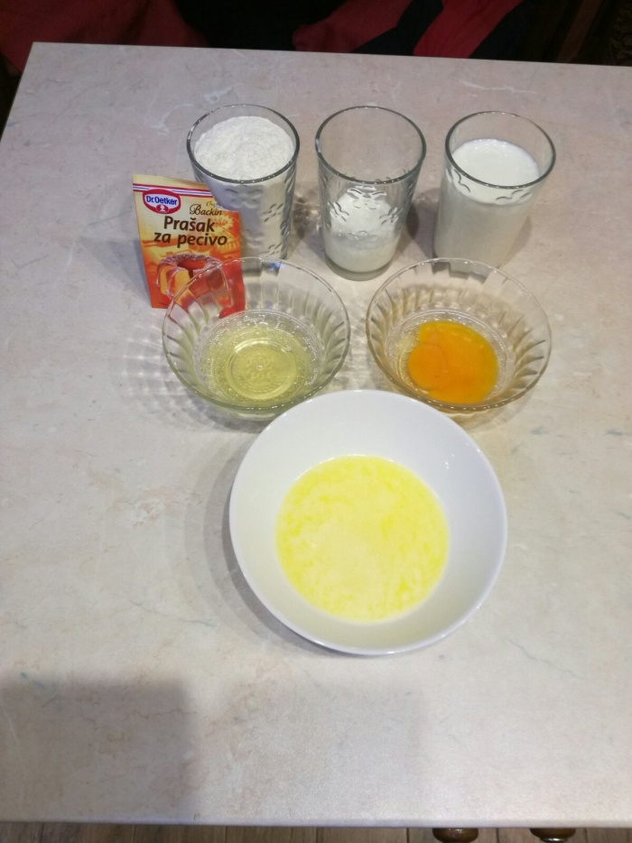
American pancakes
Ingredients:
1 egg (separate egg white from yolk)
1 cup of milk
1 cup of flour
¼ cup of yoghurt
¼ of melted butter
1 teaspoon of backing powder
1 teaspoon of salt

Slide 3
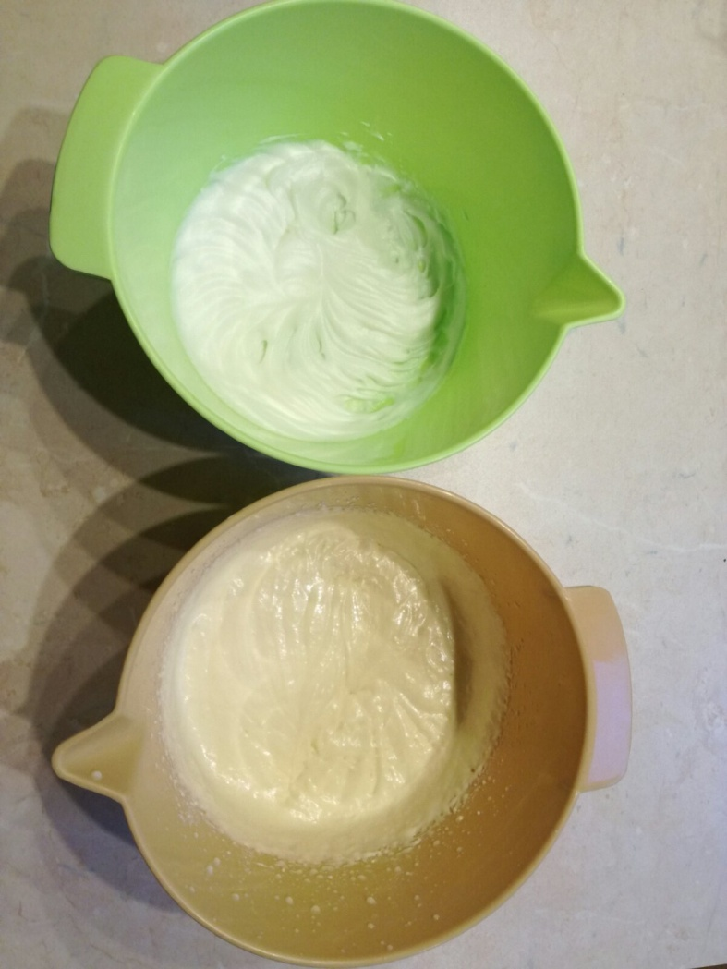
In one bowl, beat up the egg white.
In the other bowl mix together egg yolk, flour, milk, yoghurt, melted butter, and baking powder.

Slide 4
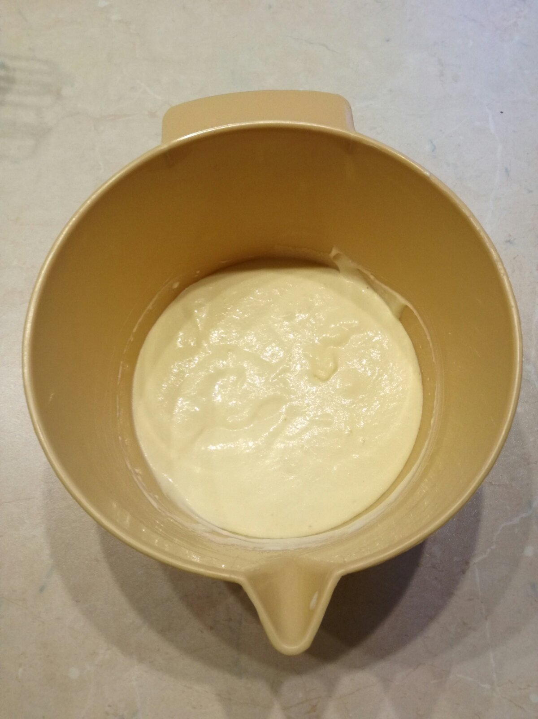
Mix the ingredients from both bowls
together

Slide 5
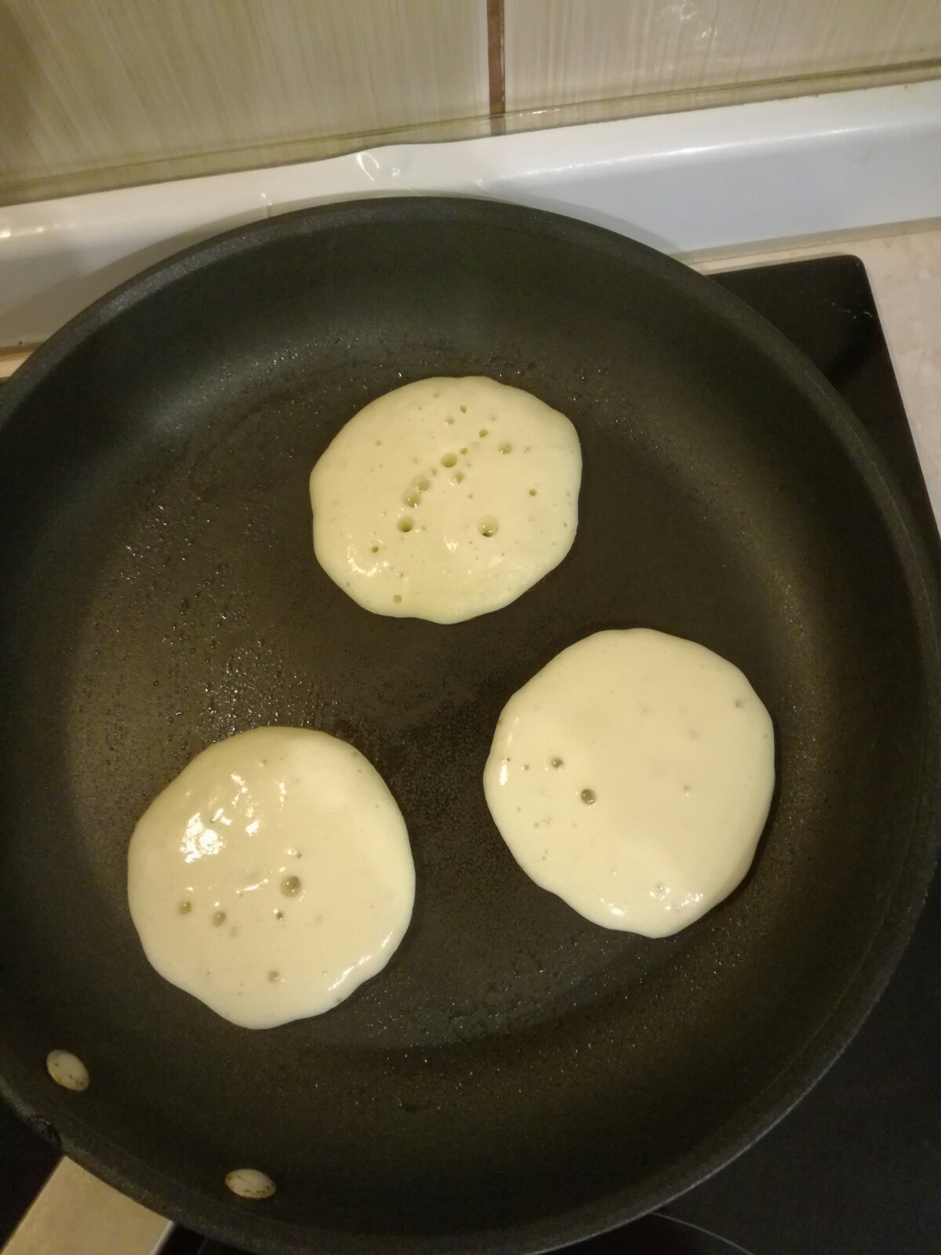
Heat the pan and bake the pancakes.
Pour one spoonful of dough onto a greased pan.
Fry until the surface of pancakes have some bubbles, 1 minute, then flip carefully, and fry for another 1-2 minutes.

Slide 6
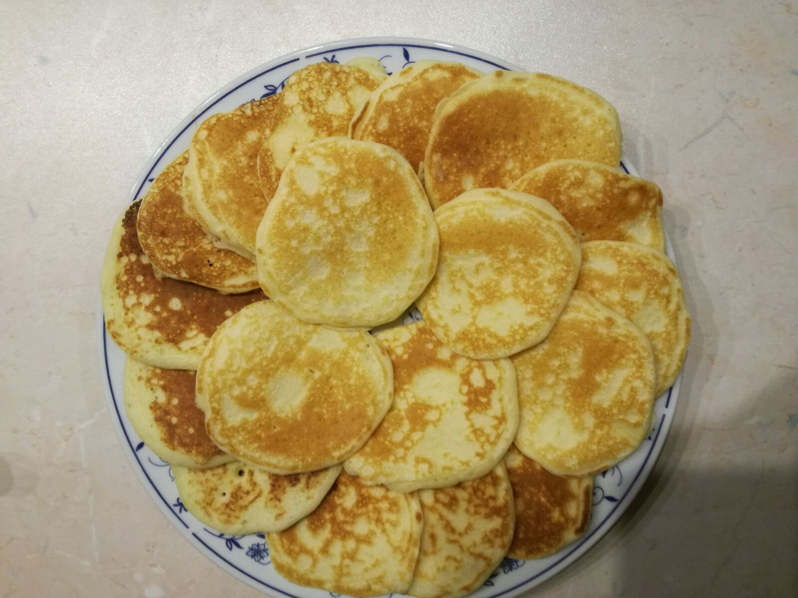
Now you can eat them with any filling.
Bon appétit!

Slide 7
American pancakes Pictures from the personal collection of the author

