Slide 1
PIZZA - MY FAVOURITE DISH
Jovan Nikolic 5-1

Slide 2
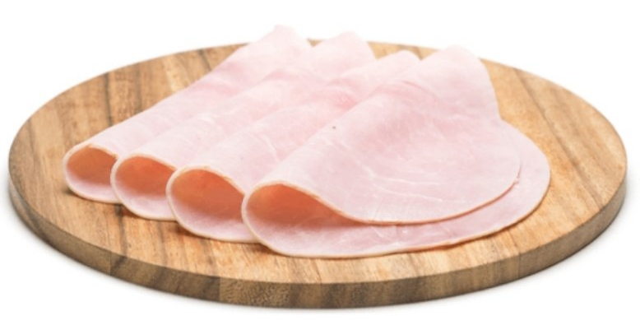
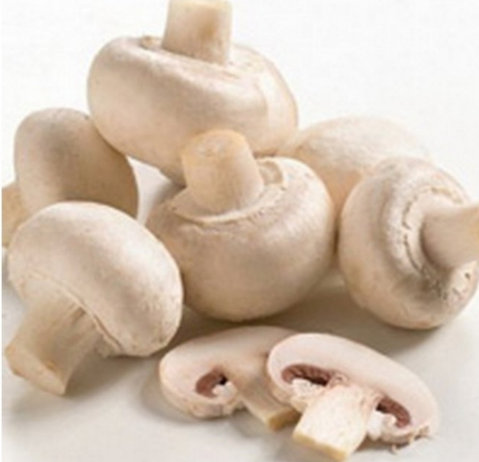
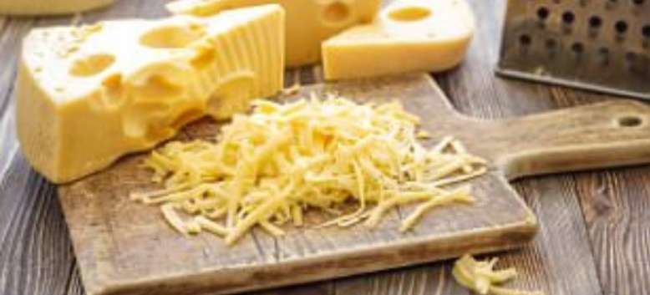
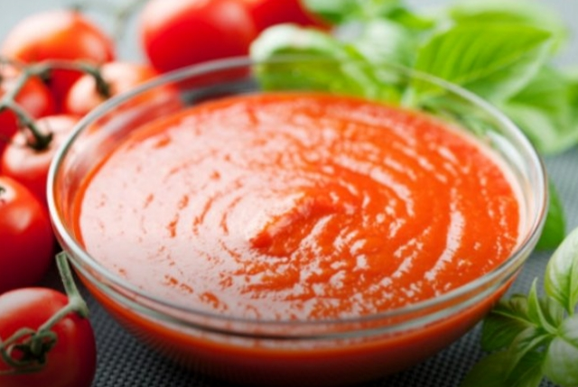
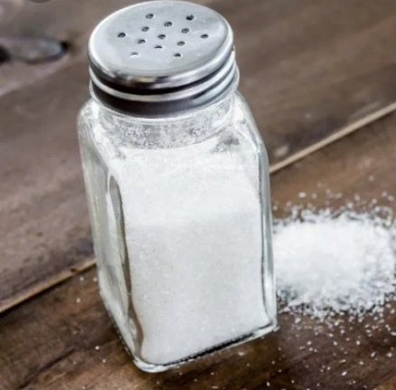
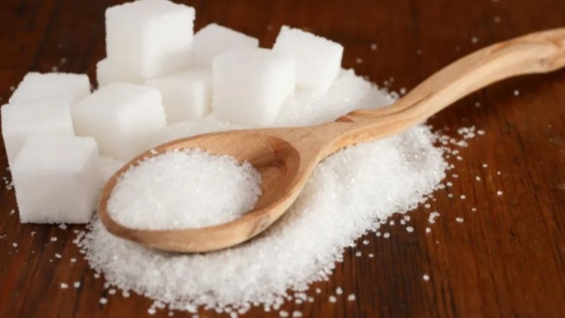
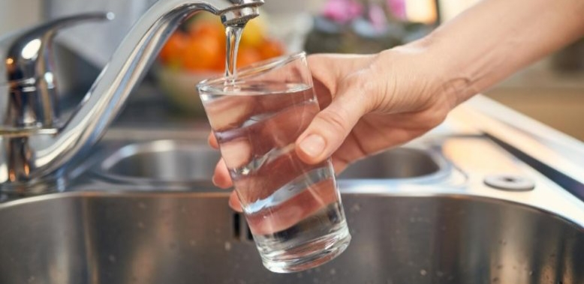
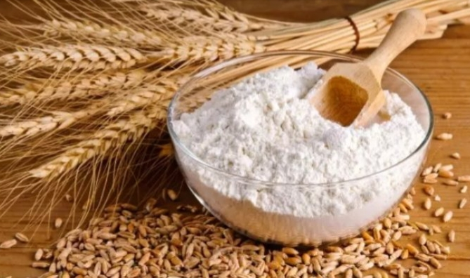
INGREDIENTS:
500g flour
1 teaspoon salt
1 teaspoon sugar
1 baking powder
325ml lukewarm water
150g Tomato sauce
150g cheese
150g ham
150g mushrooms

Slide 3
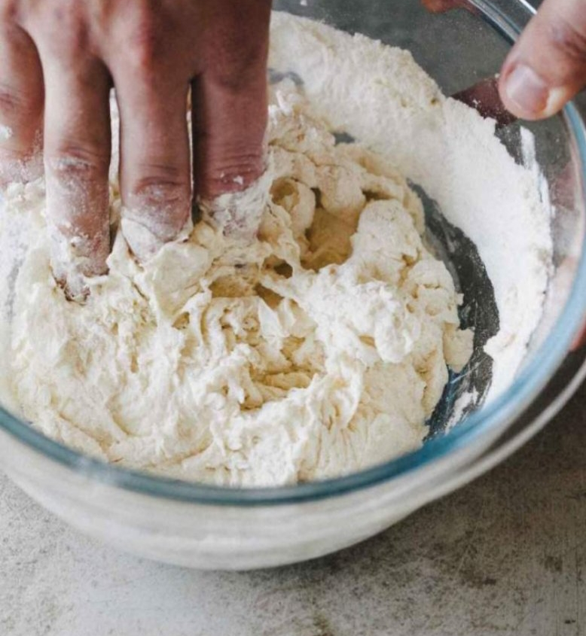
Take a bowl. Add flour, salt, sugar and baking power.
Then add watter and mix it by your hands.

Slide 4
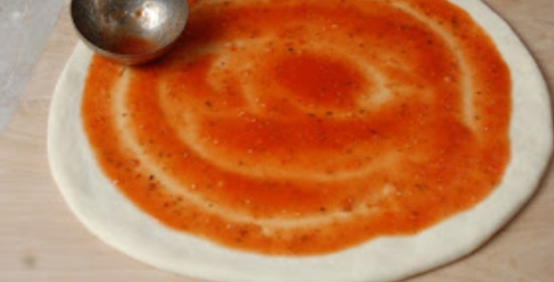
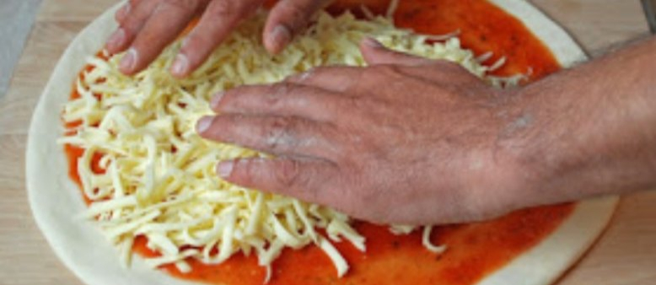
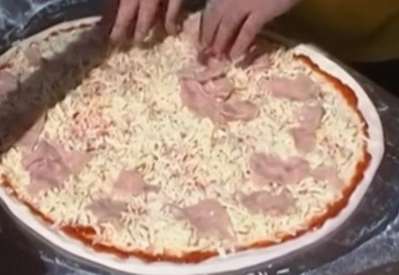
Then add to the dough:
- tomato sauce, ham, cheese and mushrooms.

Slide 5
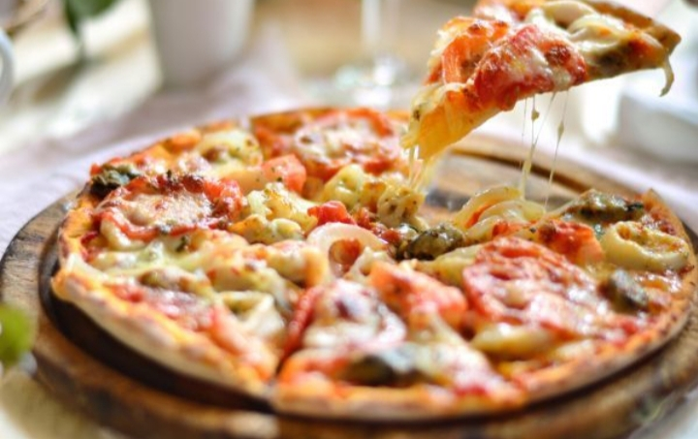
Bake for 20 min at 200°C
The finished pizza looks like this...
Enjoy the wonderful taste.

