Slide 1
Food around the world Turkish food
Author
Veljko Milisavljevic 51

Slide 2
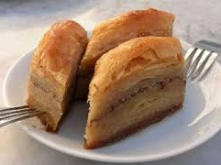
Baklava
Phyllo dough, nuts, sugar, oil

Slide 3
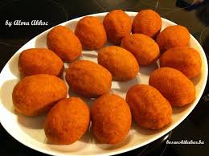
Bulger meatballs
meat, eggs, onion, garlic, vegetable spice, oil, pepper, salt, pepper, tomato juice

Slide 4
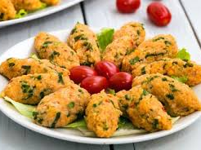
Beef and potato meatballs
meat, eggs, onion, bread, pepper, salt, butter, parsley, potatoes

Slide 5
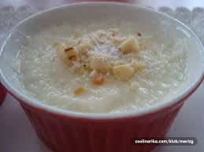
Keskul (dessert)
coconut flour, butter, grits, sugar

Slide 6
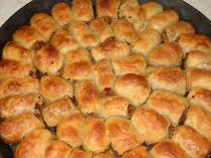
Ground meat manti
flour, salt, oil, meat, onion, garlic, pepper, yogurt

Slide 7
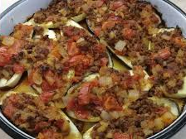
Stuffed aubergines
aubergine, onion, meat, rice, pepper, garlic, tomato juice, egg, sour cream, cheese, tomato, oil

Slide 8
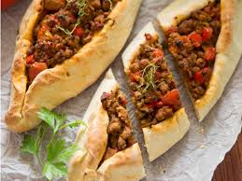
Turkish pizza
yeast, yogurt, water, butter, salt, sugar, flour, eggs, meat, pepper, oil, onion

Slide 9
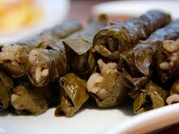
Turkish sarma
lamb, rice, onion, pepper, oil, vine leaves, lemon juice, salt

Slide 10
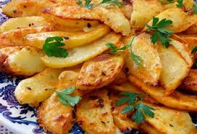
Turkish potato
potatoes, oil, yogurt, salt, pepper, mint

