Slide 1
HOW TO M A K E A S O U P
by Natasa Mizdalo 5/2
March 2020

Slide 2
Ingredients:
500g chicken meat
3 carrots
1 celery root
1 parsley root
200 g noodles
a little pepper
some salt
1l water

Slide 3
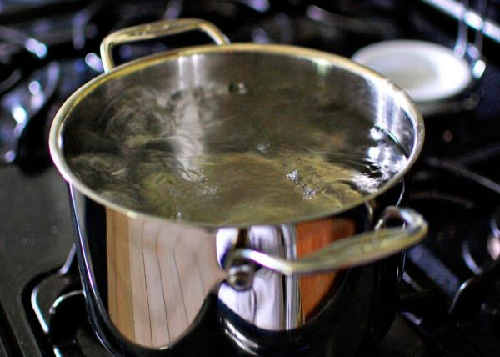
Put water to boil

Slide 4
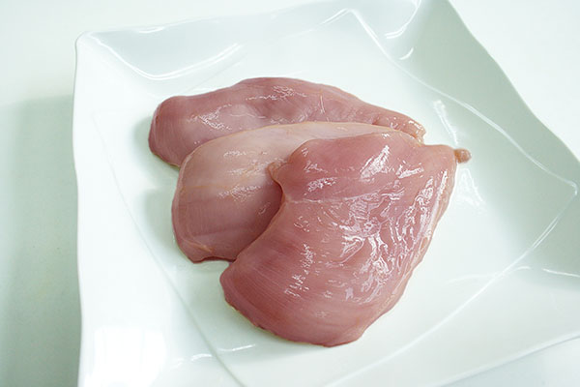
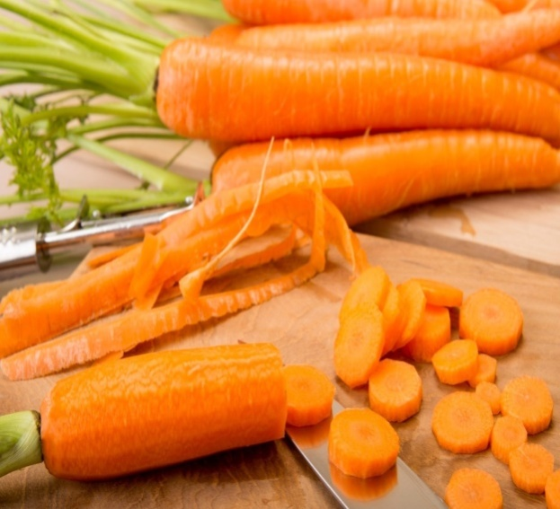
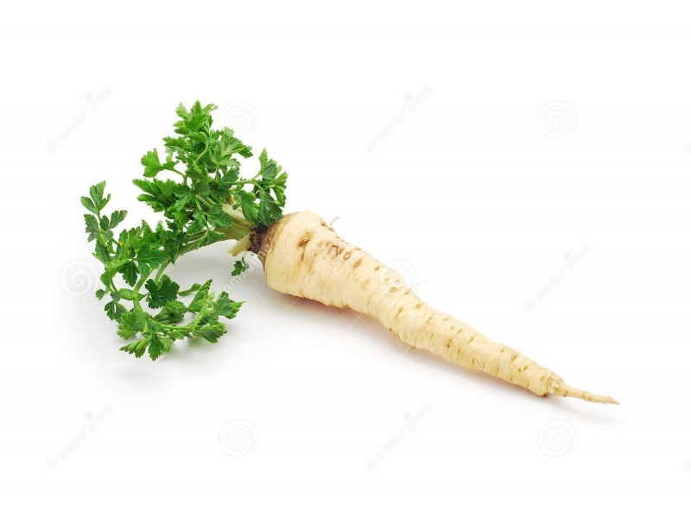
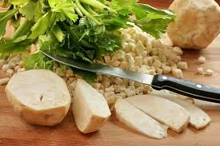
Add chicken meat, carrots, parsley and celery into the water

Slide 5
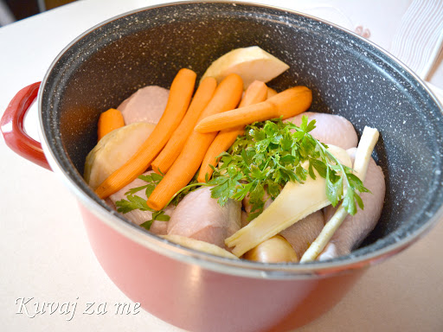
Cook for 20 minutes

Slide 6
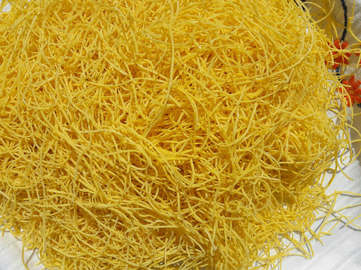
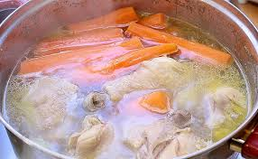
Put the noodles into the boiling water and cook them for 5 minutes

Slide 7
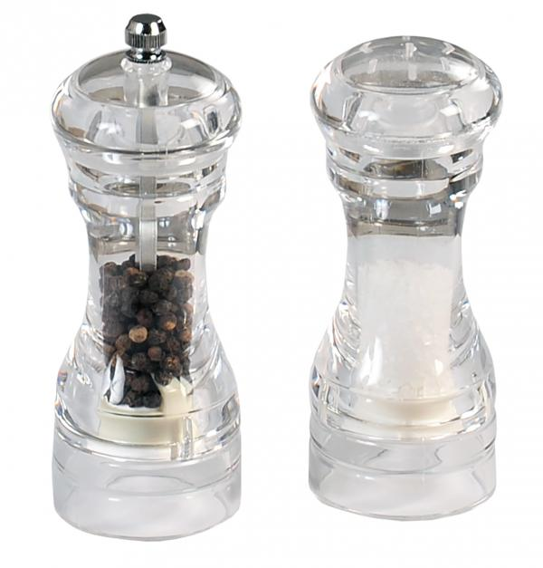
Add some pepper and salt

Slide 8
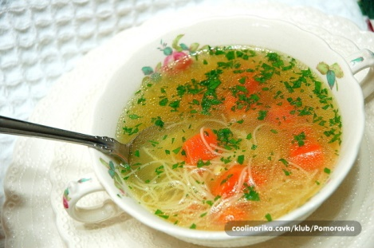
Your chicken soup is ready. Bon appetite

Slide 9
Photos taken from : www.coolinarika.com/ recepti.com/ kuvajza.me/ ukusivojvodine.rs / domacirecepti.com /beograd.in / biopjaca.rs./ srbijadanas.com /krstarica.com / kurir.rs / kuvajtesastilom.rs

