Slide 1
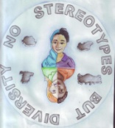
No Stereotypes But Diversity 2017-1-HU01-KA219-035974

Slide 2
Project partners
Budapest XIII. Kerületi Ady Endre Gimnázium, Budapest-Hungary
Scoala Gimnaziala "Alexandru Deparatenu" Rosiorii de Vede- Romania
Luis José Manuel y Antonio Molina Galdeano C. B., Granada- Spain
Mustafa Mihriban Boysan Middle School, Istanbul- Turkey

Slide 3
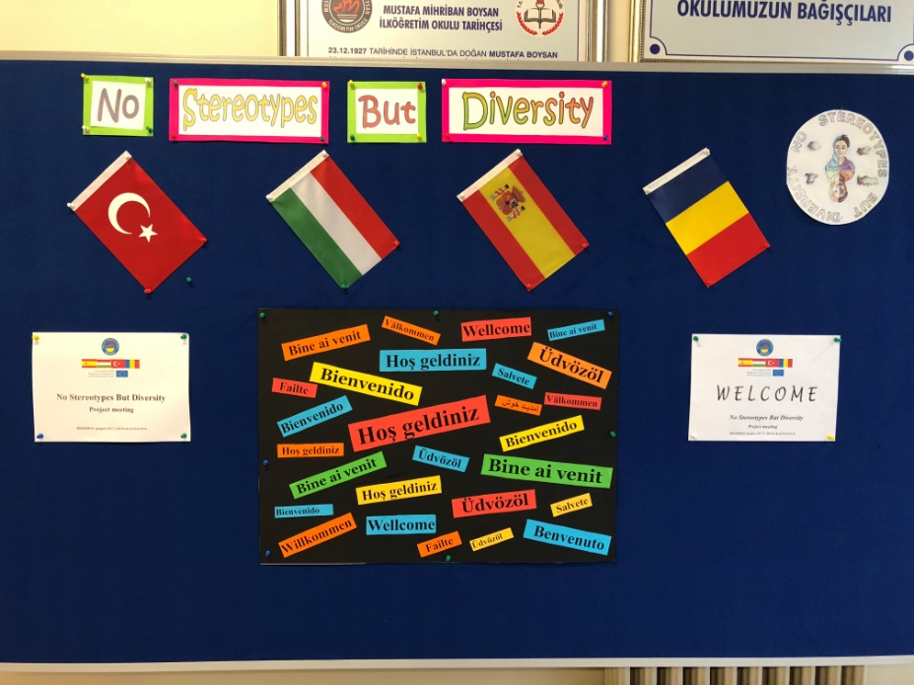
Meetings
M1- Hungary 21-24 November 2017
C1- Turkey 19-23 February 2018
C2- Romania 15-21 April 2018
C3 – Spain 22- 26 October 2018
C4- Hungary March 2019
M2- Turkey May 2019

Slide 4
We want to reach the following objectives
to fight against hate speech and hate behaviour inside schools;
to increase social awareness, tolerance, empathy for the immigrants and refugees
to destroy stereotypes and raise awareness about the risks they cause
to improve the know-how related to tackling the issues of stereotyping and discrimination inside schools
Relationship between schools and NGOs

Slide 5
Topics
TR: Stereotypical thinking and discrimination about nationalities
RO: Gender and racial equality
SP: Religious equality
HU: Stereotypical thinking& discrimination in schools

Slide 6
The final output, a booklet about
NO HATE IN OUR LIVES
Breaking free from stereotyping and discrimination
a collection of interactive games and activities
to raise awareness about the dangers and
unfairness of stereotypes and discriminating
behaviour

Slide 7
Good practises of our project
Student selection methodology for the mobilities
Checklists and project communication
Skype talk with partners
Cooperation with the NGOs
Video diaries
Evaluation reports
Twinspace
Project web page

Slide 8
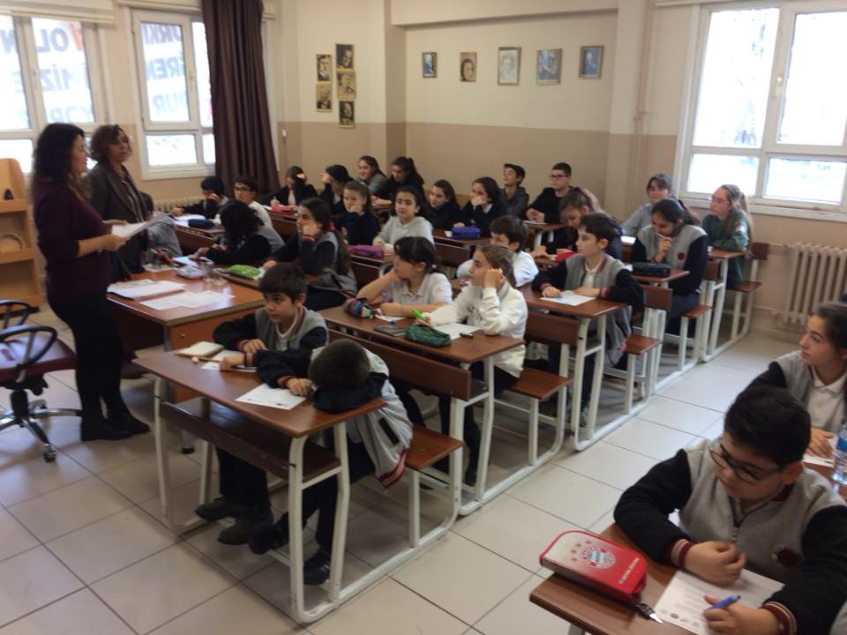
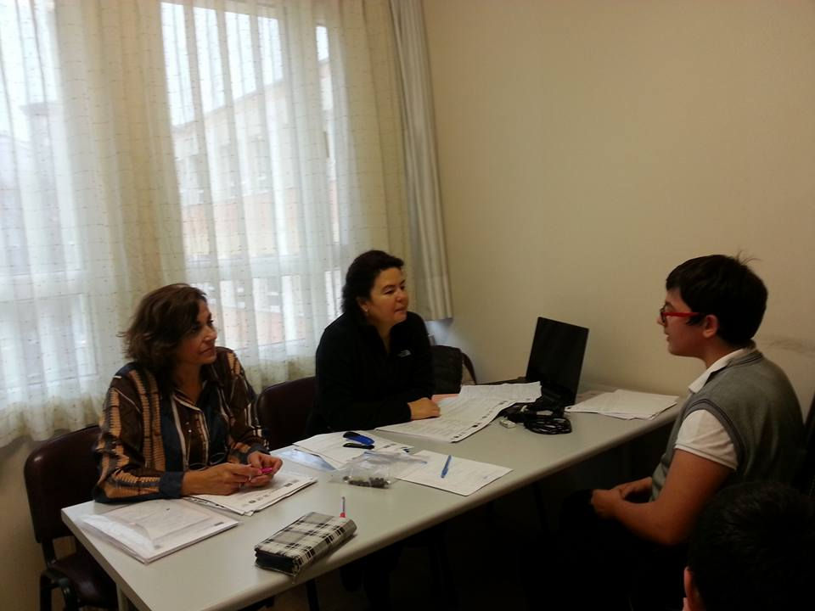

Slide 9
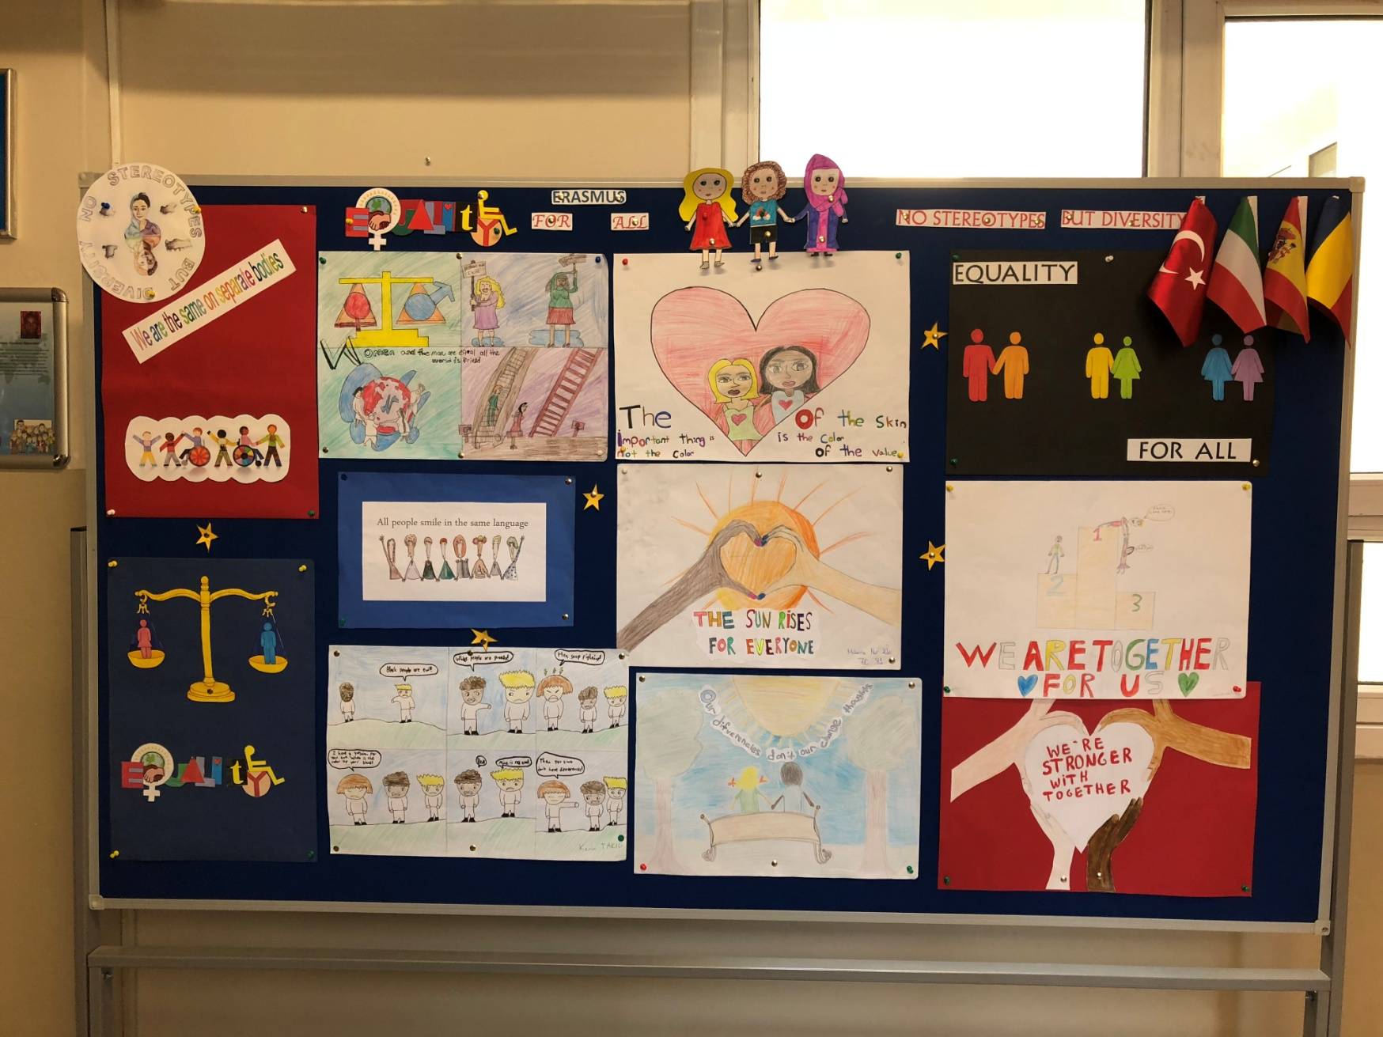

Slide 10
Student selection methodology for the mobilities
Student’s CV
Language test
Selection reports
Portfolios
https://docs.google.com/document/d/14TZDm6lO_DCKlCB7jBEsXtZroklkX2nW51yriErLG1k/edit

Slide 11
Who am I ?

Slide 13
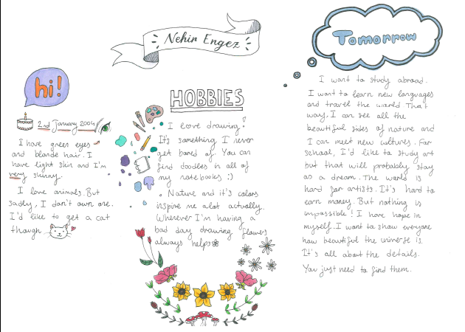

Slide 14
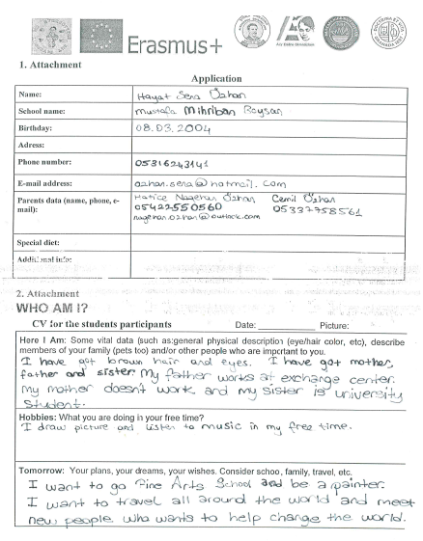
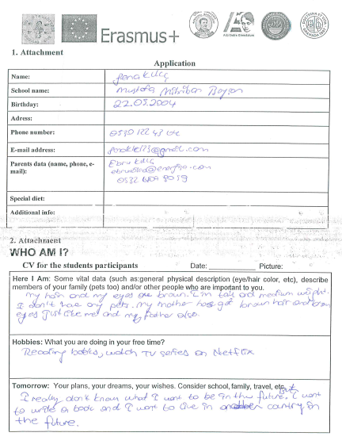

Slide 15
Video diary

Slide 16
Evaluation
Initial and final questionaires related with
The topic
Language skills
Cultural awareness
Short term evaluation reports
Meeting evaluation and report

Slide 17
Dissemination
Facebook
Twinspace
Web page
Photos on Google
Erasmus + Corner
Local Newspaper
School page

