Slide 1
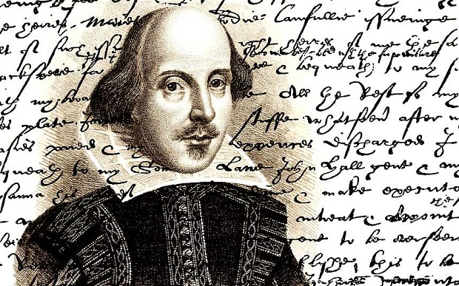
Shakespeare’s life
MADE BY ZOE

Slide 2
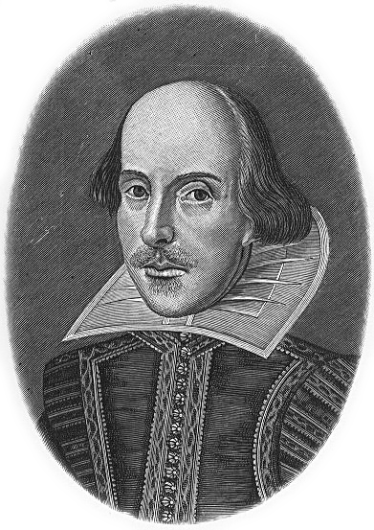
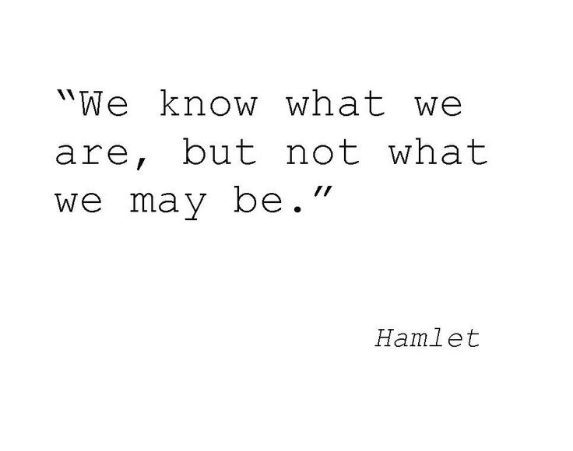
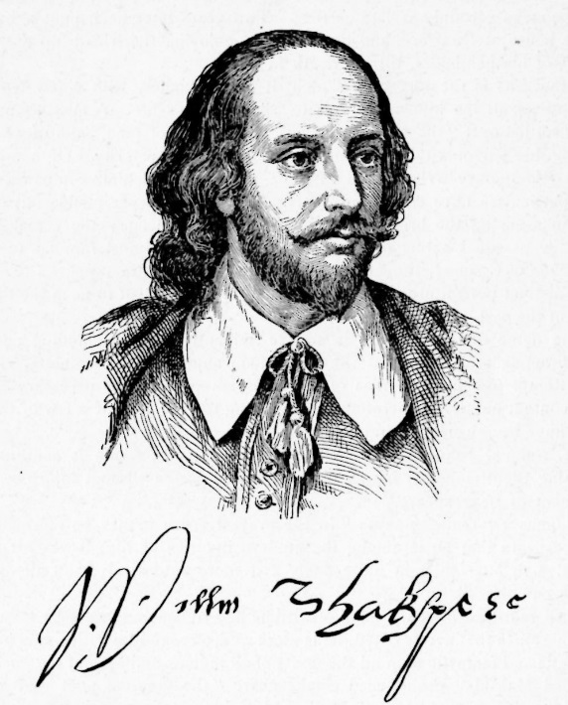
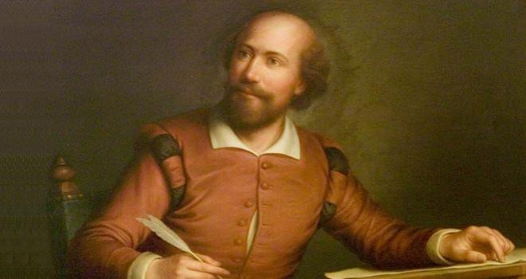
Profile
NAME
William Shakespeare
OCCUPATION
Playwright, Poet
BIRTH DATE
April 23, 1564
DEATH DATE
April 23, 1616

Slide 3
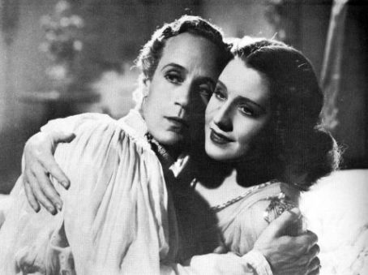
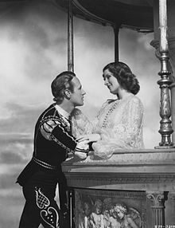
Works
Comedy | History | Tragedy | Poetry
All's Well That Ends Well As You Like It The Comedy of Errors Cymbeline Love's Labours Lost Measure for Measure The Merry Wives of Windsor The Merchant of Venice A Midsummer Night's Dream Much Ado About Nothing Pericles, Prince of Tyre Taming of the Shrew The Tempest Troilus and Cressida Twelfth Night Two Gentlemen of Verona Winter's Tale | Henry IV, part 1 Henry IV, part 2 Henry V Henry VI, part 1 Henry VI, part 2 Henry VI, part 3 Henry VIII King John Richard II Richard III | Antony and Cleopatra Coriolanus Hamlet Julius Caesar King Lear Macbeth Othello Romeo and Juliet Timon of Athens Titus Andronicus | The Sonnets A Lover's Complaint The Rape of Lucrece Venus and Adonis Funeral Elegy by W.S.
Pictures from 1936 film Romeo and Juliet.

Slide 4
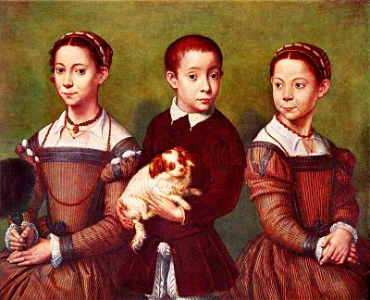
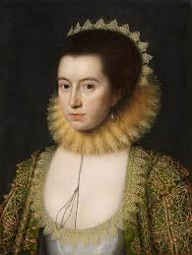
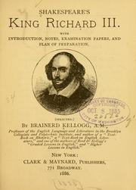
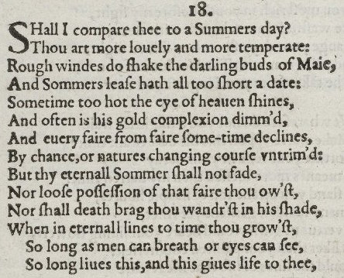
Women in Shakespeare’s life
Marriage
Possible affairs
1582 – Shakespeare (18) and Anne Hathaway (26) Six months after the marriage, she gave birth to a daughter, Susanna. Twins, son Hamnet and daughter Judith, followed almost two years later. However, after only three years of marriage Shakespeare left his family and moved to London.
With women : A lawyer said Shakespeare had an affair with a woman during a performance of Richard III.
Bisexual? We can’t really know. Some says that in his sonnets there are clear hints of him loving a man. But he may wrote it about the narrator…..

Slide 5
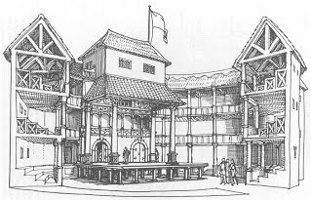
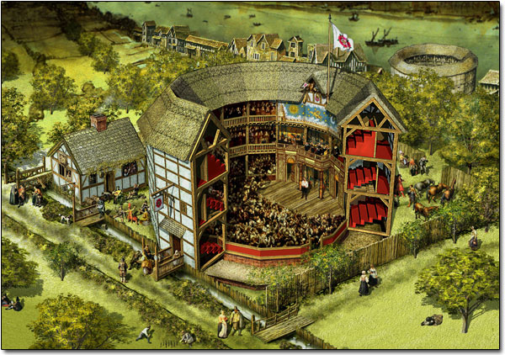
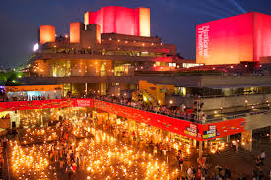
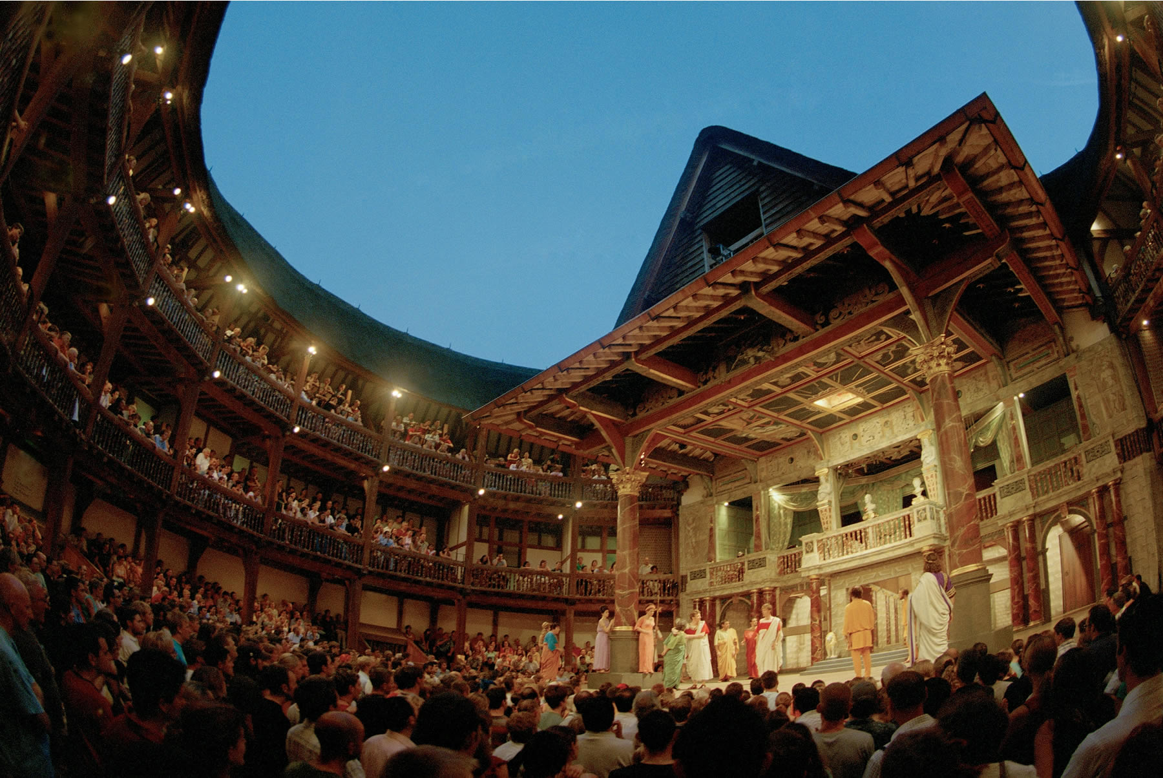
London and theatrical career
Throughout his career, Shakespeare divided his time between London and Stratford. His company constructed the Globe Theatre in 1599.
It is not known when Shakespeare began writing, but records of performances show that several of his plays were on the London stage by 1592.

Slide 6
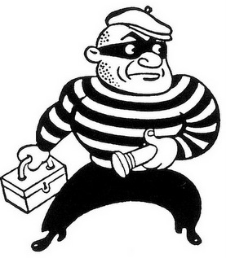
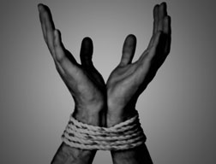
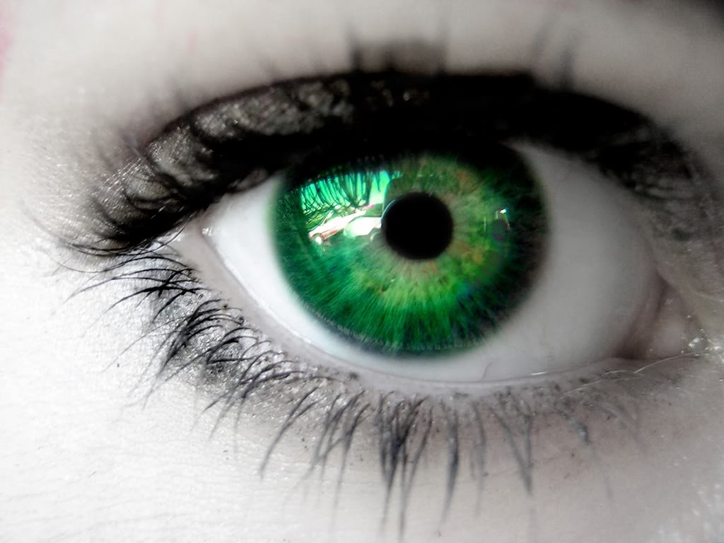
Words Shakespeare invented
There are a LOT words which were created by Shakespeare. I’m gonna show you guys a few of them.
BTW I wrote words that I think each of you heard before.
Dawn, champion, torture, green-eyed, luggage, blushing, addiction, advertise, gossip, noiseless, bandit, bedroom, lonely , excitement. etc.

Slide 7
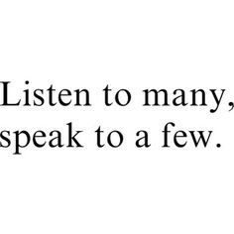
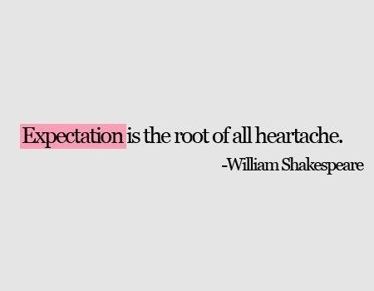
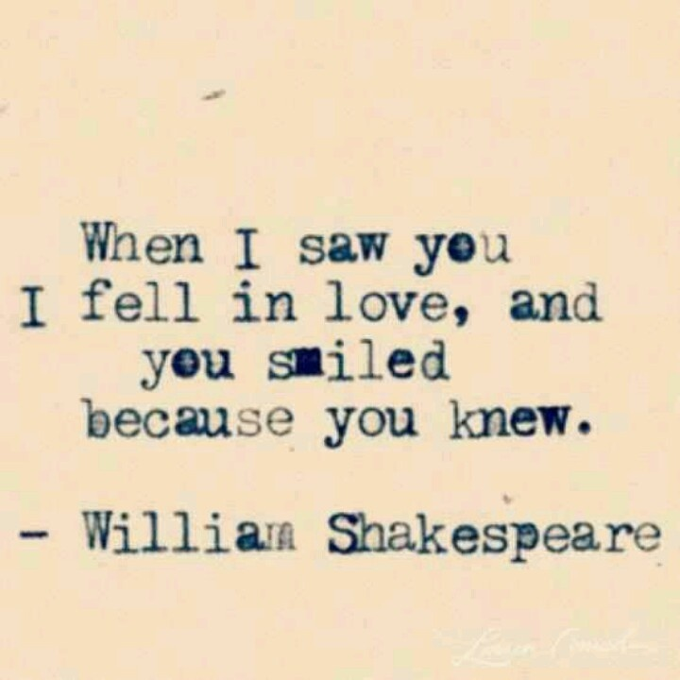
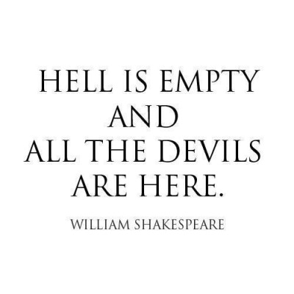
Quotes
Note: I really love his quotes, I got some so I hope you’ll like them too!

Slide 8
Death
Shakespeare died on 23 April 1616, at the age of 52. He died within a month of signing his will, a document which he begins by describing himself as being in "perfect health". Nothing explains how or why he died.
Note: The only thing I can say is that sometimes, our secrets are buried with us in the grave. Rest in peace .✝️

Slide 9
Thanks for reading / watching!

