Slide 1
Theatre in Shakespeare's time
Gréta Várkonyi

Slide 2
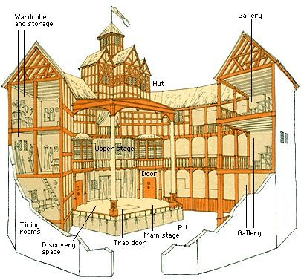
location
The Globe was built west of London Bridge on the south bank of the Thames River in an area known as Bankside.

Slide 3
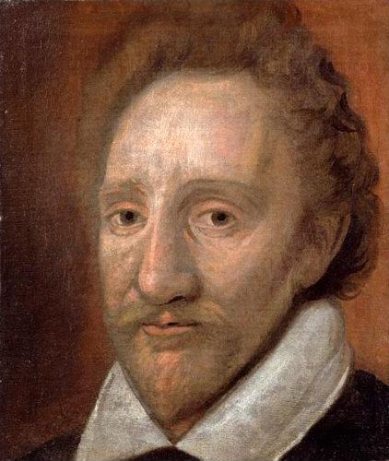
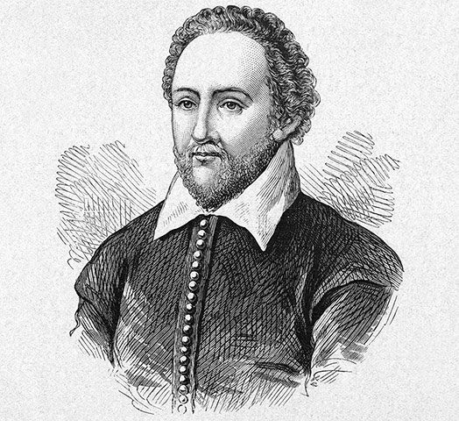
owners
Richard Burbage
The Burbage Brothers owned a 50 percent interest in the Globe. William Shakespeare and four other investors owned the remaining 50 percent in equal shares (12½ percent each).
James Burbage

Slide 4
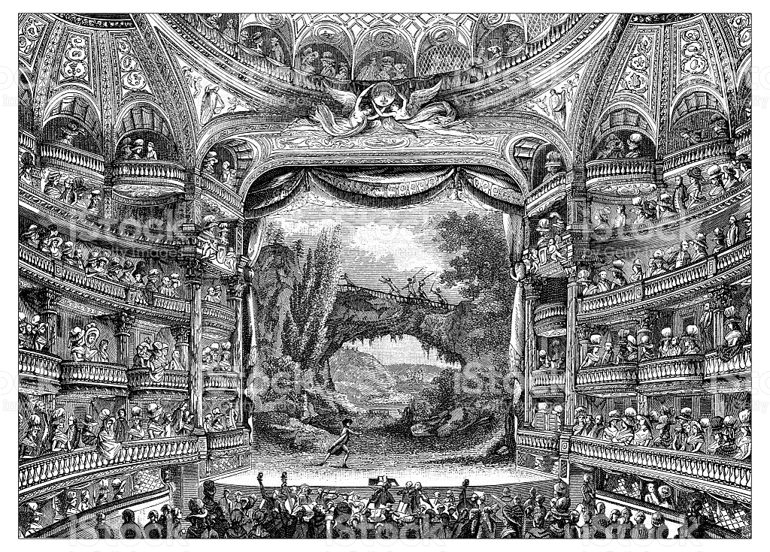
First performances
The first Shakespeare play performed at the Globe was probably As You Like It. Other Shakespeare plays performed at the theatre in its opening year of 1599 were Julius Caesar and Henry V and Ben Jonson's Every Man Out of His Humour.

Slide 5
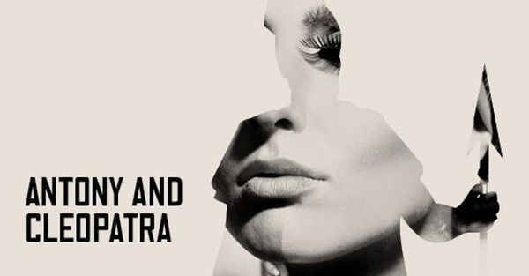
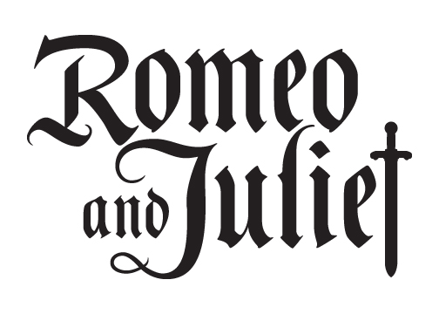
actors
All actors at the Globe and other theatres were males, even those who played Juliet (Romeo and Juliet) and Cleopatra (Antony and Cleopatra). Women were forbidden to set foot on the stage.
Productions of many Shakespeare's plays included singing, dancing, and/or instrumental music.

Slide 6
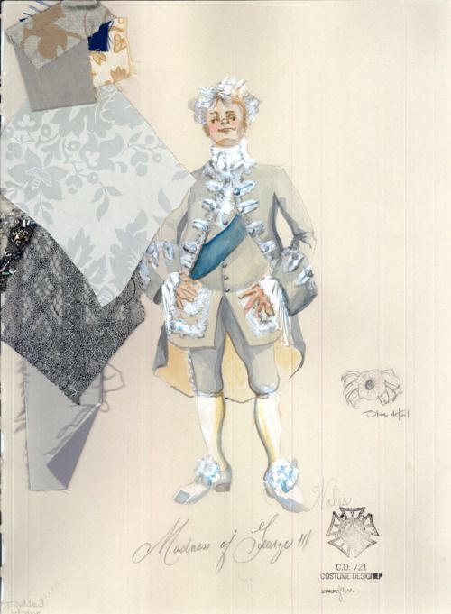
costumes
An actor in Shakespeare's time could wear any costume that reflected the social standing and/or occupation of a character. Colourful and well-designed costumes were very important.

Slide 7
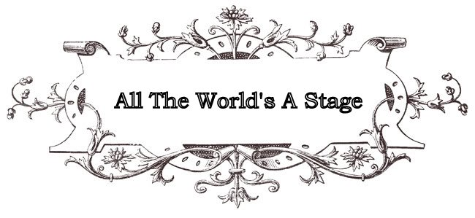
motto
The Globe had a Latin motto: Totus mundus agit histrionem. It was a translation of one of Shakespeare's most famous lines: All the world's a stage.

Slide 8
techniques
In his plays Shakespeare uses many different types of language techniques to create his plays. Such techniques include: rhythm, rhyme, alliteration, repition, assonance and onomatopeia.

Slide 9
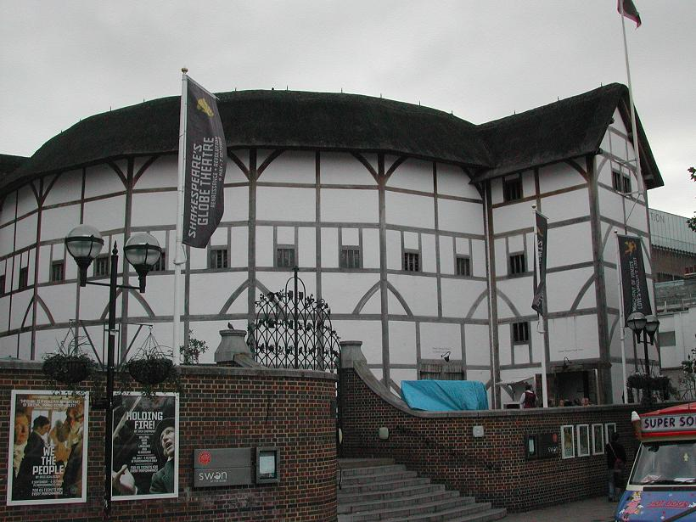
reconstruction
The reconstruction of Shakespeare’s Globe was not the idea of London’s mayor, or the government. It was the idea of an American actor, Sam Wanamaker.
All the plaster on the walls was made with a mixture including goat hair.

Slide 10
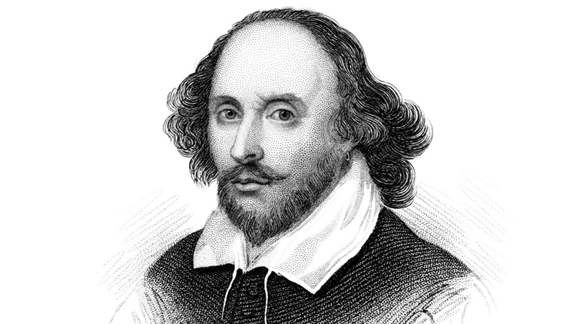

Slide 11
Thanks for watching!

