Slide 1
Shakespeare’s plays

Slide 2
Comedies

Slide 3
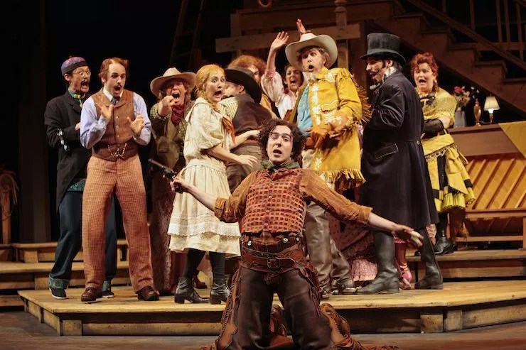
1589
Comedy of Errors

Slide 4
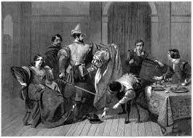
1593
Taming of the Shrew

Slide 5
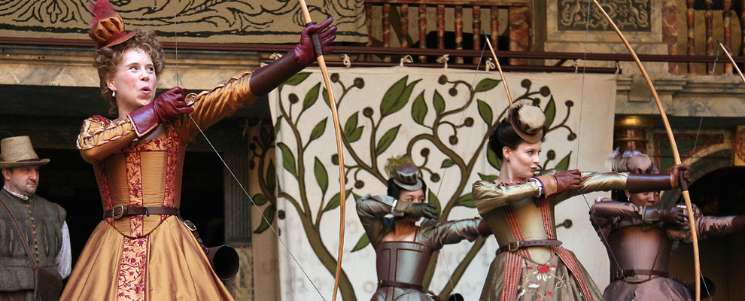
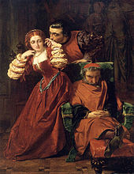
1594
Two Gentlmen of Verona
Love’s Labour’s Lost
Love’s Labour’s Lost
Two Gentlemen of Verona

Slide 6
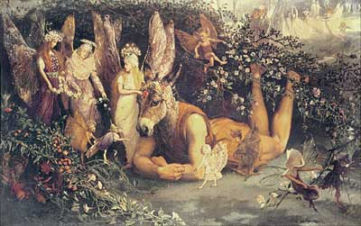
1595
Midsummer Night’s Dream

Slide 7
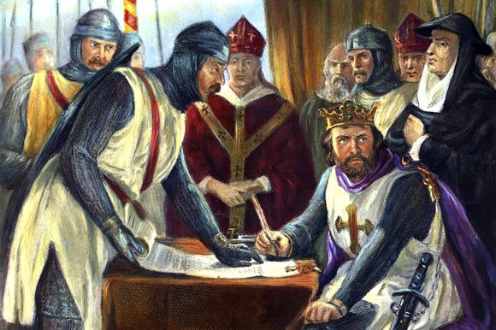
1596
The Merchant of Venice

Slide 8
1598
Much a do about Nothing

Slide 9
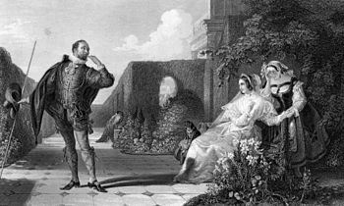
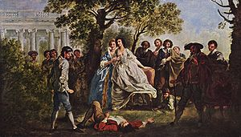
1599
Twelfth Night
As You Like It
Twelfth Night
As You Like It

Slide 10
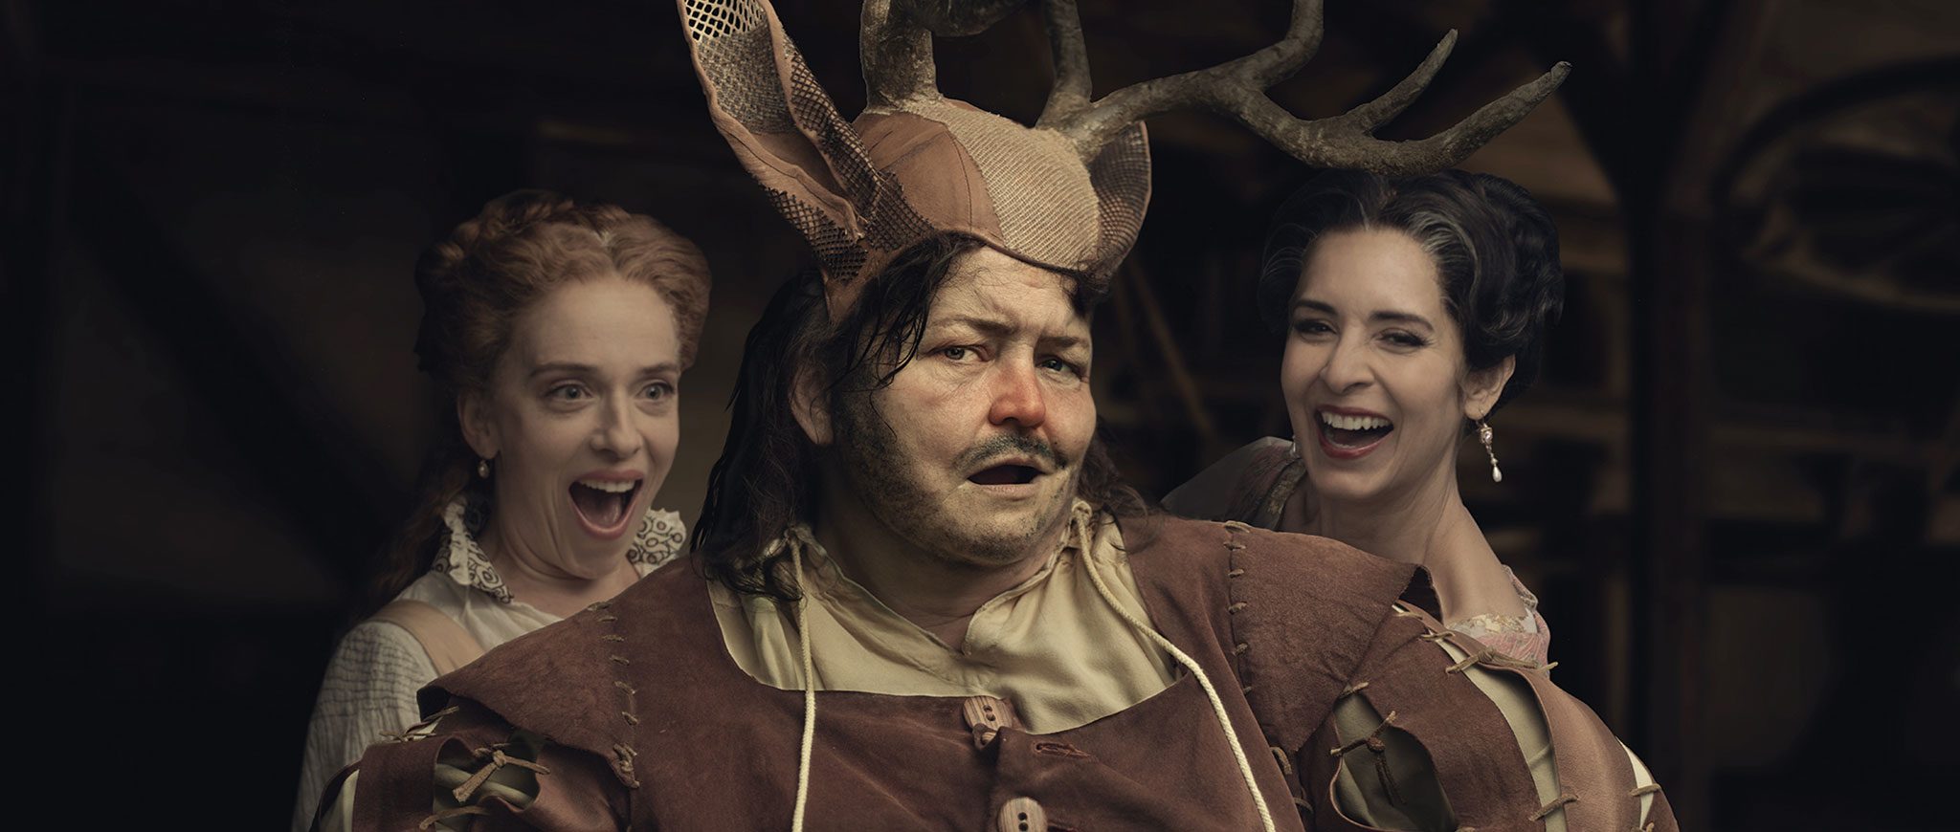
1600
Merry Wives of Windsor

Slide 11
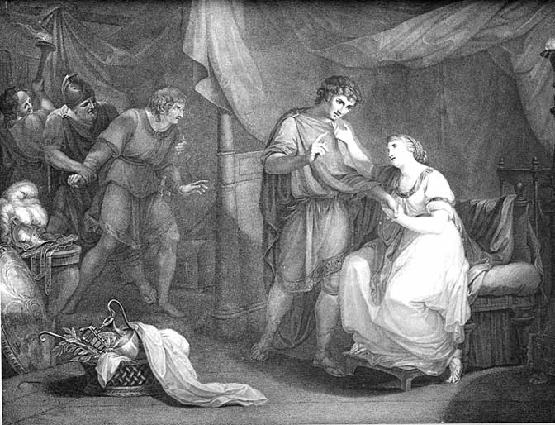
1601
Trolius and Cressida

Slide 12
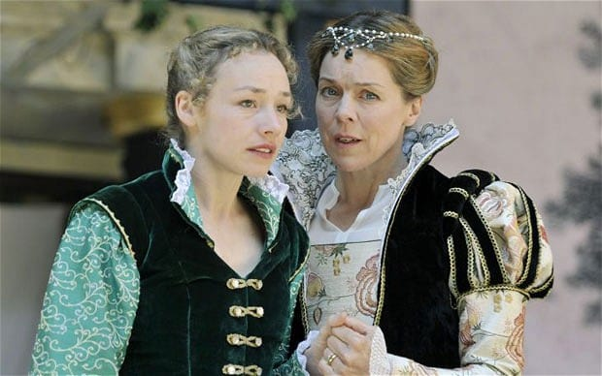
1602
All’s Well That Ends Well

Slide 13
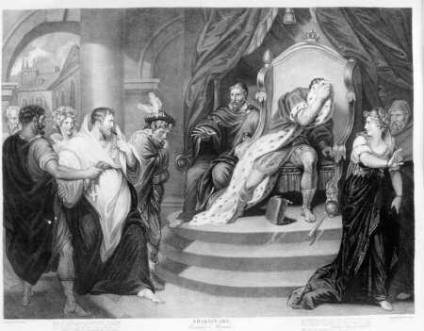
1604
Measure for Measure

Slide 14
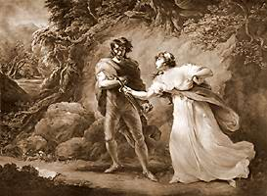
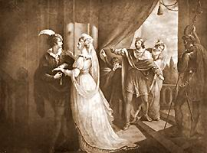
1609
Cymbeline

Slide 15
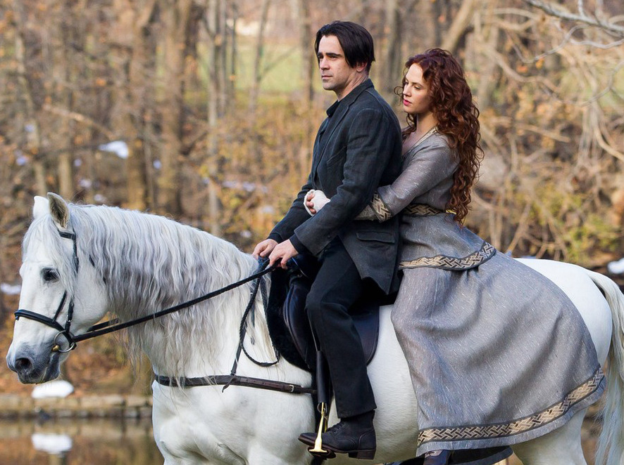
1610
Winter’s Tale

Slide 16
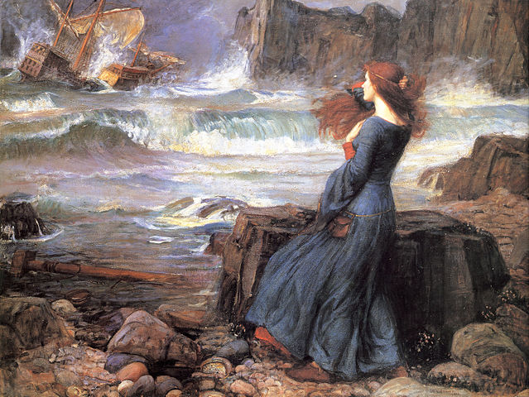
1611
The Tempest

Slide 17
Histories

Slide 18
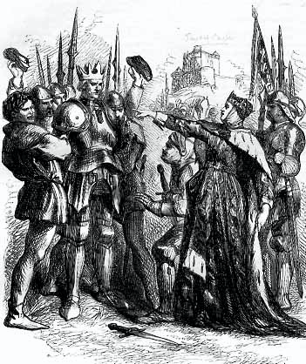
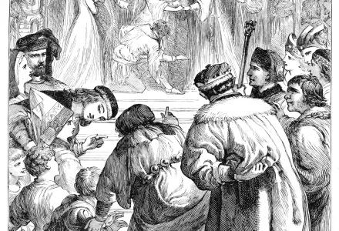
1590
Henry VI, Part-II
Henry VI, Part-III
Henry VI, Part-II
Henry VI, Part

Slide 19
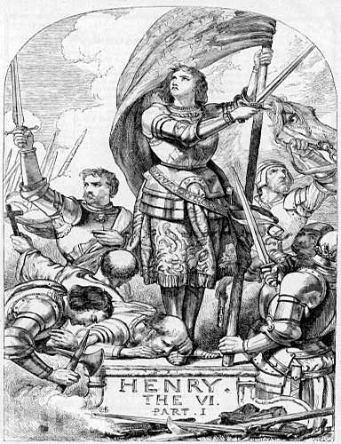
1591
Henry VI, Part-I

Slide 20
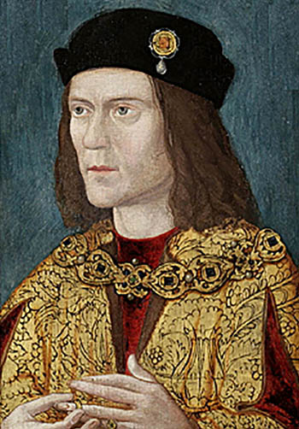
1592
Richard III

Slide 21
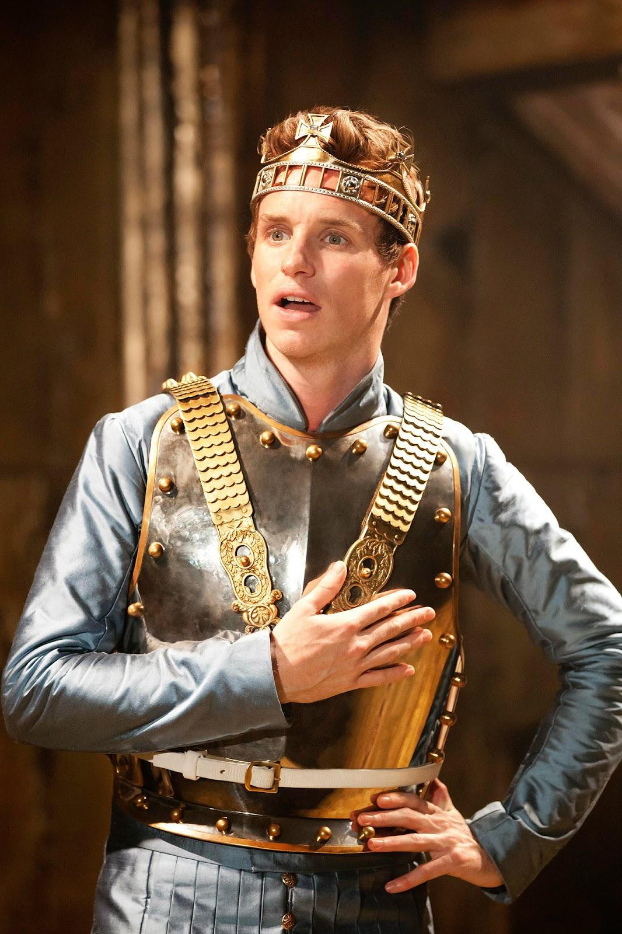
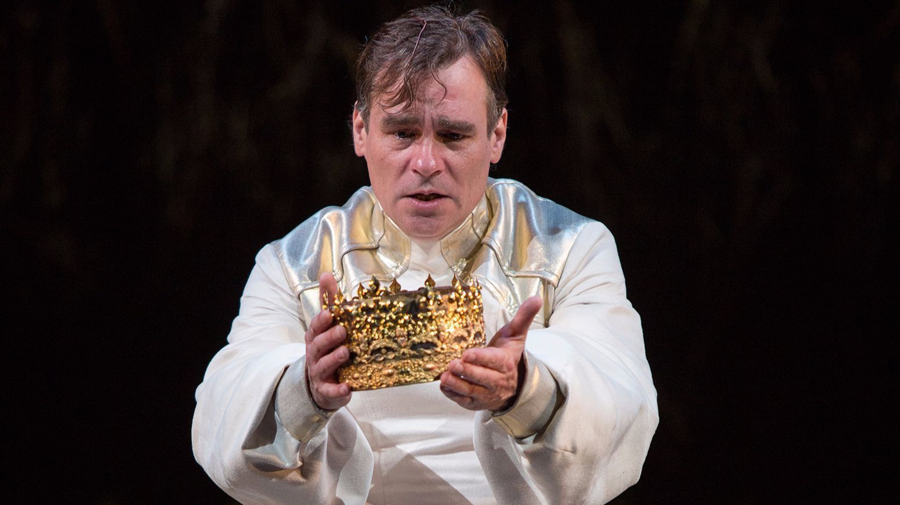
1595
Richard II

Slide 22
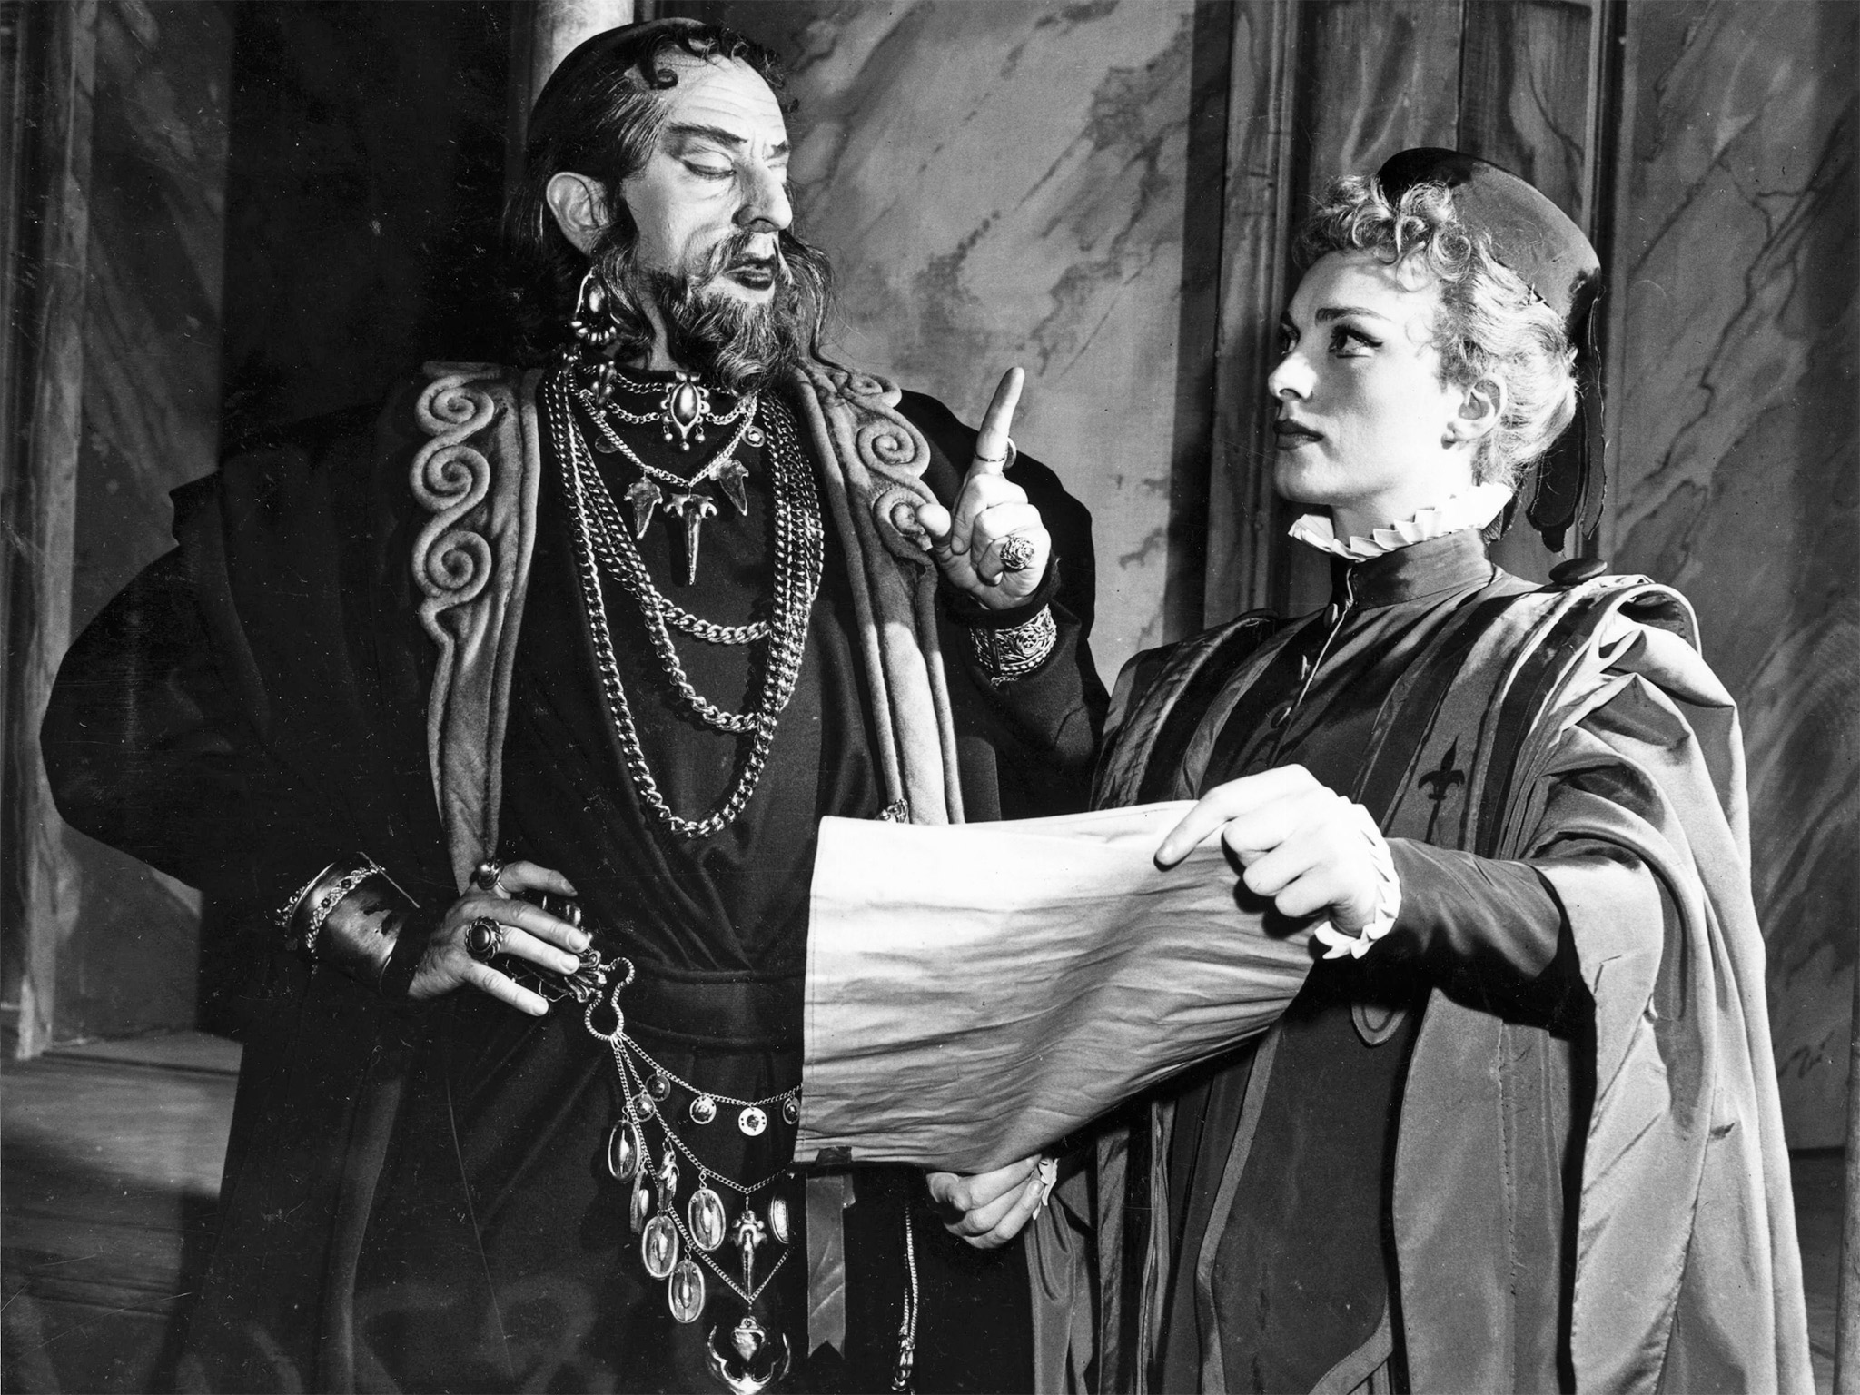
1596
King John

Slide 23
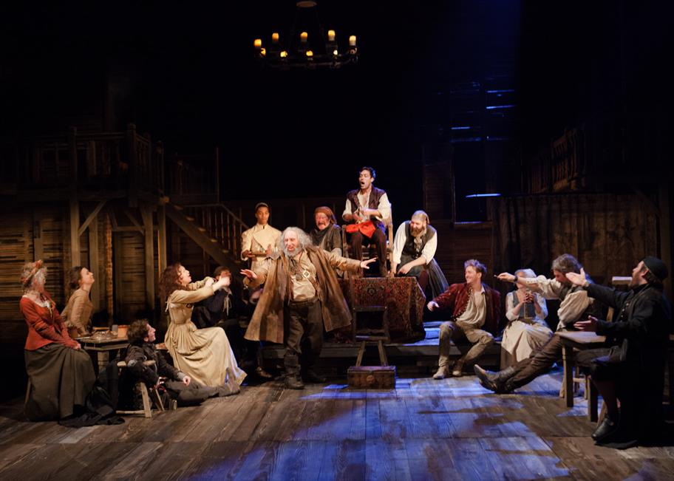
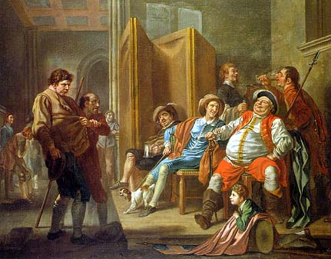
1597
Henry IV, Part I
Henry IV, Part II

Slide 24
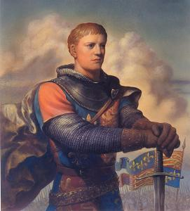
1598
Henry V

Slide 25
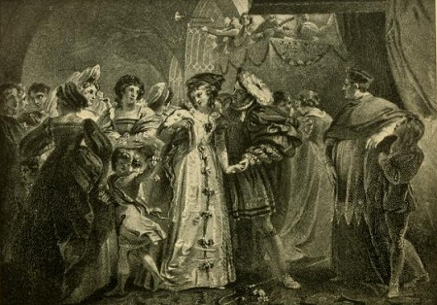
1612
Henry VIII

Slide 26
Tragedies

Slide 27
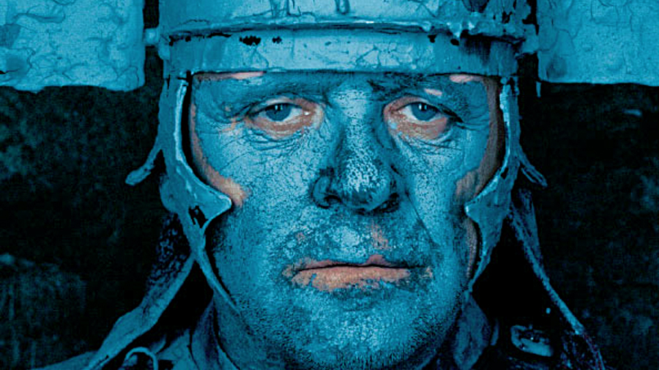
1593
Titus Andronicus

Slide 28
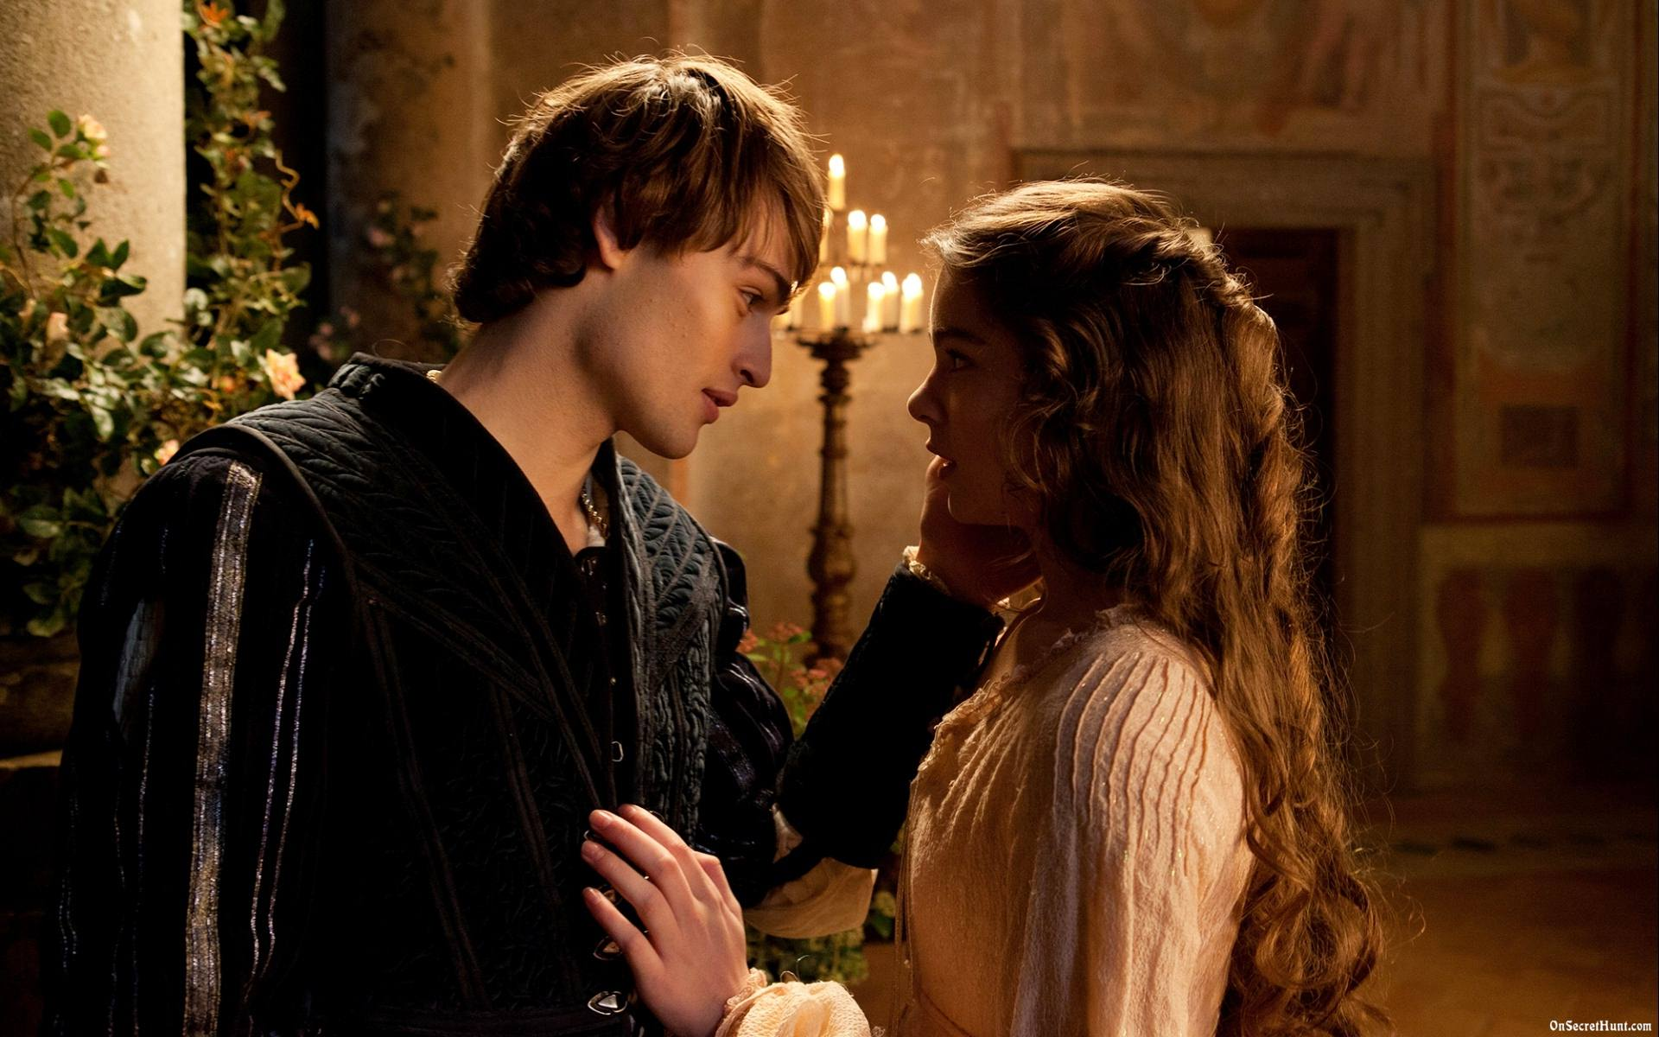
1594
Romeo and Juliet

Slide 29
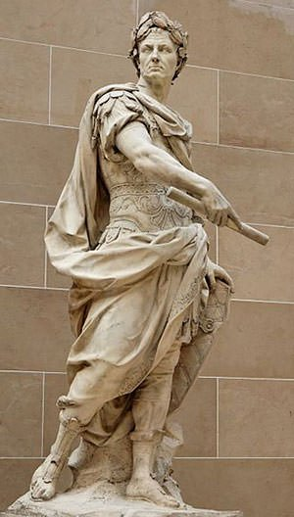
1598
Julius Ceasar

Slide 30
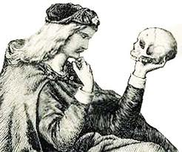
1600
Hamlet

Slide 31
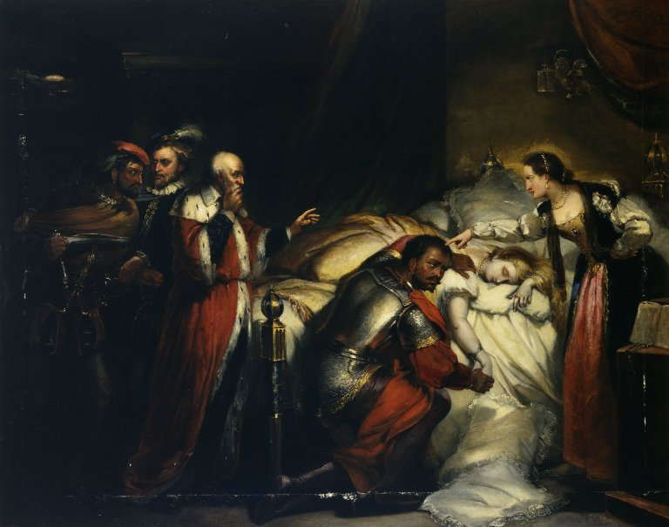
1604
Othello

Slide 32
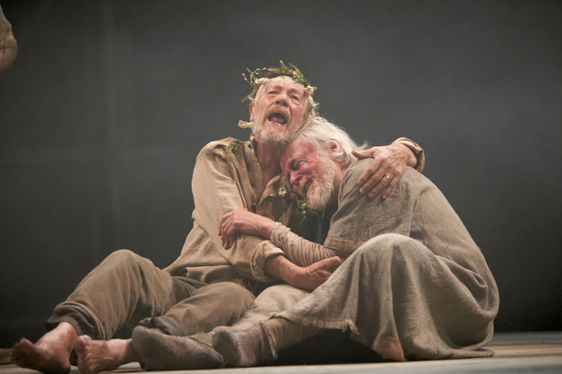
1605
King Lear
Macbeth
Macbeth
King Lear

Slide 33
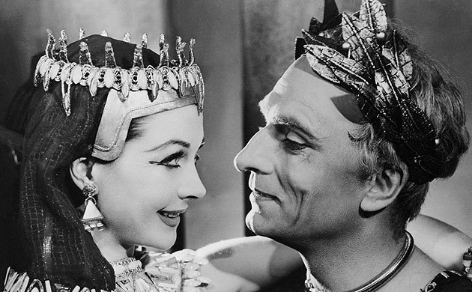
1606
Anthony and Cleopatra

Slide 34
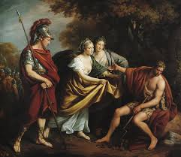
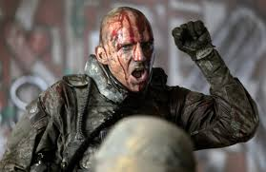
1607
Timon of Athens
Coriolanus
Timon of Athens
Coriolanus

Slide 35
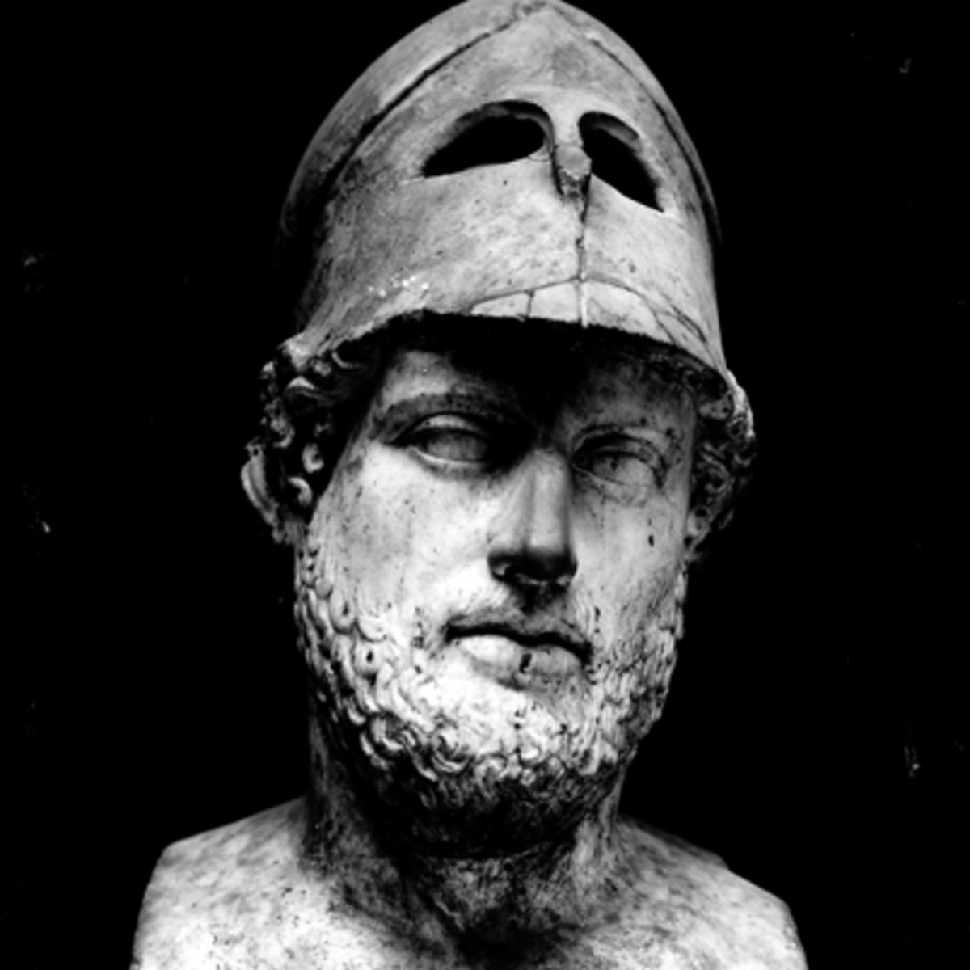
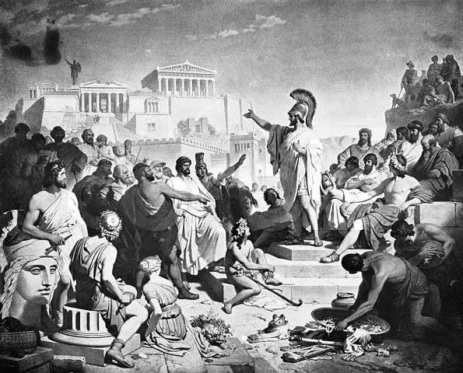
1608
Pericles

