Slide 1
TURKISH CULTURE

Slide 2
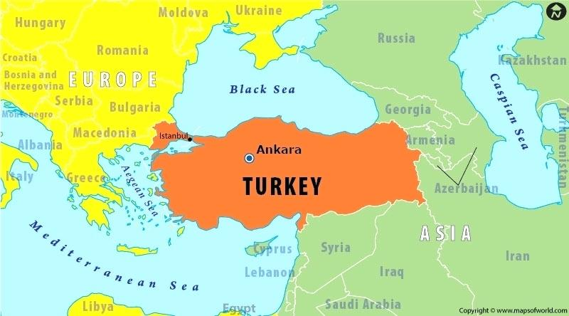
Location of TURKEY

Slide 3
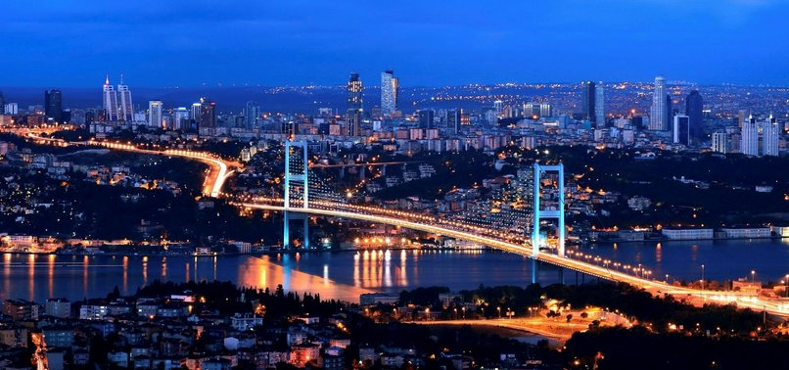
The Bosphorus- ISTANBUL

Slide 4
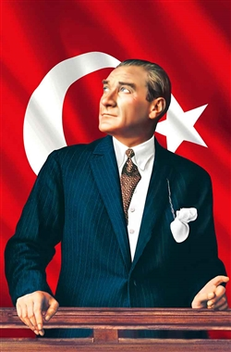
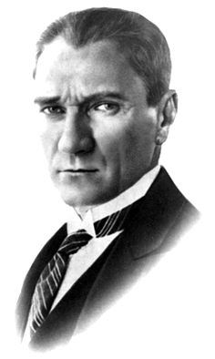
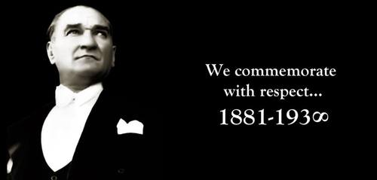
MUSTAFA KEMAL ATATURK
GREAT LEADER

Slide 5
Authority, without any condition and reservation, belongs to the nation.
Peace at home, peace in the world.
One day my mortal body will turn to dust, but the Turkish Republic will stand forever.

Slide 6
Culture
HIGH CULTURE
To point simply, we can state that High culture refers to those in aesthetics, art, literature, painting, sculpture etc.
POPULAR CULTURE
refers to the correspondence of high culture in modern times. Popular culture is commerce oriented cultural products that are consumed and appreciated by people in masses in their daily lives such as popular music, television series, magazines, kinds of dances etc.
CULTURE AS A WAY OF LIFE
Raymand Williams states that culture is a whole way of life and it is ordinary. This means that culture includes our daily life activities as well. Since we cannot observe everyone’s lives, we can take a look at those symbols, materials, practices which represent our daily lives.

Slide 7
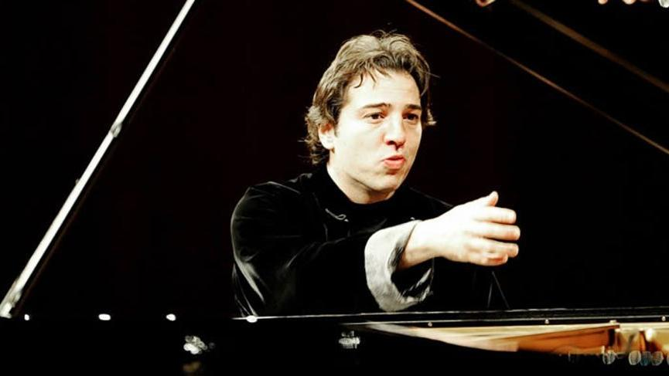
High Culture
He is a very successful and a famous musician, composer, and a pianist.
* Winner of the Young Concert Artists International Auditions (1994)
* Paul A. Fish Foundation Awards (1995)
* Le Monde Awards (2000)
* Echo Klassik (2001)
* German Music Critics’ Best Recording of the Year Award (2001)
* Ambassador of Intercultural Dialogue (2008)
* "Echo" German Record Award (2009)
* "ECHO Klassik 2013 Special Jury Award with Istanbul Symphony Album
* Prix International de la Laïcité 2015 (Comité Laïcité République, France)
* Beethoven Prize 2016 (Beethoven Academy)
* Duisburger Musikpreis (2017)[10]
www.fazilsay.com
FAZIL SAY

Slide 8
AZİZ SANCAR
CHEMIST
PROFESSOR
Has a Nobel Prize in Chemistry

Slide 9
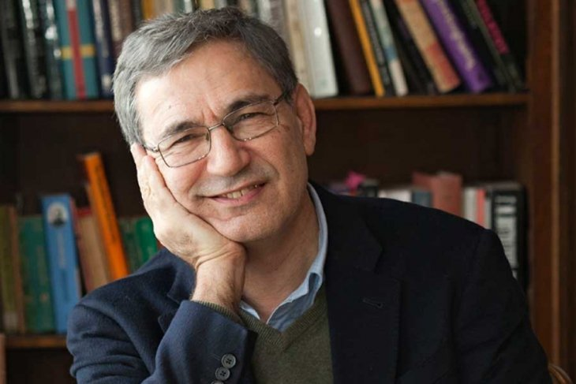
ORHAN PAMUK
He is a Turkish author who won Nobel Prize in Literature in 2006 with his novel “Snow”. List below shows some of his works.
My name is Red (1998)
The Museum of Innocence (2008)
İstanbul: Memories and the City (2003)
Snow (2002)
The Black Book (1990)
The Red Haired Woman (2016)
A Strangeness in My Mind (2014)

Slide 10
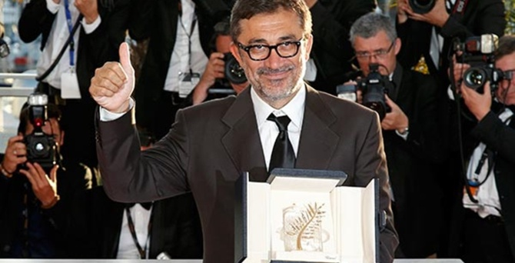
NURI BILGE CEYLAN
He is a well known Turkish movie director with various rewards including having the Best Director Reward in Cannes in 2008 with his movie ‘’Three Monkeys’’ His other movies are as follows:
Cocoon (1995)
Winter Sleep (2014)
The Climates (2006)
Far away (2005)
Clouds of May (1999)
The Town (1997)
Once upon a time in Anatolia

Slide 11
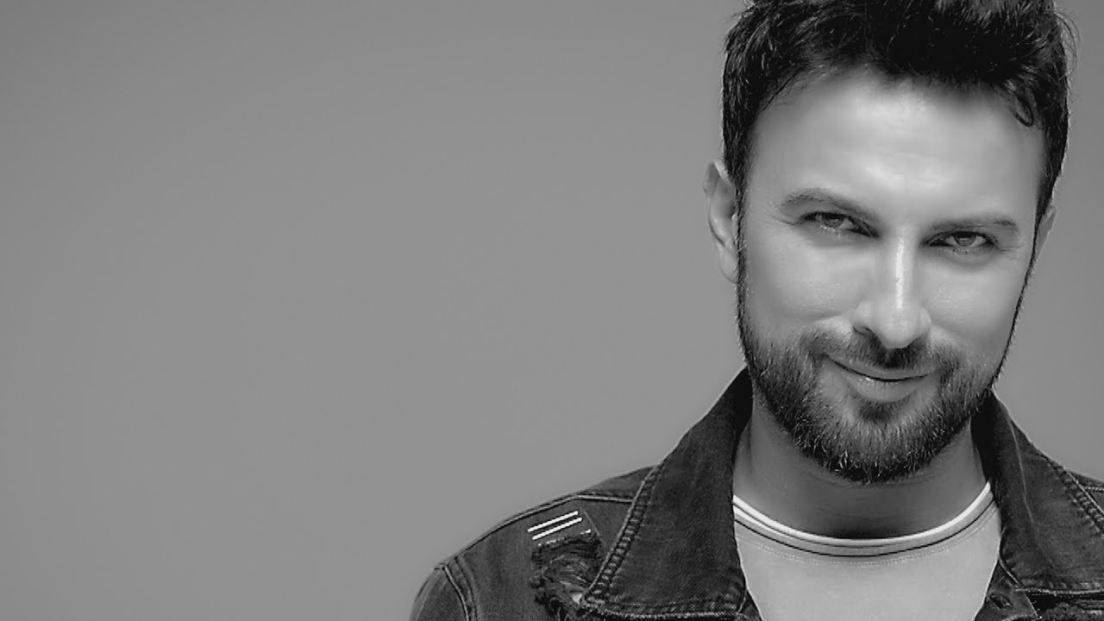
POPULAR CULTURE
Mega Star
The most famous Turkish pop singer
Best known song of him is ‘’Şımarık’’
TARKAN

Slide 12
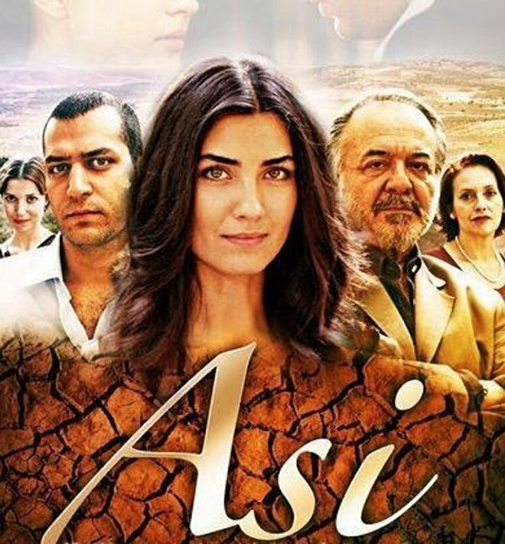
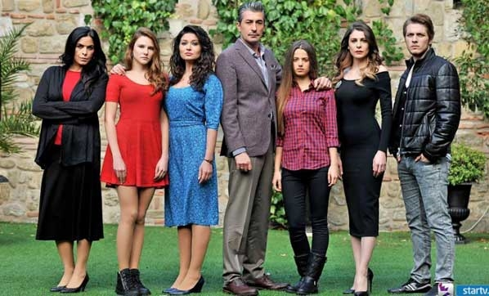
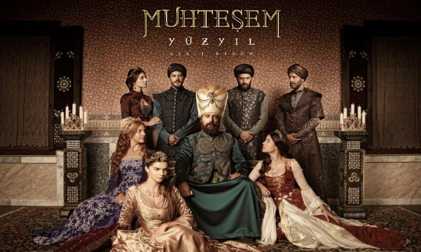
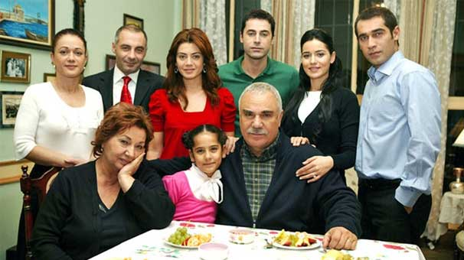
Turkish Series
ASI
DRAMA
PARAMPARCA
Drama
MUHTESEM YUZYIL
Biography,Dram,
Romantic,History
YAPRAK DOKUMU
Drama

Slide 13
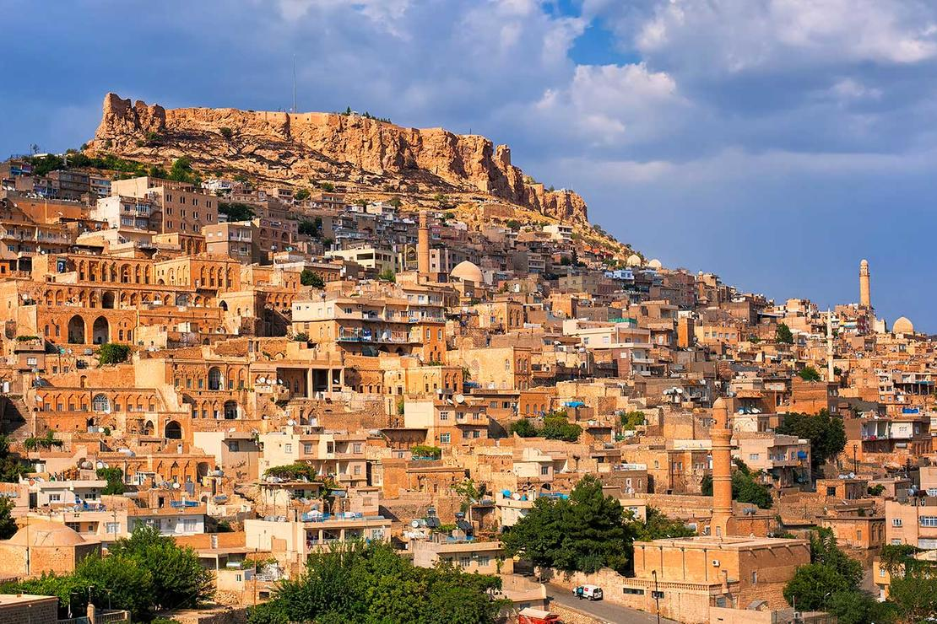
Culture as a way of life
Turkish culture has many diversities.
Various ethnicities: Turkish, Kurdish, Arabic live in Turkey
Various Religions: Muslims,Christians and Jews.

Slide 14
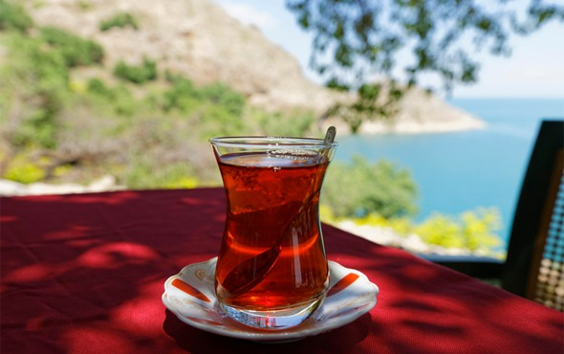
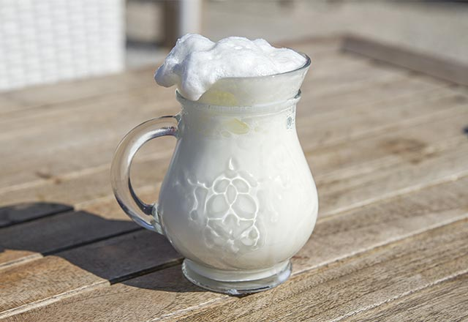
TURKISH CUISINE
TEA
AYRAN

Slide 15
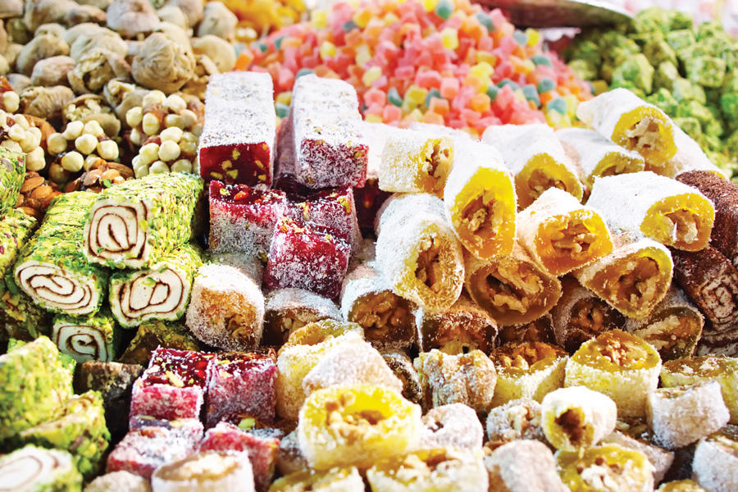
Turkish Coffee and Turkish Delight

Slide 16
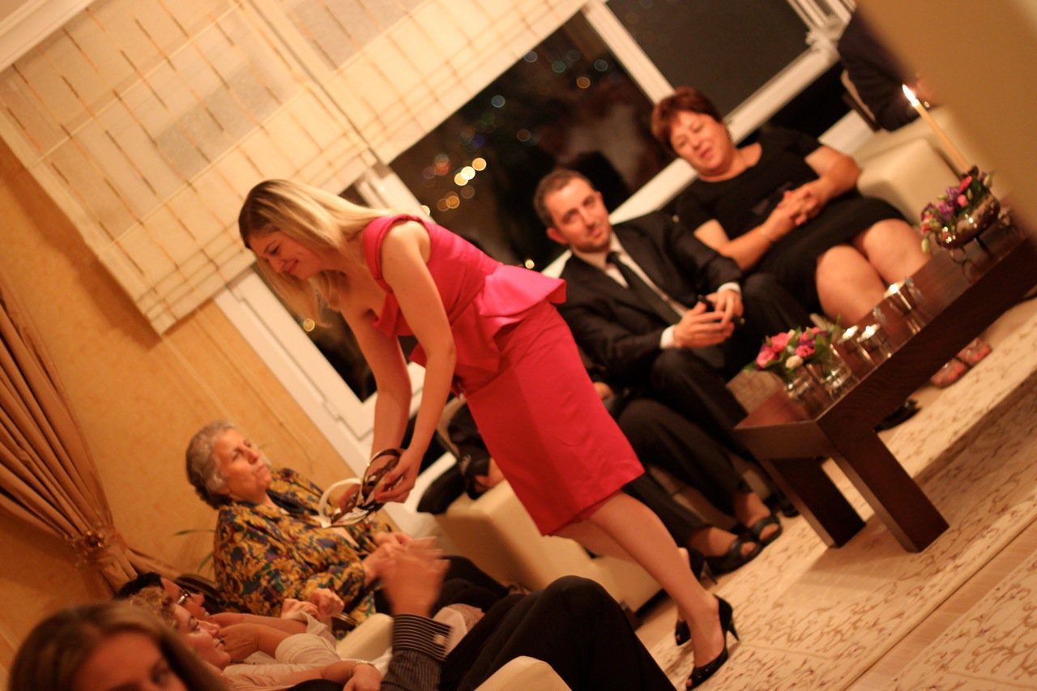

Slide 17
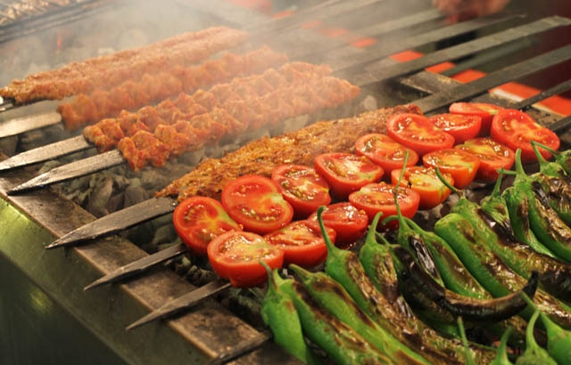
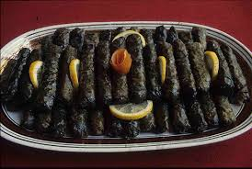
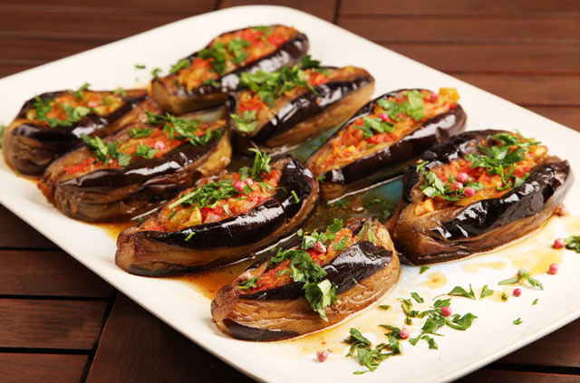
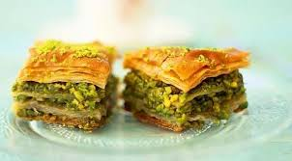
LOVE OF FOOD ☺

Slide 18
Hospitality of Turkish people
A picture of British people visiting a Turkish family.

Slide 19
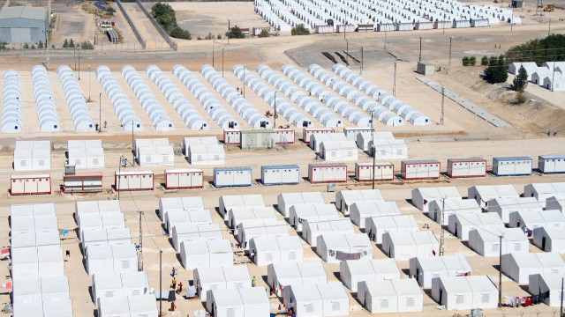
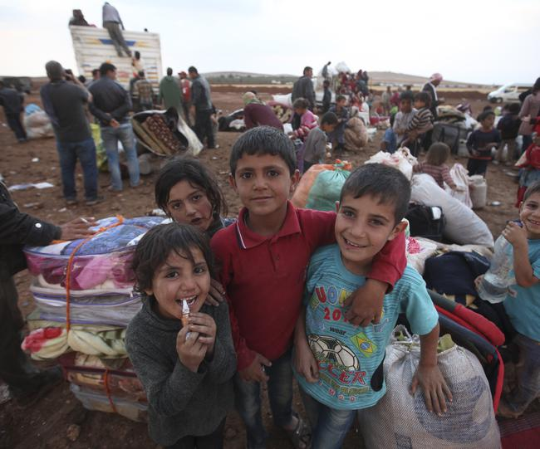
Refugees in Turkey
SYRIA

Slide 20
TURKEY AS A TOURISTIC COUNTRY
HAGIA SOPHIA

Slide 21
EPHESUS ( ANCIENT CITY )

Slide 22
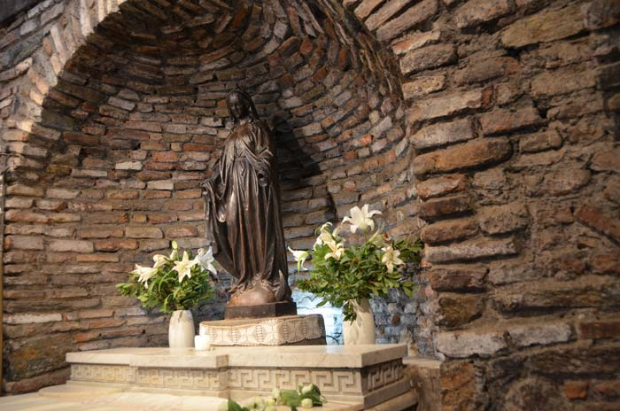
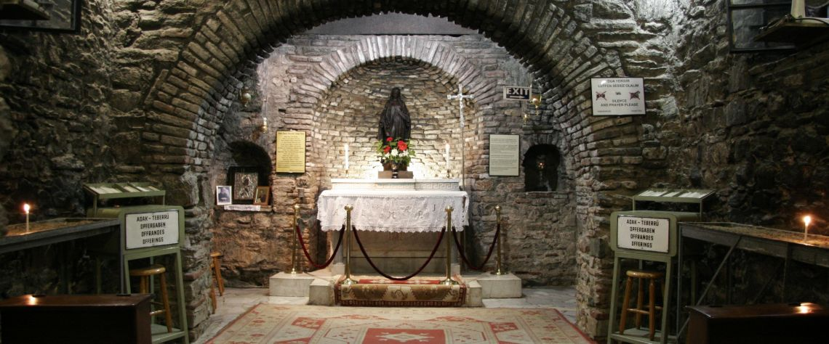
VIRGIN MARY- EPHESUS

Slide 23
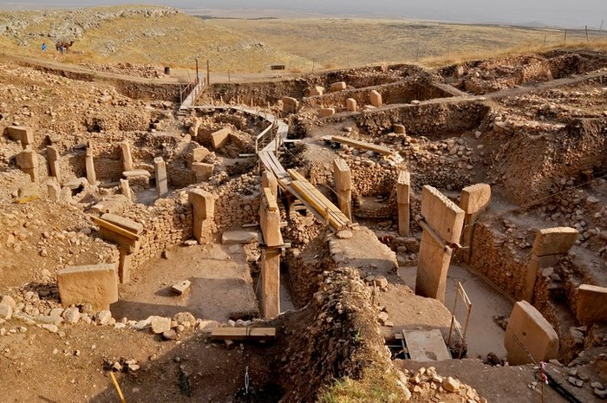
GOBEKLITEPE
The World’s First Temple ?
Göbekli Tepe is one of the most important archaeological sites in the world. The discovery of this stunning is 12,000 years old.

Slide 24
SUMELA MONESTRY

Slide 25
TRAVERTINES OF PAMUKKALE

Slide 26
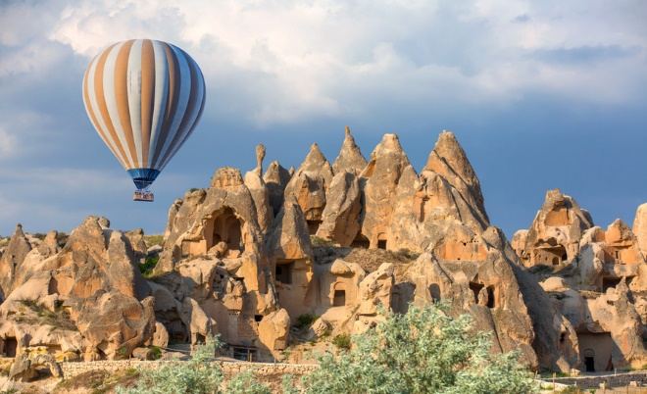
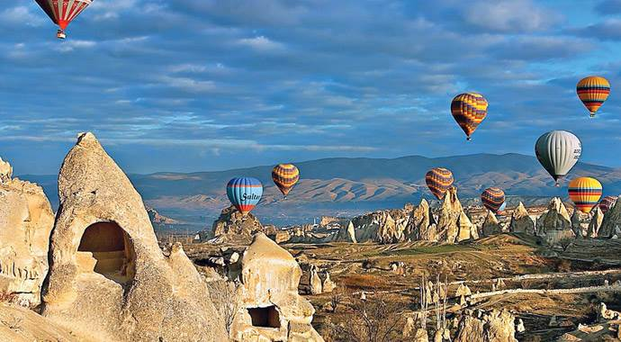
CAPPADOCIA ( FAIRY FLOORS )

Slide 27
FETHIYE/ OLUDENIZ

Slide 28
WE HOPE TO SEE YOU SOON IN OUR COUNTRY

