Slide 1
Our Adventures in Thessaly, GREECE

Slide 2
Thessaly
Farsala, our homecity, is located in the region of Thessaly, at the center of Greece. Watered by the Aegean Sea from the eastern side, only few parts of Thessaly are widely open to tourism.

Slide 3
Meteora
Meteora
is a complex of huge, dark rocks of sandstone, rising out of Kalambaka, near the first hills of Pindos and Hassia. Meteora monasteries, built on the top of some of the rocks, are today the second most important monastic complex in Greece, after Mount Athos.

Slide 4
Meteora
MONKS The wild and inaccessible landscape was a convenient place for the Christian ascetics who settled in the area in a time that is not exactly known.
Meteora , due to their morphology, offered during the Ottoman domination an ideal retreat for monasticism and saved monuments of civilization and works of post-Byzantine art

Slide 5
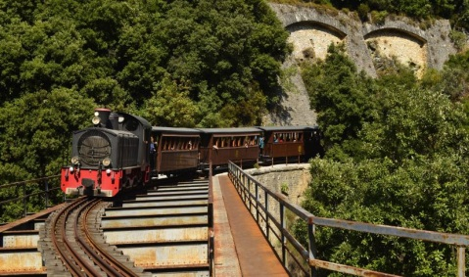
Pelion
In Greek mythology, Mount Pelion was the homeland of Chiron the Centaur, tutor of many ancient Greek heroes, such as Jason, Achilles, Theseus and Heracles.

Slide 6
OLYMPUS
Olympos is the highest mountain in Greece, known worldwide for its mythological context, as the Twelve "Olympian" Gods lived on top of it according to the ancient Greeks.
The shape of Mount Olympus, the charm of its nature, its high peaks, full of fog and low clouds that often bring storms, caused awe and admiration to the prehistoric man who lived in its foothills, where the archaeological excavation today reveals findings from settlements since the Iron Age.

Slide 7
Diachronic Museum of Larissa
The Diachronic Museum of Larissa is built on the hill "Mezourlo" on the southern outskirts of the city on the ring road of Larissa, in an area of 54 acres gradually given by the Municipality of Larissa to the Ministry of Culture.
The Museum was inaugurated on November 28, 2015 and now is open to the public.

Slide 8
The Permanent Exhibition
The exhibits come from excavations carried out during the 20th century, so far in the prefectures of Larissa, Trikala and Karditsa, from supplies and donations of objects and antiquities repatriation.
Around 2000 objects are exhibited.
Among them a lot of findings from Farsala.

Slide 9
First Ancient Theater of Larissa
The First Ancient Theater of Larissa (Ancient Theater of Larissa) is an open-air theater and the largest theater in Thessaly, with a capacity of 10,000 people. It is located on the south side of the Acropolis Hill (Fortress Hill) in Larissa.

Slide 10
First Ancient Theater of Larissa
The ancient theater was initially associated with the worship of God Dionysus, with theatrical and musical activities, and secondly with the administration of Thessaly for the meetings of the city assembly, which was called a market
The theater has the typical architecture of the Hellenistic theater with its three basic elements: hollow (hollow), orchestra and stage (stage) with a diameter of about 25 meters.

