Slide 1
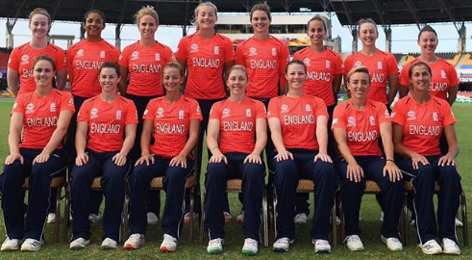
Famous cricketers
By Evie, Hannah, Ogohgoh and Izzy.T

Slide 3
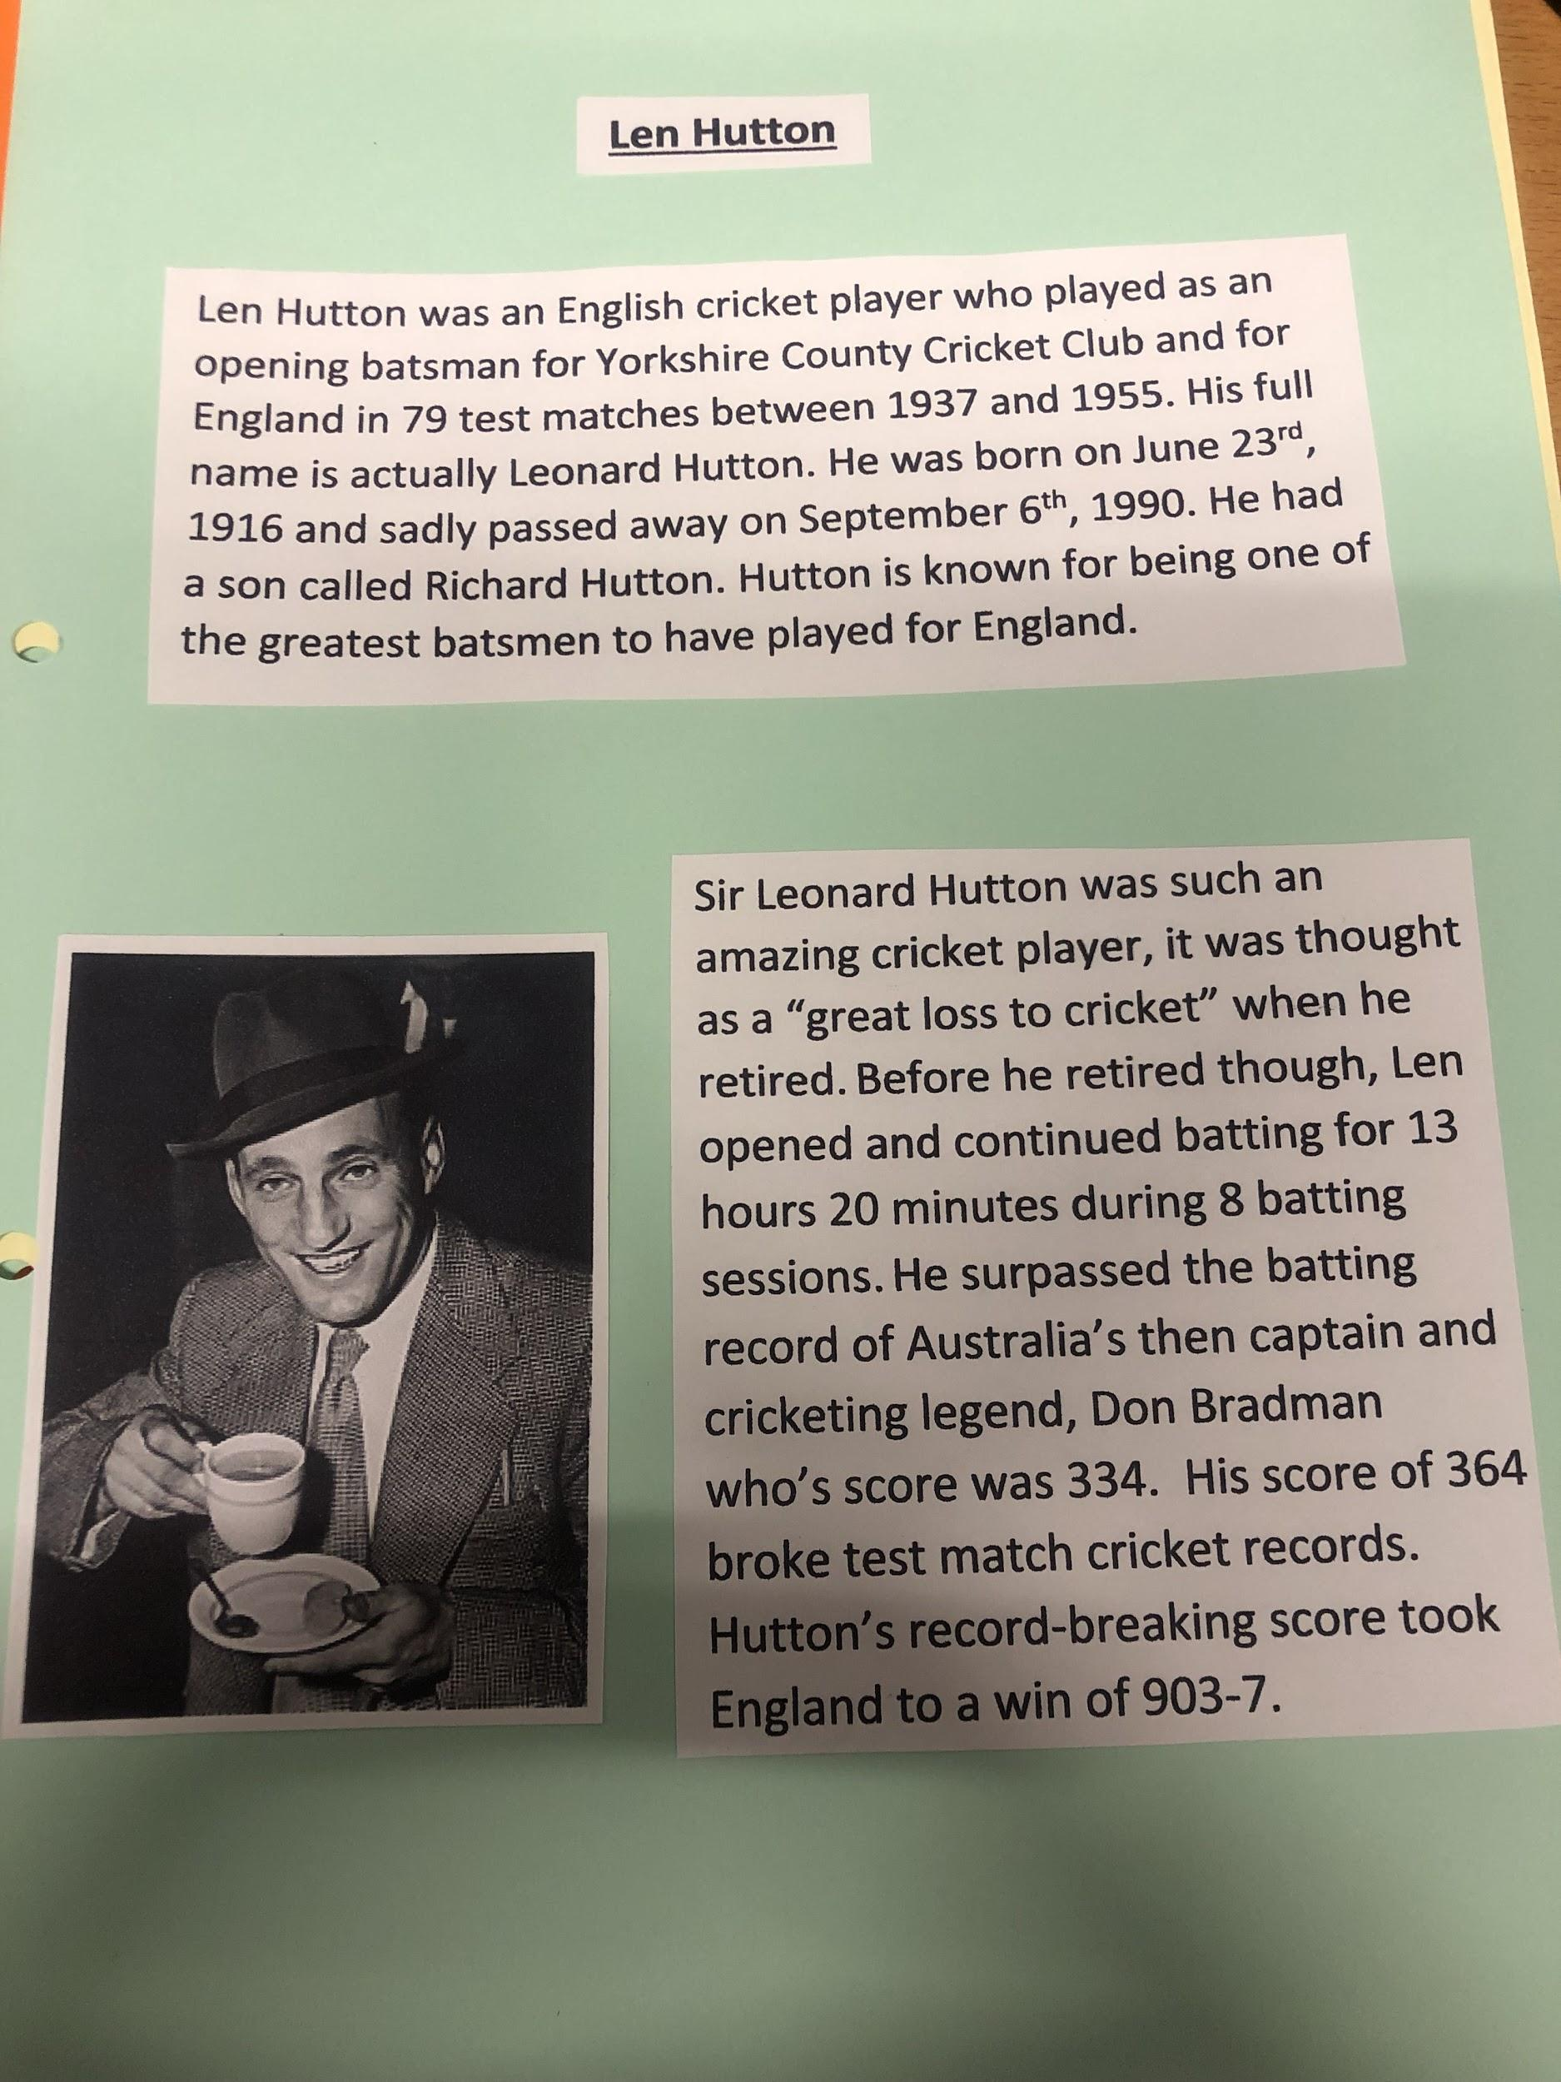

Slide 4
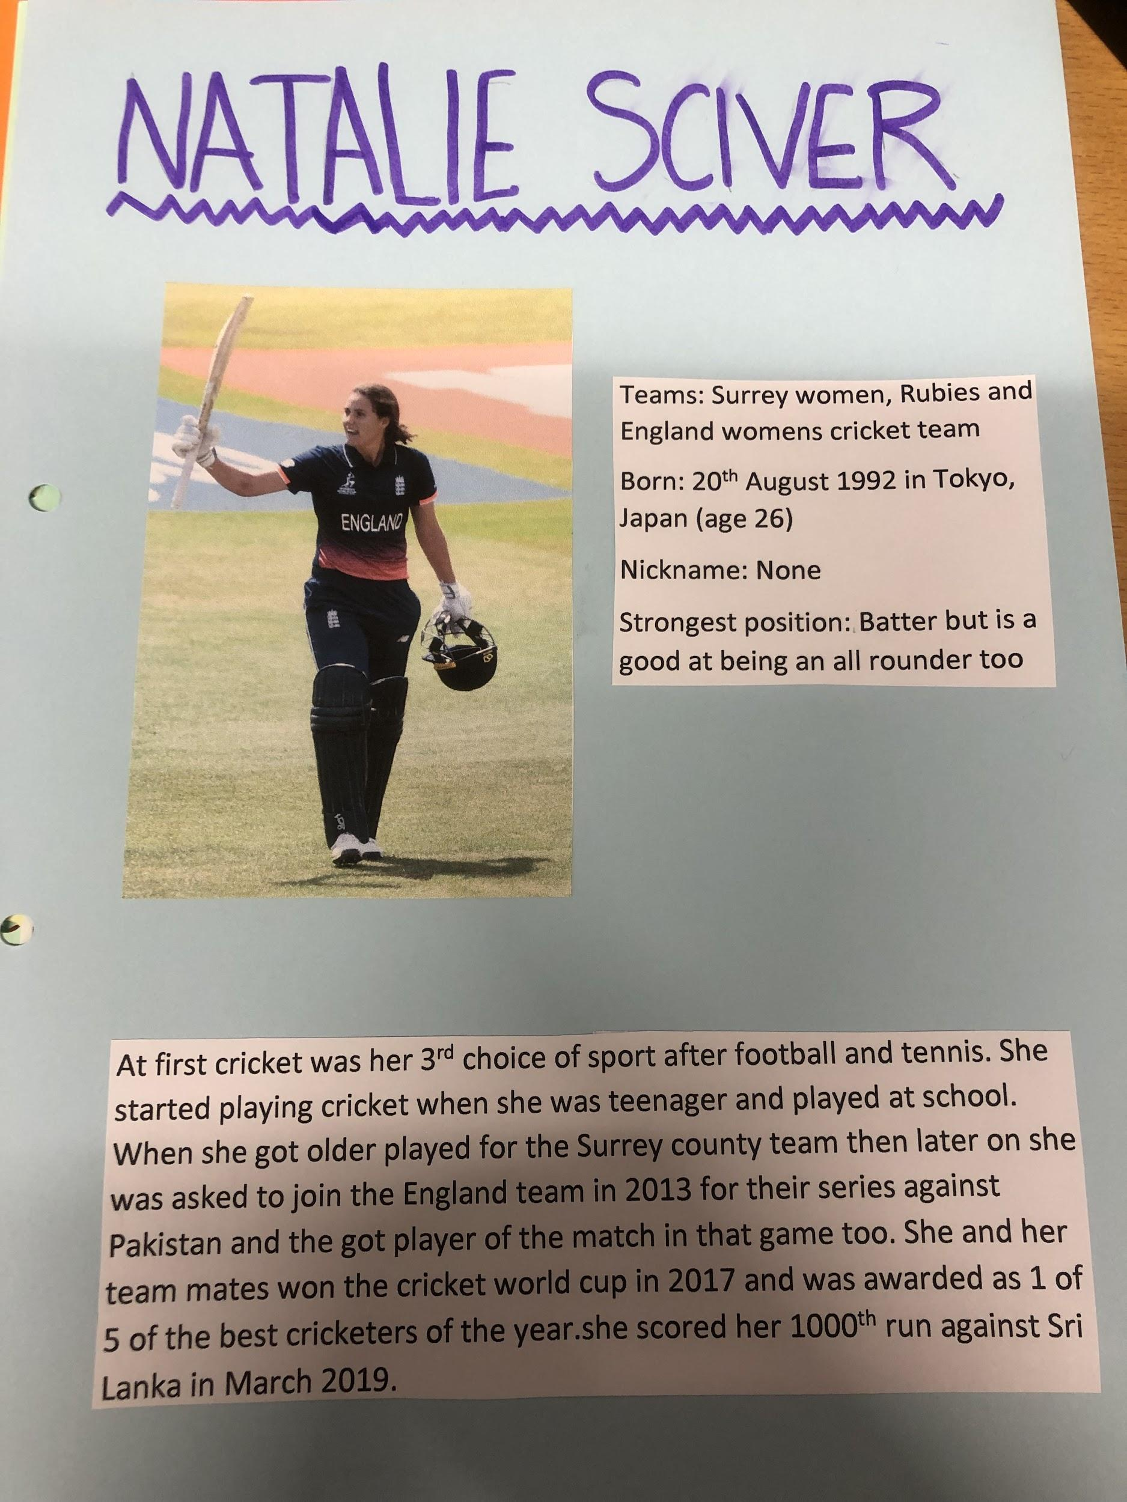

Slide 6
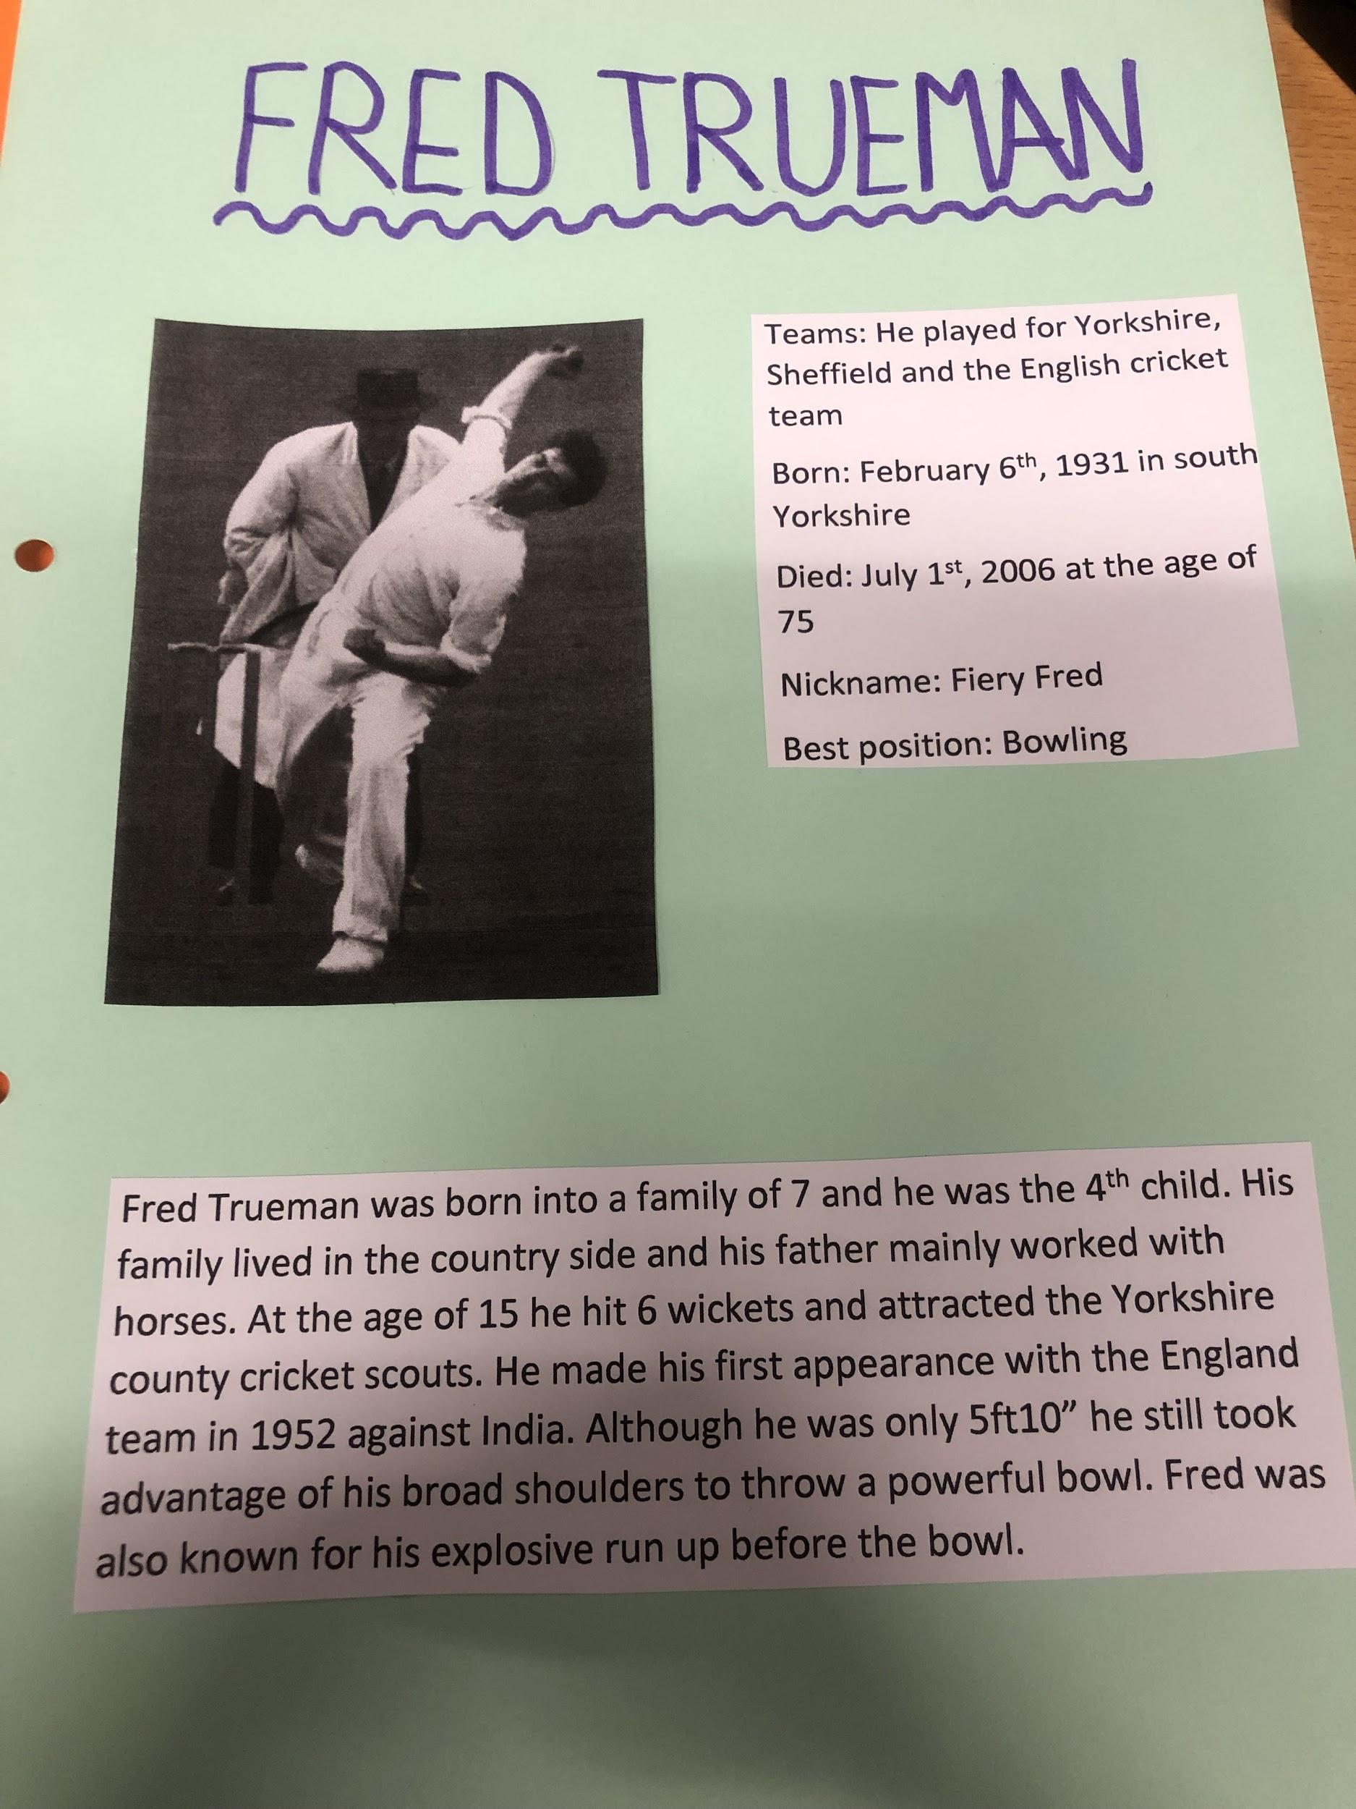

Slide 7
