Slide 1
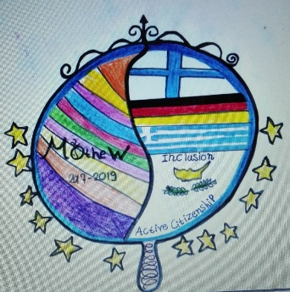
ERASMUS + “MIRROR, MIRROR ON THE WALL” 2ND SKYPE MEETING 13/12/2017 WITH GERMANY-FINLAND-CYPRUS 2ND PRIMARY SCHOOL OF SERRES

Slide 2
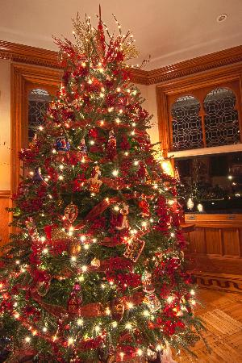
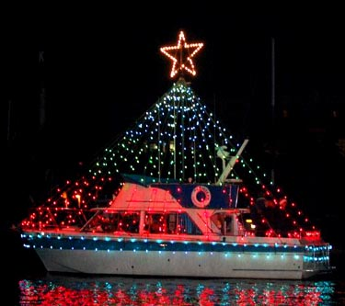
Before Christmas Holidays we decorate
a Christmas tree or a Christmas ship.

Slide 3
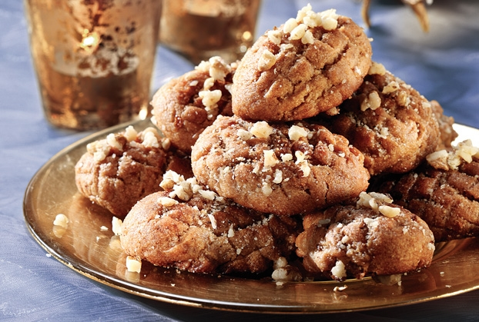
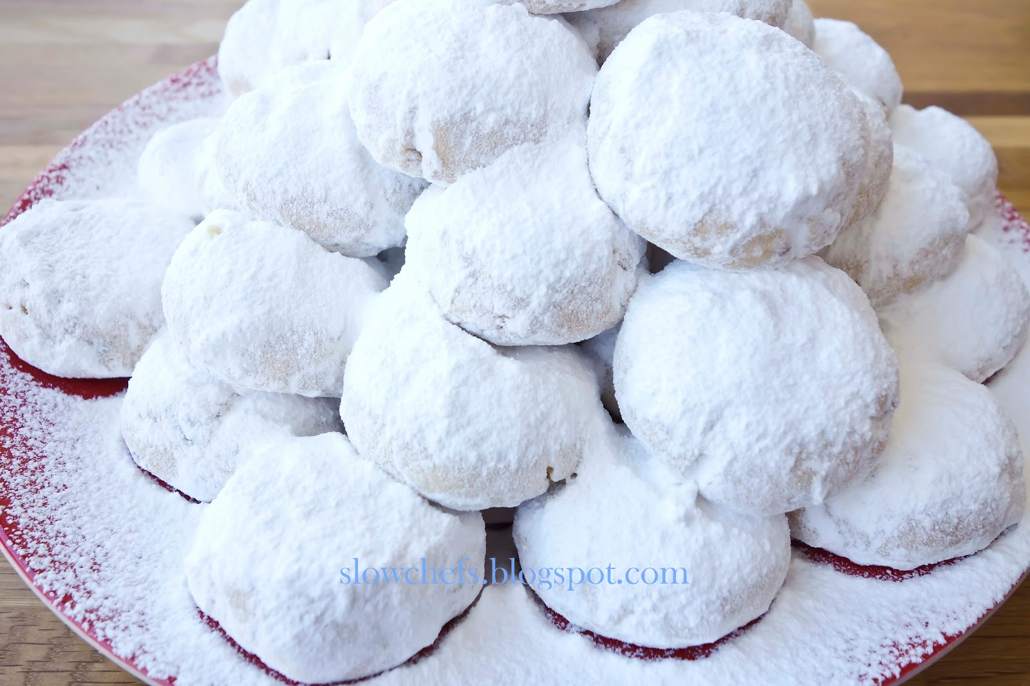
We make melomakarona
and kourabiedes

Slide 4
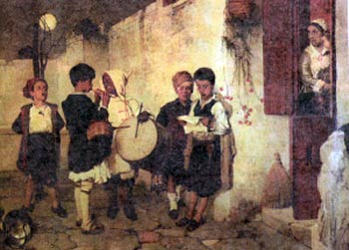
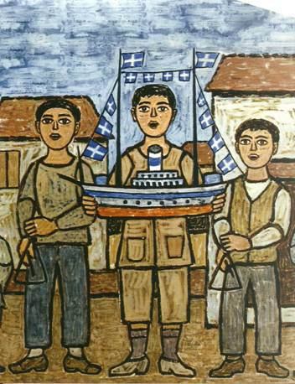
On Christmas Eve we sing carols.

Slide 5
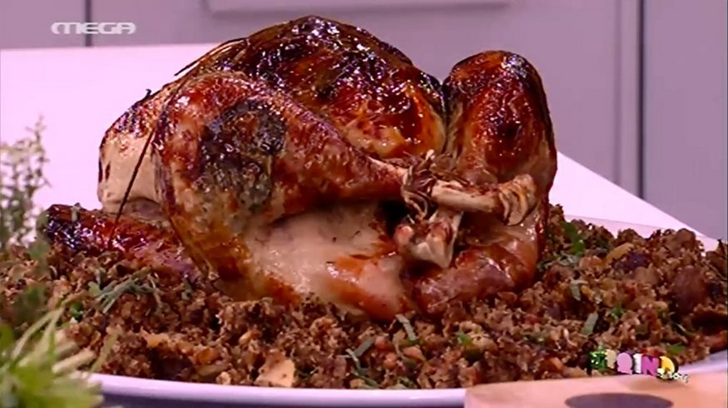
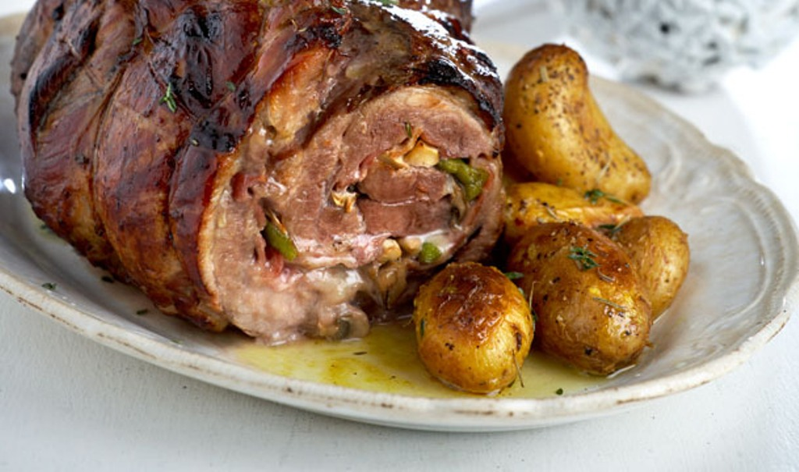
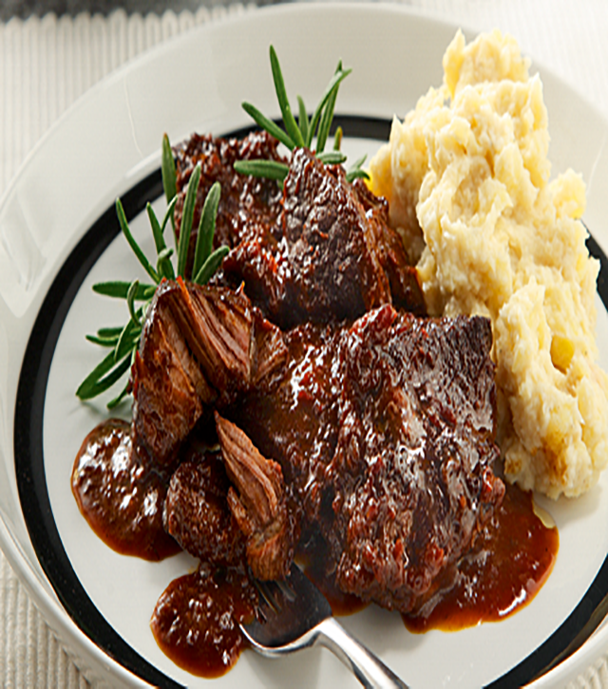
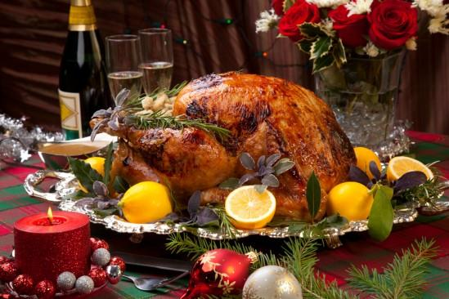
On Christmas Day all the family have lunch.
We eat stuffed chicken or turkey, beef or pork.
After lunch we open the presents.

Slide 6
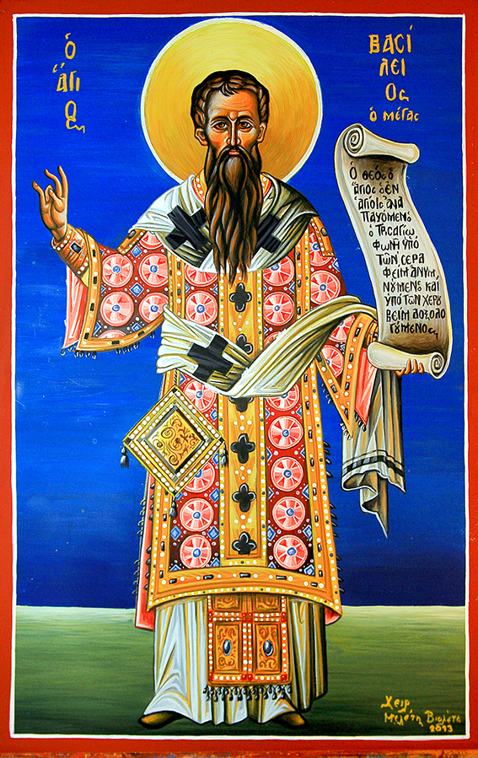
We write letters
to Saint Vasilios.
Saint Vasilios or Basil (330-379) was a Greek bishop and theologian from Caesarea, Cappadocia, Asia Minor, Byzantine Empire(modern turkey). He was a Father of the Eastern Orthodox Church and one of the three Hierarchs who protect Letters, Education and Schools.
He was rich and educated but offered his life to preaching and helping and his fortune to take care of the poor, sick and unpriviledged. He built an institute, called Ptochokomeion or Basileiada, in Caesarea, which was a poor house, a hospital and orphanage. He loved and cared for children especially. He died on January 1st.
In Greek tradition, he brings gifts to children every January 1 (St Basil's Day). It is traditional on St Basil's Day to serve vasilopita, a rich bread baked with a coin inside. It is a custom on his day to visit the homes of friends and relatives, to sing New Year's carols, and to set an extra place at the table for Saint Basil. St Basil is the saint associated with Santa Claus as opposed to the western tradition of St Nicholas

Slide 7
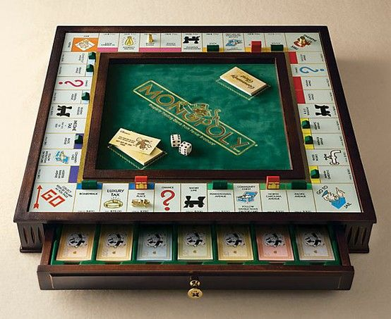
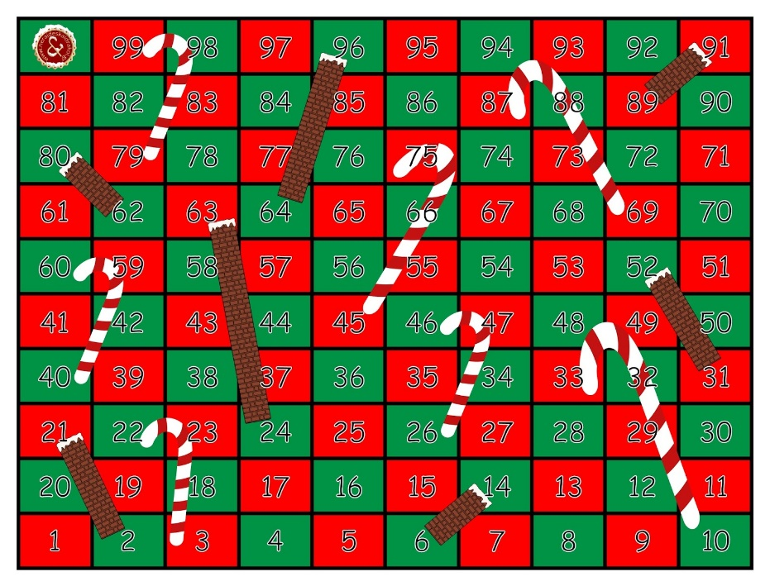
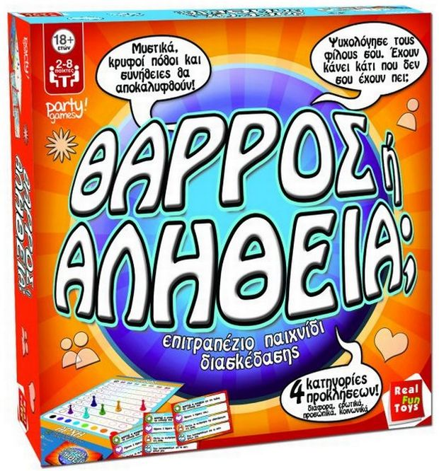
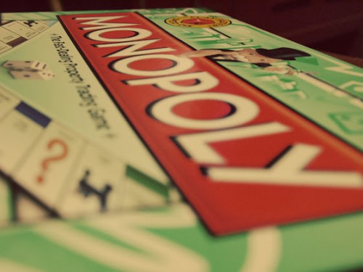
On New Year’s Eve we sing carols, we play cards and board games.
Saint Vasilios brings presents after midnight.

Slide 8
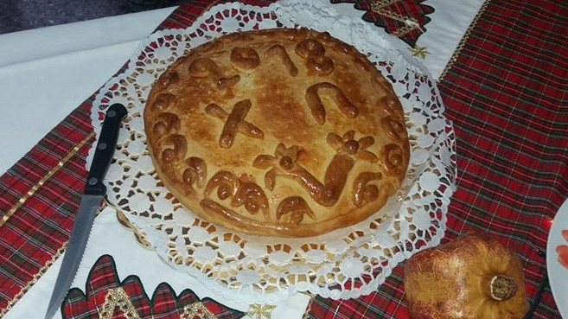
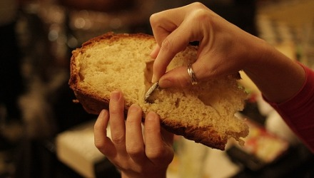
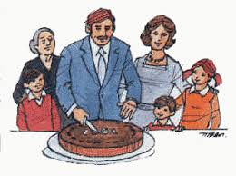
At midnight, we cut the New Year’s pie. There is a gold coin in the pie.
Ιf you find it, you are lucky.

Slide 9
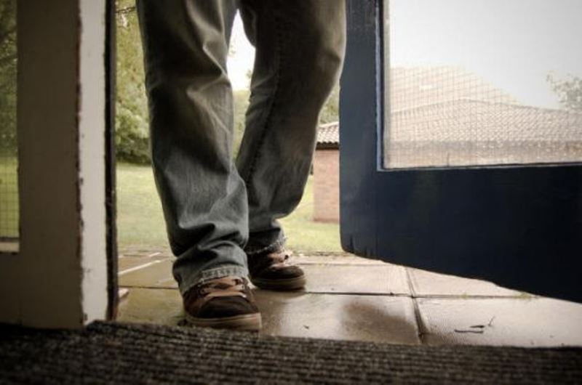
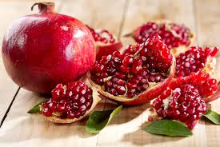
The first person who
comes in the house
puts the right foot
in for luck.
We break a pomegranate
at the door for luck.

Slide 10
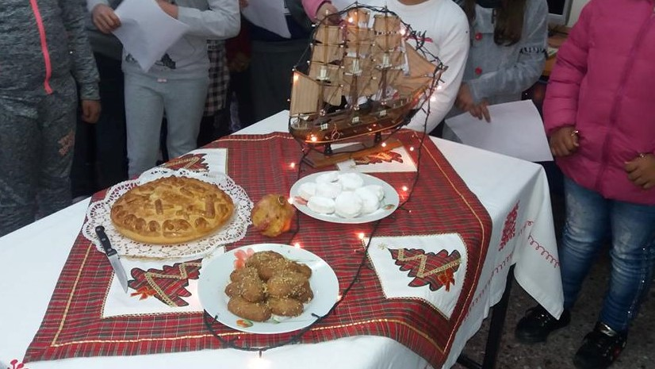
Skype moments - Greek customs

Slide 12
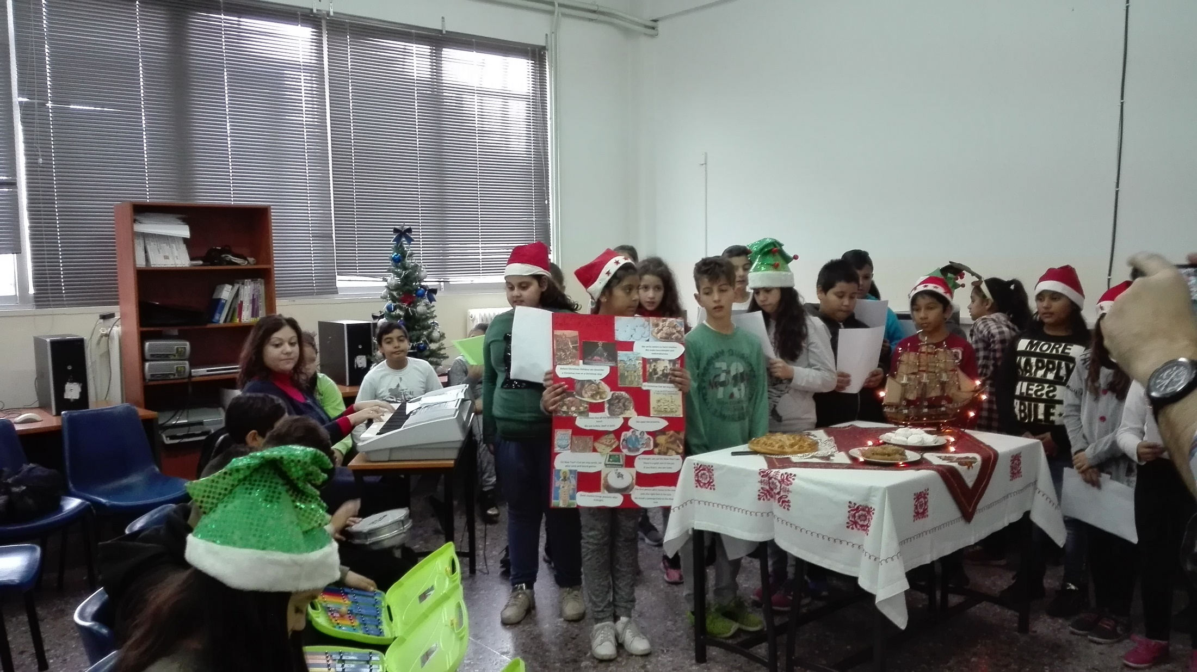

Slide 15
Decorating our school’s tree in the centre of the town 15/12/2017

Slide 20
Our cards to you. We hope they arrive before Christmas.

Slide 21
They are creations of the students in Art class. Angels, reindeer, decorated boats, Christmas trees, ornaments, lights, ornaments, stars, Santa’s sleigh, presents, hearts and lots of wishes for the best Christmas and a Happy New Year.

Slide 23
Καλά Χριστούγεννα από την Ελλάδα
Merry Christmas from Greece
Καλή Πρωτοχρονιά σε όλους!
Happy New Year
Αγάπη και Υγεία σε όλους
Love and Health to all

