Slide 1
SPECIAL EDUCATION IN GREECE
2ND PRIMARY SCHOOL OF SERRES
INTEGRATION CLASS
(TMIMA ENTAXIS)
Konstantinos Kiosses, Special Education Teacher
Soultana Drampa, Teacher of English
2/10/2017

Slide 2
“ If a person doesn’t receive the education he/she desires ,then this person is wronged by society”
Wystan Hugh Auden, Poet-Philosopher

Slide 3
In Greece, the history of Special Education begins at the dawn of the 20th century and is separated in three periods:
The period 1905-1950, which is distinguished for the rise of private initiative
The period 1950-1974, when both private and public initiative coexist in connection with the scientific framing of Special Education and finally
The period from 1974 to the present day during which the public sector has taken more and broader initiatives on the issue of Special Education

Slide 4
First period 1905-1950
In 1906 the first private institute that offers special education is founded, the “House for the Blind”. It is managed by Mrs Irini Laskaridou .
In 1923 the “House of the Deaf” is founded in Ambelokipi area, Athens.
In 1937 the “Model Special School of Athens” is founded in Kaesariani, Athens with Rosa Imvrioti as the dominant personality

Slide 5
“The most important event of the decade is the establishment of the “Model Special School of Athens (1937, A.n. 453). Its soul is Roza Imbrioti, who applies innovative teaching methods, the dominant being Single Centralized Teaching tailored to the needs of the special school. Beyond teaching and school management, Imbrioti submits specific proposals for educational reform, teacher training abroad in order to gain expertise in special education and speech therapy. Her proposals included further specialization of instructors in therapeutic gymnastics and psychiatrists in therapeutic treatment. Apart from the postgraduate education and training issues, Imbrioti demonstrates the necessity of the establishment of special schools and consultancy stations in the province and considers the higher pedagogic education should include therapeutic treatment as a key element of the curriculum. These proposals will fall on deaf ears while Imbrioti, a victim of the civil war and political conflicts, will eventually be exiled.”

Slide 6
Second period 1950-1974
In the 1960s there is a rise in the concern for children’s mental health leading to the establishment of various institutes («Stoupatheo Therapeutical Treatment Centre», «Skiaridio Institute for Maladjusted Children », where perfectly organized special schools and professional workshops work under the simple supervision of the Ministry of Welfare

Slide 7
In 1960 the “ Special School for the Deaf in Serres” is founded. The school will interrupt its operation in 2012 due to lack of students.

Slide 8
In 1972, during the Greek dictatorship, 18 public schools for Persons with Disabilities(AμεΑ) were founded. By July 1973, 20 more schools were established. According to the statistic recordings of that period, during the school year of 1973-1974, 2,969 cases of Disabled Persons were recorded in the various established schools and institutes. Special Teachers’ training was still in “infant” stage. The Special Primary School of Serres worked for the first time in the school year of 1976-1977.

Slide 9
Third Period 1974 to the present day
It is the period with the major changes in special education in Greece.
With the Constitution of 1975 (article 21) the right to education of disabled persons (AμεΑ) is constituted by law
Law 1143/81 (ΦΕΚ 80/31-3-81 vol. Α΄) introduces and establishes special education as part of the educational system. New disciplines (social worker, psychologist, speech therapist, ergo therapist and health supervisor) are created to serve in special schools.

Slide 10
Third Period 1974 to the present day
In 1982 the Presidential Decree 603/82 defines the types of special educational units. There is talk now clearly for “classes or parts of classes of special education” for the persons with disabilities, but the special students are enrolled in ordinary public schools, like all other students. Following this spirit, in 1984, 25 special classes within the ordinary public schools are established, which accept students part-time, depending on the learning difficulty they present.
Those Special Classes were the ancestors of the current Integration Classes

Slide 11
Third Period 1974 to the present day
More meaningful steps towards the integration of people with disabilities are taken with the 1566/85 Law (article 32). For the first time terms like “holistic and effective development and utilization of their skills and competences", for "the mutual acceptance from society» and «integration (of people with disabilities) in the production process” are mentioned.
The cases of persons who belong to the category of the disabled are clearly described, as well as ways of diagnostic examination, curriculums and teaching resources. Special Education will be offered: in the context of
mainstream schools,
special classes in mainstream schools,
in special schools,
in special vocational schools or
at home.

Slide 12
Third Period 1974 to the present day
Significant fact in the history of Special Education is the Law 2817/ of 2000 because:
It entitles the disabled persons to study in special schools, regardless of disability (as serious as it is).
KDAY (Evaluation and Diagnostic Support Centres for persons with special needs)are established, where the students’ educational needs are assessed, expert opinions are issued, individual educational timetables are designed and the framework of personal study plan is recommended (personnel serving in KDAY-special education teachers, social workers, psychologists, child psychiatrists, physiotherapists)
Special schools are founded in Secondary Education
A new speciality is established to work in special schools =DE 1 special supporting personnel

Slide 13
Third Period 1974 to the present day
Another equally significant milestone in the history of special education in Greece is Law 3699/ of 2008 because:
The compulsory attendance of school classes by children with special needs, regardless the kind of disability they have, is instituted. Previously, parents had the right to take that decision. After this Law, they are obliged to make sure that their child attends classes in a school unit of Special Education.
Integration Classes are increased and the parallel support of students with special educational needs, inside the ordinary classroom is instituted as well.

Slide 14
Third Period 1974 to the present day
With the article 39 of Law 4115/2013 special committees (ΣΔΕΥ-ΕΔΕΑΥ) are established:
Their aim is to face the difficulties of the students inside the ordinary class and support the students with them, as well as assist the teacher of this class in his work.
They have under their responsibility groups of up to 5 school units with Integration Classes and cover the needs of a small number of schools. For example, last year in Serres there was one committee in Primary Education for just 5 schools.
The specialities working for these committees are psychologists, social workers, special education teachers

Slide 15
Special Education Staff
Special Education Staff consists of the following specialities:
Special Teacher. The first teachers were trained in Special Education for one year in “Marasleio Academy” in 1969. Their training lasted for two years since 1976. From 1998 there are two Higher Education University Departments for Special Education teachers(4 years of studies) in Volos and Macedonia University in Thessaloniki
Psychologist
Ergo therapist
Social worker
Speech therapist
Physiotherapist
School nurse
Special Supporting School Personnel

Slide 16
Diagnostic Services
1. K.E.D.D.Y. (Diagnosis-Diaforodiagnosis and Support Center) ΚΕ.Δ.Δ.Υ.
It detects and evaluates the difficulties of the student, it gives expert opinion about them and recommends a study plan, which is necessary for the student in order for him/her to attend the appropriate special education for his/her case.
ΣΔΕΥ-ΕΔΕΑΥ(already mentioned)
They work in groups of five schools and support the teacher of general education in the classroom. This institution enables the ordinary public school to be supported by Psychologists and Social Workers.
3. ΙΠΔ Ιατροπαιδαγωγικά Κέντρα – Iatropedagogica Centra
Centres of parallel Medical and Pedagogic Support

Slide 17
Special Education Today
It is provided in the General School in the following ways:
Inside the classroom by the general teacher of the class, supported by the School Advisors of Special and General Education, when there are slight learning difficulties.
Parallel Support of the student
a) Inside the classroom by a special education teacher(provided that the student can attend the general curriculum with the above support). This type of support needs the expert recommendation of K.E.D.D.Y. (Diagnosis-Diaforodiagnosis and Support Center)
b) By the School Nurse (expert opinion of a Public Hospital) or School Supporting personnel (expert recommendation of K.E.D.D.Y. (Diagnosis-Diaforodiagnosis and Support Center)) . Parallel Support by School Supporting Personnel and Parallel Support by a Special Education teacher can’t coexist

Slide 18
Special Education Today
Parallel Support of the student (continued)
c) By a Special Assistant, suggested and disposed by the family of the student.
The prerequisites are:
1) Request form of a parent or guardian to the school management
2) CV and Criminal Record of the suggested assistant for the implementation of the support program and
3) The consent of the Director and the Association of the Teachers of the school. For the approval of the support by a Special Assistant there is no deadline and the Director of the school informs in writing the Head Office of Education about the presence of the Special Assistant in the school unit and the existence of the above prerequisites.

Slide 19
Special Education Today
In the Integration Classes established in the general school staffed by teachers of Special education. Students here follow their individual special program in the subject areas they have difficulties in and the rest of the time they follow the general curriculum of their classroom.
Integration Classes can work in two different ways:
For students with slight educational needs. These students stay for 15 periods(45 min. each) maximum in the Integration Class and for the rest of the periods(there are 30 periods a week in total) they remain in their classrooms.
Extended timetable when the educational needs of the students are more serious and the students remain in the integration class for more than 15 periods.
The attendance of Integration class requires the expert opinion of K.E.D.D.Y. or the suggestion of the School Advisor of Special Education.

Slide 20
Special Education Today
Tutoring at home, when this is considered inevitable, for serious long–term or short-term health problems, which do not allow transfer of the students to school and attendance of lessons in the classroom. Approval for tutoring at home is given with the official decision of the Regional Director of Education of the relative level of Education(Primary or Secondary) the student belongs to, after a recent medical report, where the reasons and duration of the imperative stay at home are defined. This report is provided by a public Iatropedagogiko (Medical-Pedagogic) centre or a public health committee.
.

Slide 21
Special Education Today
When attendance of the ordinary school curriculum or the Integration Classes by students with disabilities and special educational needs is considered impossible, then their education is provided:
In independent School Units of Special Education (ΣΜΕΑΕ-SMEAE)
α) Primary Education:
1) Special Kindergartens EAE for children from 4 to 7 and
2) Special Primary Schools EAE for students up to the 14th year of their lives, which have got a preliminary class and the six grades of general Primary Schools. After the suggestion of the responsible Diagnostic Centre (KEDDY) the attendance of the school can be prolonged up to the 15th year of their age.

Slide 22
Special Education Today
b) Secondary Education :
Special High Schools ΕΑΕ for students up to the 19th year of their age, which have got a preliminary class and the three classes of the general High Schools.
Special Lyceums ΕΑΕ, which also offer attendance in a preliminary class before the three classes of a General Lyceum. Students with disabilities and special educational needs, who have graduated from High School may skip preliminary class and enrol directly in the 1st class of Special Lyceums, after evaluation by the responsible Diagnostic Centre (KEDDY)
Special Vocational High schools
Special Vocational Lyceums
Institutes of Special Vocational Education and Training, where attendance lasts for 6 years. Both students who have graduated from general and special Primary Schools can enrol in these institutes. They are school units which belong to Secondary Education and grant their graduates with a certificate of level 2a with professional rights (connect education with professional rehabilitation).

Slide 23
Integration Class of 2nd Primary School
In the Integration class ten(10) students attend lessons, four (4) girls and six (6) boys.
One from 1st grade
Five from 2nd grade
One from 4th grade
One from 5th grade
Two from 6th grade
They have learning difficulties in reading and Maths. They are separated in 4 groups (two with 3 students and 2 with 2 students). The groups were created taking into consideration the students’ competences and we tried to have relative homogeneity. It belongs to the first type of Integration Classes, where students leave the general class and come to the room of Integration Class to be supported and to follow their personal educational plan, and then return to their class. No student remains in the Integration Class for more than 15 periods
At first, the student is evaluated so that his/her educational needs are specified and then his/her Individual Educational Schedule is designed. The schedule lasts for three months and the parents and teacher of general education are informed about it.

Slide 24
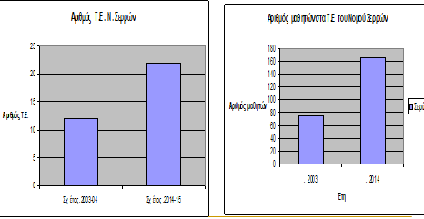

Slide 25
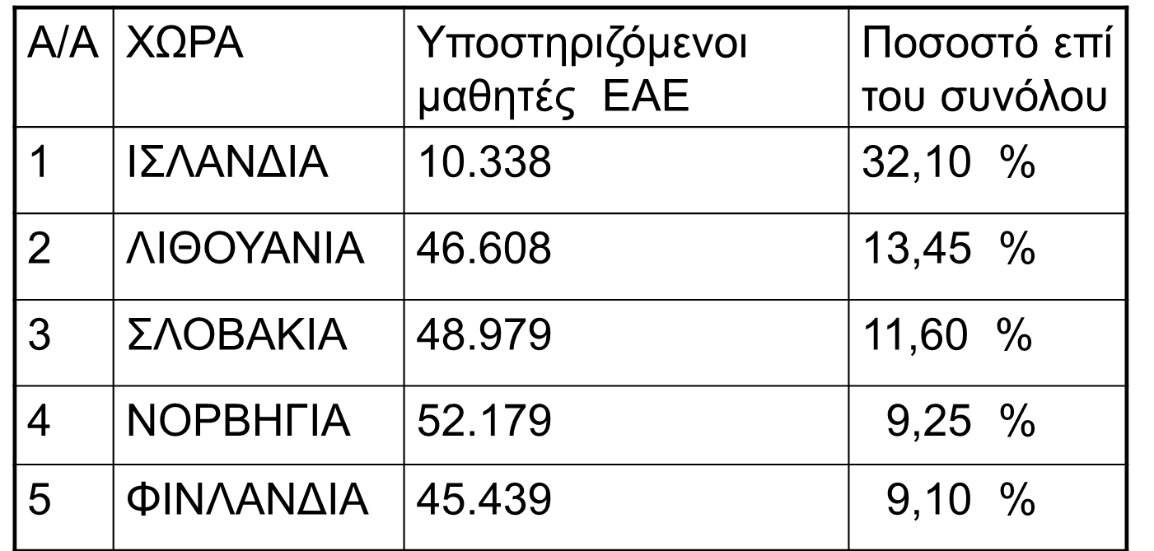
Number of students with special educational needs in Europe according to the European Organization for Special Education

Slide 26
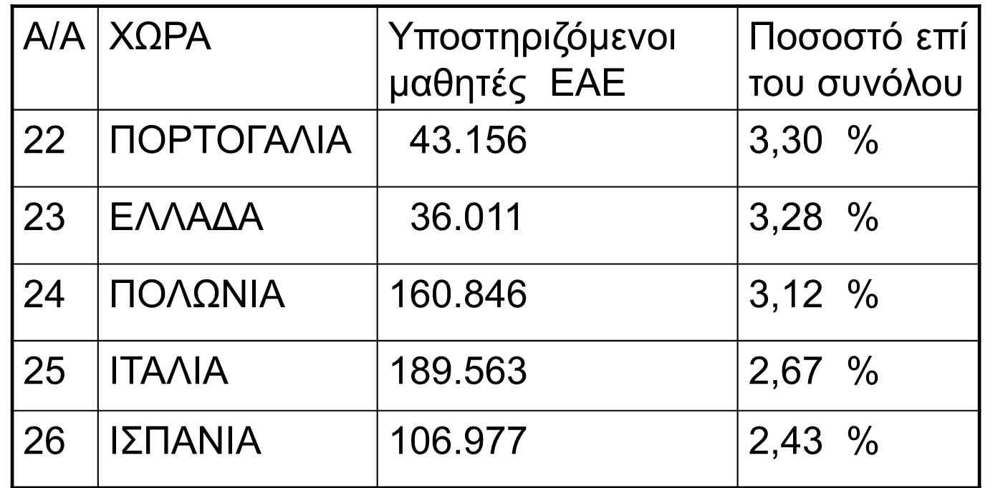
Aριθμός μαθητών με ειδικές εκπαιδευτικές ανάγκες στην Ευρώπη σύμφωνα με τον Ευρωπαϊκό Οργανισμό για την Ειδική Αγωγή

