Slide 1
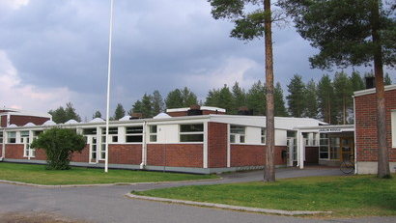
School of Jääli

Slide 2
Jääli Primary School
The elementary school of Jääli is located about 15 km from Oulu, the biggest city in northen Finland.
The school provides general education for classes 1-4 and special education for children with special needs for classes 1-9. We also have one class ment for temporary or more permanent special education and one teacher providing special education for variety groups of children with special needs.

Slide 3
Staff and students in the school of Jääli
The head teacher of the school is Mr. Arto Tikkanen.
The deputy head teacher is Mrs. Sirpa Tikkala.
During the school year 2017-2018 there are 21 teachers and 18 schooling assistants working in our school. We have 348 students in our school. In addition we have personnel working in administration, catering, cleaning and maintenance.

Slide 4
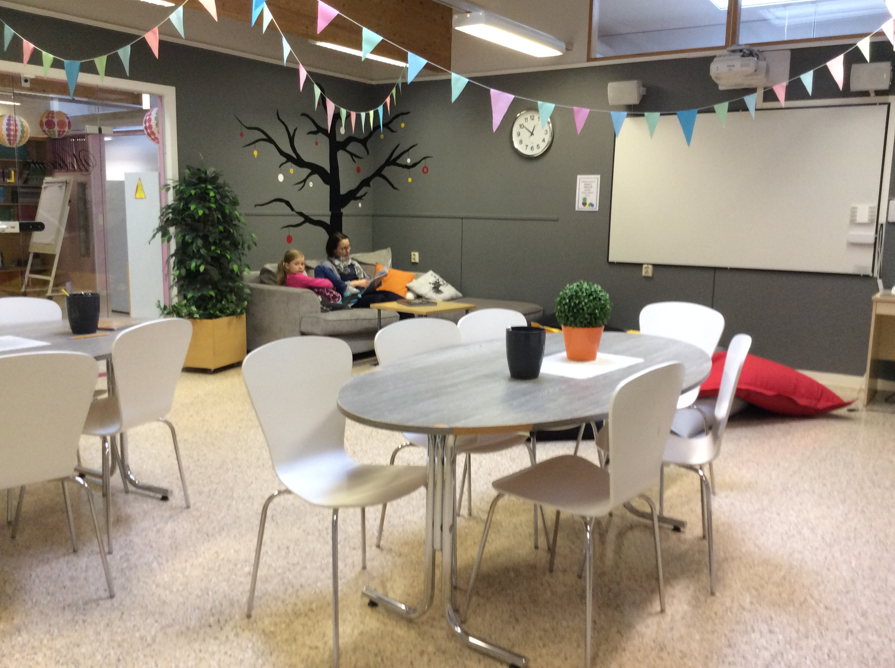
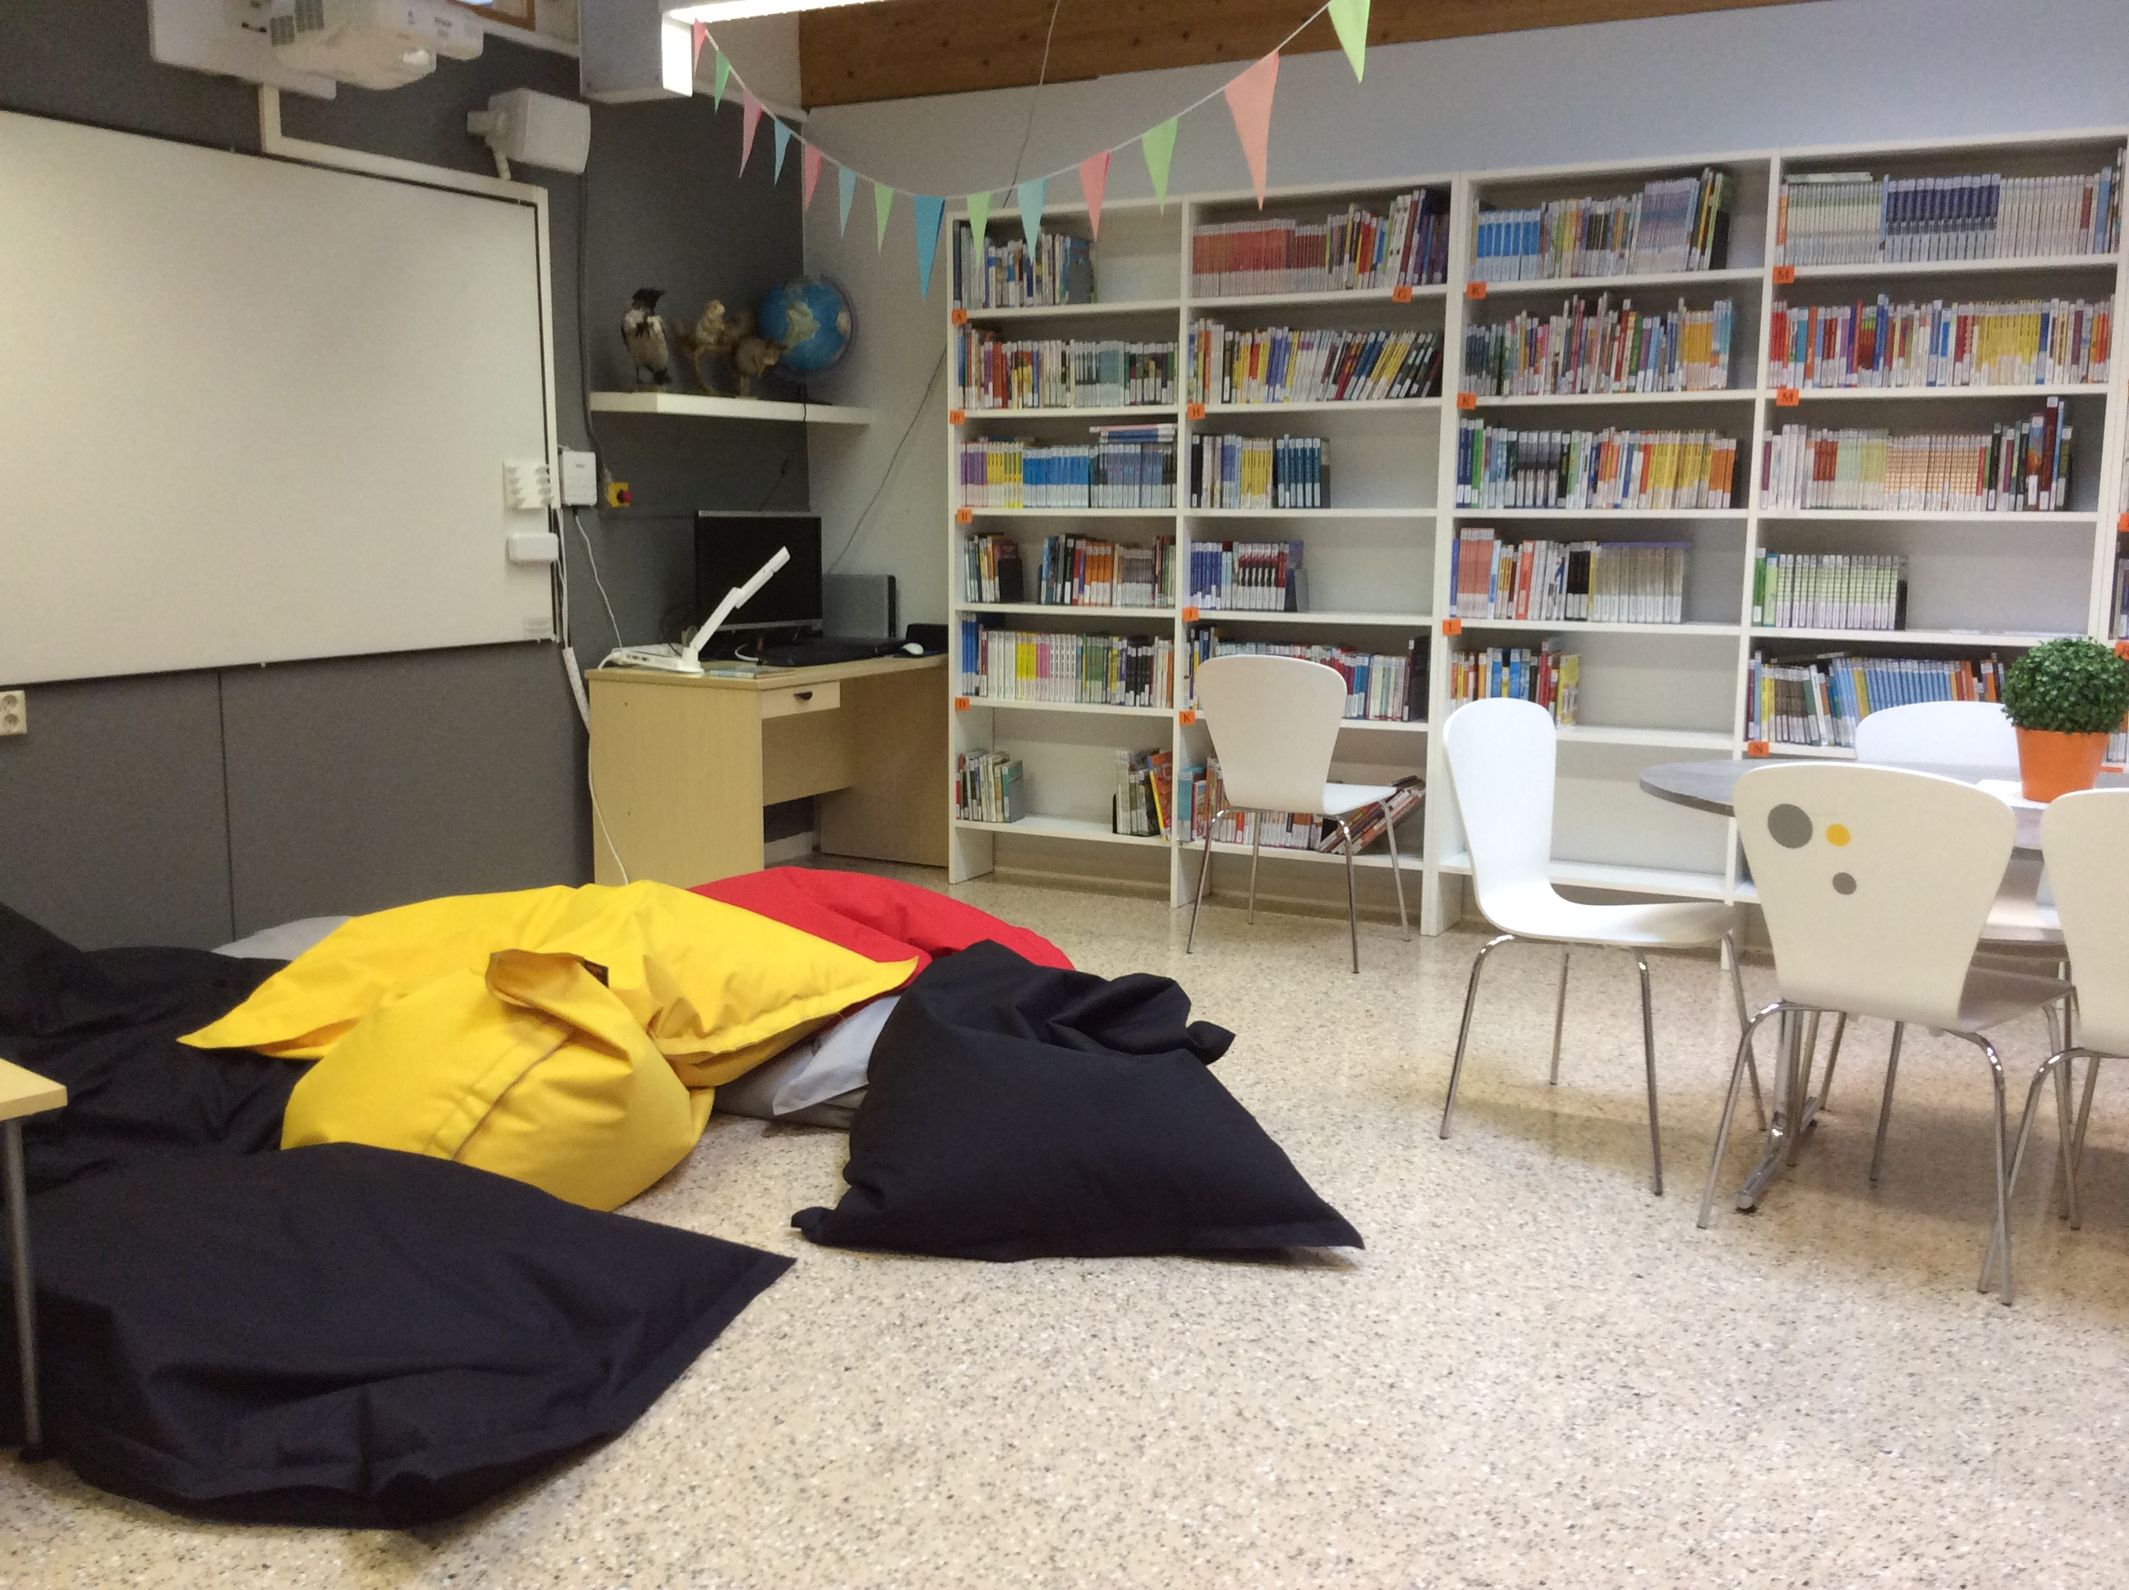
Library

Slide 5
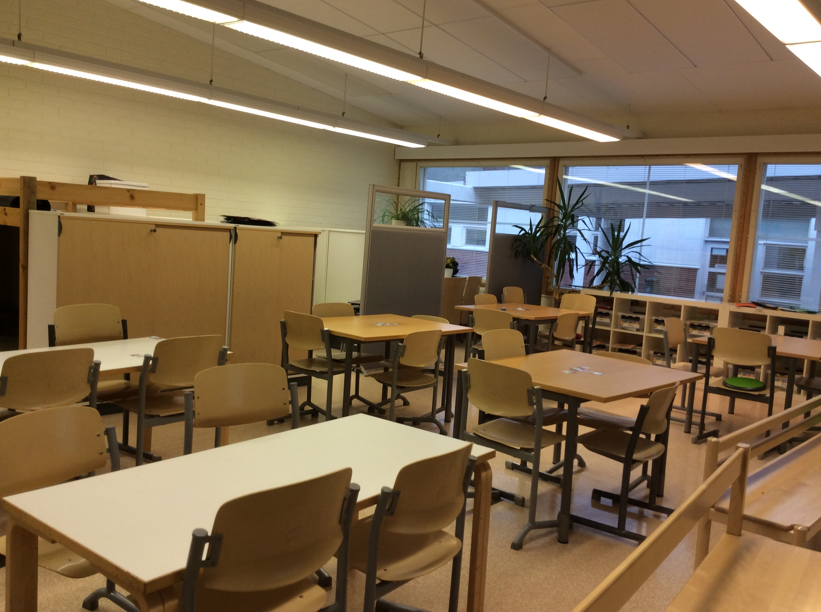
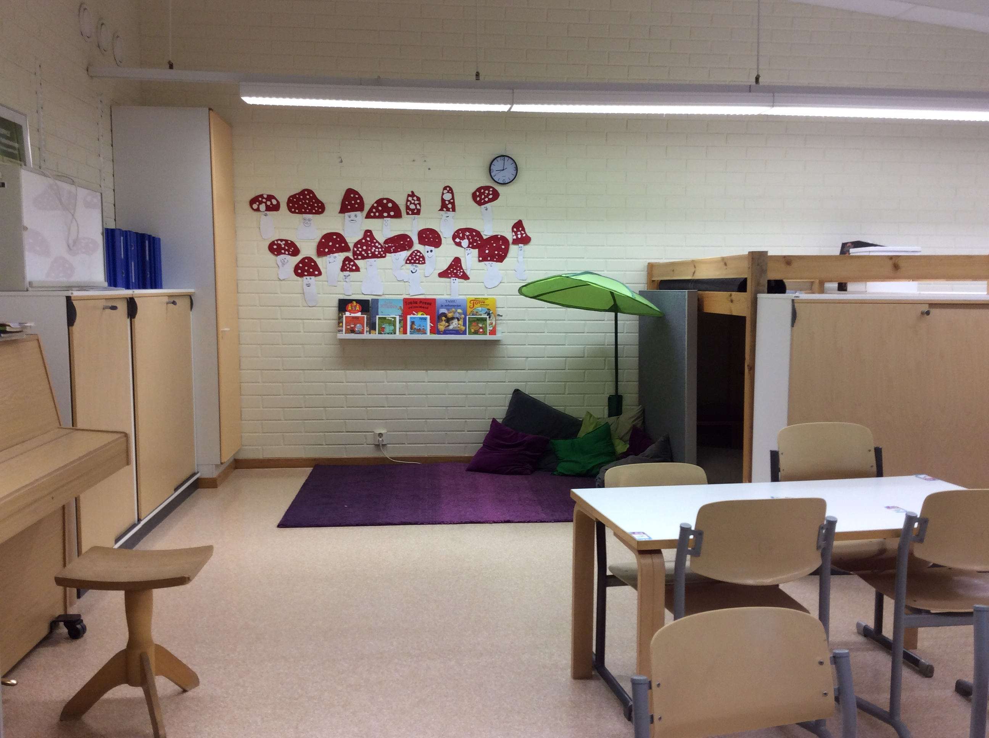
1st grade

Slide 6
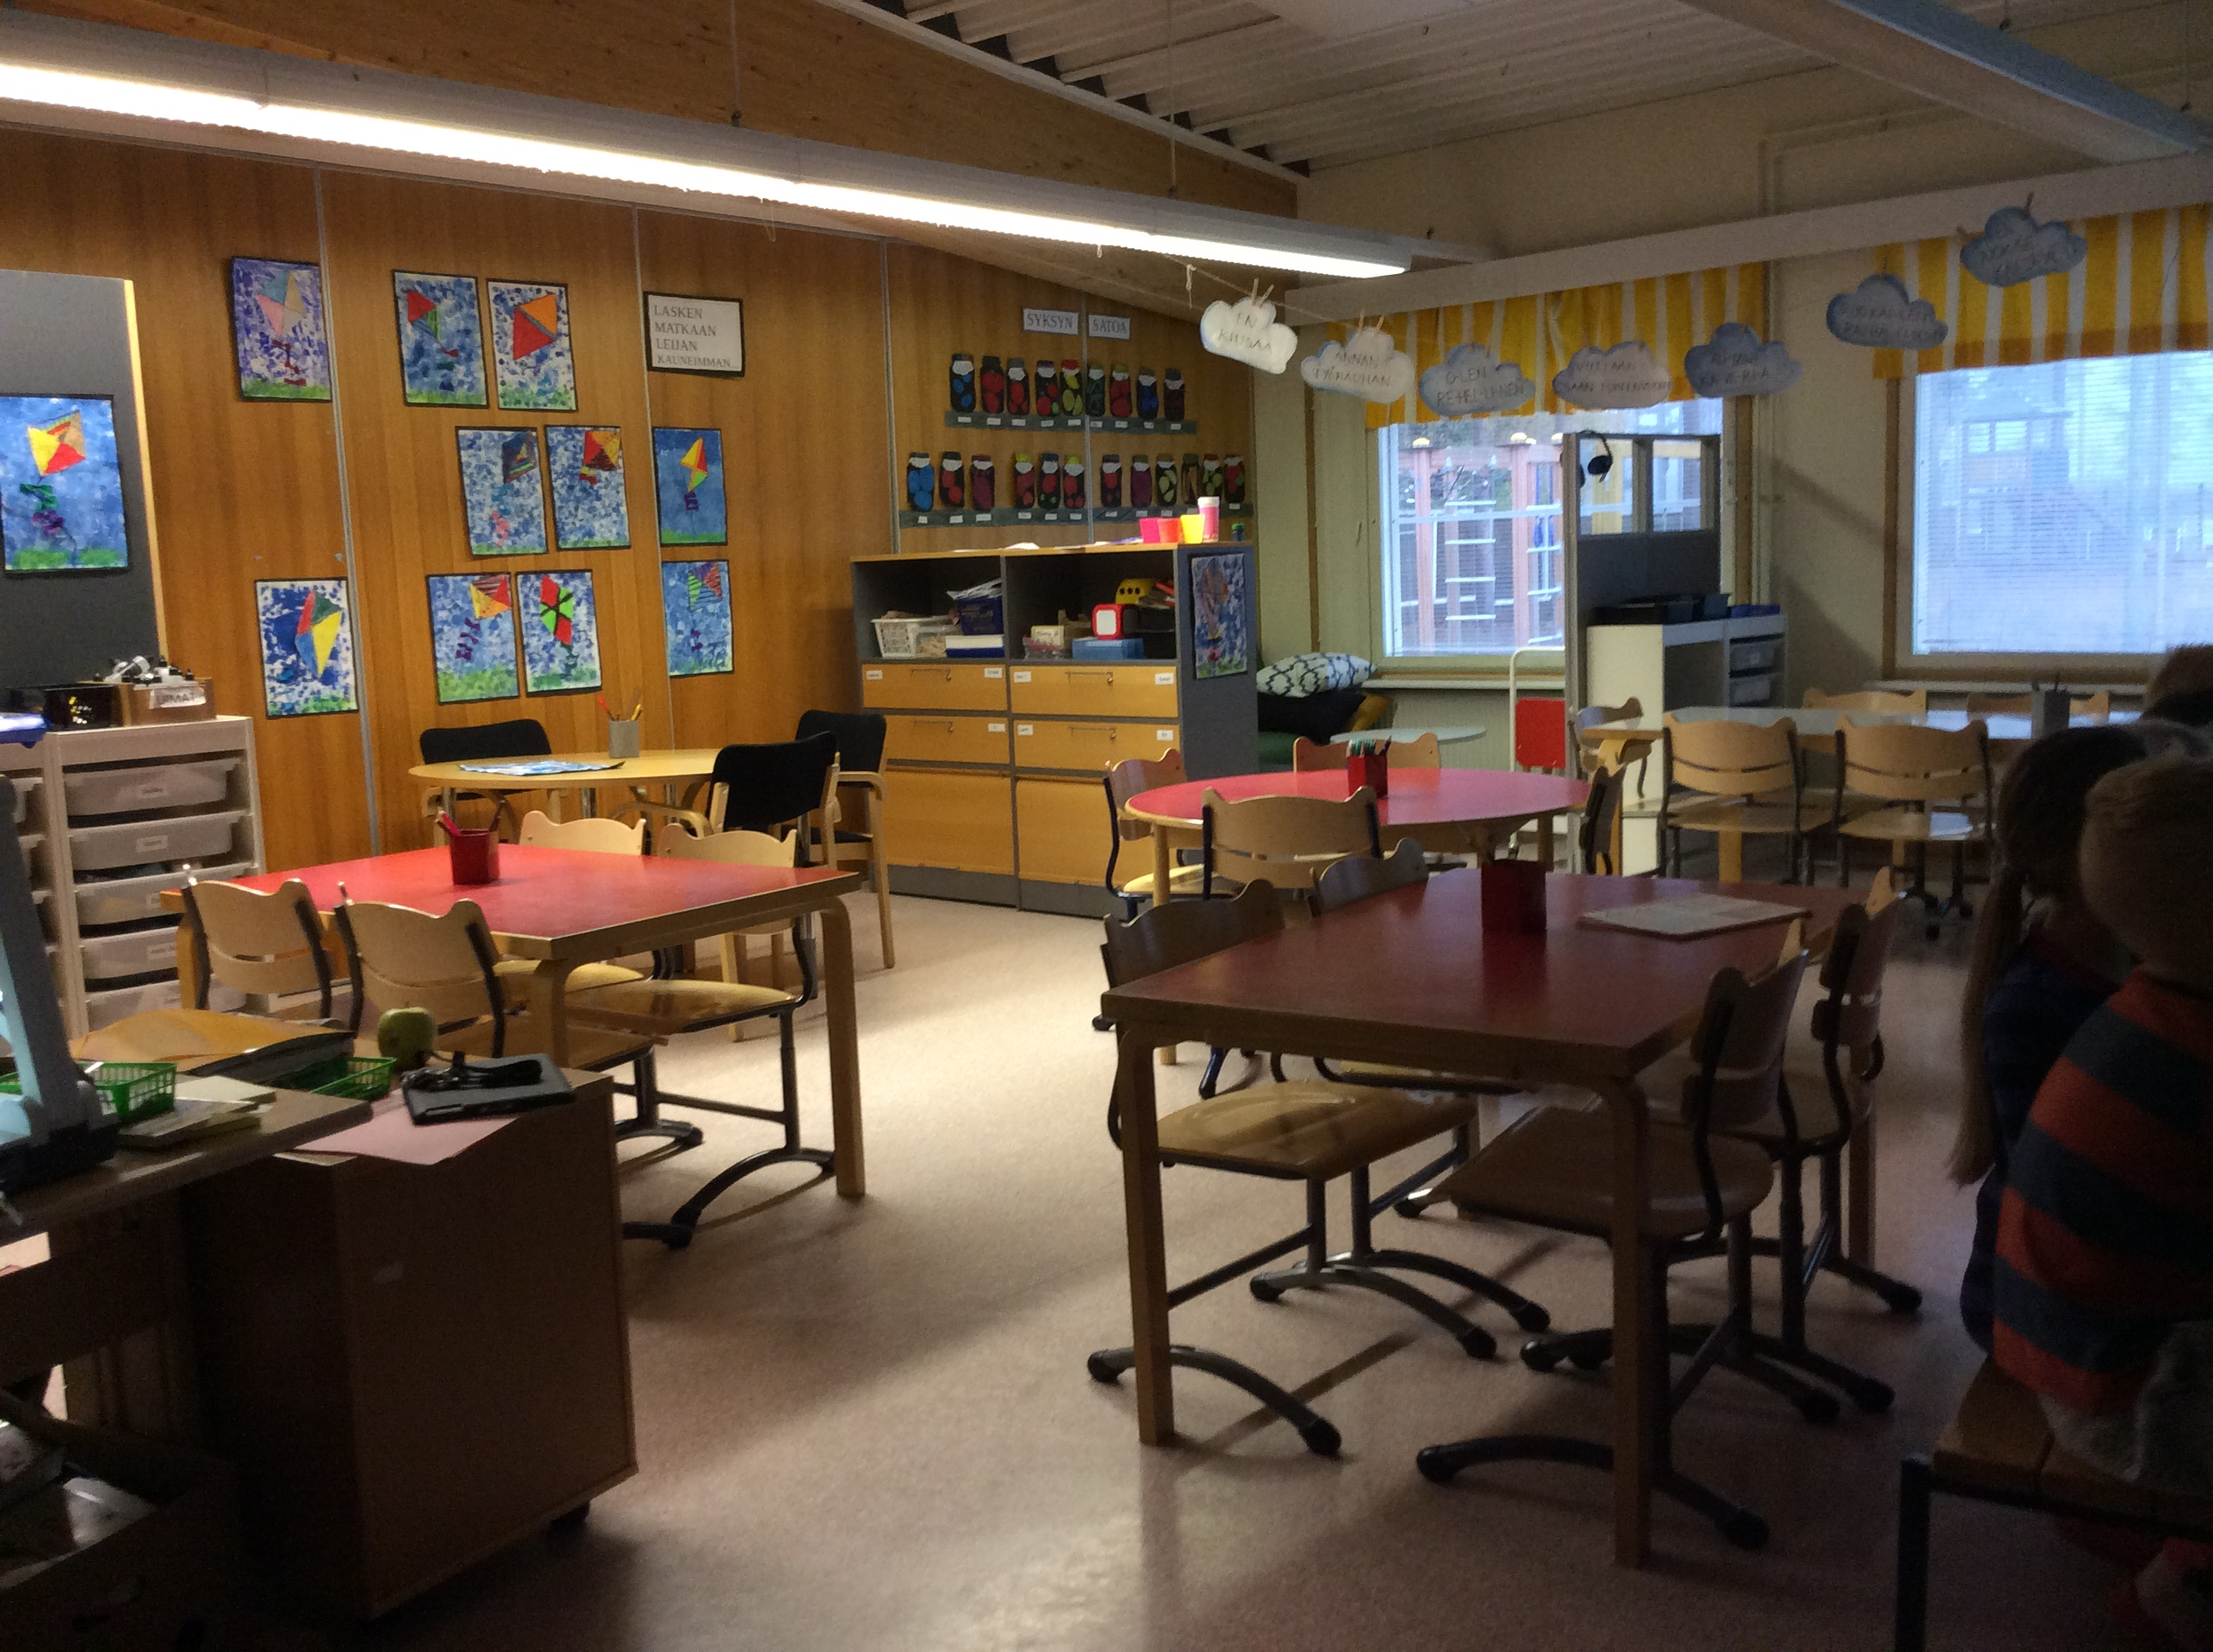
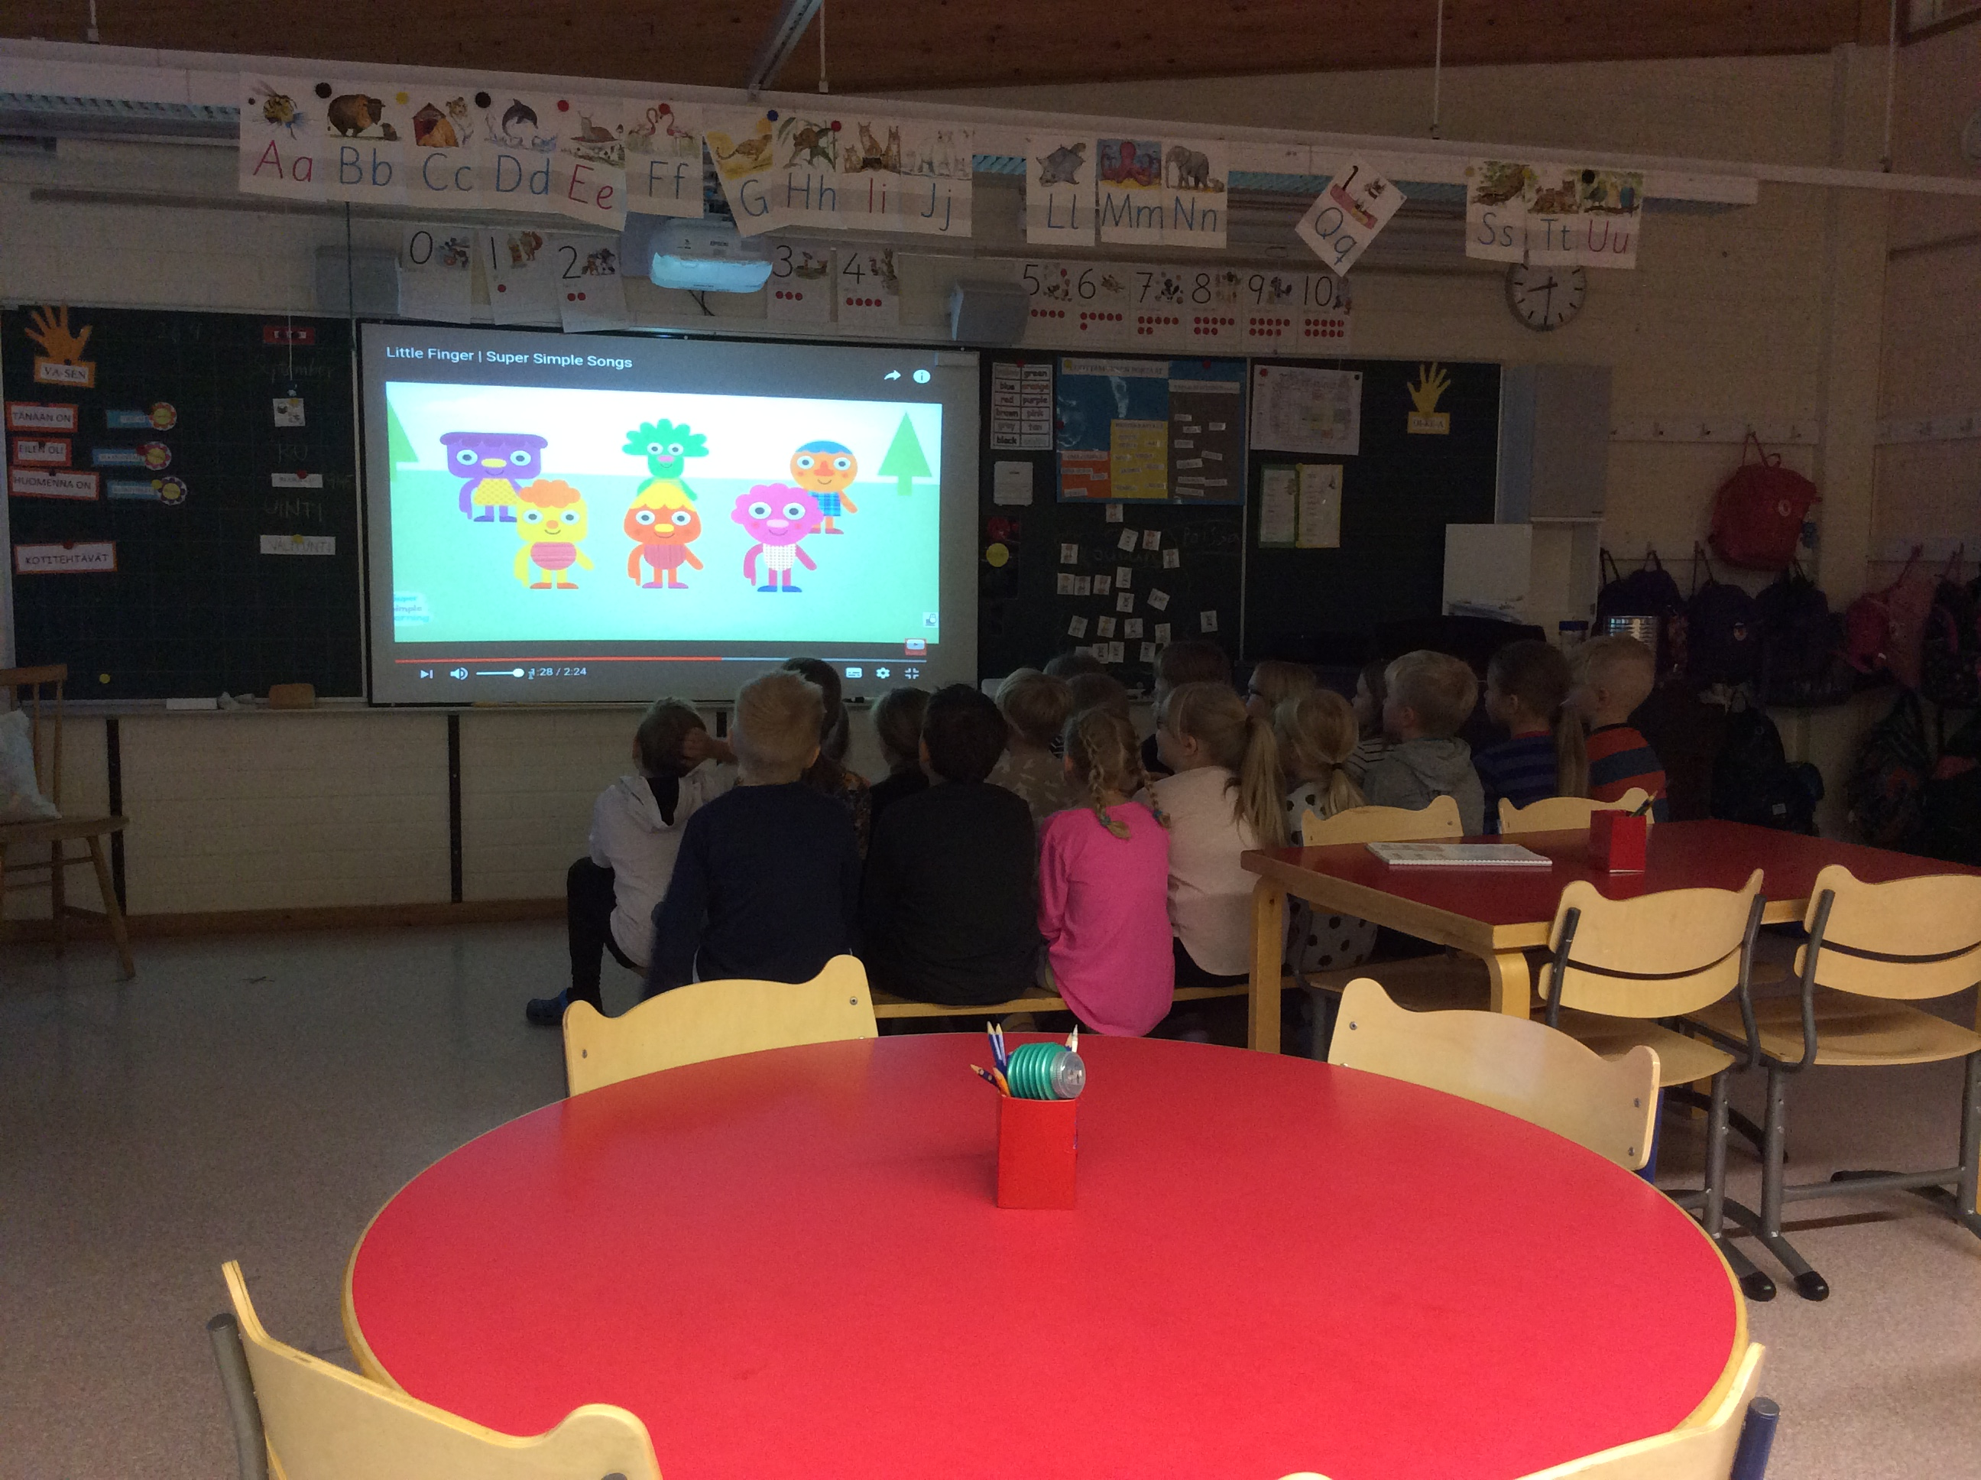
2nd grade

Slide 7
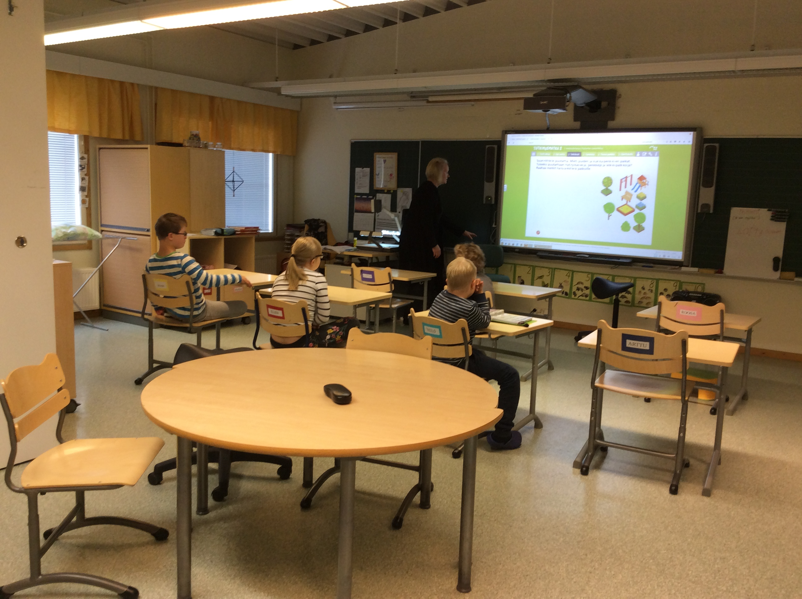
Special needs classroom

Slide 8
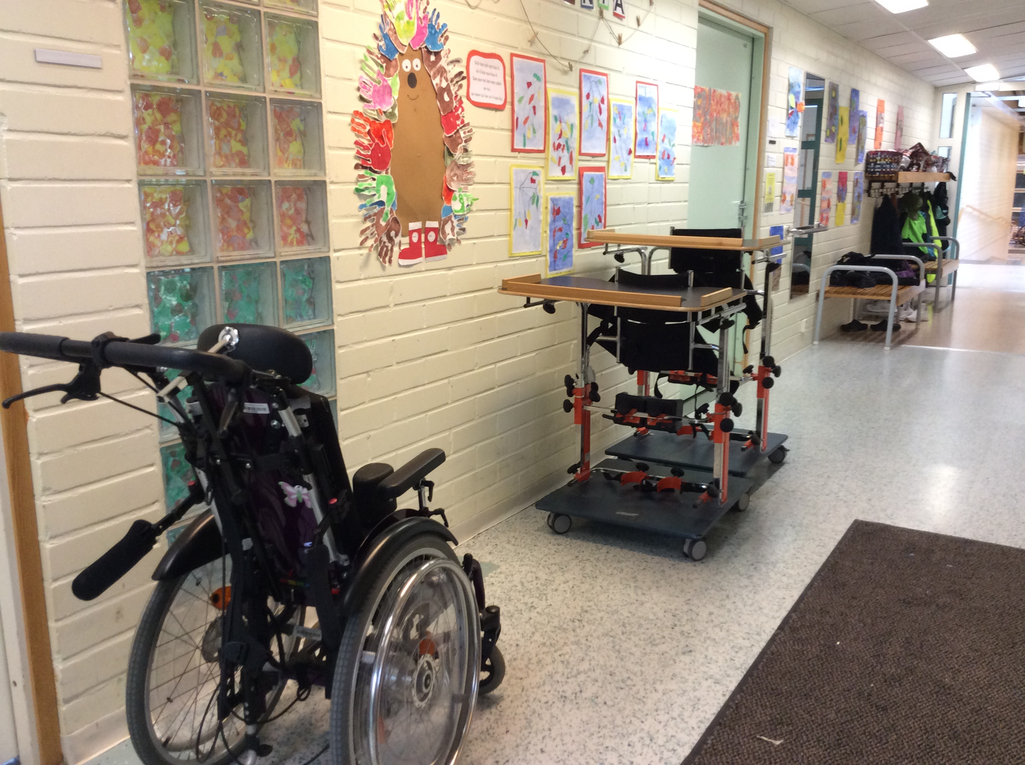
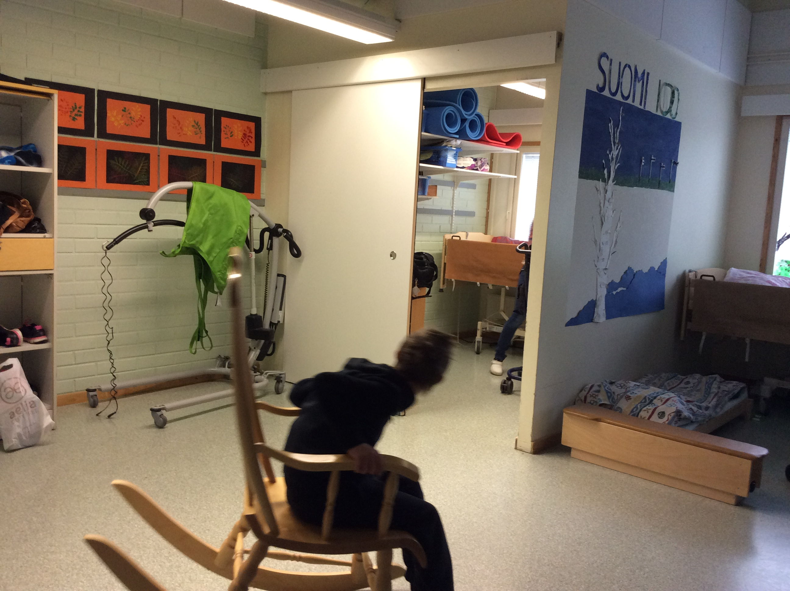
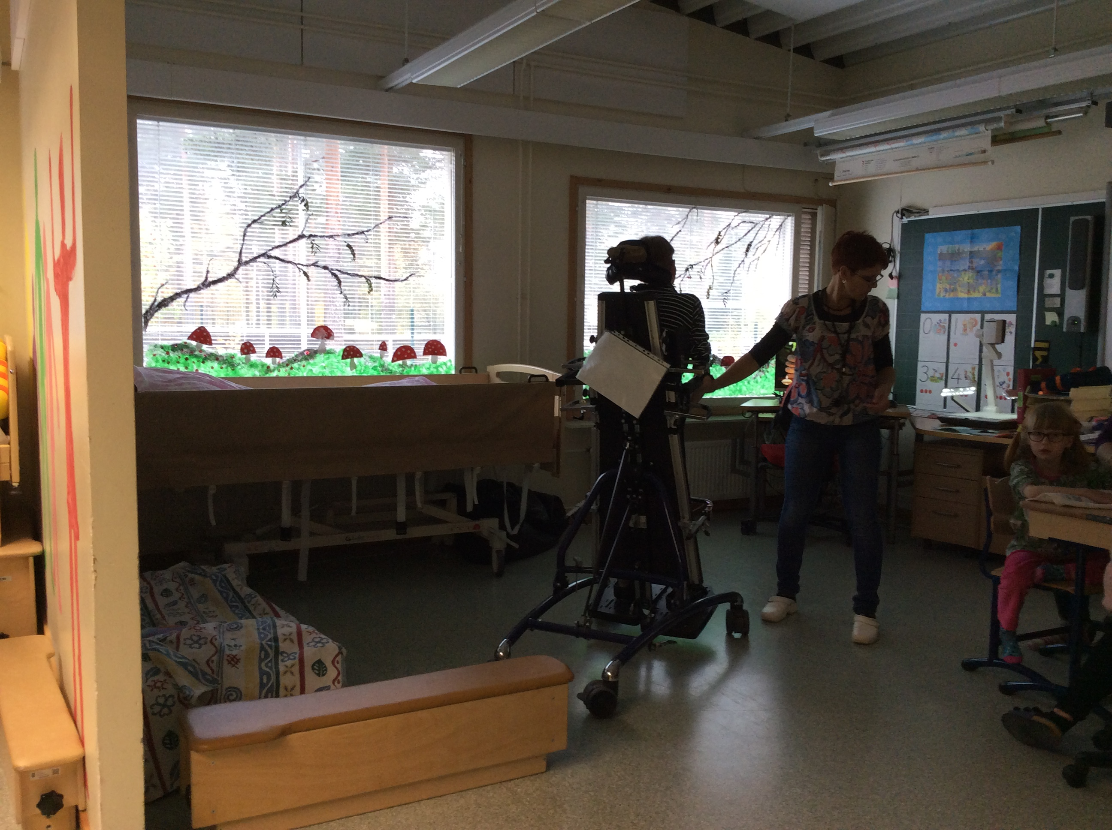
Very special needs classroom

Slide 9
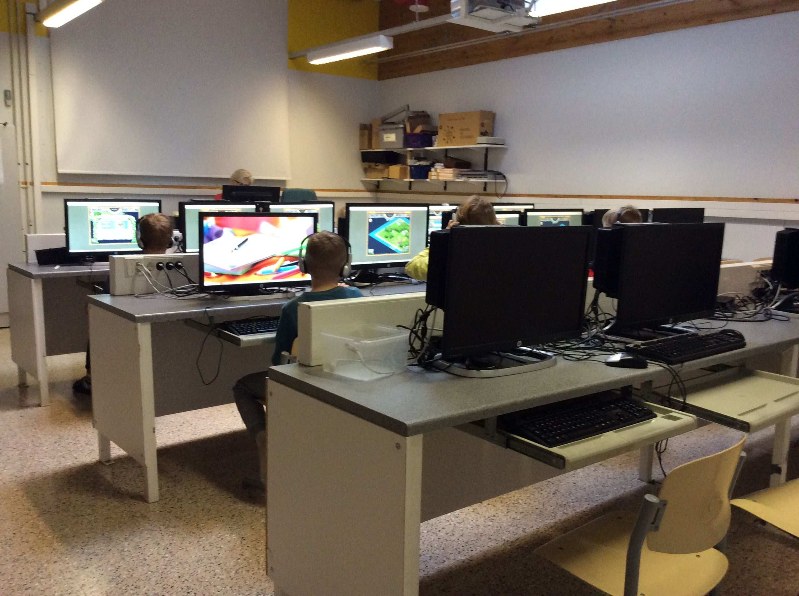
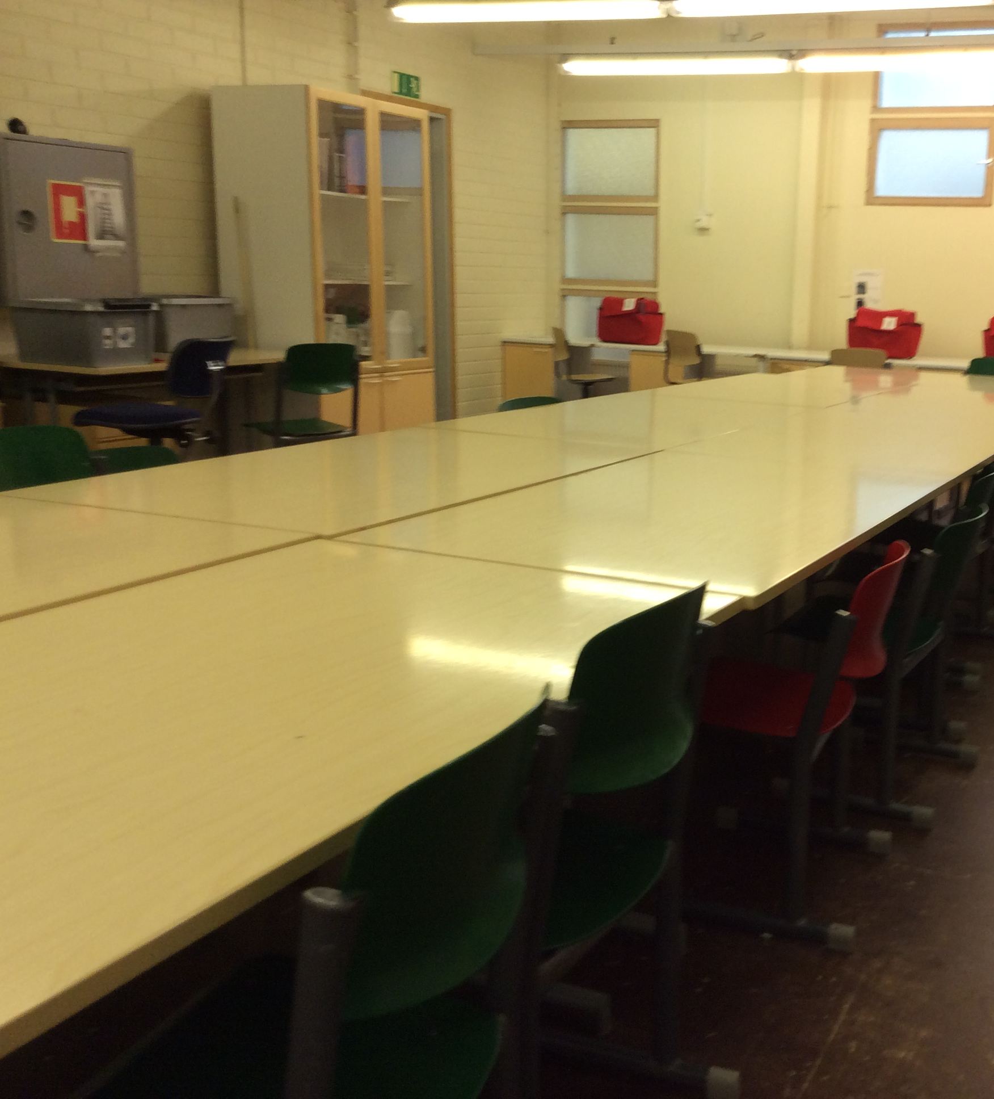
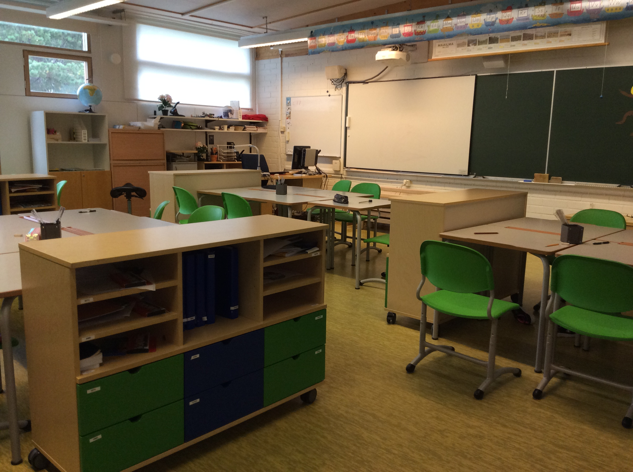
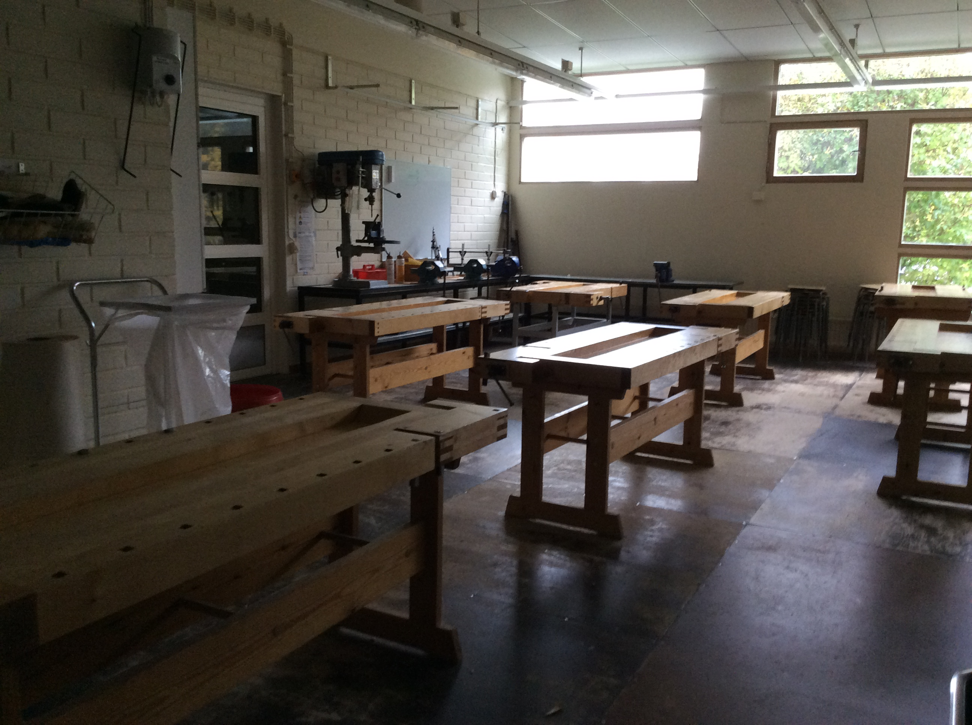
Other classrooms of our school
Computer lab
Tekstile classroom
3rd classroom
Technical classroom

Slide 10
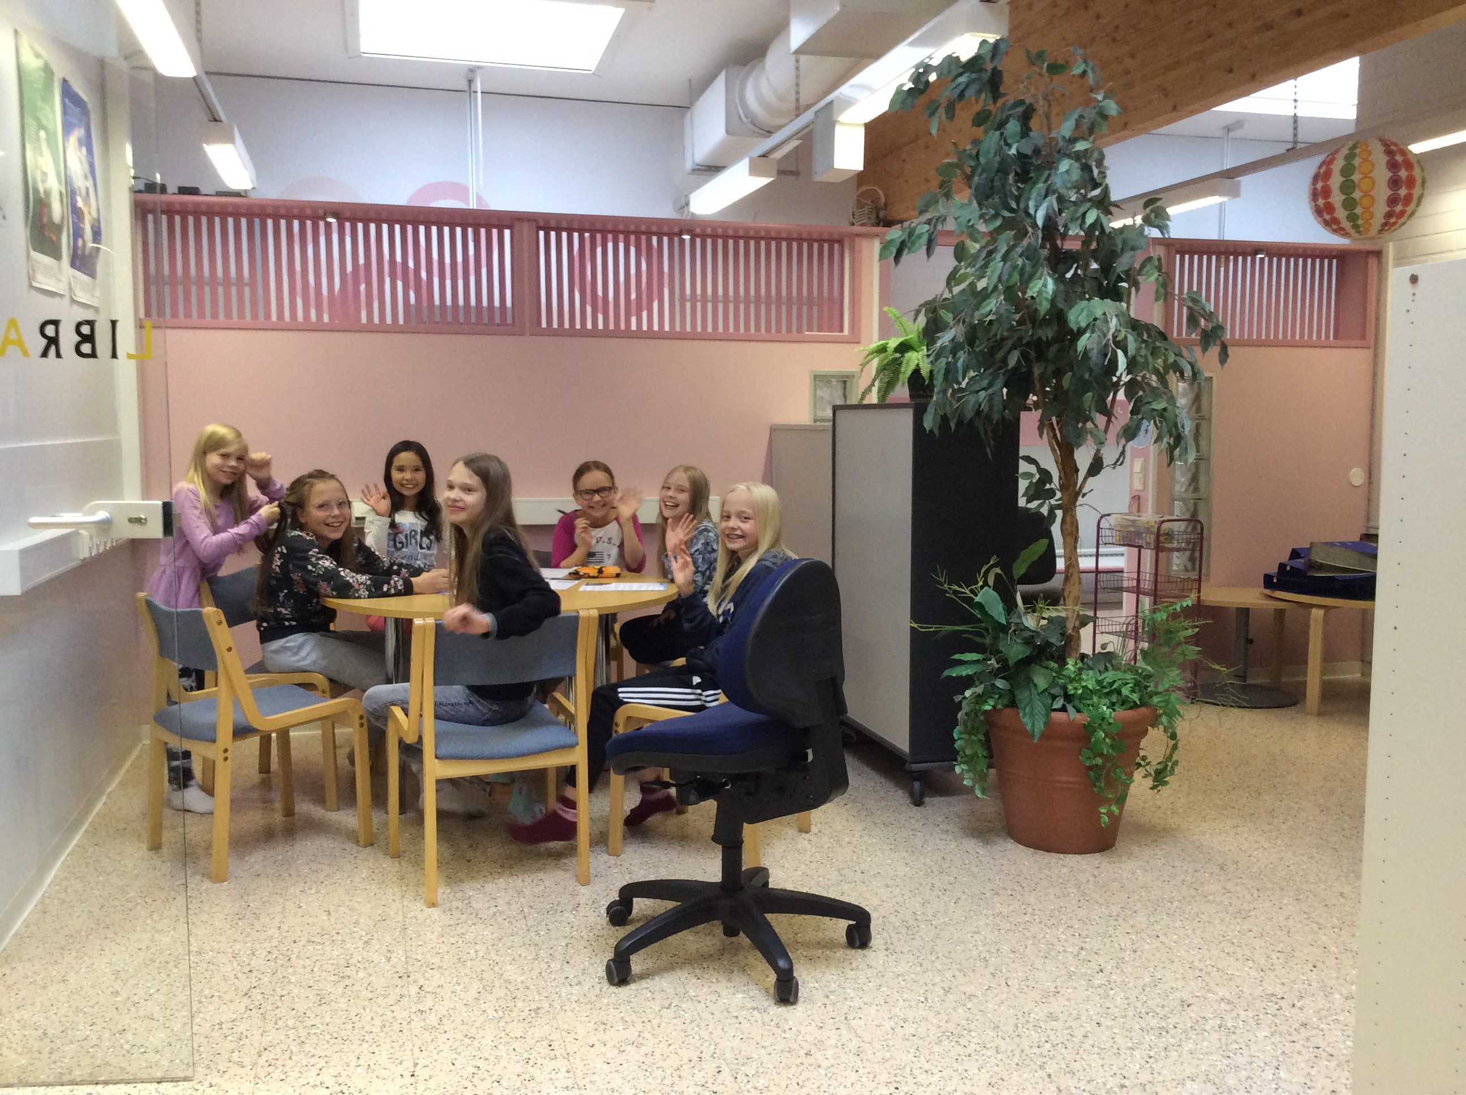
Greetings from the Finnish kids

