Slide 1
„Mirror Mirror on the wall „– M²OtheW (09/2017 – 08/2019)
School development concerning inclusion
an exchange project of „Astrid-Lindgren“ primary school

Slide 2
structure
What is ERAMUS + ?
What happened until now…
Goals
What will happen ?
Cooperation parents - school

Slide 3
1. What is ERAMUS + ?
program for education, youth and sport of European Union
= exchange program of „Astrid-Lindgren“ primary school between…

Slide 4
1. What is ERAMUS + ?
topics
„inclusion“ „active citizenship“
title = „Mirror, mirror on the wall“
running time: 01. 09. 2017 - 31.08.2019
http://www.astrolymp.de/magische-spiegel/

Slide 6
2. What happened until now…
European further education: “school development concerning inclusion“
many open questions about „inclusion“
How do other countries deal with the idea of inclusion?
development of a concept , plan for 2 years & application
application was successful (leading school)
http://inklusion-wenn-dann-richtig.de/Startseite/

Slide 7
3. goals
chance & enrichment for pupils, teachers, parents & public
reflection / development for the purpose of children
Why an exchange project at the age of primary school children ?
http://www.dw.com/de/%C3%BCber-den-tellerrand-schauen/l-19264871
confirmation for own actions
exchange on country level

Slide 8
concept / plan for 2 years
activities mobility
(all members of project) (We go travelling.)
4. What will happen?
http://bookboon.com
http://www.grusskartenkaufen.de

Slide 9
4. What will phappen? concept for 2 years
activities for all pupils :
initiation of an active participation at social life
„special needs“– practical initiation/implementation
of the idea of inclusion
active English learning (Skype-meetings, correspondences, visit of exchange country…)
Project days (see plan at information corner)
Creation of an audiobook
Establishment of a presentation corner

Slide 10
4. What will happen? concept for 2 years
mobility:
01.10.-05.10.2017 in Greece 3 teachers
19.03.-25.03.2018 in Finland 3 teachers & 4 pupils
24.09.-29.09.2018 in Germany only teachers
17.02.-23.02.2019 in Cyprus 3 teachers & 4 pupils
19.05.-25.05.2019 in Germany teachers & pupils (final meeting)

Slide 11
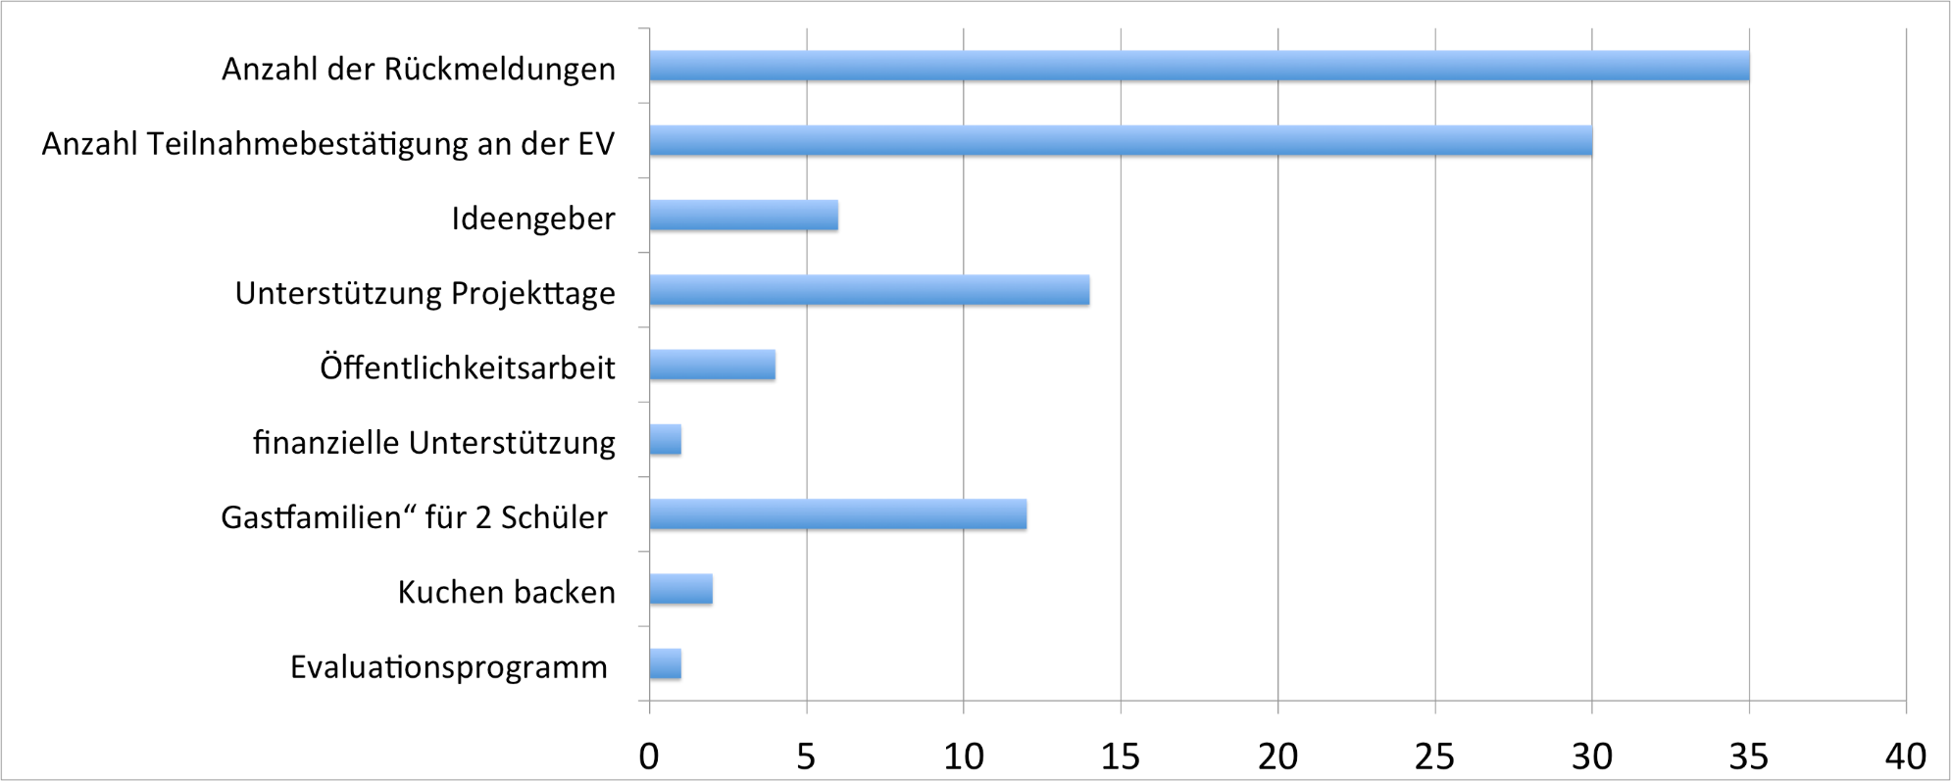
5. cooperation parents-school feedback of parents

Slide 12
5. cooperation parents-school open questions
as „idea givers“
Implementation of transnational meetings
for example spare time activities, accommodation, transfer, sightseeing, political/public institutions for example Parliament
support at project days
for example report about holiday experiences, cooking/baking, plants/animals, language, celebrations

Slide 13
5. cooperation parents-school open questions
technical support
set up of a Homepage, eTwinning/ Skype, evaluation
public relation
foreign language correspondence
for example translations, contact with print media

Slide 14
5. cooperation parents-school open questions
financial support
support of sponsors
for example for final celebration, accounting
„host families“
accommodation for exchange students/teachers
(19.05.-25.05.2019)

Slide 15
5. cooperation parents-school
open questions
How is the project financed?
financial support by EU – Etat :
500,00 € per month for purchases, plus airfare flat rate, exklusive food costs
exchange: holiday destinations, program/procedure on site (short term announcement), no participation of parents
Mailfriendships (see first project day)
???

Slide 16
5. cooperation parents-school contact
contact via e-mail:
erasmus-lindgren@t-online.de
Homepage
http://www.grundschule-lindgren.de/
presentation corner
„Round Table“ (exchange of experiences) – January and May 2018
Contact list of parents

Slide 17
https://eu.fotolia.com

