Slide 1
Erasmus+ Project Title: mirror mirror on the wall

Slide 2
“Ayios Dhometios Elementary school A systemic view”
A glance to the school’s history/A glance to the history of Cyprus
A.1 Two important dates:
The school was established in 1960 as a public school of the Greek Cypriot Community in Cyprus.
The Cyprus Republic was founded on 16th August 1960.

Slide 3
A glance in the history of Cyprus
1974. The Turkish invasion in Cyprus. The island is separated in two parts.
The school is on the Green Line

Slide 4
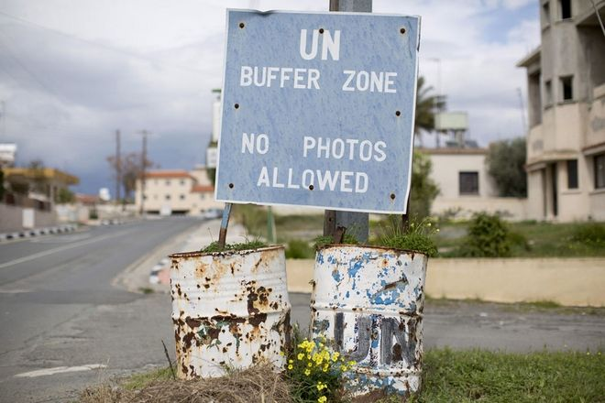

Slide 5
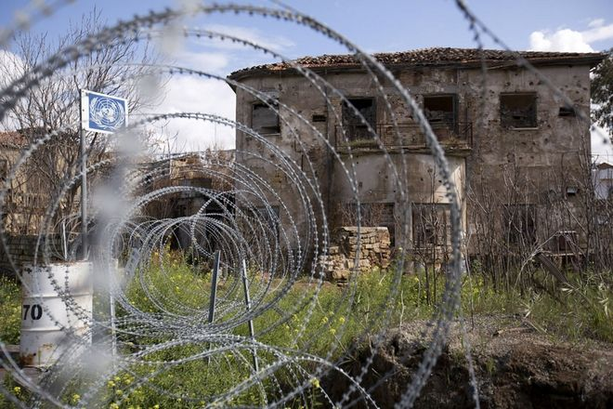

Slide 6
The Green Line
“A buffer zone in Cyprus was first established in 1964, when Major-General Peter Young was the commander of the British peace force (a predecessor of the present UN force) set up in the wake of the intercommunal violence of the early 1960s. After stationing his troops in different areas of Nicosia, the general drew a cease-fire line on a map with a dark green crayon, which was to become known as the "Green Line”.

Slide 7
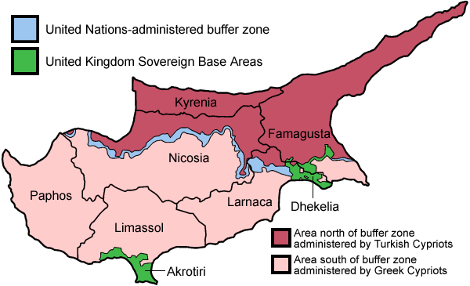

Slide 8
But for us, is the line where the clock stopped in 1974… a place of silence and desert. A line that divides the Island of Cyprus, 112 miles from east to west across the island. A place where Cypriots have been forbidden to pass or even come close to. Some people visit it to look towards the other side of the island in the hope that they may once again tread the ground they belong to.

Slide 9
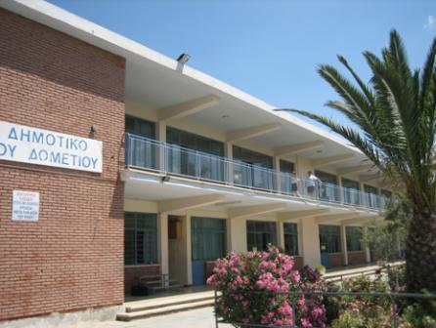

Slide 10
The school as an organisation
Under the Greek Ministry of Education and Culture.
Follows the National Curriculum of the Greek Ministry of Education and Culture.
“School Based Curriculum Development (SBCD) is weak in Cyprus and is also a consequence of high central control that does not allow for much differentiation among the schools.” (Kyriakides 1994).

Slide 11
A/A | LESSON | A | B | C | D | E | ST | TOTAL
1 | Greek Language | 12 | 12 | 10 | 10 | 9 | 9 | 62
2 | Math | 7 | 7 | 7 | 7 | 6 | 6 | 40
3 | History |  |  | 2 | 2 | 2 | 2 | 8
4 | Religious Education | 2 | 2 | 2 | 2 | 2 | 2 | 12
5 | Geography | 2 | 2 | 2 | 2 | 2 | 2 | 12
6 | Science and Technology | 2 | 2 | 2 | 2 |  |  | 8
7 | Science |  |  |  |  | 2 | 2 | 4
8 | Art | 2 | 2 | 2 | 2 | 2 | 2 | 12
9 | Music | 2 | 2 | 2 | 2 | 2 | 2 | 12
10 | PE | 2 | 2 | 2 | 2 | 3 | 3 | 14
11 | English | 2 | 2 | 2 | 2 | 2 | 2 | 12
12 | Design and Technology- Education for Healthy life |  |  |  |  | 2/2 | 2/2 | 8
13 | Education for Mental Health- Environmental Education | 2 | 2 | 2 | 2 |  |  | 8
14 | Environmental Education |  |  |  |  | 1 | 1 | 2
Total 35 35 35 35 37 37 |  |  |  |  |  |  |  | 214
Timetable of the public elementary schools in Cyprus

Slide 12
“The aims of the education service in Cyprus are set out in various government publications and policy documents. By analyzing these aims one can identify an attempt to link education to the historical, social, moral, cultural, economic, and political context of Cyprus” (Kyriakides 1994; UNESCO 1997).
However, this year, for the first time, the schools were allowed to set the majority of their aims alone- only one centrally given aim

Slide 14
The school as a building/ facilities
Six classes, one for each year
Music room
Technology room/ Science room
Computer Lab
“Theatre”
Staff room
One room for students with special needs: eg. logotherapy.

Slide 15
The staff
a principal
a vice-principal
7 more teachers to teach the other subjects of the curriculum.
a music teacher
a gymnastics teacher
a speech therapy teacher
a teacher for special needs students

Slide 17
A multicultural population!
Table 2
The countries of origin of the student population
COUNTRY | Number of Students
Syria | 2
Georgia | 10
Bulgaria | 8
Russia | 3
Romania | 9
Greece | 4
China | 1
Ukraine | 1
UK | 2
Eritrea | 1
Sri Lanka | 1
Philippines | 1 (43/84=51,19%)
Maronite community | 1
Turkish Cypriot Community | 2
Greek Cypriot Community | 38 (48,81%)

Slide 18
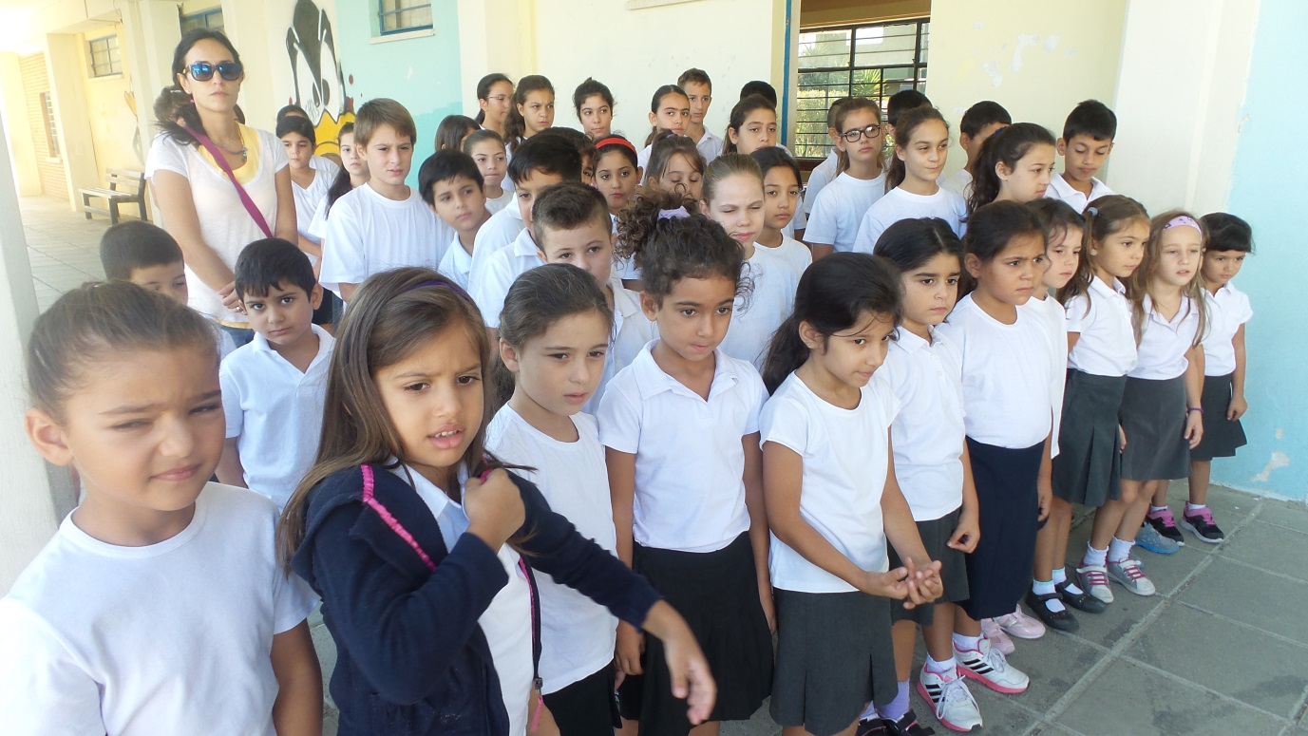
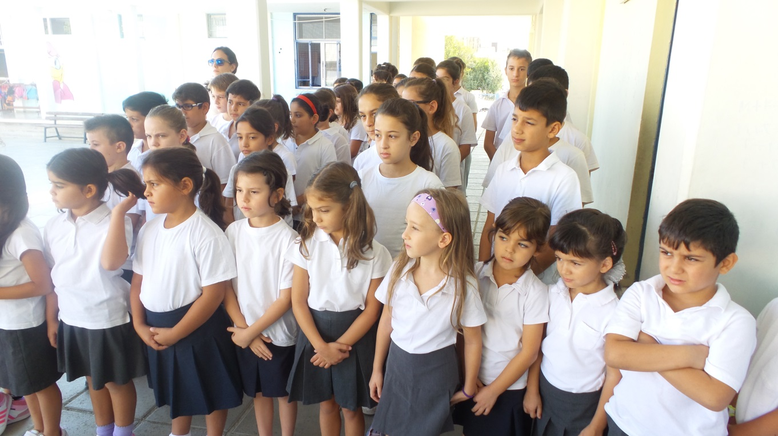

Slide 19
Aims of the school for last yEar
1. To improve the results of students in Mathematics and Literacy.
Mathematics: There is a need for our students to improve their ability to conduct mathematic equations orally. Also a need to improve their ability for problem solving.
Literacy: There is a problem in the written expression of our students and especially a real problem in spelling in the social subjects. Also many students lack the vocabulary which is necessary so as to follow the national curriculum in many subjects (eg. the new curriculum of history education in year 3)
2. To prevent and deal with the phenomenon of bullying making our students stronger and happier in the school environment and also more capable to cope with problems outside school.

Slide 20
THE HISTORY OF SPECIAL NEEDS EDUCATION
1929: School for the Blinds
1953: School for the Deaf
1959: the first sanatorium for sick children
1962: special class for “mentally retarted” children who can learn
1965: special schools for the above children
1977: special professional school for children with mental problems (children 18+ years old)

Slide 21
Special education today
TODAY (the last 20 years): education for all the children until they finish their cycle of education (Law of 1999/regulations of 2001)
4 different methods of inclusive education:
Full inclusion in a usual class of a public school with nessesary support
Special unit in a public school for partial inclusion
Special schools for the very “difficult cases” that are associated with public schools
4. Education in places like hospitals or at home (the case of our student)

Slide 22
Problems with special education
There is no structured and scientifically accepted policy for facing the problems of these children.
There is almost nothing for locating the problem and the necessary education from the birth until the age of 3 (“it seems that the problem starts after the child becomes 3years old”)
There is an increase on the number of children attending special schools, but there are a lot of problems in organizing the work in these schools.
The special units in public schools have a lot of problems and don’t really help the children
Huge problems for the support of children with full inclusion in an ordinary class
After the age of 21 there is nothing for these children…
Every educational chycologist is responsible for about 1000 students of primary and secondary education
If I send a report for a child in year 2, I will be very happy if he gets support at the beginning of year 3!

Slide 23
Challenges/ Difficulties for the School
1. Broad Curriculum/ lack of a way to measure students’ knowledge, competences in specific years/ lack of validated tests
2. Difficulties to address the needs of the students mainly because of their differences especially in language acquisition. Lack of an induction period.
3. Need for focused staff improvement seminars to address the needs of the teachers of the school.
The system allows children with no competences regarding their age to continue, finish elementary school and enter secondary education were is difficult to “survive” .

Slide 24
What about the program?
● We are going according to the agreed program of activities
● We discussed the program in staff meetings
● Teachers conducted evaluations of their students/ profile of each child was developed
● We informed the parents and the students/ powerpoint presentations
Critical friends visited the school and presented their work connected with the program:

Slide 25
Lectures in school
Dr Katerina Theodoridou: POLYGLOT: Seminar for Multilingualism and Multiculturism
www.polyglot.expert
2. Mrs ERIA Markidou: Eliminating Bullying
www.combatbullying.eu
3. Mr Charalambos Stergiou: Presentation of Eat Think: A European Program
4. Dr Elena Papamichael: Democratic Citizenship/ teaching about controversial issues http://agogyd.schools.ac.cy/index.php/el/
5. Mrs Yolanda Frangou: Teaching about Refugess and imigrands in the school

Slide 26
http://fys-forums.eu
http://sfyouth.eu

Slide 27
The school on the edge of the forest
There was once a community of people who lived in dense forests on the side of a mountain range. They were religious people who brought their children up strictly to worship the gods of their people. Their religion believed there were no differences between men and women.
Between the mountains and the farthest edge of the country was a huge expanse of plain. A different community of people lived on the plain. They had no religion, but worked hard for each other. They were fierce warriors and men were the dominant sex. Women were respected but could not rise to become leaders.
The people of the forest had nothing to do with the people from the plains. They hated and feared each other. There had sometimes been wars between them.
One day a young man arrived on the edge of the forest. He announced that he wanted to build a school there so that the children of both communities could be educated together, so that there could finally be peace between the two peoples.
Soon, a simple wooden building was ready and the day came when the teacher opened his school for the first time. A few children from both communities came to see what it would be like. The parents and the leaders of the two communities watched anxiously.
At first, there were problems between the children. They called each other names and there was often fighting. But the children could see the value of coming to school and gradually things began to settle down. The teacher was strict but fair and treated all his pupils equally. He said he respected both ways of life and the children were taught about their different ways of life.
More and more children started attending the school on the edge of the forest.
However, it soon became clear that more children from the plains were attending the school. The forest children now made up only a quarter of the school. The teacher talked to the parents of both sides to encourage and reassure them.
But then one morning, the teacher arrived to find that someone had burned the school to the ground.
(Based on a story by Ted Huddleston of the Citizenship Foundation)
http://www.living-democracy.com/textbooks/volume-3/part-1/unit-3/student-handout-5/
http://www.pi.ac.cy/pi/files/epimorfosi/antiratsistiki/Teaching_Controversial_issues_COE_PACK_sep15.pdf

Slide 28
Thank you for your attention!

