Slide 1
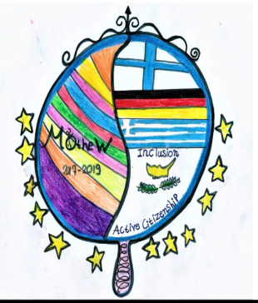
„Mirror Mirror on the wall „– M²OtheW (09/2017 – 08/2019)
School development regarding inclusion through active citizenship An exchange project

Slide 2
Structure
1. This is us…. 2. What happened until now… 3. Review goals 4. What will happen ? 5. Your ideas ... .. 6. Contact

Slide 3
1. This is us…
https://www.dropbox.com/home/Öffentlichkeitsarbeit?preview=Pr%C3%A4sentation+Grundschule.mp4

Slide 4
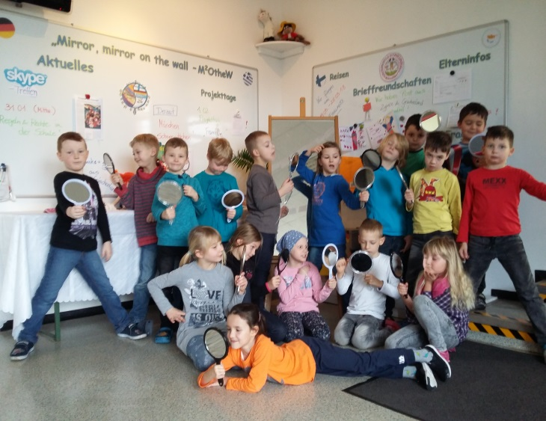
2. What happened so far ... „M²OtheW“
For the pupils:
* Fairy tale "Snow White" - "Mirror, mirror on the wall" -M²OtheW * 27.09.2017 1st project day - get to know the partner countries * Ethics: different activities (That's me, team building, democratic Values, children's rights, perspectives ...) * English: letters written in English * Project file created and designed * Project LOGO design, mirror decoration * 19.12.2017 2nd project day - Christmas in our partner countries * Christmas present "Mirror" * School social work: video recording, school newspaper, rules and duties at the school * thematic questionnaire & regular mirror reflections * Skype meetings * 01.02.2018 3rd project day "Family Day"

Slide 5
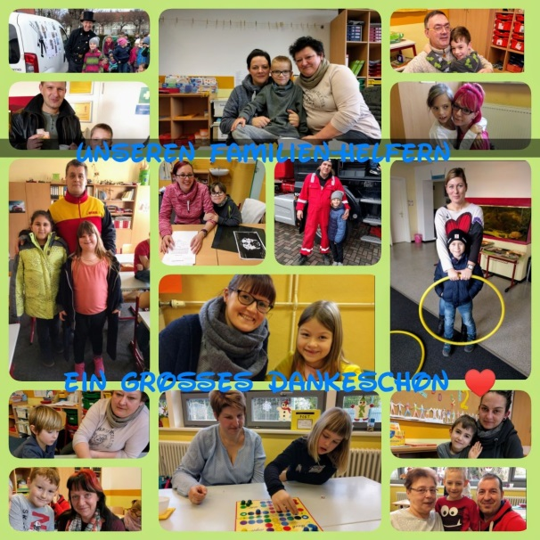
2. What happened so far .. „M²OtheW“
In the field of parenting:
great support with sweets and cakes, letter writing, with material, for the project days, with personal support at the Family Day (32 adults ☺), Participation in the parents' survey
Special thanks to: Mrs. Thum for the computer-technical implementation of our questionnaires Mr. Günther for the technical support Mr. Schulze & Mr. Rose for the linguistic support in the translations Mrs. Mehlhase for the mediation of the painter & the Greeks from the restaurant Kreta in Merseburg Mrs. Stypka for her technical know-how in Skype and eTwinning & her coordination under the project-oriented parenting
parents meetings:
11.09.2017 , 20.02.2018

Slide 6
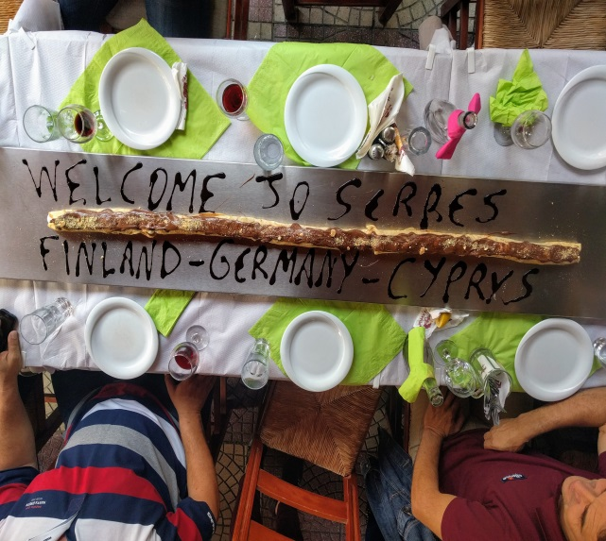
2. What happened so far .. „M²OtheW“
eTwinning

Slide 7
3. Review of the goals
chance & enrichment for pupils, teachers, parents & public
reflection / development for the purpose of children
Why an exchange project at the age of primary school children ?
http://www.dw.com/de/%C3%BCber-den-tellerrand-schauen/l-19264871
confirmation for own actions
exchange on country level

Slide 8
Concept / 2-years- plan
Activities Mobility
(all project participants) (4 students & 3 teachers & Ms. Baer)
09.05.2018 Project day „Europe“ 19.03.-25.03.2018 to Finland
24.09.-29.09.2018
Transnationale meeting in Schkopau
4. WHAT will
be happen
next ?
http://bookboon.com
http://www.grusskartenkaufen.de

Slide 9
5. Now your ideas are asked ...
https://www.google.de/search?hl=de&biw=1438&bih=727&tbm=isch&sa=1&ei=nXGIWq2OBNH6kwX0_JvIDg&q=cartoon++ihre+ideen&oq=cartoon++ihre+ideen&gs_l=psy-ab.3...0.0.0.10073.0.0.0.0.0.0.0.0..0.0....0...1c..64.psy-ab..0.0.0....0.9qCLfQUuIic#imgrc=khft6--cX1zOPM:

Slide 10
https://eu.fotolia.com

