Slide 1
Animal species unique to Cyprus
Mirror mirror on the wall

Slide 2
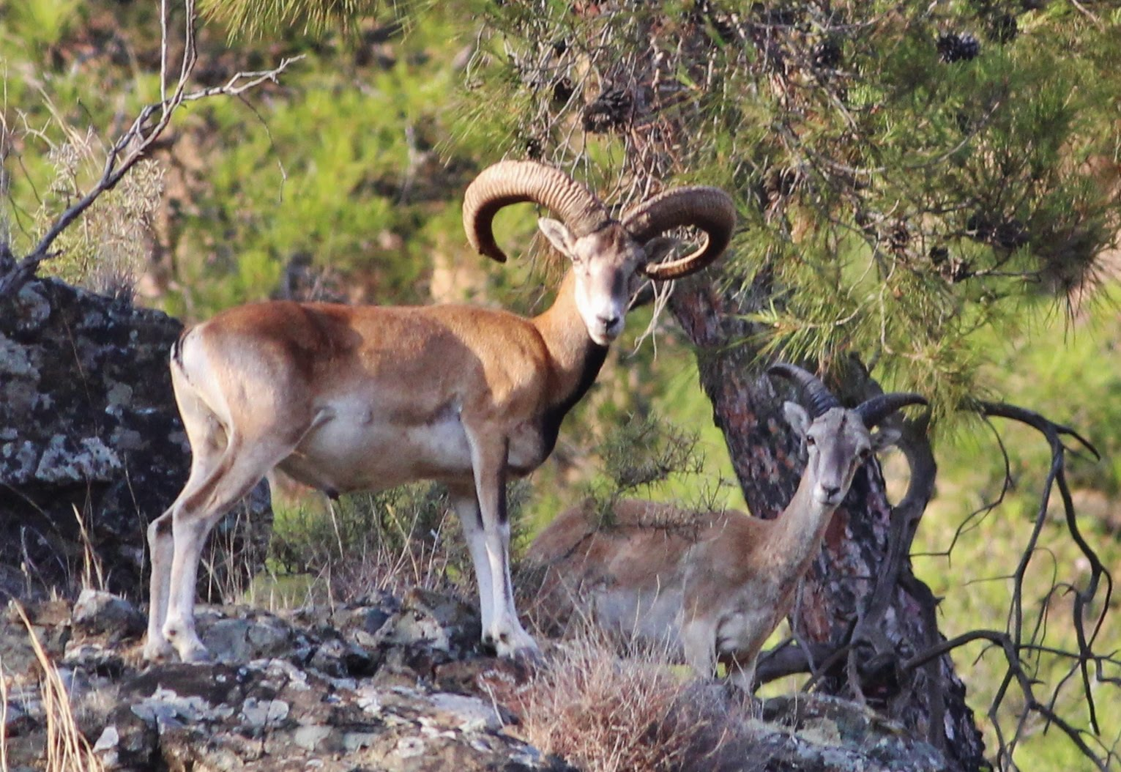
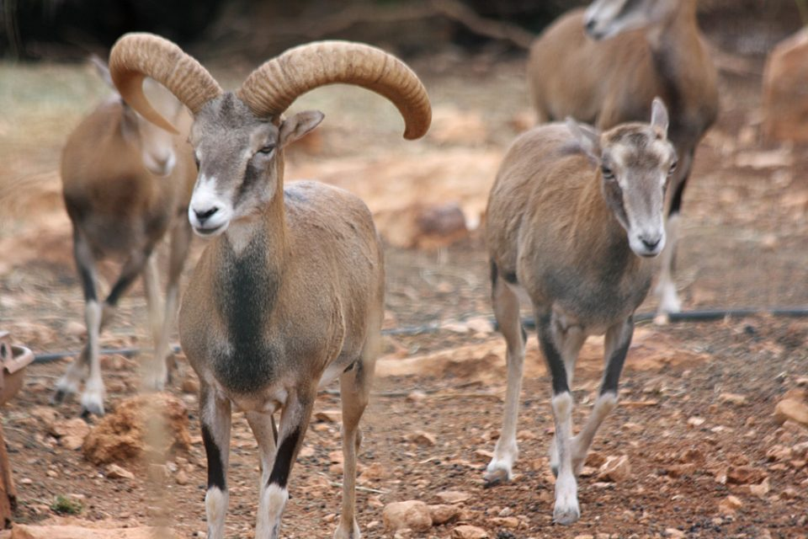
The Cyprus Mouflon Ovis orientalis ophion (wild sheep) (AGRINO), an endemic subspecies and the national animal of Cyprus
Lives in Troodos mountainsides
male
female

Slide 3
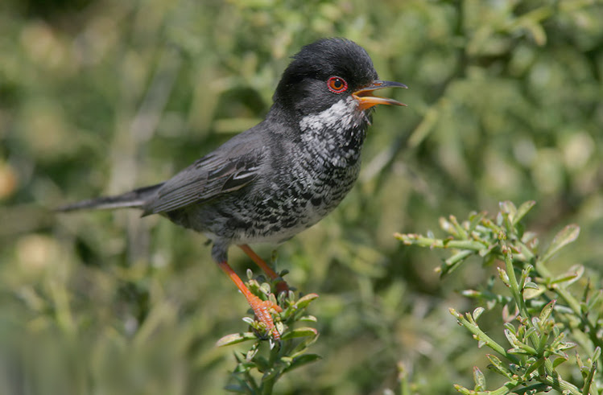
The Cyprus Warbler bird, a typical warbler which breeds only on Cyprus

Slide 4
The Cyprus Scops Owl, which has recently been proposed as being a full species distinct from the widespread Eurasian Scops Owl.

Slide 5
The Cyprus Water Frog, Pelophylax cypriensis, an endemic species of Messinian origin

Slide 6
The Cyprus Eastern Rock Grayling butterfly, which emerges in April but disperses to higher altitudes by early summer

Slide 7
The jumping spider Aelurillus cypriotus

Slide 8
The scorpion Mesobuthus cyprius, known as M. gibbosus anatolicus until DNA analysis showed that this an unique species.

Slide 9
Cyprus Whip Snake, Hierophis cypriensis, a species of snake in the Colubridae family

Slide 10
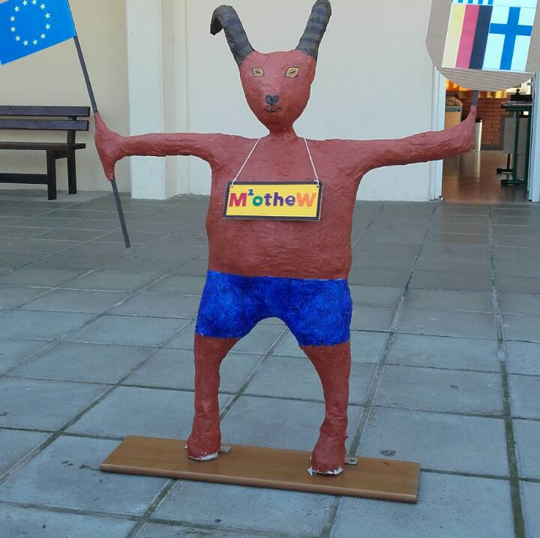
Which animal do you think inspire us to create our project mascot?
Source: http://www.cyprusbeat.com/12-unique-animal-species-cyprus/

