Slide 1
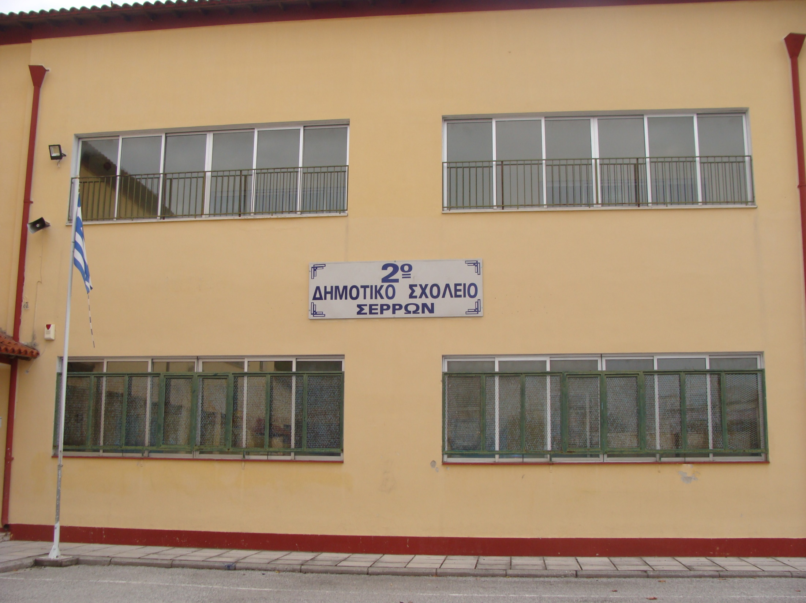
2o PRIMARY SCHOOL OF SERRES
2o PRIMARY SCHOOL OF SERRES

Slide 3
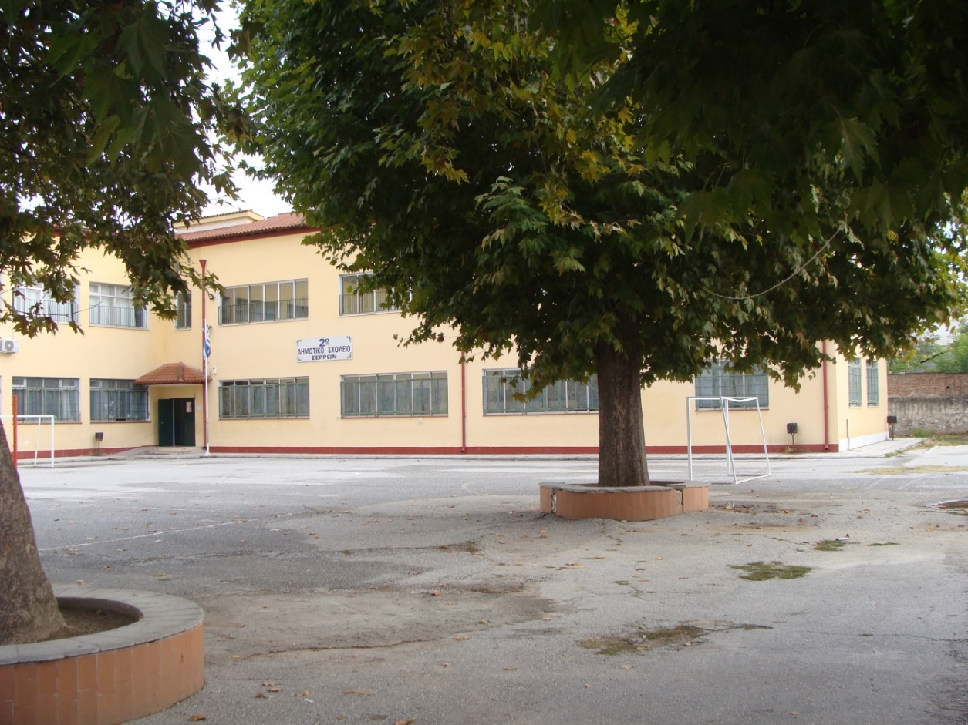
ACCORDING TO THE ARCHIVES OF OUR SCHOOL, OUR 6/CLASSES PRIMARY SCHOOL WAS FOUNDED IN 1927
THE CONSTRUCTION STARTED IN 1928 AND THE BUILDING WAS DELIVERED FOR USE IN 1930.
IT WAS INITIALLY USED UNDER ANOTHER NAME AND IN 1952 IT WAS RENAMED AS “2ND PRIMARY SCHOOL OF SERRES”.

Slide 4
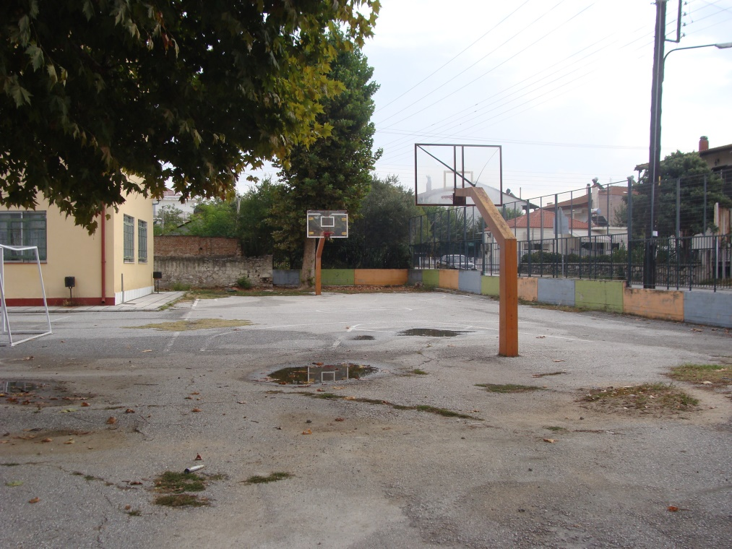
IN 1966 A SECOND SCHOOL, WHICH WAS LATER NAMED “22ND PRIMARY SCHOOL OF SERRES”, WAS FOUNDED AT THE SAME SITE.
FOR THIS NEW SCHOOL’S NEEDS A NEW BUILDING WAS ADDED WITH EASTERN ORIENTATION.

Slide 5
THESE TWO SCHOOLS WORKED AS SEPARATE SCHOOL UNITS UNTIL 2011
DURING THE SCHOOL YEAR 2011-12 THEY MERGED IN ONE SCHOOL “2ND PRIMARY SCHOOL OF SERRES.

Slide 6
STATISTIC FACTS OF 2ND PRIMARY SCHOOL

Slide 7
A GREAT REDUCTION OF THE STUDENTS’ POPULATION IS OBSERVED SINCE 2005
DURING THIS PERIOD, THE INHABITANTS OF THE AREA RESIST TO THE CONSTANTLY GROWING PARTICIPATION OF ROMA STUDENTS IN THE SCHOOL TIMETABLE AND TAKE THEIR CHILDREN TO OTHER SCHOOLS AT A GRADUAL BUT FAST RATE.

Slide 8
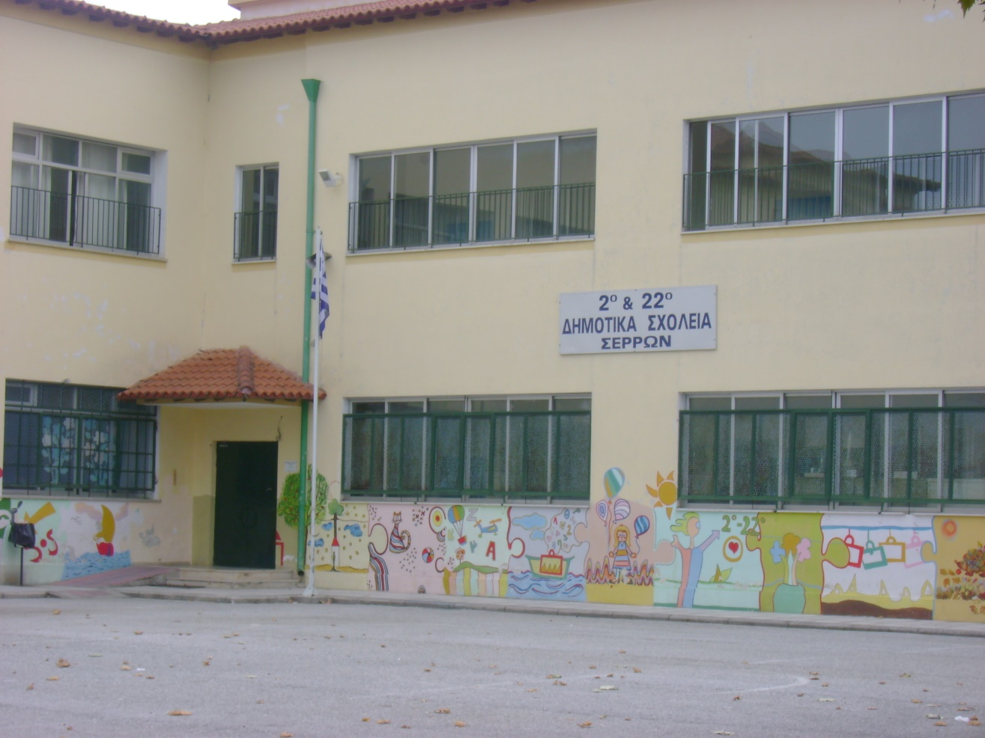
THE TWO SCHOOLS, 2ND AND 22ND , NECESSARILY MERGED INTO ONE SINCE THEY ONLY HAD 100 STUDENTS AND 59 STUDENTS RELATIVELY.

Slide 9
THE NEW SCHOOL WHICH RESULTS, CONSISTS OF ROMA STUDENTS IN ITS OVERWHELMING MAJORITY.

Slide 10
STATISTIC FACTS OF STUDENTS’ POPULATION DURING THE LAST 5 SCHOOL YEARS

Slide 11
STREETS AND BORDERS OF THE AREA WHOSE STUDENTS BELONG TO OUR SCHOOL

Slide 12
THE RED LINE INCLUDES THE AREA WHOSE STUDENTS BELONG TO OUR SCHOOL AND THE BLUE LINE SHOWS THE LIMITS OF THE AREA WHOSE STUDENTS ACTUALLY COME TO THE SCHOOL
THE LAST 10 YEARS THERE IS A FLOW OF THE STUDENTS’ POPULATION TO OTHER SCHOOLS AND A SIMULTANEOUS CREATION OF A GHETTO IN THE SCHOOL WHICH NOW CONSISTS ALMOST EXCLUSIVELY OF ROMA STUDENTS.

Slide 13
YELLOW CIRCLE-SCHOOL BLACK CIRCLES-THE ROMA NEIGHBOURHOODS

Slide 14
THE SCHOOL WAS FURTHER DOWNGRADED BECAUSE OF THE ECONOMIC CRISIS AND THE LACK OF MATERIALS, EQUIPMENT AND TECNOLOGICAL INFRASTRUCTURE.
A BRIGHT EXCEPTION TO THIS DIFFICULT SITUATION WAS THE DONATION OF COMPUTERS AND PROJECTORS FOR ALL THE CLASSROOMS FROM THE “STAVROS NIARCHOS FOUNDATION AND CULTURAL CENTRE” UNDER AN INITIATIVE FOR HELPING AGAINST THE GREEK CRISIS AND SCHOOL SUPPORT.

Slide 15
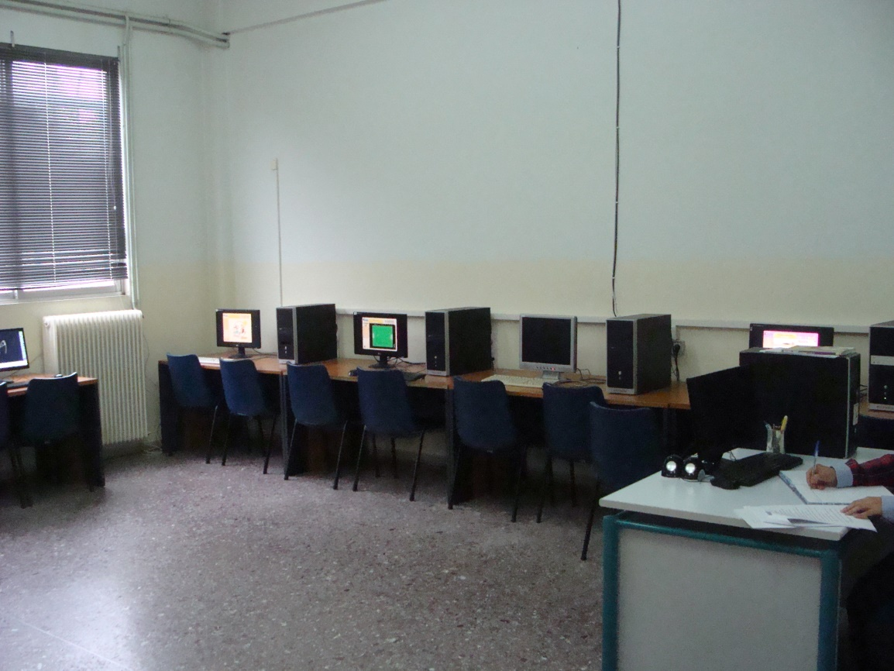
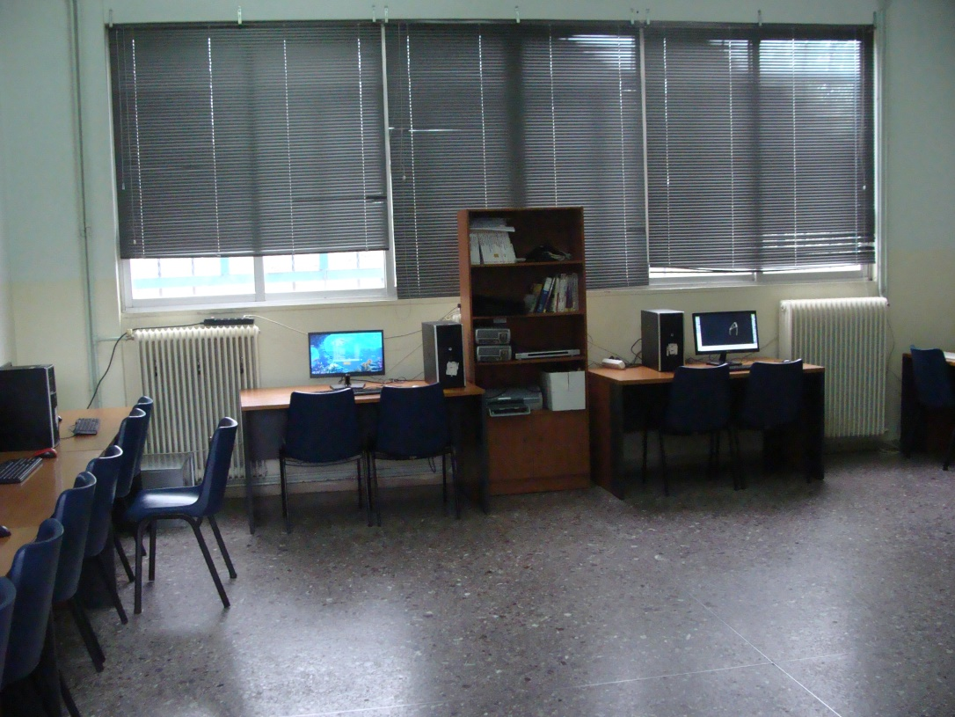

Slide 19
THERE ARE 10 CLASSES IN THE SCHOOL AT THE MOMENT
2 CLASSES FOR 1ST GRADE
2 CLASSES FOR 2ND GRADE
1 CLASS FOR 3RD GRADE
2 CLASSES FOR 4TH GRADE
1 CLASS FOR 5TH GRADE
2 CLASSES FOR 6TH GRADE

Slide 21
THERE ARE TWO TIME ZONES OF OPERATION
MORNING ZONE FROM 8:15am TO 13:15pm
THE AFTERNOON ZONE FROM 13:15pm TO 16:00pm
UNFORTUNATELY, DUE TO LACK OF TEACHING STAFF, THE AFTERNOON ZONE STOPS AT 15:00pm THIS YEAR. WE HOPE THE NECESSARY STAFF FOR THE PROPER FUNCTION OF THE SCHOOL WILL BE FOUND AS SOON AS POSSIBLE.

Slide 23
EVERY DAY, THE AFTERNOON ZONE (WE CALL IT “ALL-DAY” SCHOOL) STARTS WITH
1 HOUR FOR LUNCH
1 HOUR FOR DOING HOMEWORK FOR NEXT DAY AND
1 HOUR FOR OTHER ACTIVITIES SUCH AS PHYSICAL EDUCATION, FOREIGN LANGUAGES, ART AND COMPUTERS.

Slide 24
CURRENT OBJECTIVES
THE OBJECTIVES OF THE SCHOOL UNIT AS A WHOLE ARE
THE REDUCTION OF THE ROMA STUDENTS’ DROP-OUT RATE
THE GRADUAL LIFT OF THE GHETTO SITUATION WITH THE ENROLLMENT OF STUDENTS WHO LIVE OUTSIDE THE ROMA AREAS
THE MORE FREQUENT CONNECTION OF THE SCHOOL WITH THE LOCAL COMMUNITY (AND FURTHER AWAY ) WITH THE PARTICIPATION IN OUT-OF-SCHOOL ACTIONS.

Slide 25
THE BETTER COOPERATION BETWEEN TEACHERS AND PARENTS
THE ACTIVATION OF THE PARENT’S ASSOCIATION AND THE INTERACTION BETWEEN THE SCHOOL AND THE SURROUNDING COMMUNITY
PARTNERSHIPS BETWEEN OUR SCHOOL AND OTHER SCHOOLS

Slide 26
THE IMPLEMENTATION OF THE ABOVE OBJECTIVES IS FEASIBLE SINCE THE NEW LEGAL FRAMEWORK GIVES THE OPPORTUNITY TO THE DIRECTOR OF THE PRIMARY EDUCATION TO REDIRECT THE STUDENTS’ POPULATION AND DISTRIBUTE THEM TO OTHER BORDERING AREAS OF THE TOWN.
THE OBJECTIVE IS THE EQUAL DISTRIBUTION OF STUDENTS TO ALL SCHOOLS .

Slide 27
IN GREECE THERE AREN’T BIG SCHOOL UNITS, NEITHER SCHOOL UNITS WITH MIXED STUDENTS’ POPULATION, OTHER THAN
THE SCHOOLS WITH ROMA STUDENTS AND
THE MULTICULTURAL SCHOOLS IN ATHENS AND THESSALONIKI.

Slide 28
A NEW CHALLENGING TARGET FOR GREEK EDUCATION AND SOCIETY IS THE SMOOTH INTEGRATION OF THE REFUGEES’ CHILDREN IN THE EDUCATIONAL PROCESS.
THERE IS ALREADY A REFUGEE CAMP IN SERRES, WHICH HOSTS A STUDENTS’ POPULATION OF MORE THAN 70 STUDENTS.

Slide 29
AHEAD OF US IN THE FUTURE THERE ARE…
NEW CHALLENGES
MULTICULTURAL SOCIETIES
RESPECT TOWARDS THE DIFFERENT AND
THE MAIN OBJECTIVE FOR SOCIAL INCLUSION AND ACTIVE PARTNERSHIP OF CHILDREN AS CITIZENS OF THE FUTURE SOCIETY

Slide 30
