Slide 1
Our School
Primary school Astrid Lindgren in Schkopau

Slide 2
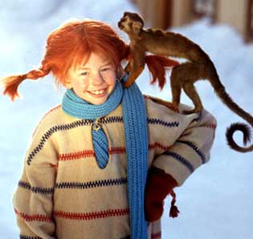
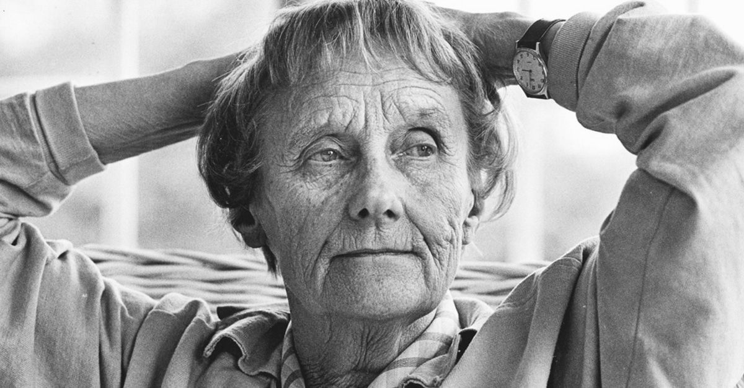
Pippi Longstocking
Astrid Lindgren
Pippi Longstocking

Slide 3
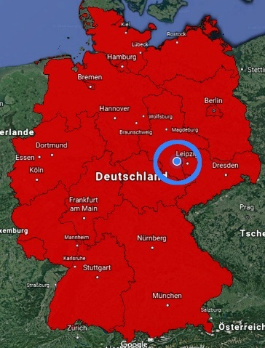
Schkopau / Saxony-Anhalt

Slide 4
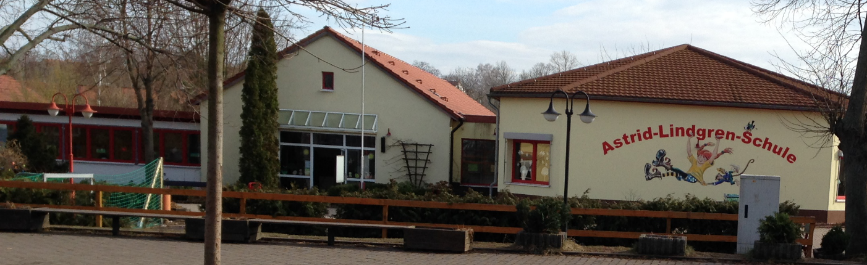
School information
School year 2017 / 2018:
182 pupils
9 classes
11 teacher, one educational staff, two teacher in preparation service and a support teacher
Notes:
Foto Lehrerteam?

Slide 5
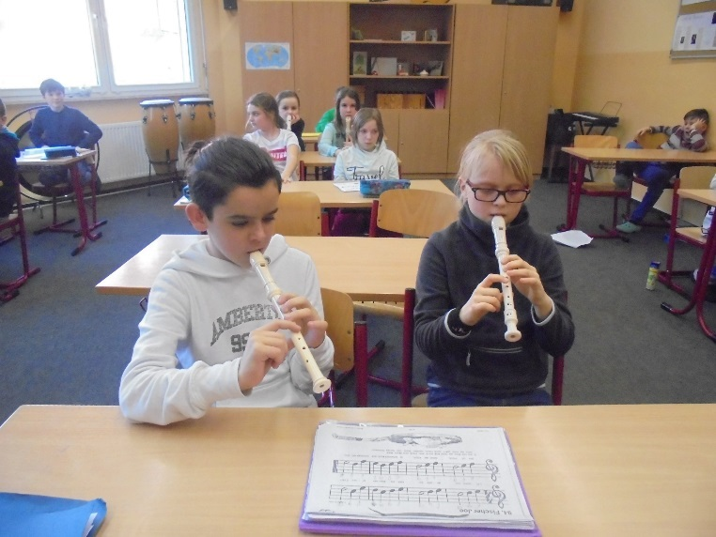
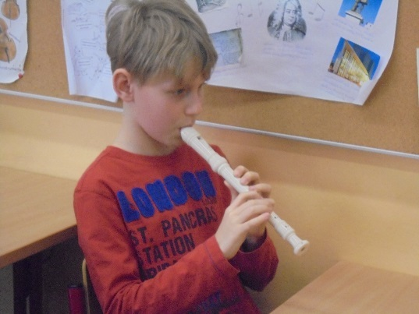
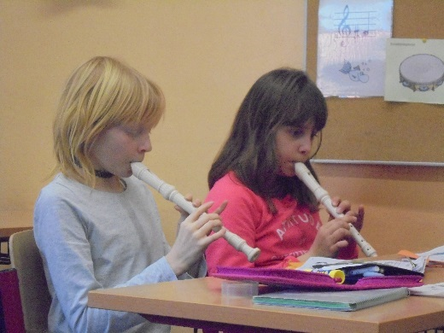
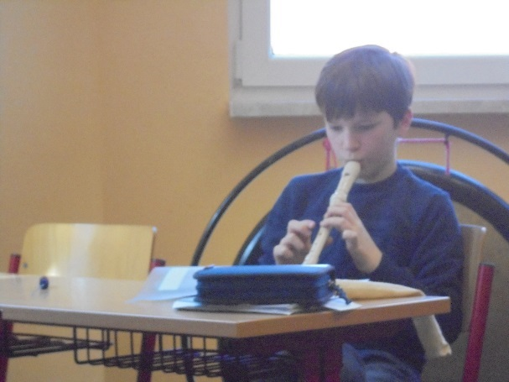
School specials
artistic – musical profil
increased reading promotion
Notes:
Zweite Bild Foto Lesekönig?

Slide 6
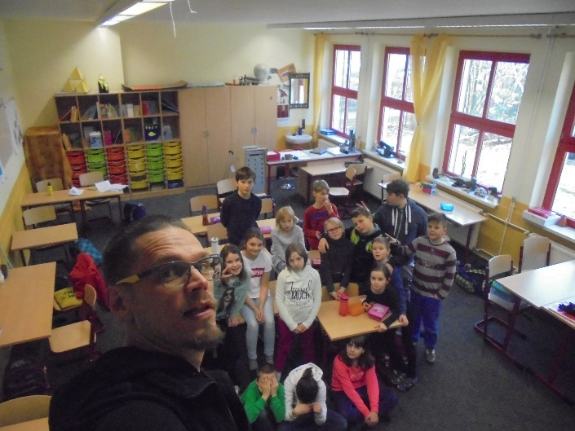
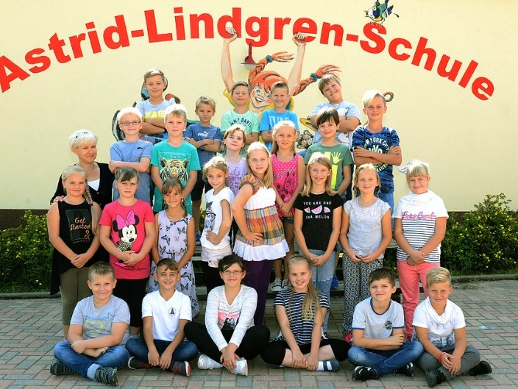
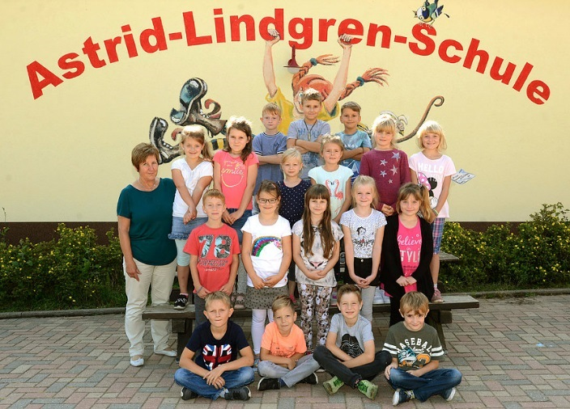
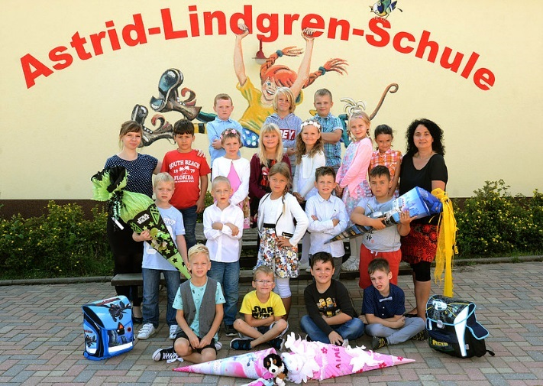
Class rooms
class 4b
class 3a
class 2b
class 1a
Notes:
Klassenraumbilder 4b, 3a, 2b, 1a

Slide 7
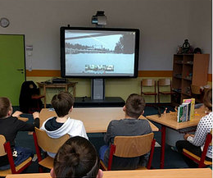
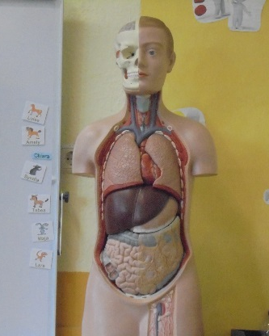
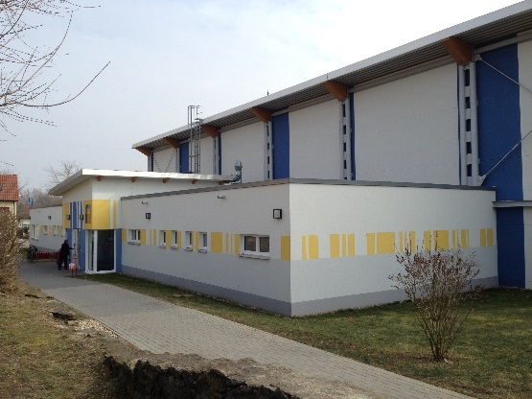
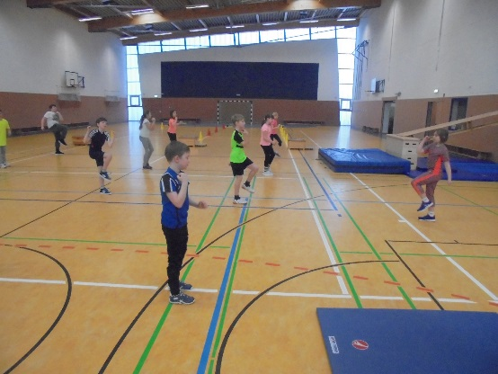
Functional rooms
Science teaching
Multimedia room
Sport hall
Notes:
Fachräume englisch, sachkunde…, Turnhalle

Slide 8
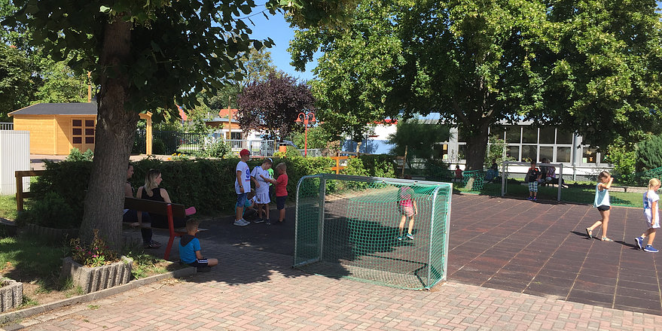
School yard
Girls and boys play football
many space for playing

Slide 9
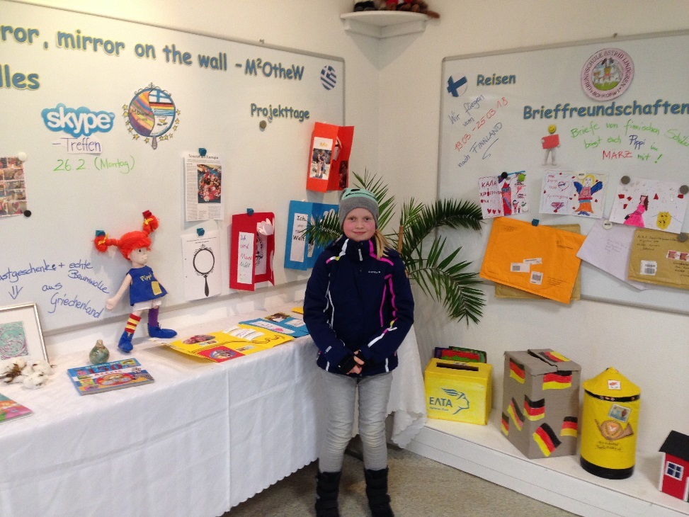
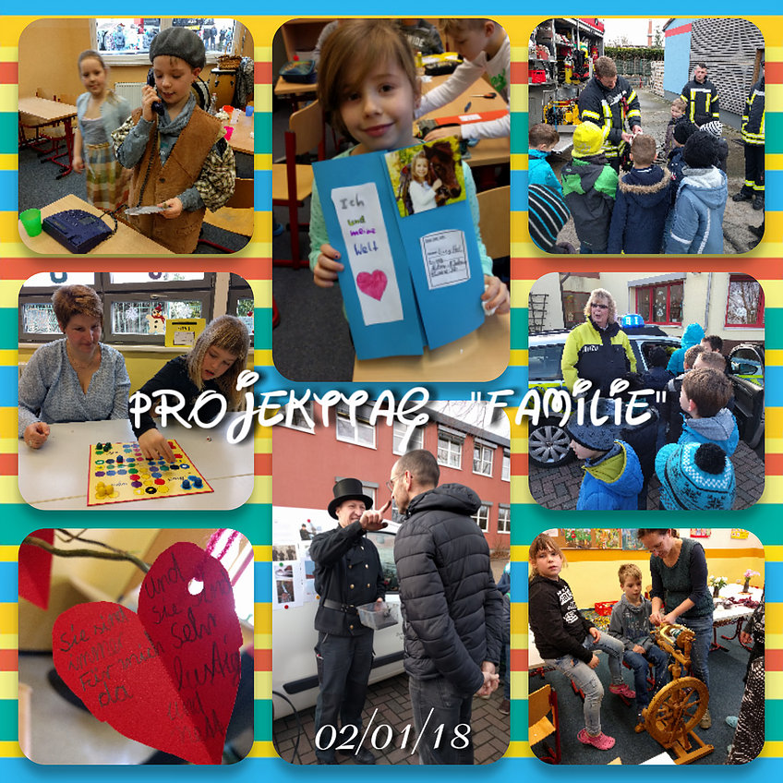
Our Erasmus+ project
Project day family
Our project wall
Notes:
Alternative Bilder?

Slide 10
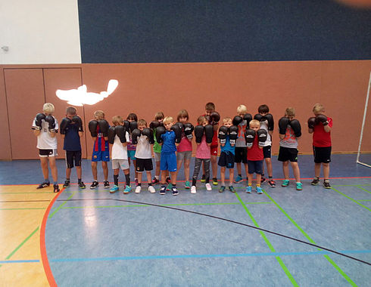
Working groups (after school activity)
Musical
Dance
Metal construction
School newspaper
Mediator
Boxing
Ball games
Notes:
Mehr AG Fotos

Slide 11
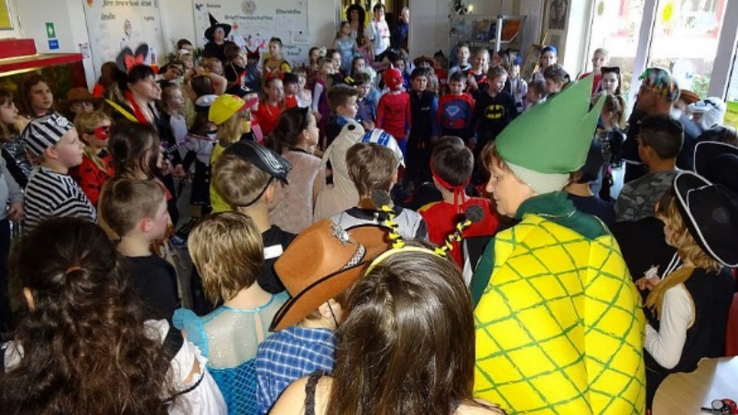
Traditions on our school
Reading contest „How is the reading king?“
Reciter contest
Project day „Road safety education“
Sport contests
Open-door day
Chrismas project days with Musical and dance show
Notes:
Hier fehlen sicher noch einige! (Fasching, Einschulung) Fotos

Slide 12
The end

