Slide 1
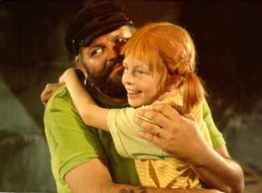
Family Day elementary school “Astrid-Lindgren“ Schkopau
„I am proud of my family“
February 1st 2018
http://www.absolutfamilie.de/2011/03/30/pippi-langstrumpf-wild-frech-und-wunderbar/

Slide 2
Mirror reflection
we talked about…
our family members
which makes us proud of our family
We looked in the mirror to find out ...
what role we play in our family
we have for strengths

Slide 3
Our Mirror Worksheet
Grade 1 to grade 4 students wrote down what role they play in their families Farrell (1st grade) wrote:
"I know a lot about technology and I'm the smallest in the family."

Slide 4
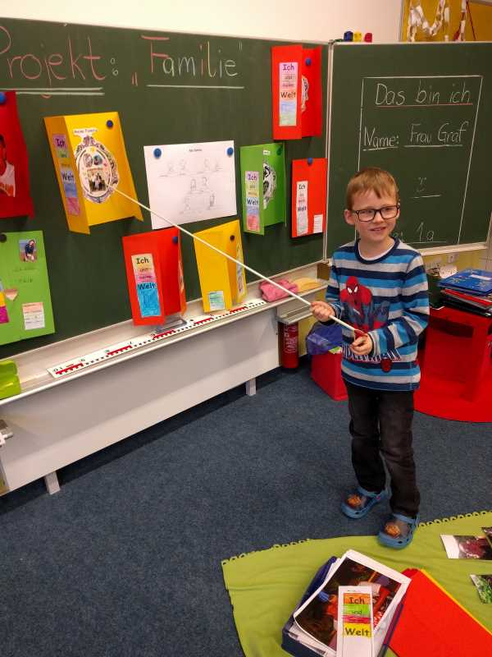
Our lapbook – „Me and my world“
Pupils designed a lapbook with the contents:
This is me!
Family members
Family tree
traditions, games, recipes, undertakings, hobbies, peculiarities of our family

Slide 5
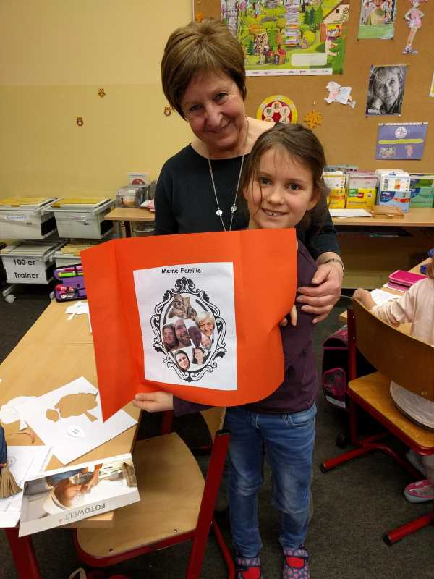
Our lapbook – „Me and my world“
1st grade
2nd grade

Slide 6
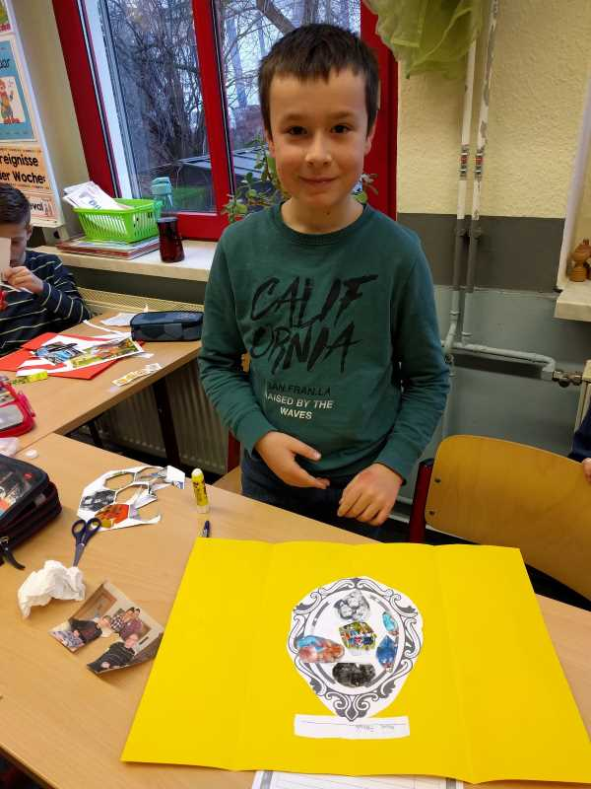
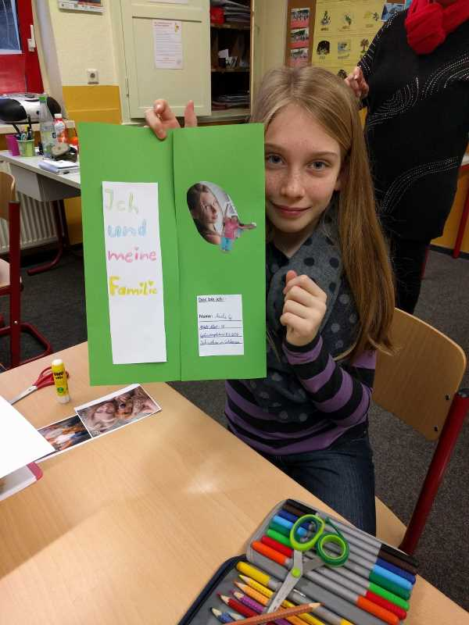
Our lapbook – „Me and my world“
3rd grade
4th grade

Slide 7
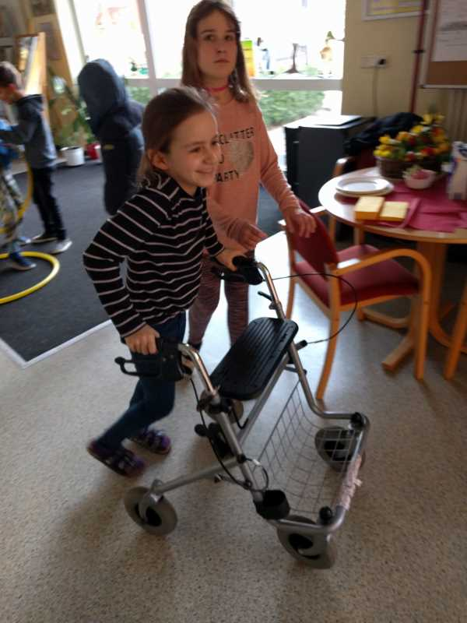
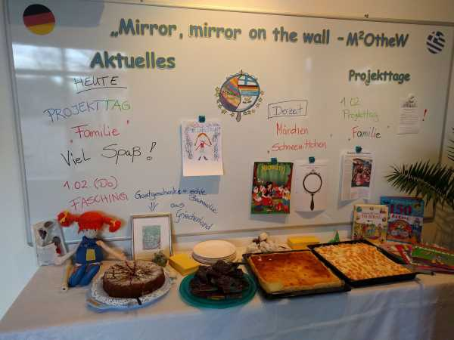
Learning at "Family Stations"
We had a great deal of parental support and students were able to learn at very diverse stations: Let's present it, be curious :-)

Slide 8
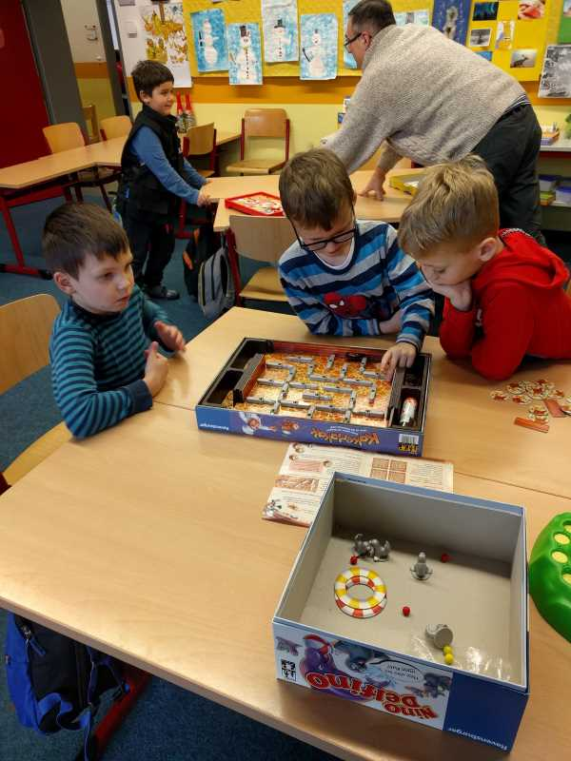
1st station: Familiy games
Parents and students brought
their favorite family games.
They gave the students a new
idea for playing in their free
time.
The digital media have a
major impact on family
communication in all partner
countries.
For us it was
important to disable an
original and beautiful form
Of communication.

Slide 9
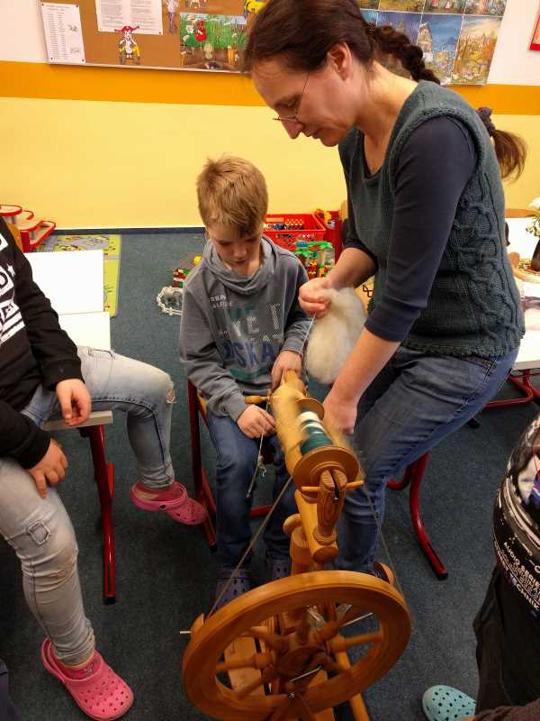
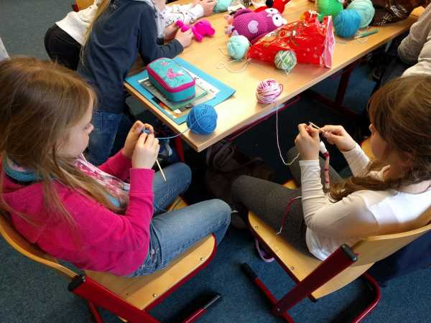
2nd Station: Knitting and crochet
here the students learned to knit, crochet and weave
Finger tip feeling was in demand

Slide 10
3rd Station: be handicapped
The students had to master a course in the school building. They were affected and needed help. What did the students learn?
to meddle in a blind person
recognize how difficult it is to be handicapped on foot (for example, the grandmother with the rollator)
to recognize that our school is not handicapped accessible (stairs, hard-to-open doors ...)
to reflect on oneself in their behavior and to feel helpfulness and appreciation towards disabled people

Slide 11
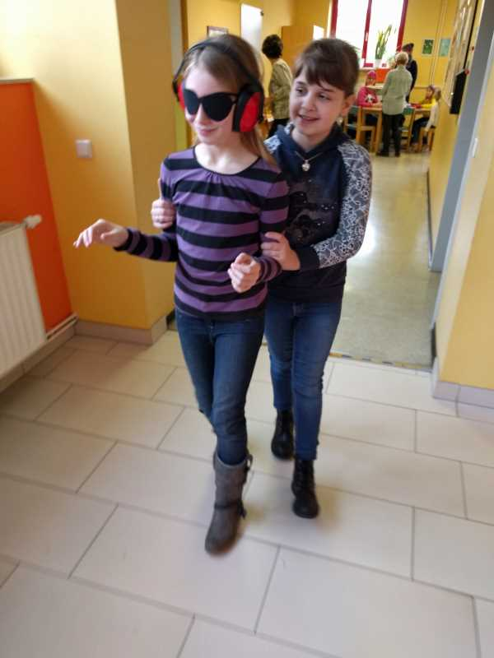
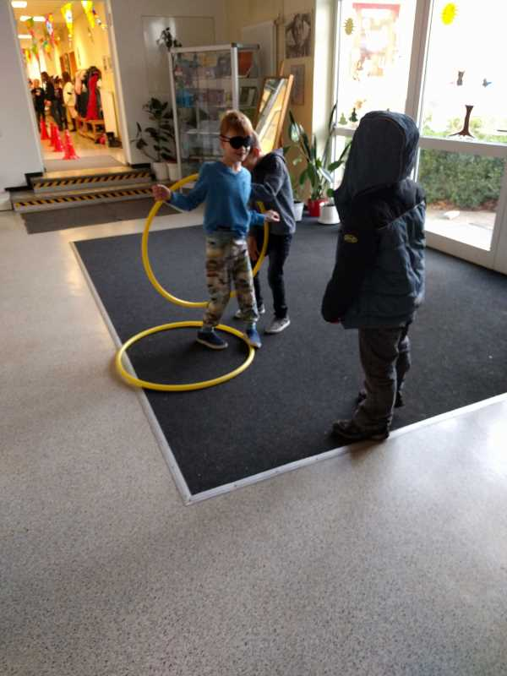
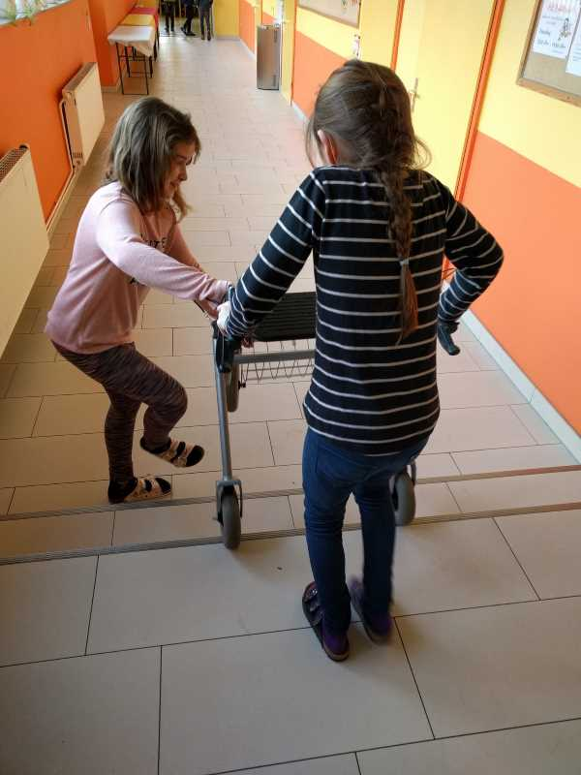
3rd Station: be handicapped

Slide 12
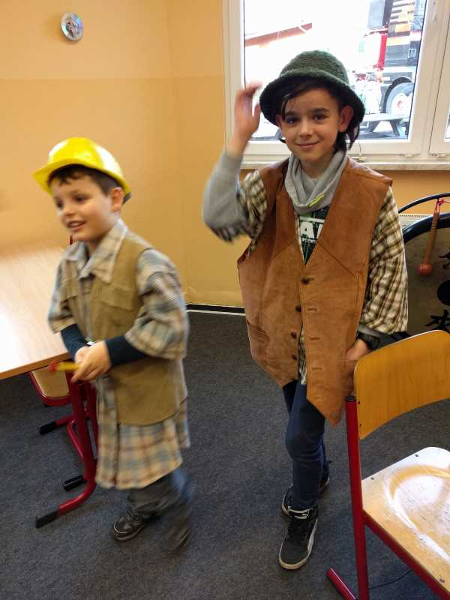
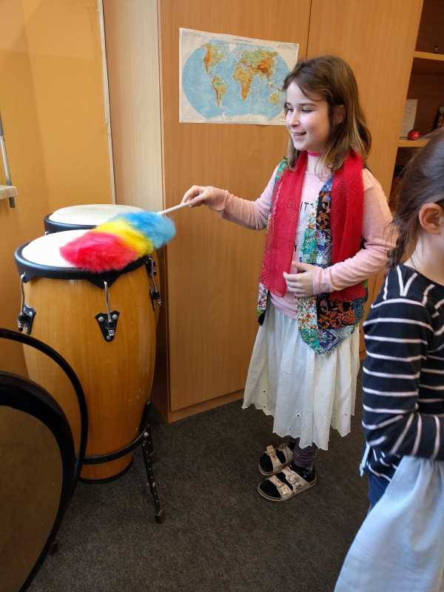
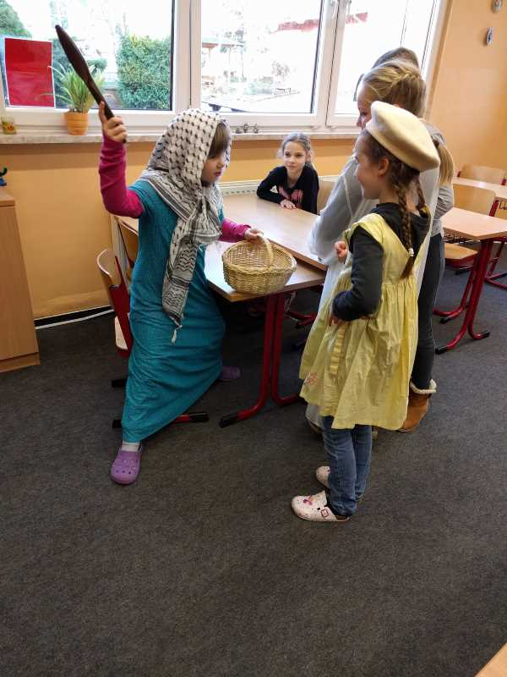
4th Station: family models
The students were able to get to know different family models in the theater play.
They took on different roles (single parents, patchwork families, foster care, father, mother, child, grandma, grandfather etc.).

Slide 13
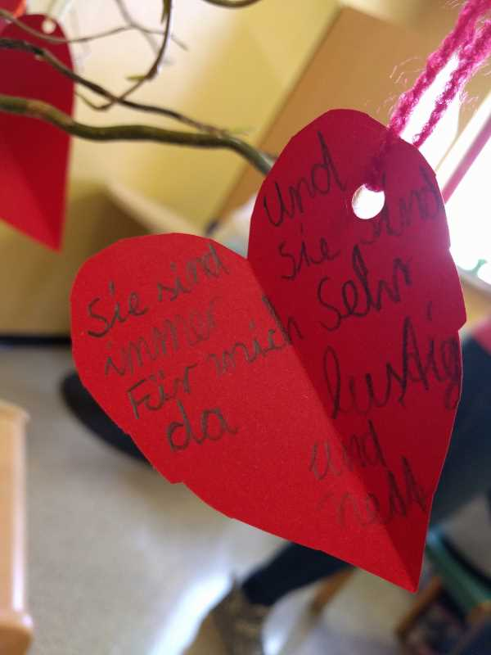
5th Station: heart of pride
The students made hearts and described them with the following content: “I'm proud of my family
because ...”
One student wrote:
"I am proud of my family because they are always there for me, funny and nice.

Slide 14
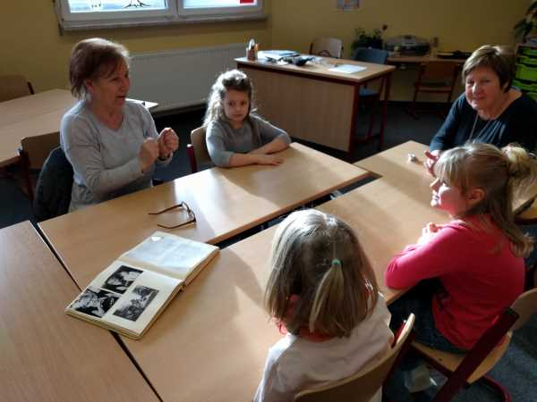
6th Station: Grandma told us
…about her childhood and brought a photo album
the students were able to get an insight into the life of 60-70 years ago and could discover parallels but also differences

Slide 15
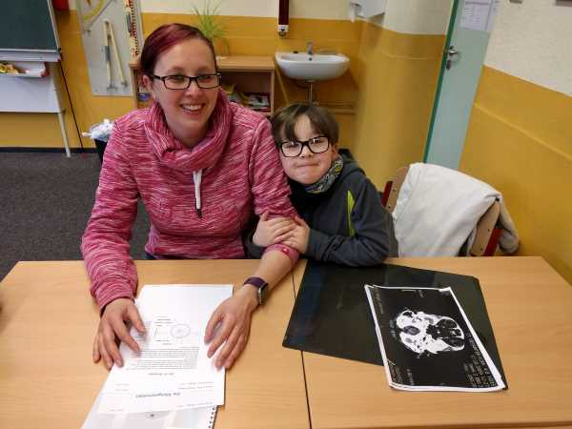
7th Station: Jobs of the parents
Our parents were very actively involved in the project day and
showed their jobs. So it was possible for the students to gain
insight into different professions.
Our goals:
be able to publicly present your own
pride in the parents
feel proud
get insight into professions to better their content and tasks
to take a look into the future (What would I like to become?)

Slide 16
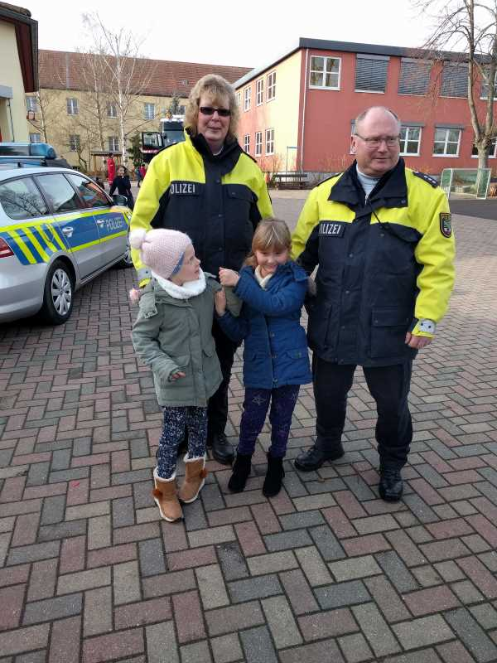
7th Station: Jobs of the parents
The following professions were presented:
Chimney Sweeper
Firefighter
Police Officer
X-ray assistant
Employees of the German
Retail Logistics (DHL)
Heavy duty transporter /
crane operator

Slide 17
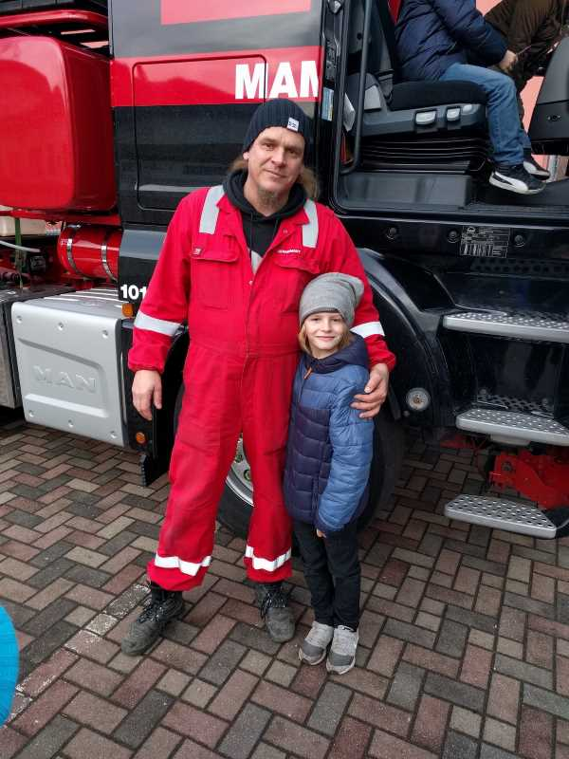
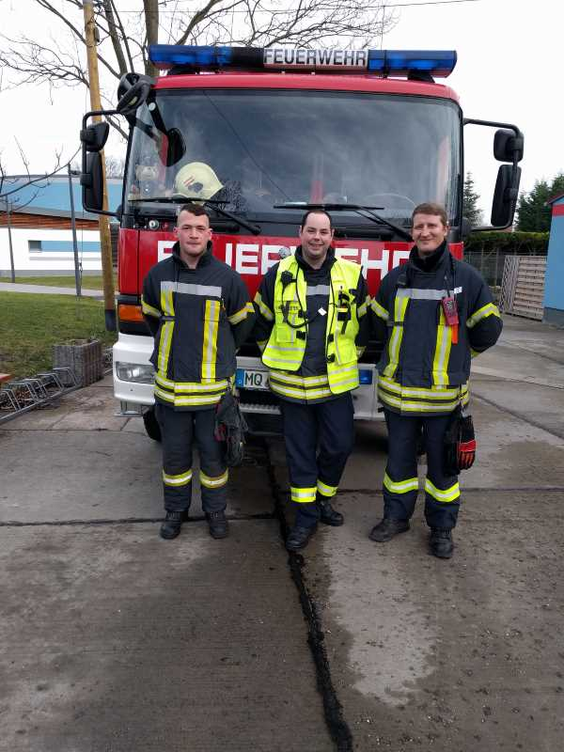
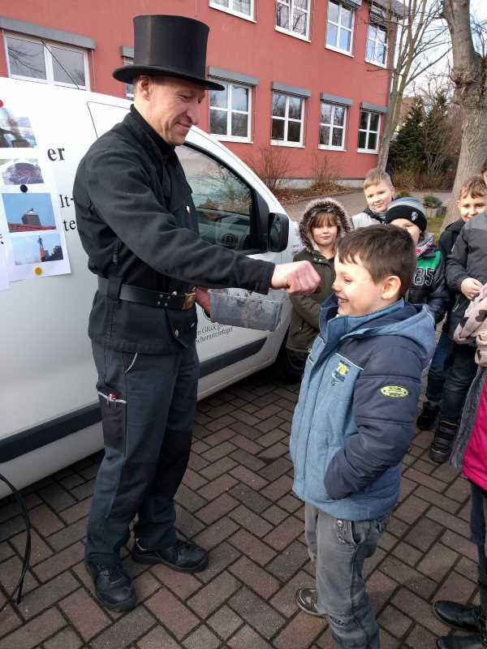
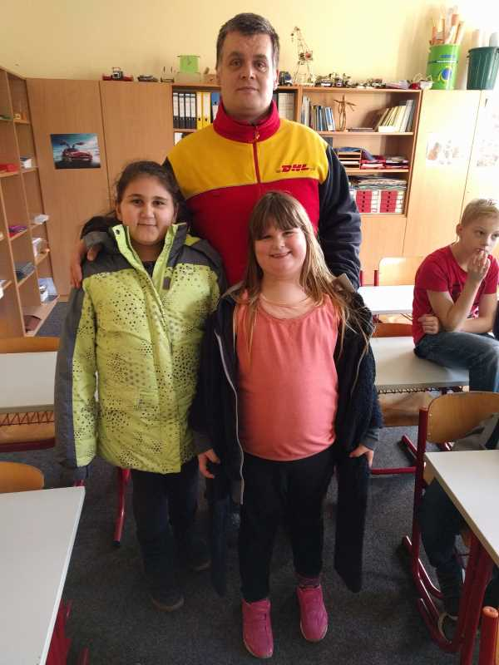
7th Station: Jobs of the parents

Slide 18
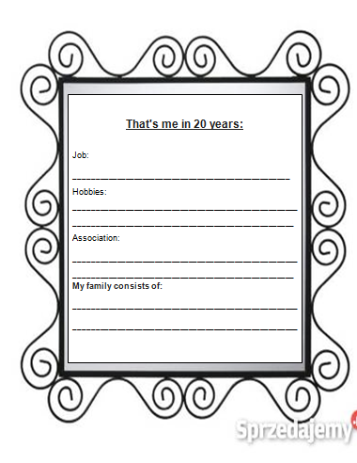
Final reflection
at the end of our project day we reflected again
students noted: "I am in 20 years"
For example, 4th grade student wrote:
"In 20 years I'm married to Pit, have 2 children and live in a house."

Slide 19
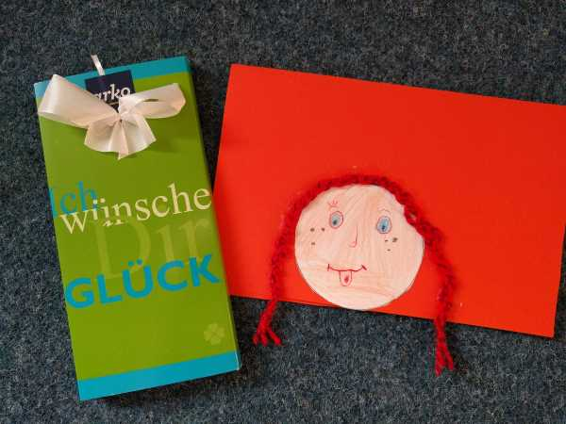
Great gratitude and success
We expressed our great gratitude for the great activity of our parents and helpers with the help of Pippi and chocolate
Our thanks also go to the
international Erasmus Team :-)

