Slide 1
Game Children´s Right „1,2 or 3“ engl. „Runaround“
The game is based on a well-known children's television program in Germany called “1,2,or 3”, so you have clear rules for the Kids.
→ in GB called “Runaround”. (https://www.youtube.com/watch?v=rmIVkG6R57c)
Quick start Guide
→ Moderator (pupil or teacher or alternately) prescribe children's rights.
"What does Article ... mean to you?“
"Does that mean ..." - Moderator clicks, reads first solution
"Does that mean ..." - Moderator clicks, reads second solution
"Does that mean ..." - Moderator clicks, reads third solution
Children have to decide and go (or hop, or…) to the window for 1, to the center for 2, to the door for 3 (corresponding to the classroom - left, center, right)
Moderator ends the round with the slogan "1,2 or 3, last chance over".
Moderrator solves with the saying "If you are really correct, you see when the light comes on." And clicks on solution film.
Pro right there are points (or small prizes ... for example candy)
Answers can be adapted or rewritten to the direct experiences of the children.
Moderator's comments from German TV (rhymes in German) can also be adapted.
Herr Motzek
Ethik

Slide 2
Herr Motzek
Ethik

Slide 3
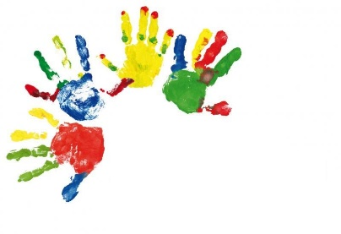
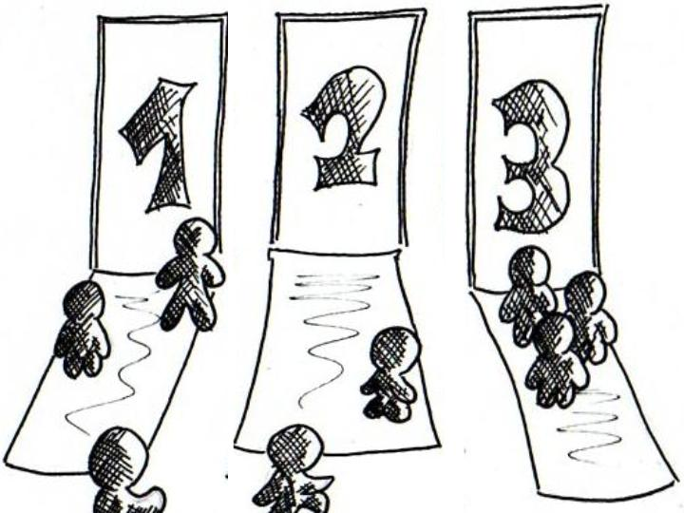
Childreen´s Right
Herr Motzek
Ethik

Slide 4
Art.2
All children are the same. No one should be discriminated against because of his skin color, race, language, religion, ability, disability, parents and family or because it is a girl or boy.
Herr Motzek
Ethik
... to be treated equally, whether they are poor or rich.
... own a room.
... to be better treated if they have rich parents.

Slide 5
Art.2
All children are the same. No one should be discriminated against because of his skin color, race, language, religion, ability, disability, parents and family or because it is a girl or boy.
Herr Motzek
Ethik
... to be treated equally, whether they are poor or rich.

Slide 6
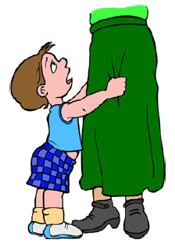
Art.5
Parents need to take care of their child and take care that the child is treated fairly.
Herr Motzek
Ethik
... that they can be beaten at most once a week.
... that they can beat their parents if they forbid their child.
... that her parents are not allowed to beat her in any case.

Slide 7
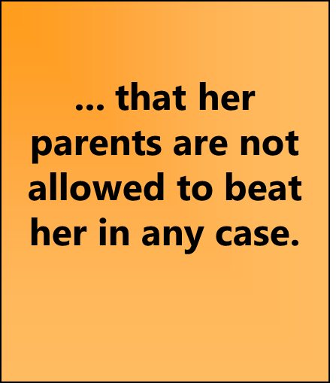
Art.5
Parents need to take care of their child and take care that the child is treated fairly.
Herr Motzek
Ethik

Slide 8
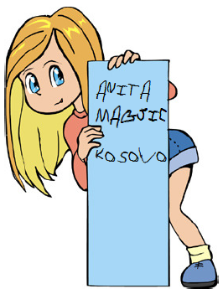
Art.7
Every child has the right to a name, to a family and to a state to which it belongs.
Herr Motzek
Ethik
... to determine who becomes president.
... to belong to three countries.
... to belong to a country.

Slide 9
Art.7
Every child has the right to a name, to a family and to a state to which it belongs.
Herr Motzek
Ethik
... to belong to a country.

Slide 10
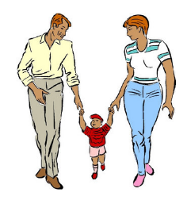
Art.10
If the parents are separated, the child has the right to visit both parents regularly.
Herr Motzek
Ethik
... to stay overnight with her best friend every week.
... to see father and mother, even if the parents do not live together anymore.
... to choose their own parents.

Slide 11
Art.10
If the parents are separated, the child has the right to visit both parents regularly.
Herr Motzek
Ethik
... to see father and mother, even if the parents do not live together anymore.

Slide 12
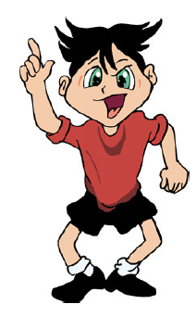
Art.12
Every child has the right to give his opinion. The adults should listen to the child and, if possible, take his opinion into account.
Herr Motzek
Ethik
... to participate in topics that affect them (for example, in the family or at school).
... to determine where they want to live.
... to determine which teachers should work at their school.

Slide 13
Art.12
Every child has the right to give his opinion. The adults should listen to the child and, if possible, take his opinion into account.
Herr Motzek
Ethik
... to participate in topics that affect them (for example, in the family or at school).

Slide 14
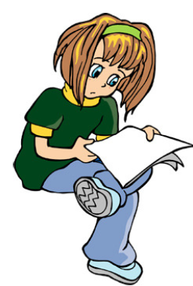
Art.16
Every child has a right to his private life. Diaries or letters should not be secretly read by others.
Herr Motzek
Ethik
... that they are allowed to read their parents' mail.
... that nobody is allowed to read their mail without asking.
... that they have to get mail at least once a month.

Slide 15
Art.16
Every child has a right to his private life. Diaries or letters should not be secretly read by others.
Herr Motzek
Ethik
... that nobody is allowed to read their mail without asking.

Slide 16
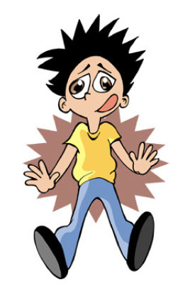
Art.19
The state protects the children from physical or mental violence.
Herr Motzek
Ethik
... never to be scolded, even if they did something bad.
... to berate others if they did something really mean.
... not to be abused or laughed at.

Slide 17
Art.19
The state protects the children from physical or mental violence.
Herr Motzek
Ethik
... not to be abused or laughed at.

Slide 18
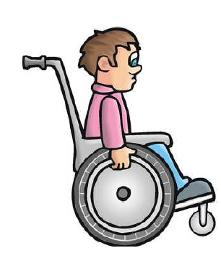
Art.23
Handicapped children are treated the same as everyone else, but have the right to special care.
Herr Motzek
Ethik
... to get at least 10 € pocket money every month.
... to be loud everywhere, because that's the way kids are.
... as well as you go to a normal school when you are in a wheelchair.

Slide 19
Art.23
Handicapped children are treated the same as everyone else, but have the right to special care.
Herr Motzek
Ethik
... as well as you go to a normal school when you are in a wheelchair.

Slide 20
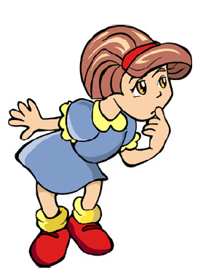
Art.27
So that children of poor parents do not have to suffer any hardships, the state also has to give their parents money for food, clothes and housing.
Herr Motzek
Ethik
... getting a wholesome breakfast every day that feeds her.
... to go to McDonald's at least once a month.
... to get her favorite food every day.

Slide 21
Art.27
So that children of poor parents do not have to suffer any hardships, the state also has to give their parents money for food, clothes and housing.
Herr Motzek
Ethik
... getting a wholesome breakfast every day that feeds her.

Slide 22
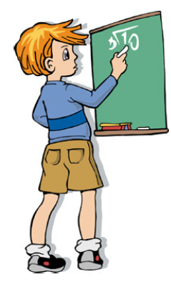
Art.28
Every child has the right and the duty to attend a school.
Herr Motzek
Ethik
...to go to school.
...to go to the swimming pool.
...to go to the ice cream shop.

Slide 23
Art.28
Every child has the right and the duty to attend a school.
Herr Motzek
Ethik
...to go to school.

Slide 24
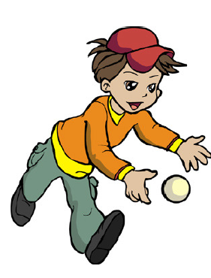
Art.31
Every child has the right to enough free time.
Herr Motzek
Ethik
... to give away her toys to other children, even without asking her parents.
... time and space to play.
... getting exactly what you want at Christmas.

Slide 25
Art.31
Every child has the right to enough free time.
Herr Motzek
Ethik
... time and space to play.

Slide 26
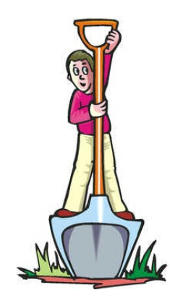
Art.32
Children must be protected from exploitation. They must not be used for low-paid adult work.
Herr Motzek
Ethik
... once they are half a year old, to refuse their afternoon nap.
...to… relax.
... to sleep deeply and firmly at school.

Slide 27
Art.32
Children must be protected from exploitation. They must not be used for low-paid adult work.
Herr Motzek
Ethik
...to… relax.

