Slide 1
Special Education Skype meeting Exchanging views on Inclusive schooling techniques Wednesday, May 30, 11:30 am to 12:15 pm
Greek special teachers team-2nd Primary School of Serres
Kostas Kiosses, Special teacher
Vaya Delitsikou, Teacher

Slide 2
Skype meeting Schedule
Short introductory round
2. How do you work as a teacher in your school?
3. What are the funding needs of your children with special needs?
4. What special methods do these children need?
5. Are your schools equipped accordingly?
6. How do you make the transition from kindergarten to school?
7. What positive conclusions can you draw from the inclusive schooling ?
8. What resources are missing for inclusive schooling?
9. eTwinning

Slide 3
Kostas Kiosses, Special Teacher –Integration Class
One Special Teacher per school
One Special Integration class for children with Special Needs ( mostly learning difficulties)
12 students maximum
Students can attend this class, for five to ten periods every week depending on the seriousness of their difficulties
Vaya Delitsikou, Teacher, Z.E.P. class(Zone of Educational Priority)
One Z.E.P. class in selected schools (majority of Roma students, refugees, intercultural diversity etc.)
One teacher (no need to be Special teacher)
In the framework of Intercultural Education –preventing inequalities, promoting equalities, ensuring equal opportunities for education for all students
Established by Law, the institution of ZEP has got the following objectives: equal opportunities for inclusion of all students in the educational system through the creation of welcoming supportive classes for the improvement of learning progress with the use of differentiated teaching techniques
Actions co-funded by the Greek Ministry of Education and European Union Funds

Slide 4
The Special Teacher has the responsibility:
to conduct the evaluation of the learning disabilities of the students
To cooperate with the official diaforodiagnosis centre
to draw their individual supportive educational schedule/plan
to apply it in the integration class
to evaluate their progress in the Integration class
The ZEP class teacher has the responsibility:
to work with students with language difficulties and diverse cultural background
to enhance their self-knowledge and self-confidence
to promote inclusion of the above students in the school routine and in the human resources
to strengthen team building with multicultural and/or multilingual students
To achieve the above through Art, Music, Literature, Games, Group activities etc.

Slide 5
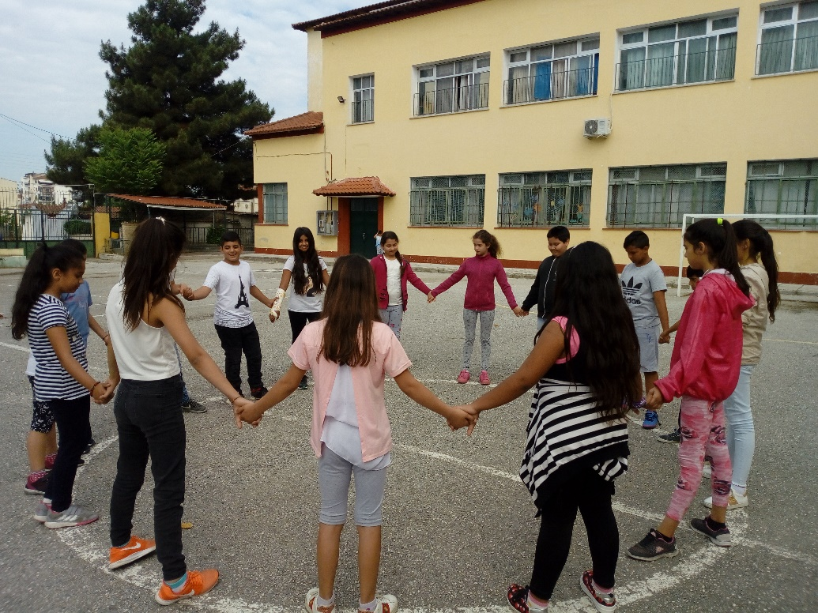
An Integration Class hosts students with:
General learning disabilities (students with low learning pace, ADHD syndrome, DOWN syndrome etc.)
Special learning difficulties (Dyslexia, dyscalculia-problem with arithmetics, dysgraphia/dysorthographia-problems with written speech and right spelling)
Some but not all Integration classes are supported by a team of a Psychologist and Social Worker for one day each week, and our school is one of them.
Students with more serious physical disabilities
or hearing and visual impairments
attend specials schools
The circle as a symbol of inclusion

Slide 6
Integration Class of 2nd Primary School
In the Integration class ten(10) students attend lessons, four (4) girls and six (6) boys.
One from 1st grade Five from 2nd grade
One from 4th grade One from 5th grade Two from 6th grade
They have learning difficulties in reading and Maths.
They are separated in 4 groups (two with 3 students and 2 with 2 students).
The groups were created taking into consideration the students’ competences and we tried to have relative homogeneity.
At first, the student is evaluated so that his/her educational needs are specified and then his/her Individual Educational Schedule is designed.
The schedule lasts for three months and the parents and teacher of general education are informed about it.
It belongs to the first type of Integration Classes, where students leave the general class and come to the room of Integration Class to be supported and to follow their personal educational plan, and then return to their class.
No student remains in the Integration Class for more than 15 periods

Slide 7
Individual differentiated learning plan and Special teaching material
Generally, the general curriculum is followed but with a simpler form and lower objectives. The quantity and the difficulty of information that the student has to absorb is reduced.
Each student has his/her own individual learning plan which covers his/her own educational needs, which is created after and according to his/her evaluation.
The teaching material is formed according to the student-subject
and the special needs we want to cover each time.
There are no books with special teaching material in Greek
and the materials are collected and formed by the special teacher (worksheets, letter cards, word cards, exercises with various methodology like ordering, classification etc.)

Slide 8
Methodology we use:
Task analysis & chaining: A target-skill is divided into smaller/shorter steps which follow /and are connected to each other. In this way the student can recognise them and understand them more easily.
Modeling: The desired behaviour and method is presented to the student as an example, who is expected to imitate and repeat it.
Shaping: This technique concerns the gradual acquisition of the desired behaviour or reaction to an activity by the student. The basic principle is that it starts from the level at which the student is and with the help of amplifiers, supports the student to reach the expected level of performance.
Prompting(Encouragement): The aim is to provide less and less support to the learner gradually. Prompts (encouragement) may be verbal/acoustic, visual and natural/physical. Methods of prompts: increased guidance, descending guidance, graded guidance.

Slide 9
Equipment and Facilities for the special students
We use a common laptop, a projector and a common board (not interactive in the special class) and we have internet connection. It is very important that most Integration Classes are nowadays equipped with these basic teaching supports because it was not a fact a few years ago.
In case we have students with a physical disability (use of wheelchair) only the 1st floor of the school is accessible with a ramp at the main entrance because there is no lift for the 2nd floor.
The toilets are accessible and new but not specially adapted for the disabled students/or teachers There aren’t any special signs for the visually impaired.
There are special books for students with eye problems and the new digital interactive books material is also given in oral form online but there aren’t books for the special classes. The teacher uses material he/she chooses or creates.

Slide 10
Greek schools are not 100% inclusive:
Serious cases with physical or learning disabilities attend special schools classes
Hearing and visually impaired students also attend special schools
The reasons are that Special Schools are better equipped to deal with all these cases and that the staff is specially trained to offer support

Slide 11
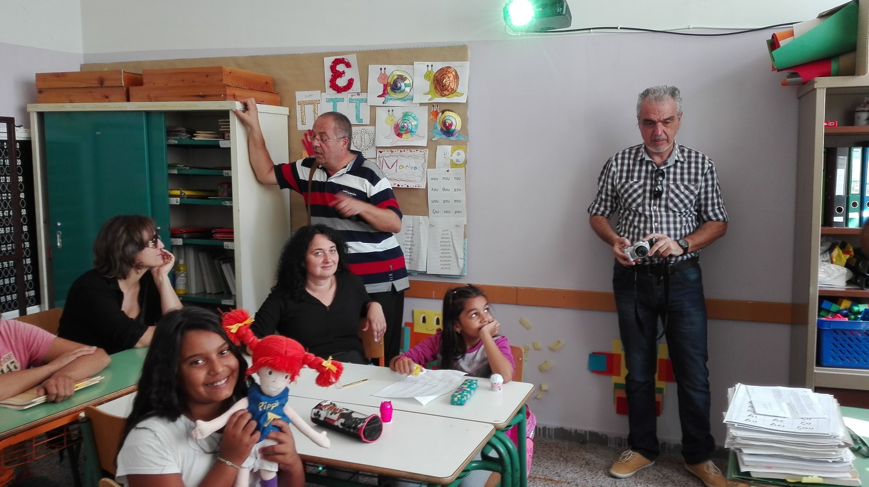
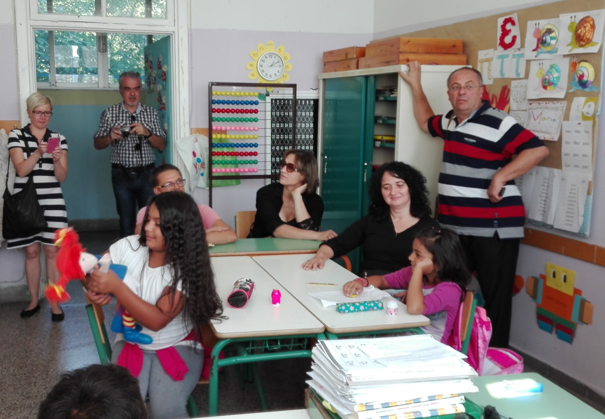
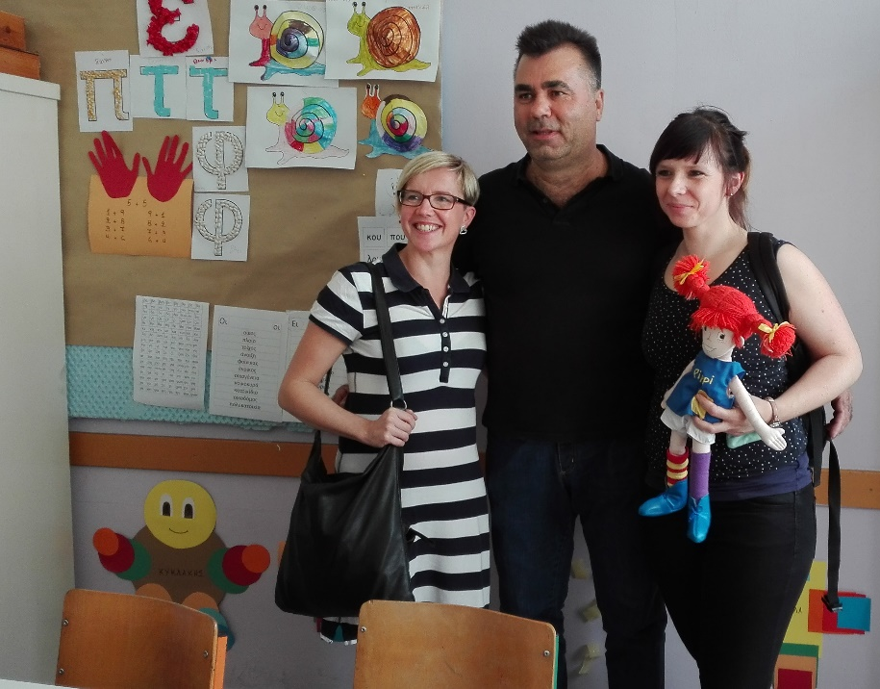
Special Class

