Slide 1
ACTIONS TAKEN FOR INCLUSIOn
Ayios Dometios III, Elementary School, Nicosia, CYPRUS

Slide 2
The provision of special education and training is offered in the following ways
1. At a Public Mainstream School – in a Mainstream classroom Children with special needs who have been assigned special education and training are entitled to free tuition at a public school where they are provided with special education and training in a mainstream classroom. Mainstream schools and classrooms which include children with special needs are equipped with the appropriate infrastructure, according to the Ministry’s educational program, which is adapted to the specific needs of the children and their individualized educational program.

Slide 3
2. At a Public Mainstream School – In a Special Education Unit A child which has been assigned special education and training can attend a Special Education Unit operating within a mainstream school. Special Education Units are integrated and embedded into mainstream schools and operate in designated classrooms which are comfortable and accessible to children with special needs. The headteacher of the mainstream school which houses the Special Education Unit is responsible for its operation.

Slide 4
3. At a Special Education School
A Public Special Education School is established and operated in accordance with the provisions of the Law to provide special education to children with special needs. These schools are staffed with the necessary teaching staff and other specialists (psychologists, speech therapists, doctors, physiotherapists and others) as well as support and auxiliary staff. The schools are equipped with modern infrastructure and equipment that are necessary for them to carry out their mission.

Slide 5
4. Through Services provided at other sites (outside school premises) Special needs children of primary and secondary education who, due to health reasons, cannot attend the regular school program for a prolonged period of time, can be provided access to education through different options. In this case, attending lessons outside school can be considered part of the regular educational program which is offered in the mainstream classes that children are registered in.

Slide 6
AS A SCHOOL WE FOLLOWED THE 1ST WAY: OUR CHILDREN WITH SPECIAL NEEDS FOLLOWED THE PROGRAM OF THEIR CLASS AND LEAVE THE CLASS AND WORK WITH A SPECIAL EDUCATION TEACHER FOR 2-3 PERIODS PER WEEK (OUT OF THE 35 PERIODS)
There is one child with movement problems- caused by bone growing imperfections (Osteogenesis imperfecta) -that uses a pram and needs the constant presence of an assistant. Also, one child has recently been identified as “autistic” and needs a specific assistant and special educational programs. It has to be noted also that in addition to these pupils, there are pupils with special educational needs in the area of language and mathematics that are given personalized help by teachers of the school.
On October 8th of 2017 a new child arrived from Greece facing a lot of difficulties in all the areas, Cognitive and Psychomotive.

Slide 7
child with movement problems
Evaluation by a physiotherapist for deciding which wheelchair is the best for the child
Hiring an assistant to help her with anything she needs during the school day, except from lesson in the class.
Evaluation and provision of special education from special teachers, one for language and one for logo-therapy from the age of 7.
The special education for her during the years and especially this year was focused in her social and sensitive empowerment: she is accepted by the other students to work in groups, to take part in school celebration of her class, to have and play with her friends during the brakes. We still have problem with dance and gymnastics, even though our P.E. teacher encourages to try exercising with her class. She is very confident about herself, she knows her limits and seems quite happy at school.

Slide 8
child with autistic characteristics
For the autistic child we did a lot with the cooperation of the parents and especially the father. They did not want him to be in the special education team and took him to specialists in the private sector. At the same time they have – almost everyday- communication with the teacher about his behavior and his progress at school. It seemed that he is a totally different person this year and nobody could say that this child is autistic.
We have to do more for his social improvement: to be accepted by all the kids in his class and be friends and play with them during the school day. Almost all the kids want him as a friend but is not ready to be friend with them.

Slide 9
The “new” child
He is 7, in year 1 (1 year delay). From the very 1st day we started the procedure of hiring an assistant because the child needed someone next to him in the class. According to his mother, he should be allowed to leave the class for some time to get rest and then go back.
For 2 months, for 7 periods per day, a teacher was next to him in the class, or in a different class, doing language lessons and try to teach him some rules of school life.
After we hired an assistant, we have an everyday program with the lessons and the homework that is done with the guidance of the assistant during the afternoon school, where we registered the kid, until 3:00pm. At the same time we have objectives for improving his behavior on an everyday basis with the cooperation of the teacher of the class, the special education teacher, the assistant and the mother.
His progress is great but there is still a lot to be done due to family problems.

Slide 10
Children provided special education
The procedure to take special education (maths and language) for a child is very bureaucratic and long-lasting. It might take 1-2 years (e.g. if the teacher begins the prosses in the middle of the school year –jan2018, the child would receive special education in sep2019!!!).
When a child is given special education, during September the special teacher should do evaluation in language and maths. Afterwards, s/he will prepare a program with specific objectives for each student. The child is evaluated every month and its program changes with higher objectives.
The special teacher should have very good cooperation with the class teacher.

Slide 11
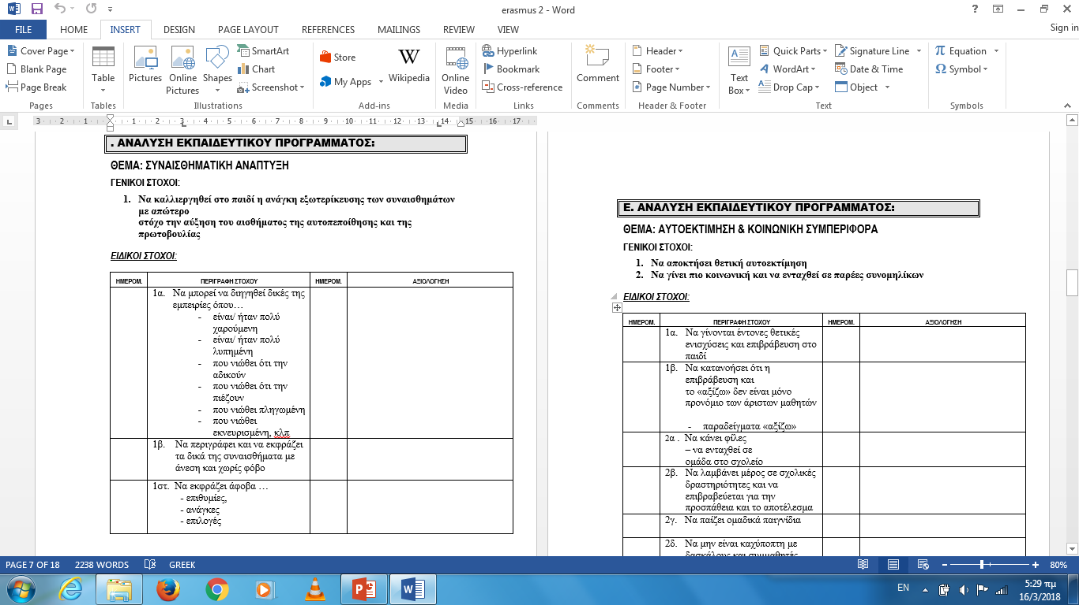
Example of a program:
EMOTIONAL IMPROVEMENT
SELF-ESTEEM& SOCIAL BEHAVIOUR

Slide 12
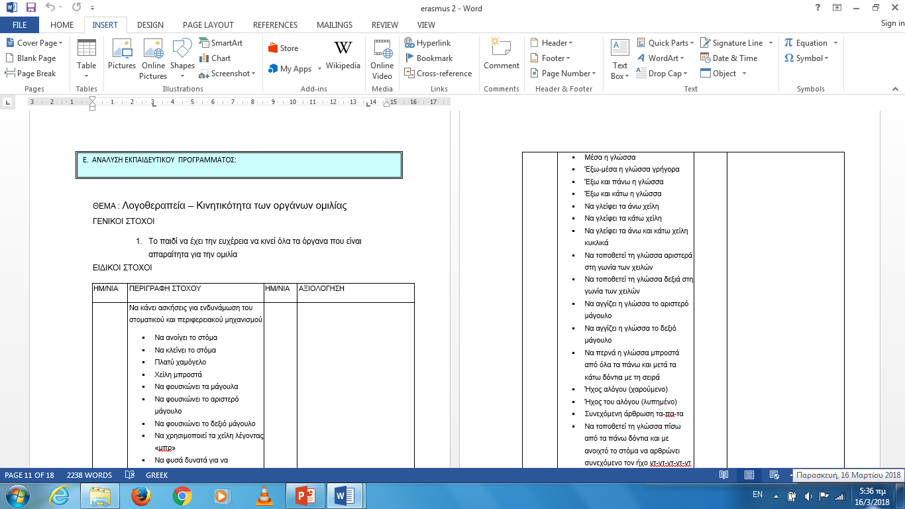
LOGO-THERAPY: EXERCISING SPEECH

Slide 13
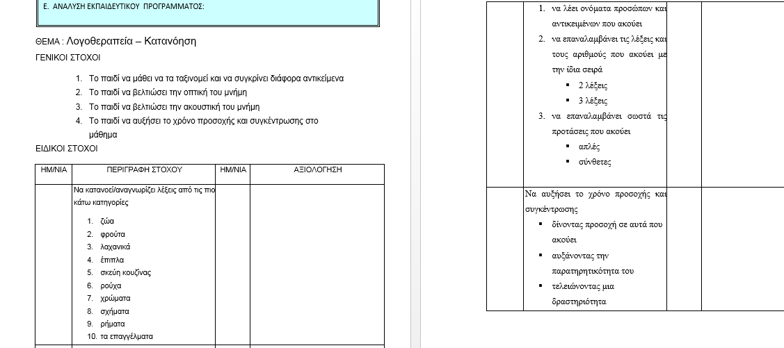
LOGO-THERAPY: UNDERSTANDING

Slide 14
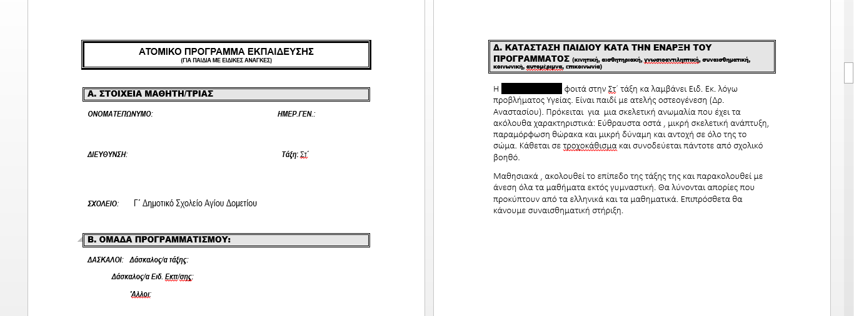
THE SITUATION OF THE CHILD WHEN PROGRAM STARTED
INFORMATION ABOUT
THE CHILD

Slide 15
INCLUSION FOR THE OTHER STUDENTS… ACTIONS TAKEN FROM THE START OF THE YEAR…
IN 10 STAFF MEETINGS, GUESTS FROM THE MINISTRY DISCUSSED ISSUES ABOUT INCLUSION AND CITIZENSHIP. THE INSPECTOR OF SPECIAL EDUCATION IN OUR MINISTRY WAS ONE THE THEM. THE OTHER QUESTS WERE FROM PRIVATE UNIVERSITIES OR THE PEDAGOGICAL INSTITUTE OF CYPRUS.
IN EVERY CLASS STUDENTS SET A “CODE OF BEHAVIOUR”, WHERE RIGTHS AND OBLICATIONS ARE DECIDED, WRITTEN ANG SIGNED BY ALL THE CHILDREN.
THE CHILDREN’S BOARD PREPARED A PROGRAM FOR EACH CLASS WITH GAMES DURING THE BREAKS
WHEN AN UNPLEASANT BEHAVIOUR IS REPEATED 2-3 TIMES OR IS TAKEN AS HIGH RISK, THE CHILD COMPLETES A FORM CALLED “RETHINKING FORM” WHERE S/HE DESCRIBES AND EXPLAINS THE BEHAVIOUR, THE IMPACT ON THE OTHER CHILDREN, HOW DIFFERENT S/HE COULD REACT, AND WHAT S/HE COULD DO TO MAKE AMENDS. THE FORM IS SIGNED BY THE CHILD, THE PARENTS AND THE HEADTEACHER. (SO FAR WE HAVE ONLY 2-3 CHILDREN THAT DISPLAY HIGH AGGRESSIVENESS)

Slide 16
ACtIONS TO BE TAKEN… 1. PARENTS’ INVOLVEMENT IN THE SCHOOL WORK IS DISSAPOINTING. WE SHOULD FIND MORE WAYS TO “makE” THEM SHOW MORE INTEREST 2. THE TEACHERS SHOULD REMIND TO THE KIDS IN AN EVERYDAY BASIS WHAT THEY HAVE DECIDED FOR THEIR SCHOOL life: ATTITUDES AND BEHAVIOUR, RIGHTS AND OBLIGATIONS, RESPECT THE PROGRAM OF LESSONS AND GAMES, ACCEPTING THE DIFFERENT, ELIMINATING INCIDENTS OF BAD BEHAVIOUR, dealing with ‘negative’ FEELINGS SUCH AS ANGER and RESPECTING EACH OTHER. 3. WE HAVE TO “TAKE MORE” FROM OUR CRITICAL FRIEND, mr angelides, SINCE HE IS ONE OF THE BEST FOR INCLUSION IN CYPRUS and WE NEED HIS SUPPORT AND GUIDANCE.

