Slide 1
Special education in our school ayios dometios III elementary school by
By Georgia Tsiapini,
Special Education Teacher
May, 2018

Slide 2
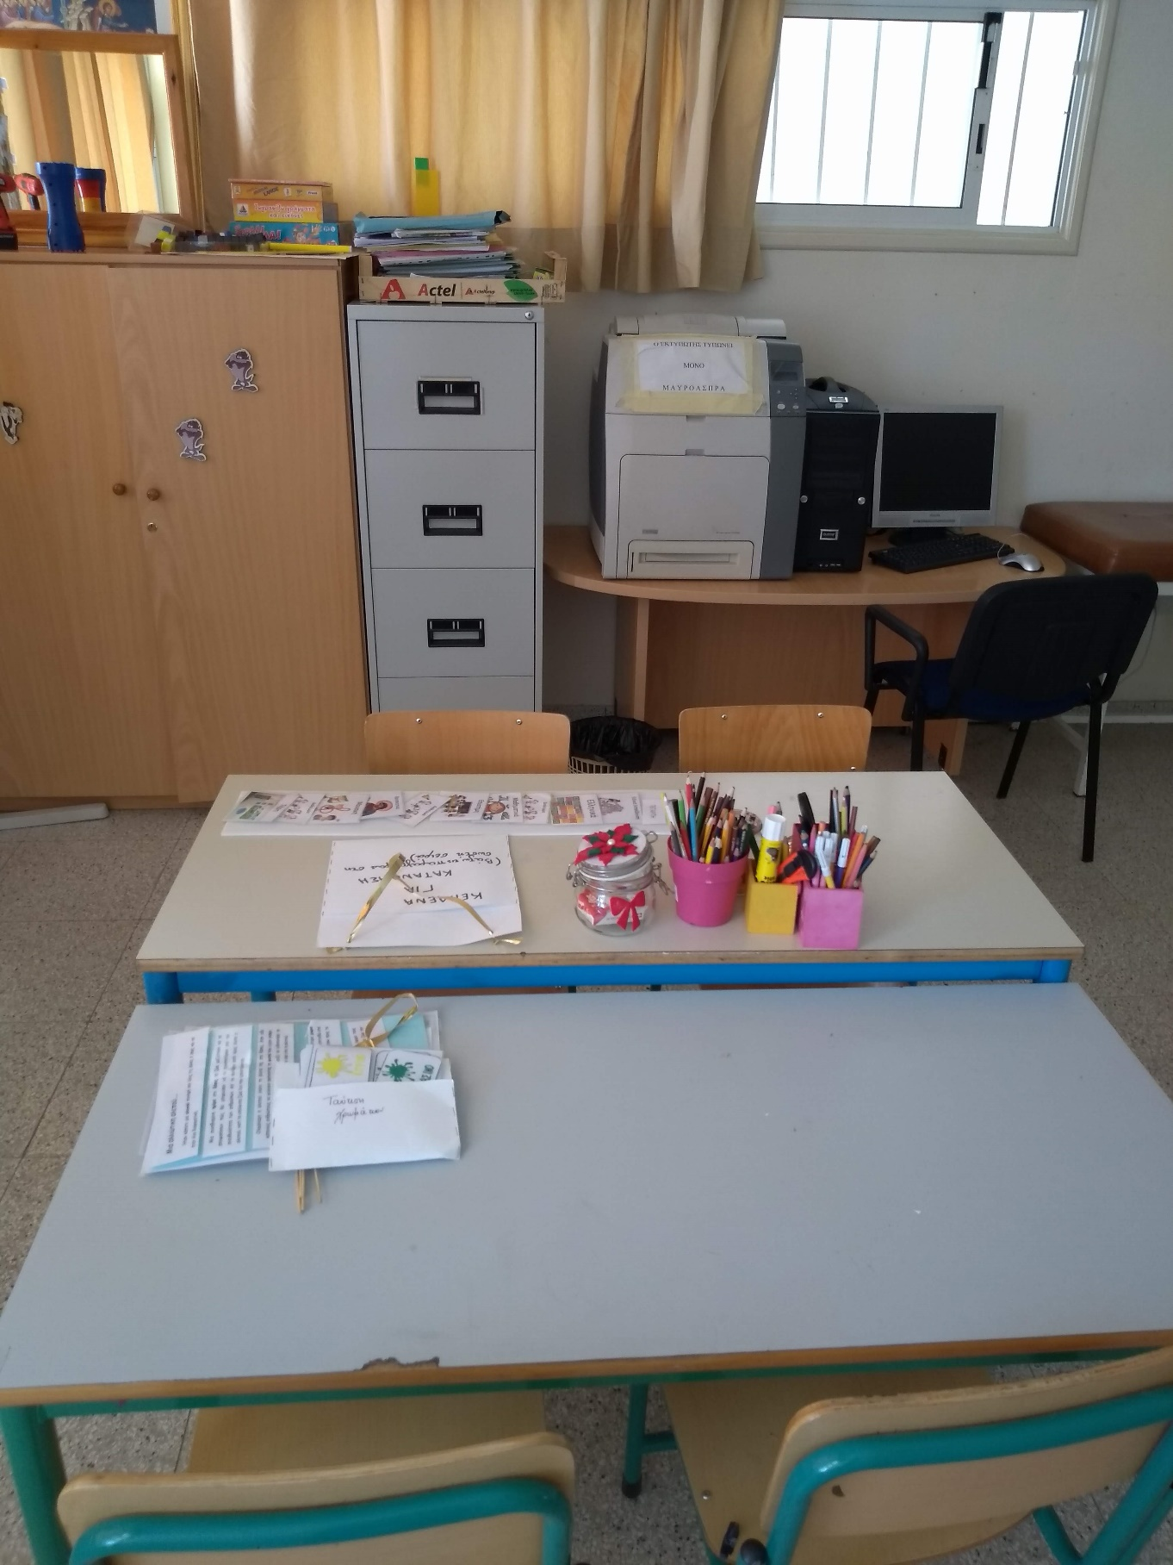
The special education department of our school includes speech therapy and special education.

Slide 3
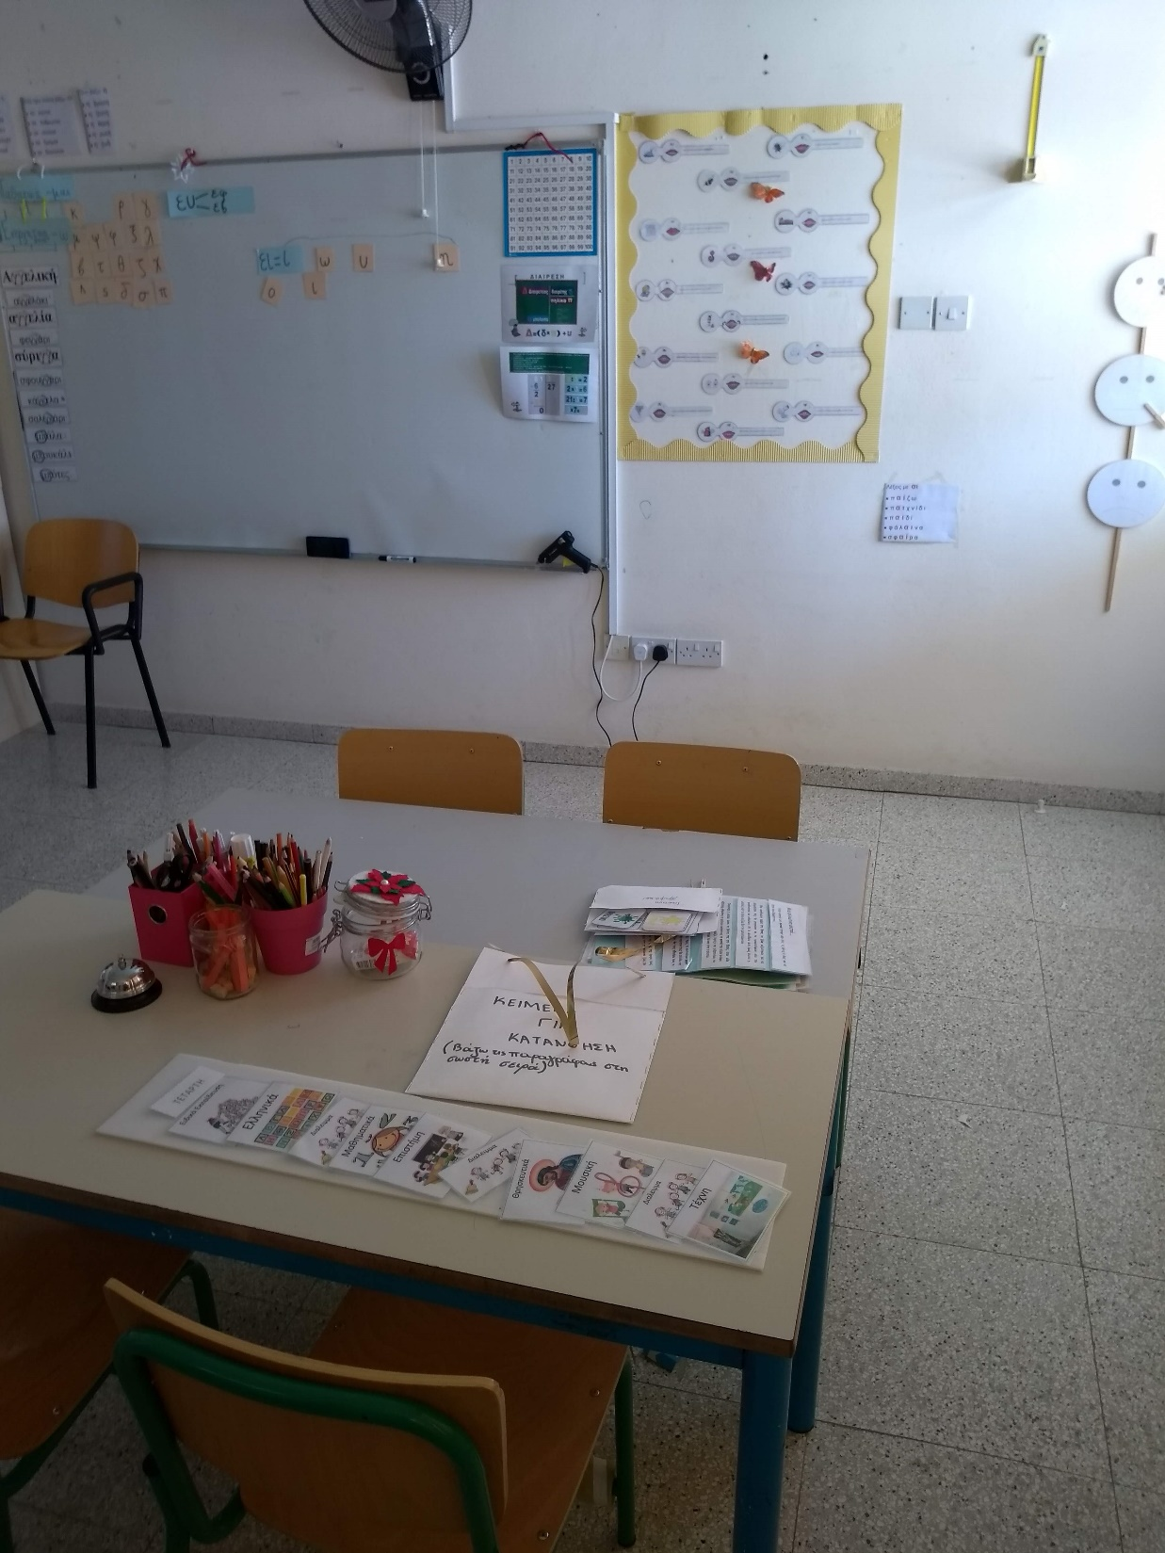
Special Education and Speech Therapy
In special education we are using one to one teaching, group teaching (2-3 students), co-teaching between special education and speech therapy and special education with main stream teacher.

Slide 4
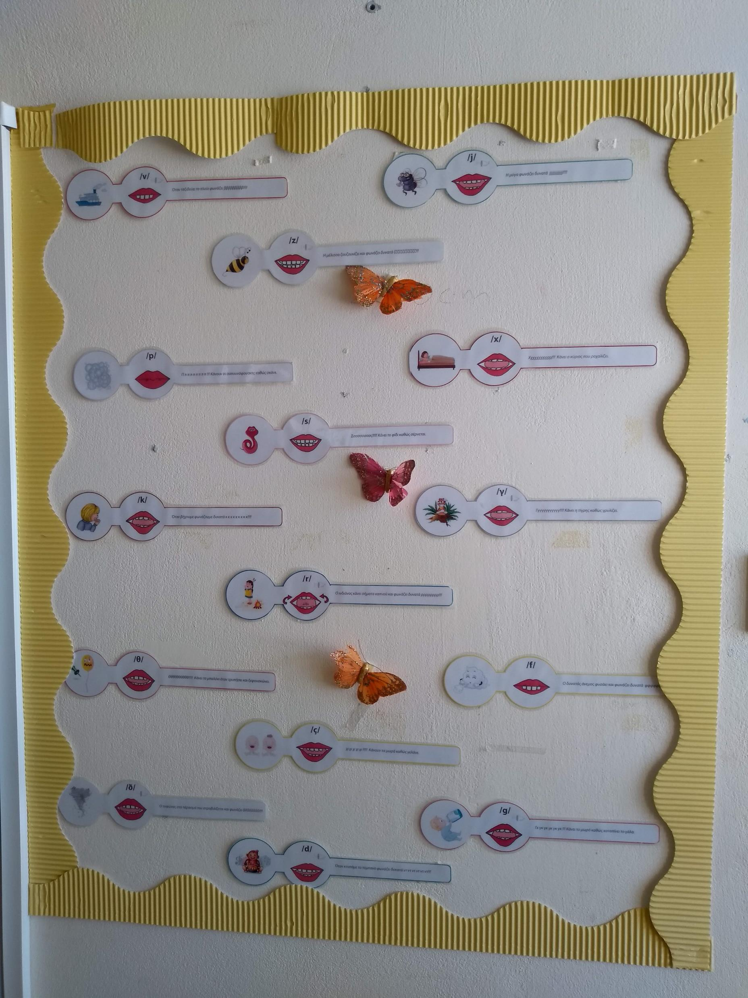
Funding needs
The funding needs of the children with special education in our school are:
Emotional support
Support for the personal hygiene
Socializing (build their communication skills that can be transferred from a small group to a large one) and build up their confidence.

Slide 5
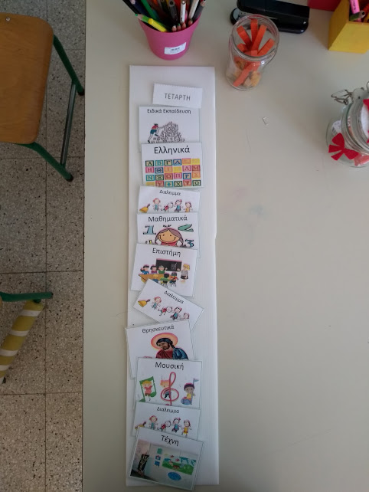
Methods
Our daily program
The methods that we are utilizing are:
Applied Behavior Analysis (ABA)
Every day school equipment are adapted to each individual student based on their needs to enhance and enable their performance e.g. we create a small window to enable the student to focus on the reading line and not be distracted from the visual overload of information. Another example is simplify class homework to enable understanding.

Slide 6
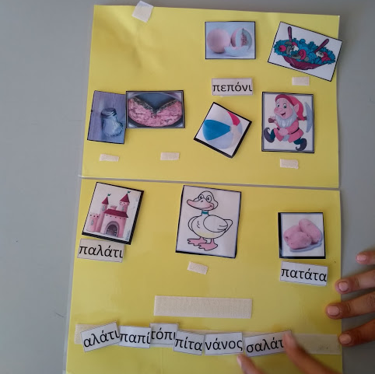
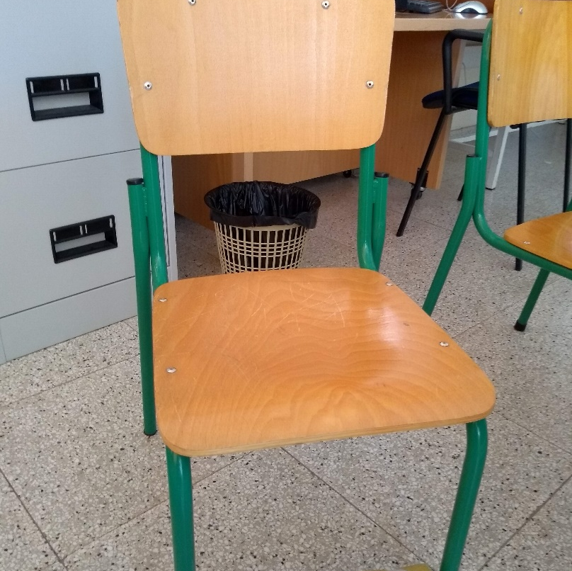
Visualize method for spelling is another method we use for our student that we found efficient and very beneficial for them.
Unfortunately, founding in Cyprus is minimal within the school system. We utilize standard school equipment and adapt them for special education.
e.g. we use insulating pipe foam on desks and chairs for the ADHD (attention deficit hyperactivity disorder) student to roll it while sitting down.

Slide 7
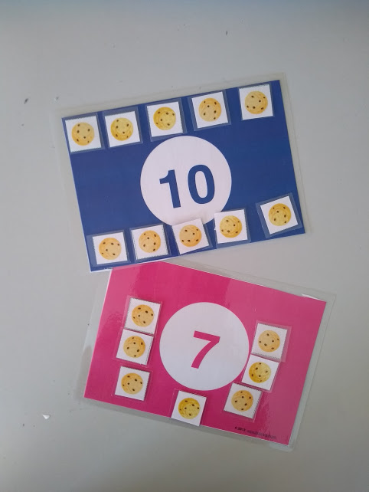
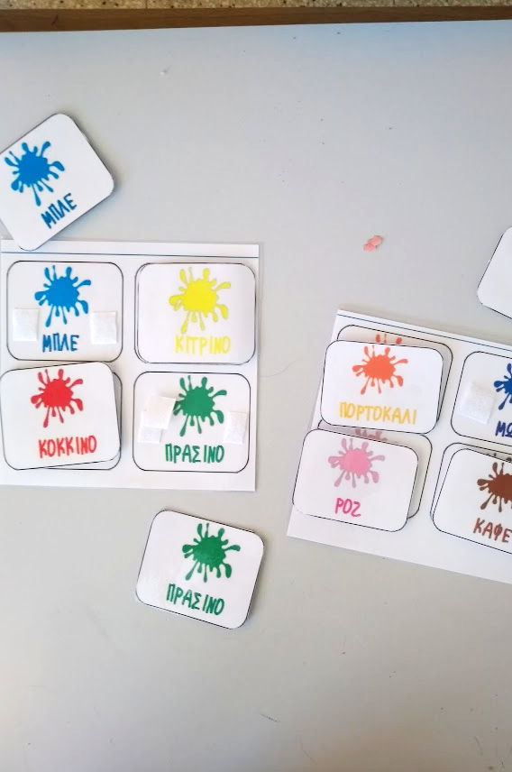
Learning COLOURS and NUMBERS

Slide 8
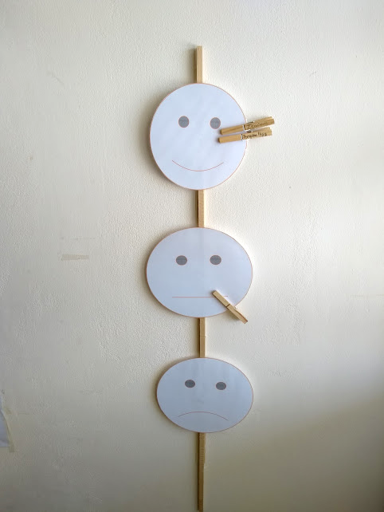
Mood board
Students express how they feel every day, by placing the peg with their name on the face that represents their mood on the current day.

Slide 9
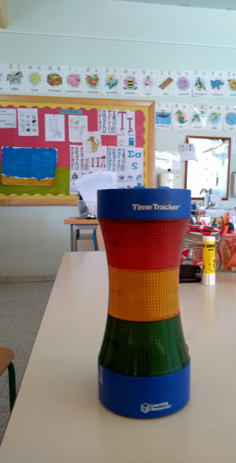
The timer
This timer works the same way traffic lights do. When the time is set, the green light is on, then as the time is close to the end the orange light is on (as warning) and when your time is up the red light flashes.

Slide 10
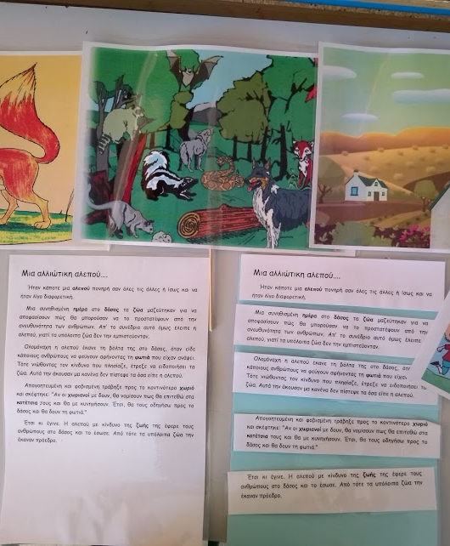
Visualising the story, breaking it into small parts and putting it back together in the correct order.

Slide 11
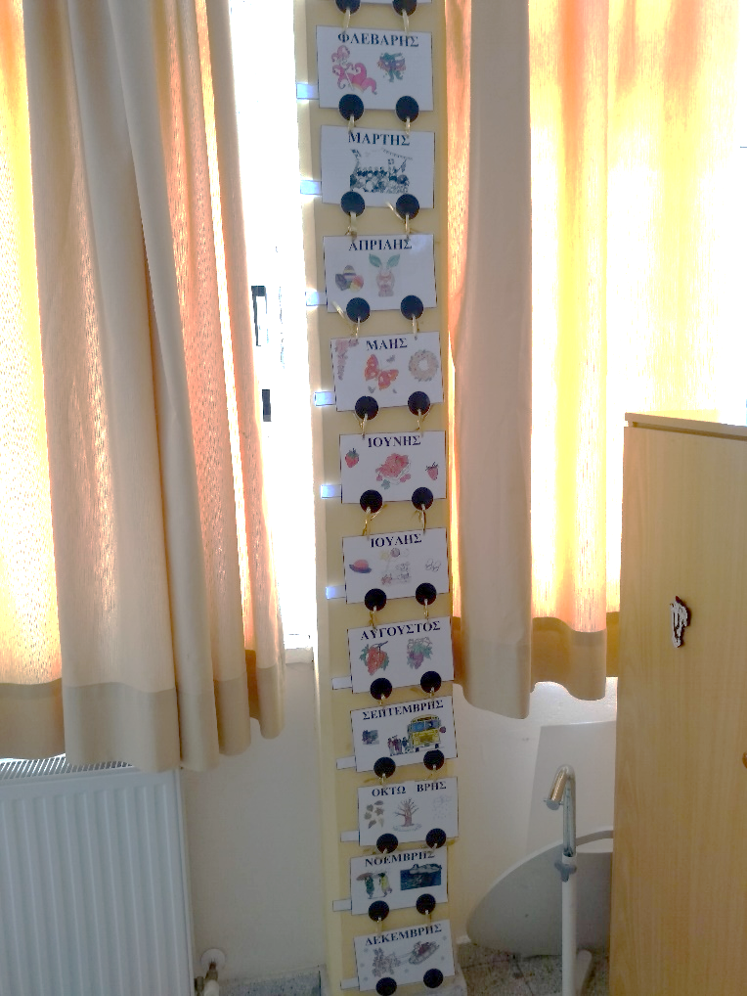
Positive conclusions…
Inclusive schooling enables and empowers each child with enough transferable skills to use in their everyday life, such as communication, socializing, and self-esteem.
The major problem that inclusive schooling has to overcome is funding which causes problems in equipment, the use of professionals, time for inclusive teaching and space availability.
Problems…

Slide 12
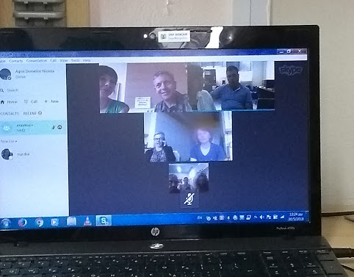
Thank you for your attention!

