Slide 1
Evaluation team cy
First Student Learning Activity
Finland 18/03/2018 – 23/3/2018

Slide 2
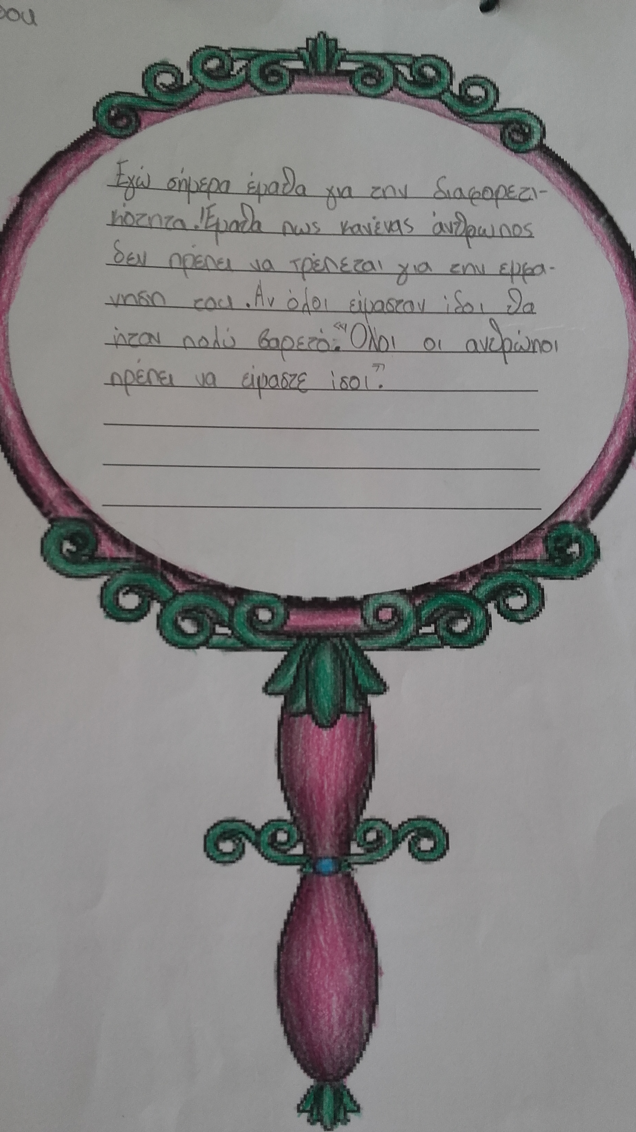
Evaluation Tools
The Mirror at the beginning and the end of each unit served as a qualitative type of evaluation.

Slide 3
MEASURING ACTIVE CITIZENSHIP
We used three questionnaires depending on the age of our students.
Grade 1
Grade 2-3
Grade 4-5-6
The Questionnaires measure values, beliefs and actions
Based on a questionnaire found on an academic research that was validated and reliable.

Slide 4
The Questionnaires Used

Slide 5
Grade 1

Slide 8
Grade 2-3

Slide 13
Grade 4-5-6

Slide 19
Main Results of Active Citizenship Questionnaire for Grade 1
Grade 1 | Values | Beliefs | Voice | Action
Mean | 2,5 | 1,2 | 1,7 | 2, 6
Results:
They value helping other people
They act often as active citizens
Their voice is not heard so much at school/family

Slide 20
Main Results of Active Citizenship Questionnaire for Grades 2-3
Grade | Values | Beliefs | Voice
Grade 2 | 4.7 | 2.0 | 1.5
Grade 3 | 3.9 | 2.2 | 1.7
Action
3.4
2.8
Results: Children don’t think that they are heard sufficiently in school and family. In grade 3 there is need for more active citizenship behavior.

Slide 21
Main Results of Active Citizenship Questionnaire for Grade 4/5/6
Grade | Values | Beliefs | Ability for action | Voice | Actions
Grade 4 | 4.2 | 3.3 | 3.1 | 3.5 | 3.1
Grade 5 | 4.5 | 3.3 | 2.2 | 3.0 | 3.3
Grade 6 | 3.9 | 3.1 | 3.0 | 3.5 | 3.0
Actions in last year
3.1
1.4
2.4
Results: It is valued highly to help others, however there is room to improve in active citizenship actions since the children only sometimes act as active citizens.

Slide 22
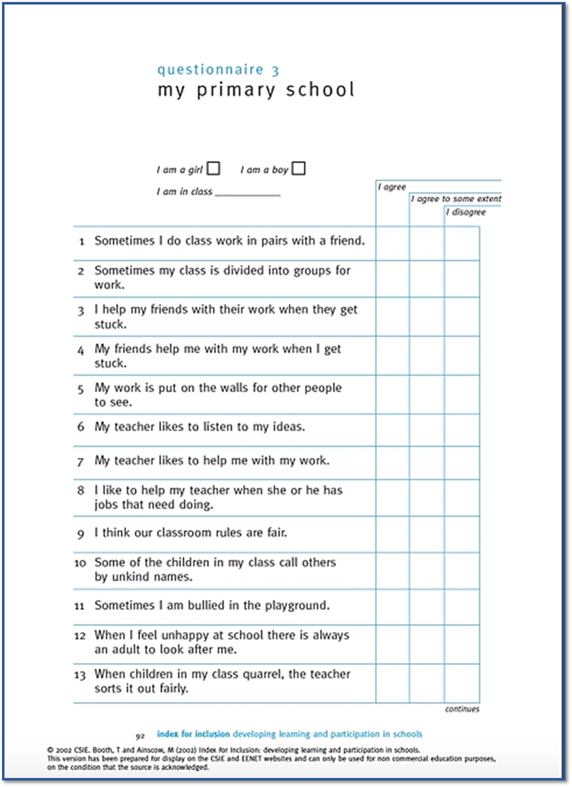
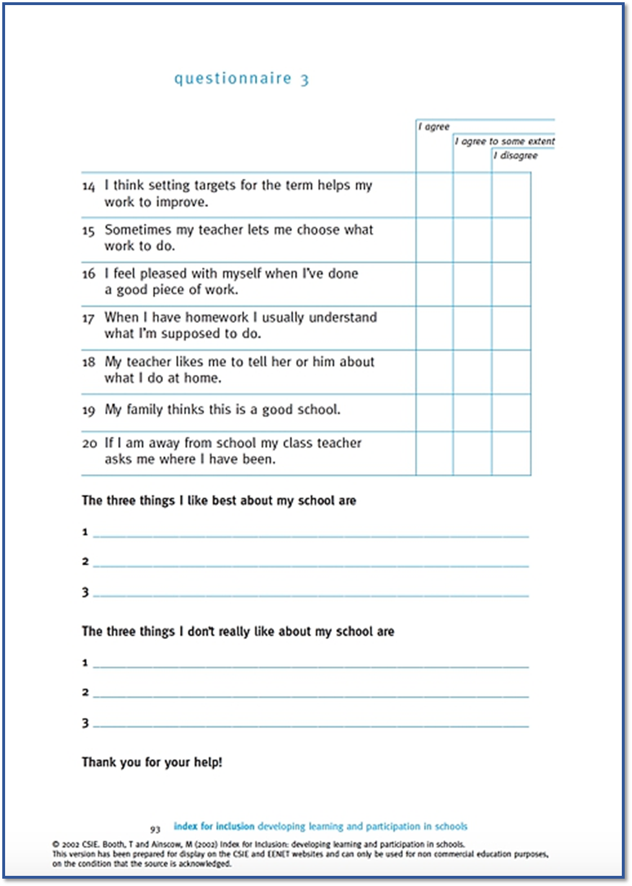
Questionnaire for Inclusion

Slide 23
Results of Inclusion Questionnaire
Grade mean score | Question1-9 & 12-20 | Questions 10-11
Four | 1.53 | 1.25
Five | 1.56 | 0.10
Six | 1.79 | 0.21
Results: Generally children tend to agree that they are included in the school life since the mean scores are near to 2 which was a sign of agreement. For questions 10-11 “Some of the children in my class call others by unkind names”, “Sometimes I am bullied in the playground”, we can see that there is a problem with the fourth grade.

Slide 24

What do I like in my school?
Art, Maths, PE
My teachers
Kids are helpful
Football
The competitions
The time in my class
My lot of friends
Teachers are helpful
The games
When parents come to school to do kepab
The trips
The breaks
When they judge me fairly
When I help my teacher
When I do things for the environment
The big garden
The small number of students in class
The daily program with games
The Erasmus program
When we try to do the school better

Slide 25

WHAT I DON’T LIKE ABOUT MY SCHOOL?
When we fight…
When they I am bullied…
When we pollute the environment…
When I lose my break…
When some teachers shout…
The fact that there no nets in the football goal posts…
The tests…
That I would not go to Finland…
That in the afternoon some people come in the school and do gratifies e.tc.
That some teachers show preference to some students…
I don’t like that we only have basketball and football pitch.
That some kids are calling me names
That some teachers are not so strict…
That Mr. S tells me the answers instead of helping me…
When we hit each other…
When I don’t have friends
The delay in the canteen…

