Slide 1
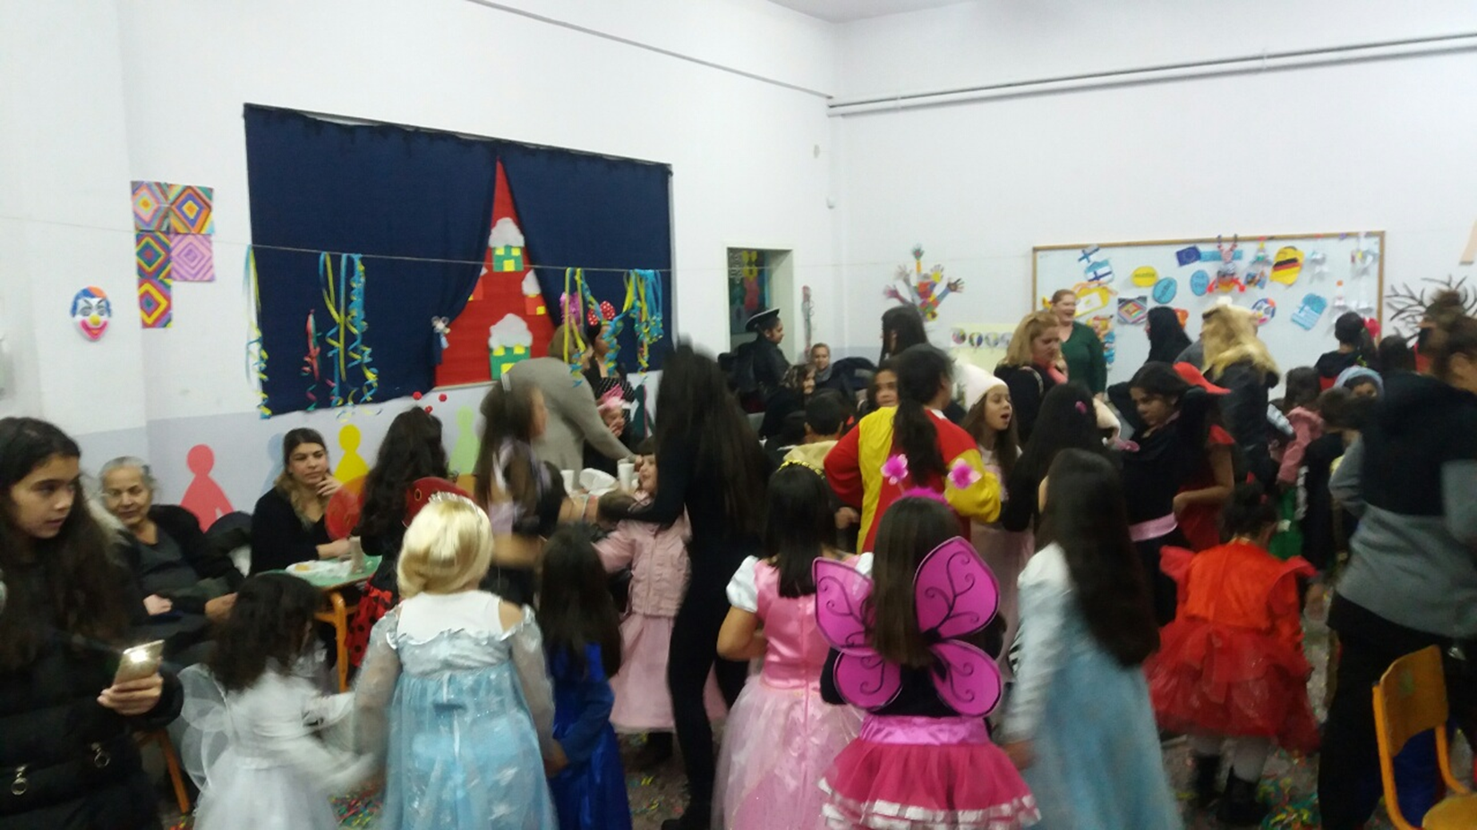
CARNIVAL FANCY DRESS PARTY-2ND PRIMARY SCHOOL/SERRES-FEBRUARY 7TH 2018
On February 7th the Parents’ Association organised
a Fancy Dress Party at school

Slide 2
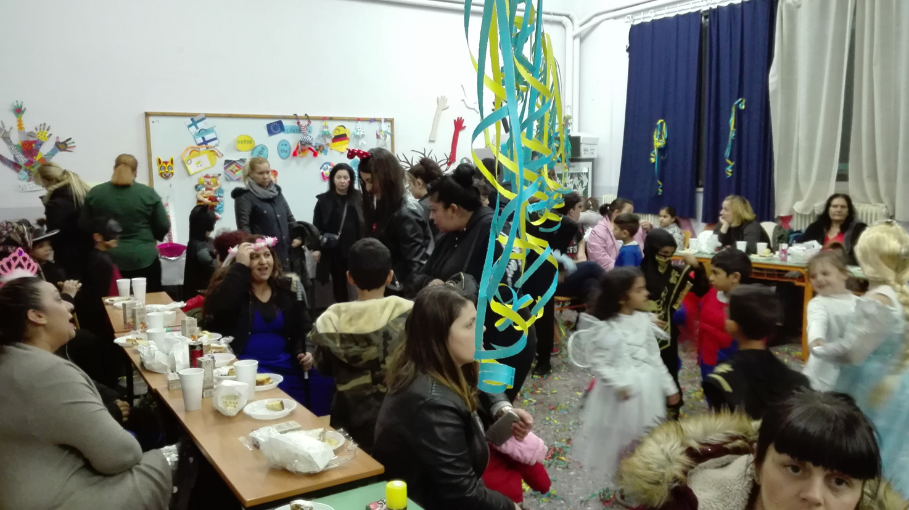

Slide 3
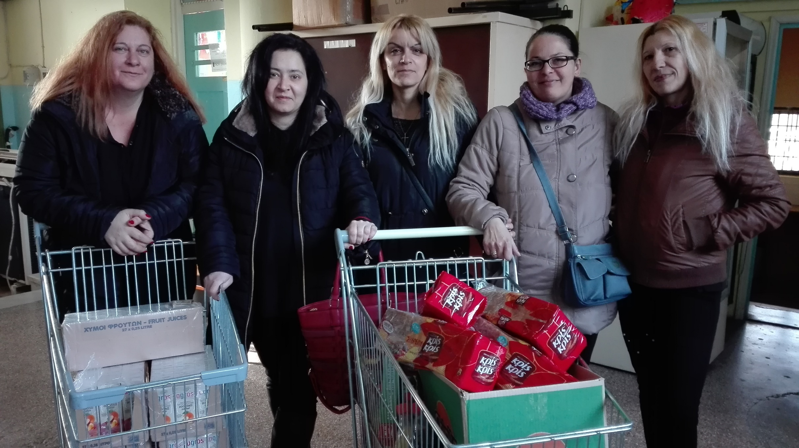
Our mothers prepared the buffet and decorated the room

Slide 4
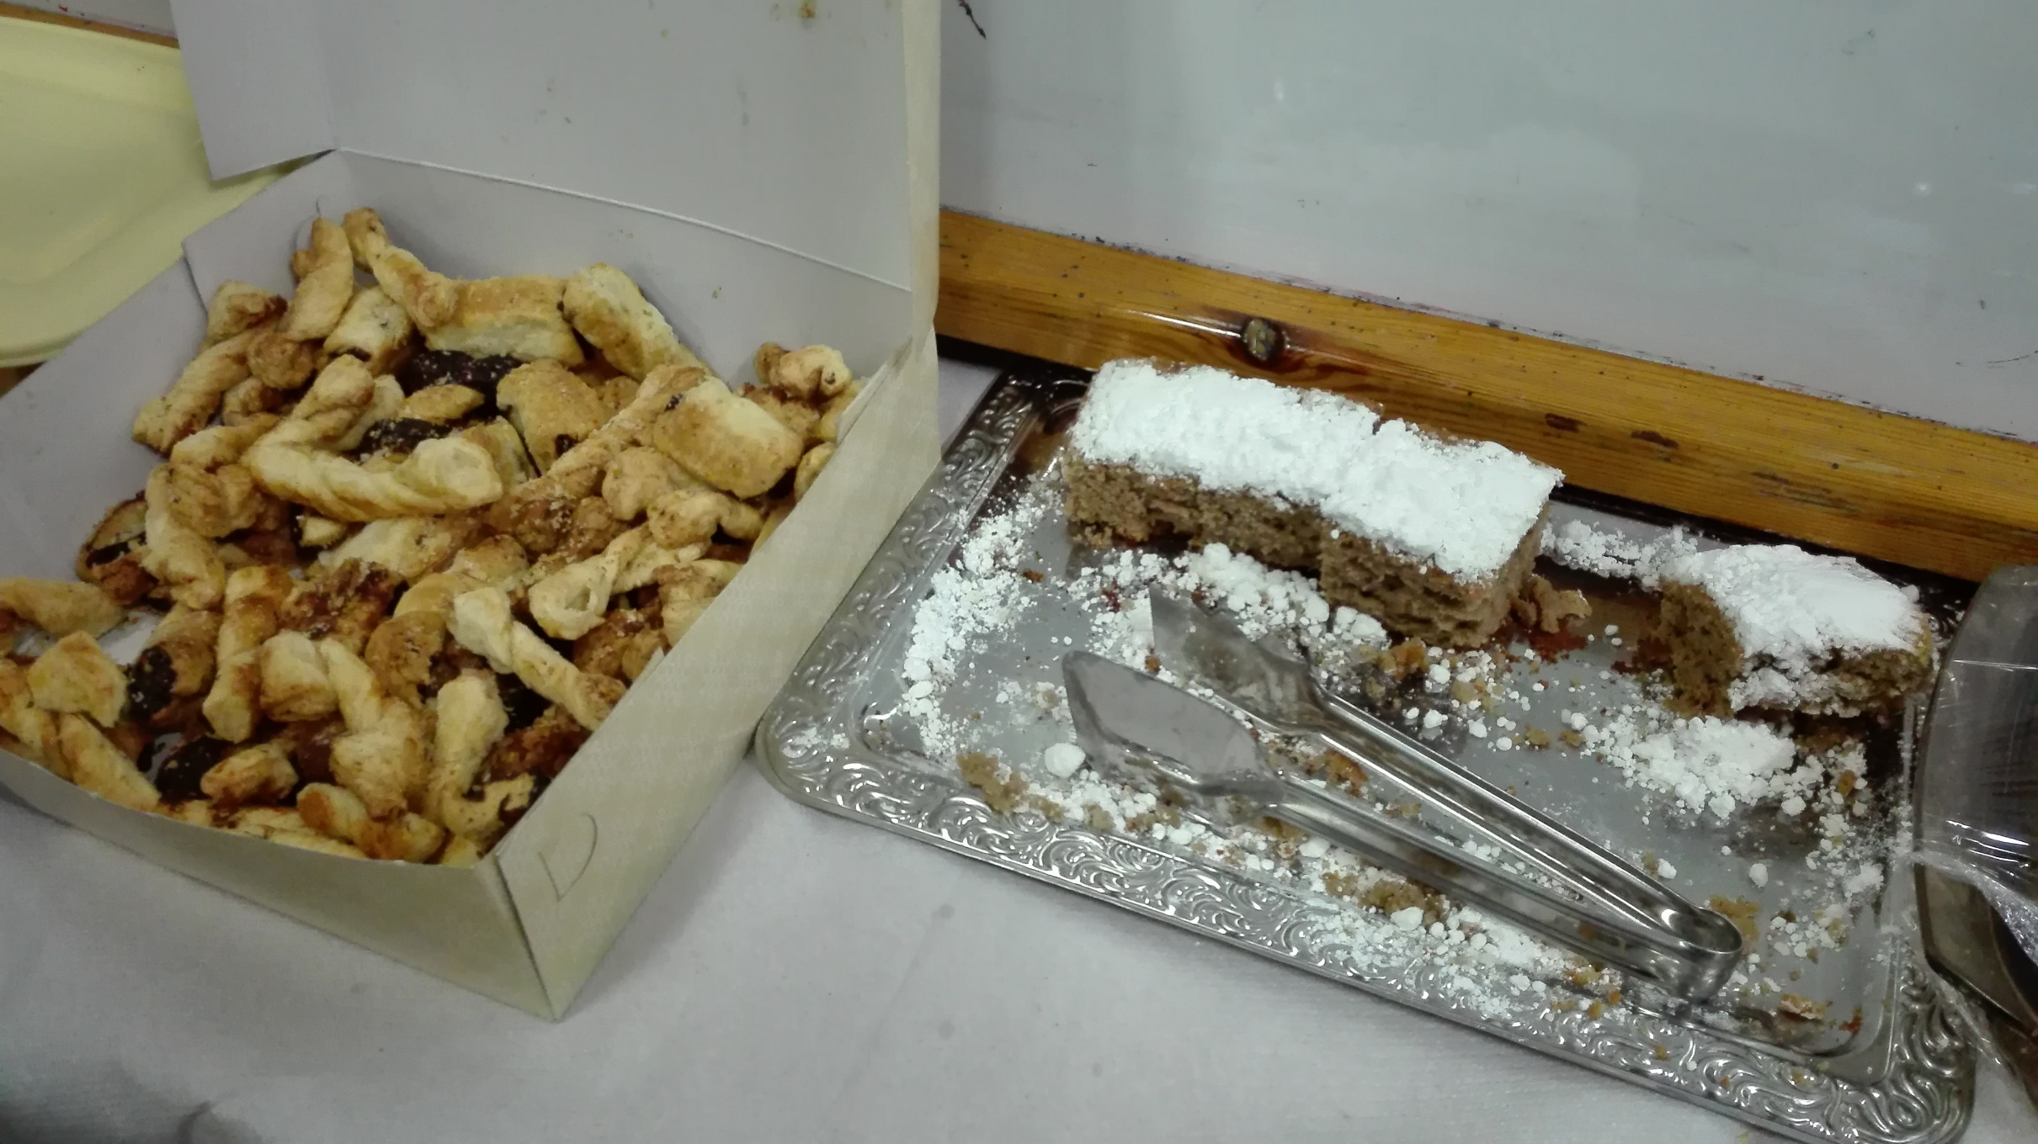

Slide 5
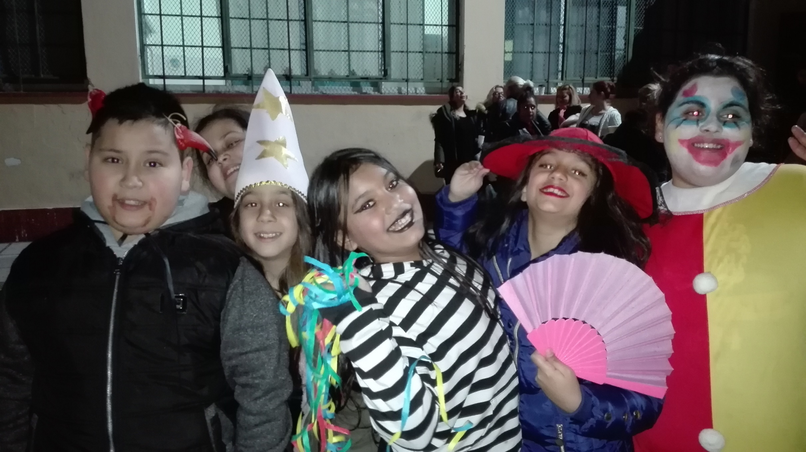
We put on our fancy costumes

Slide 6
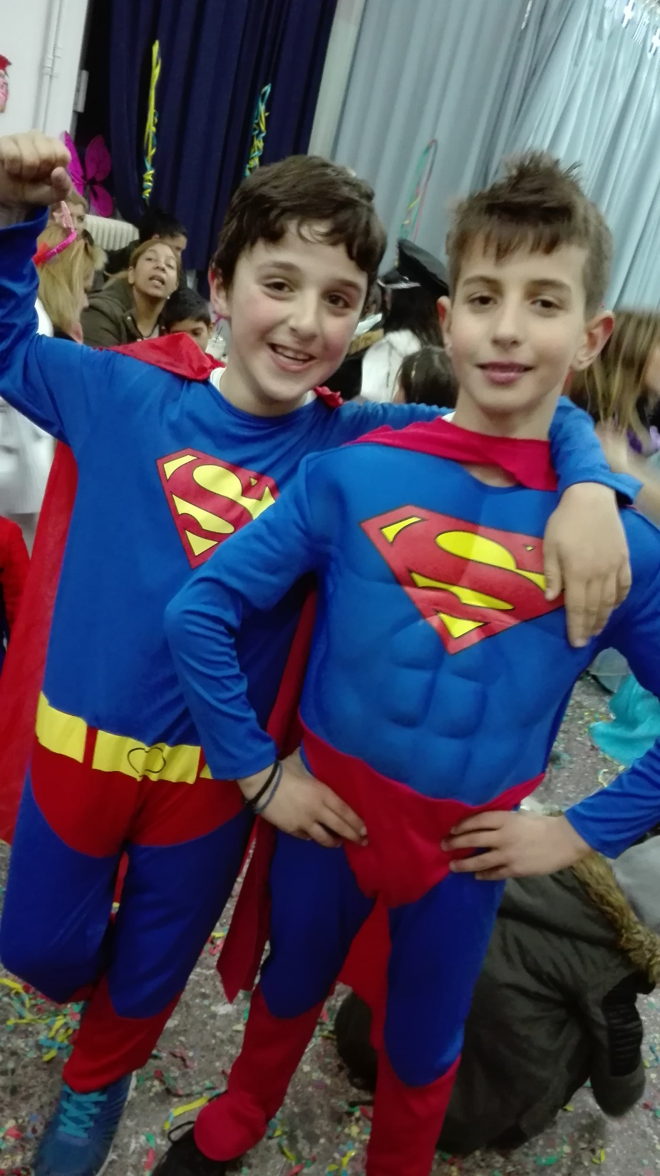
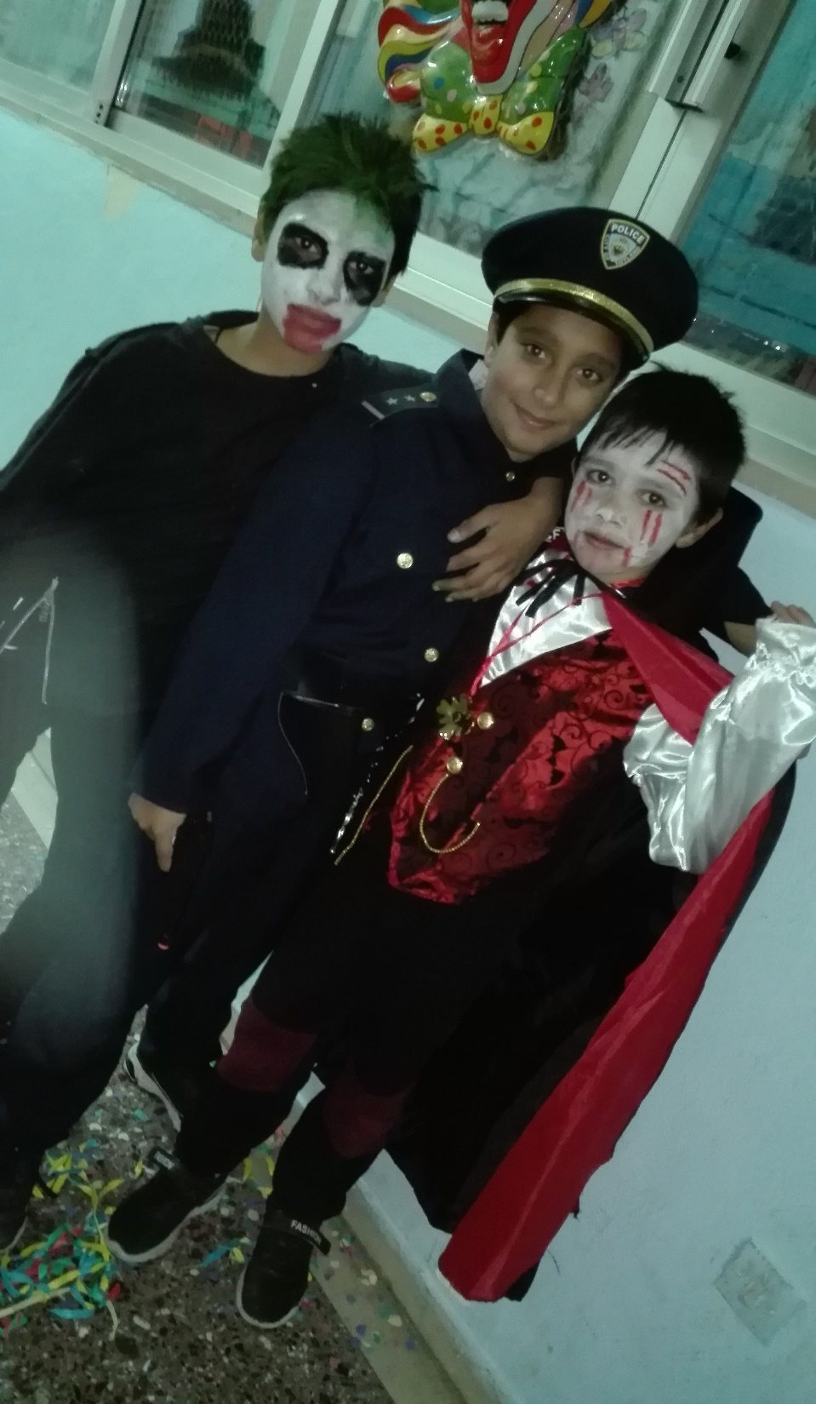
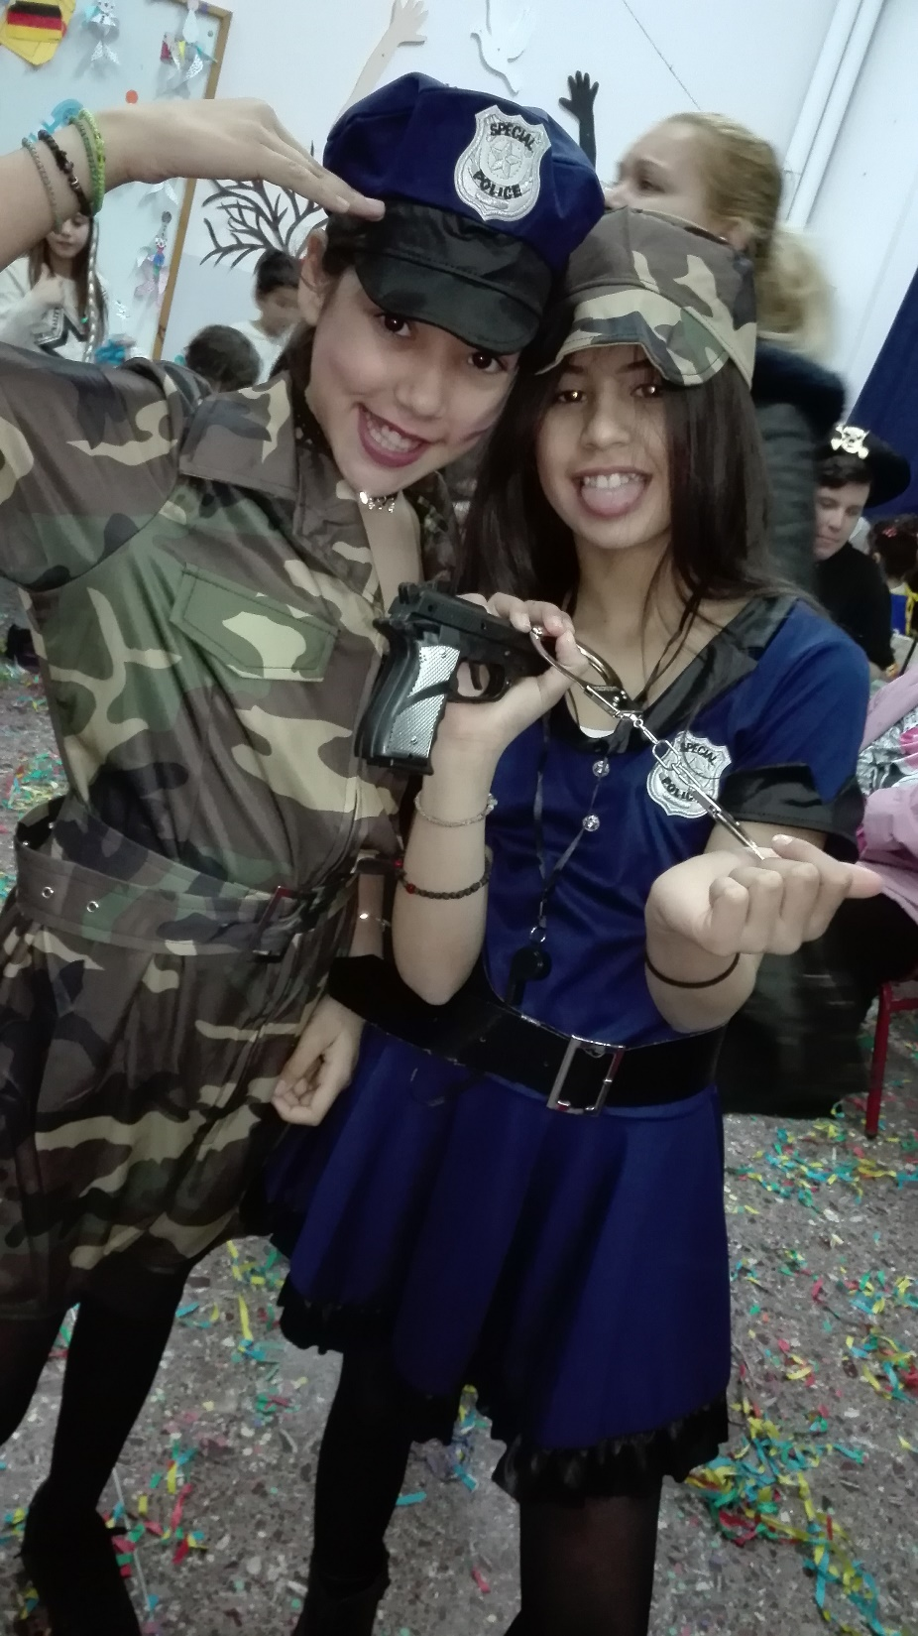

Slide 7
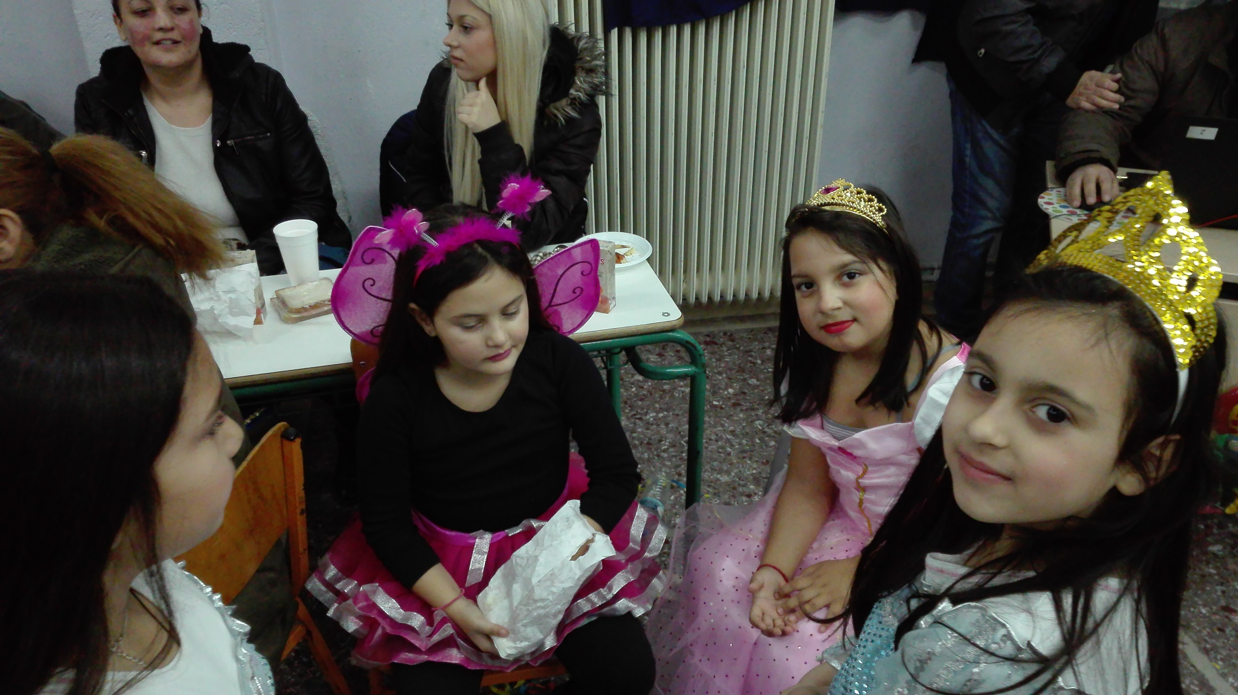
We talked

Slide 8
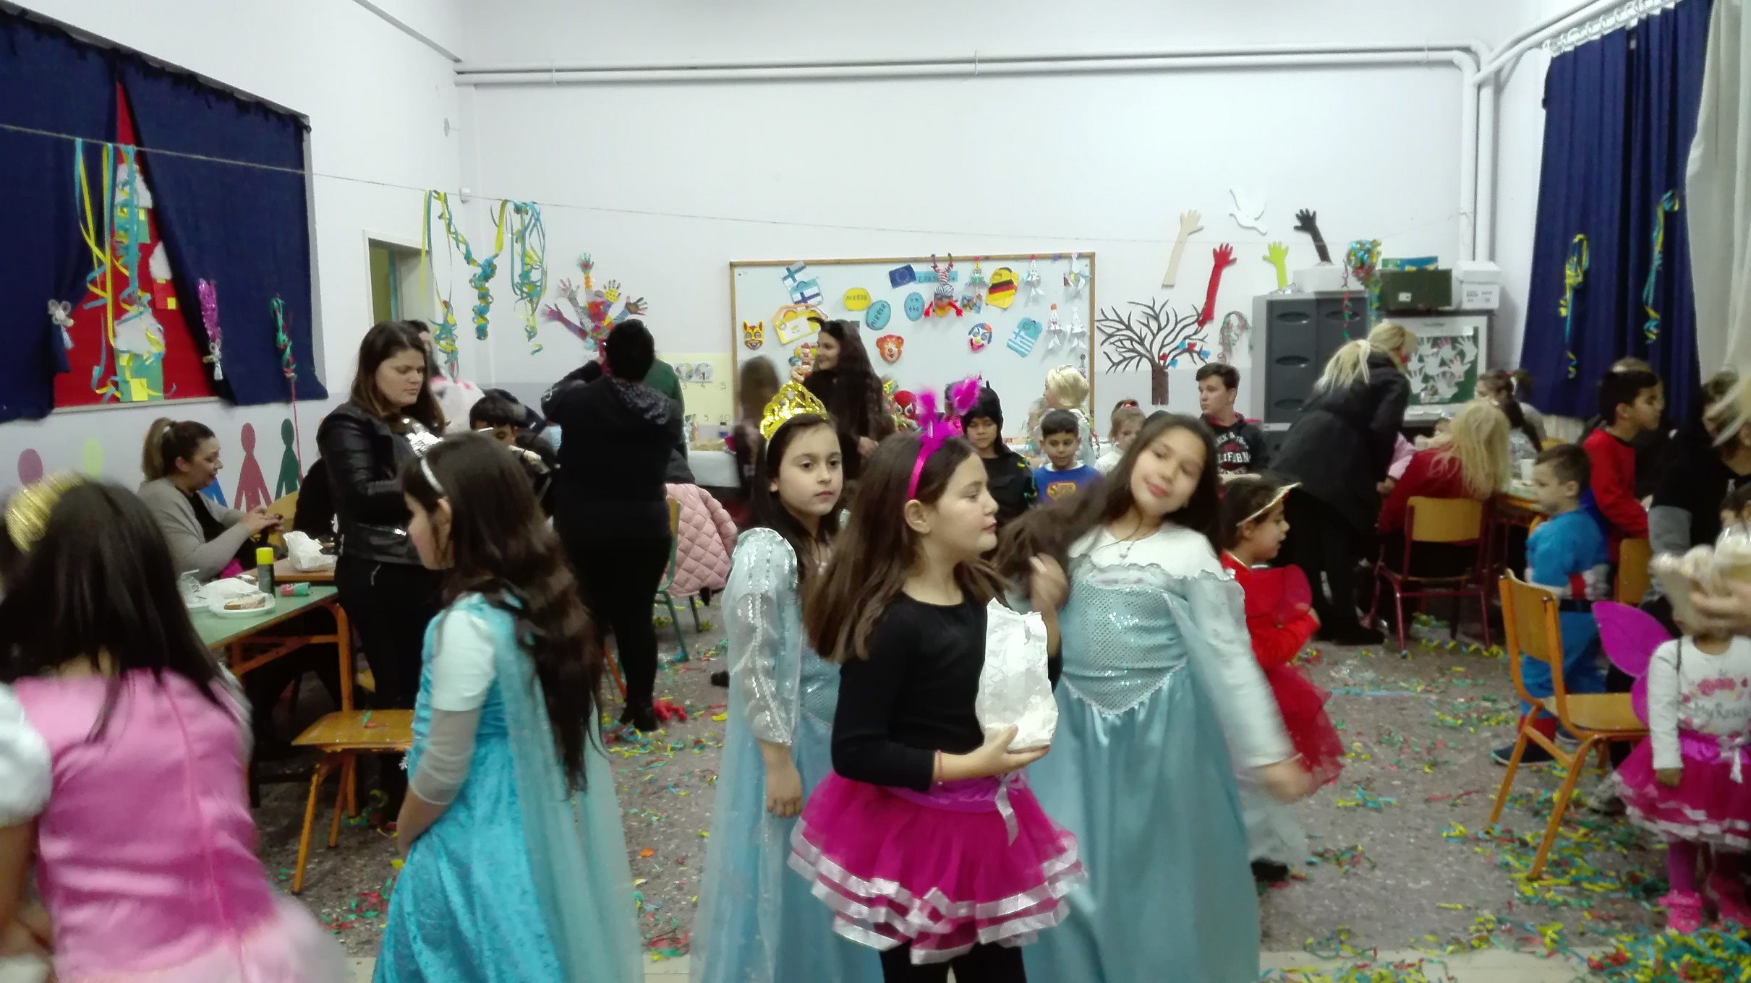
We danced

Slide 9
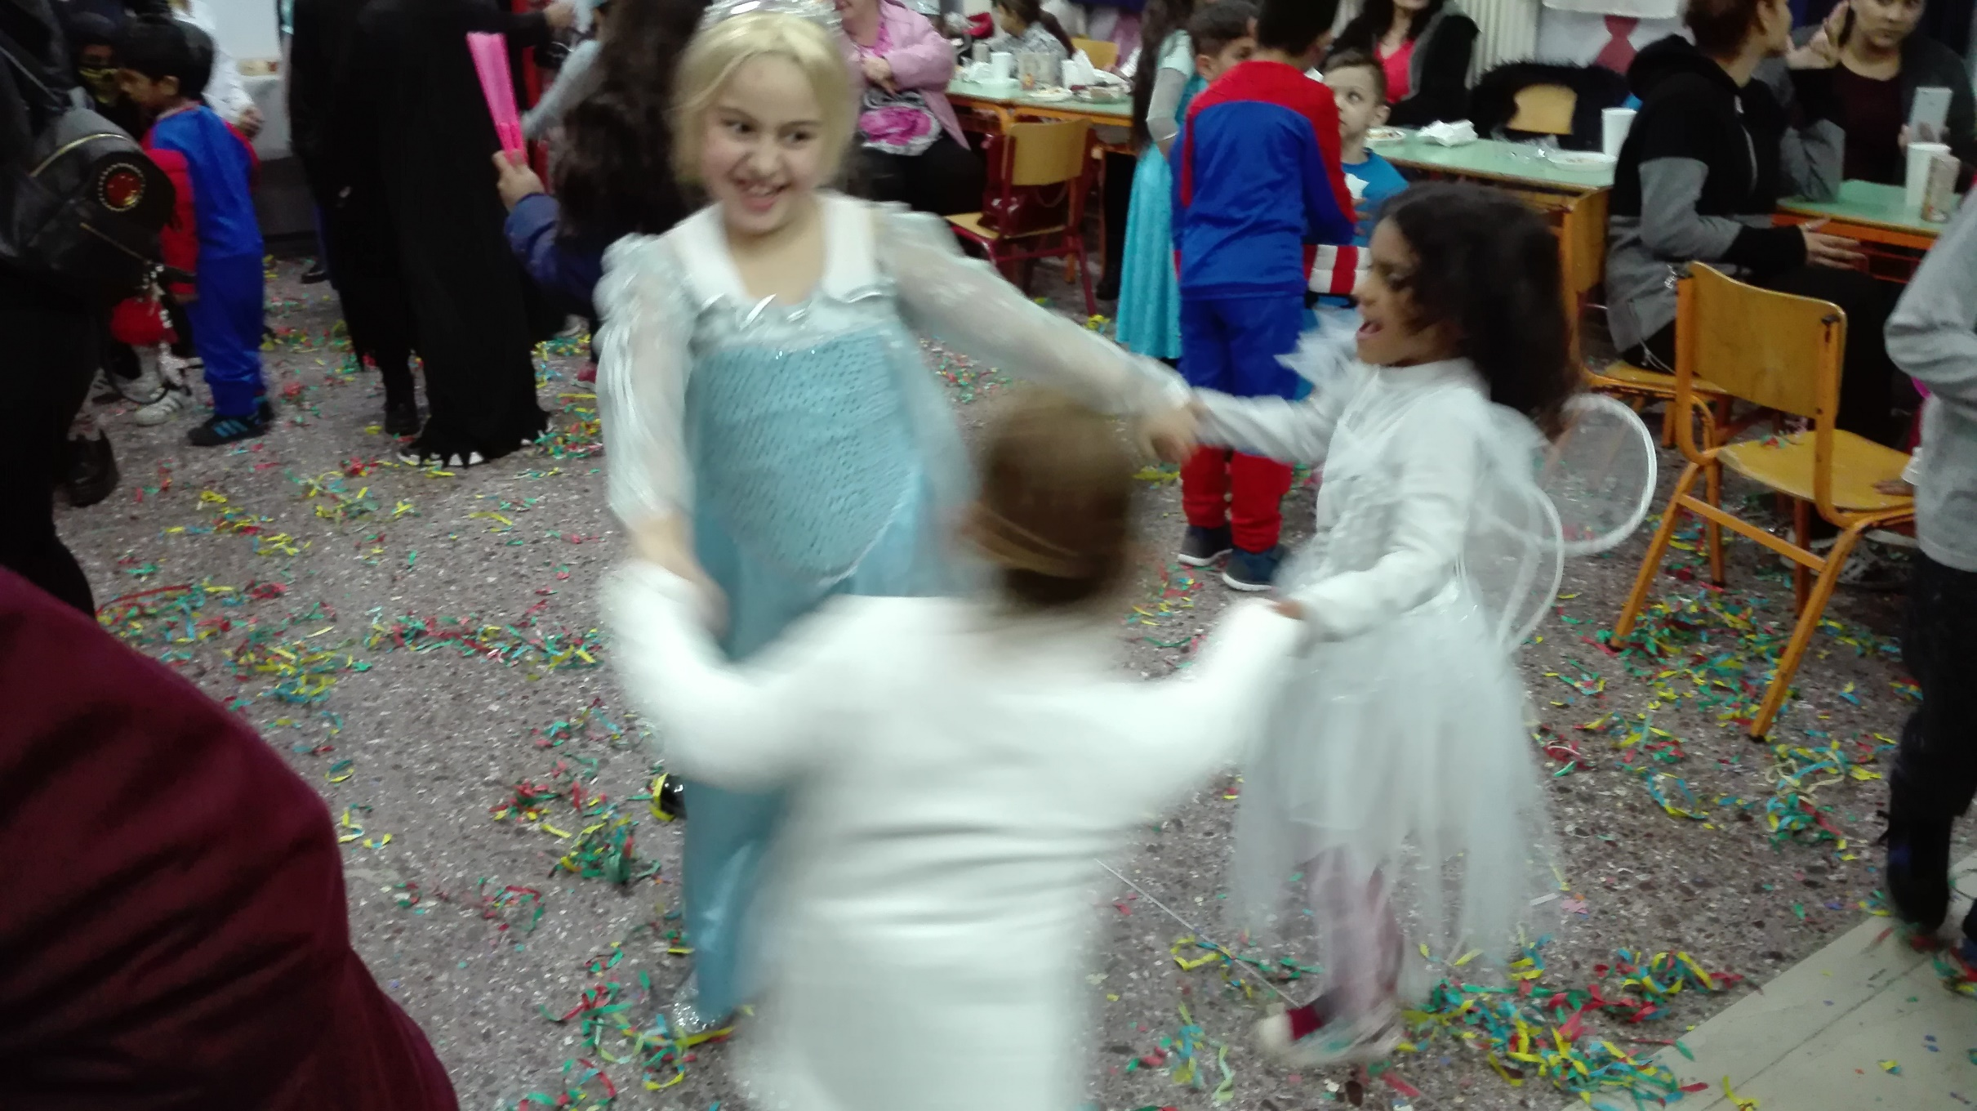
We laughed

Slide 10
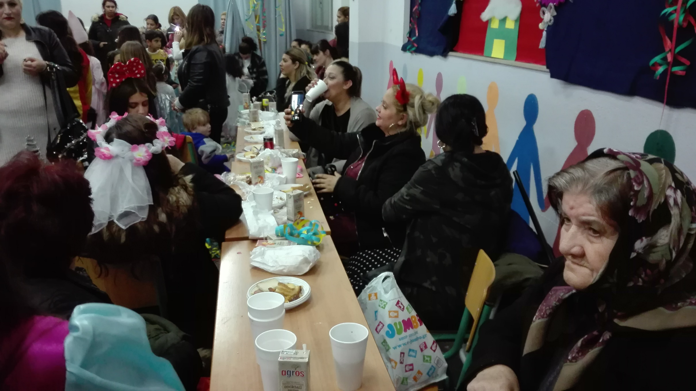
We had fun with parents, grandparents, teachers and friends

Slide 11
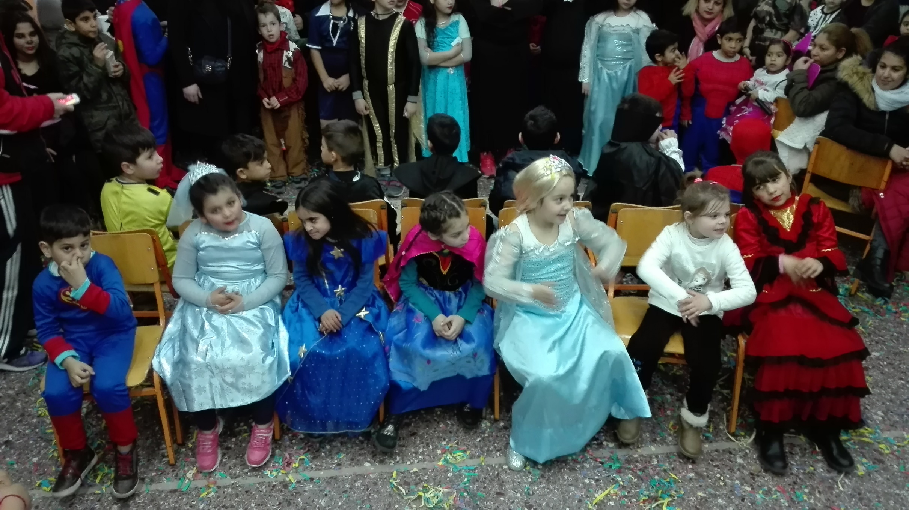
We played games together

Slide 12
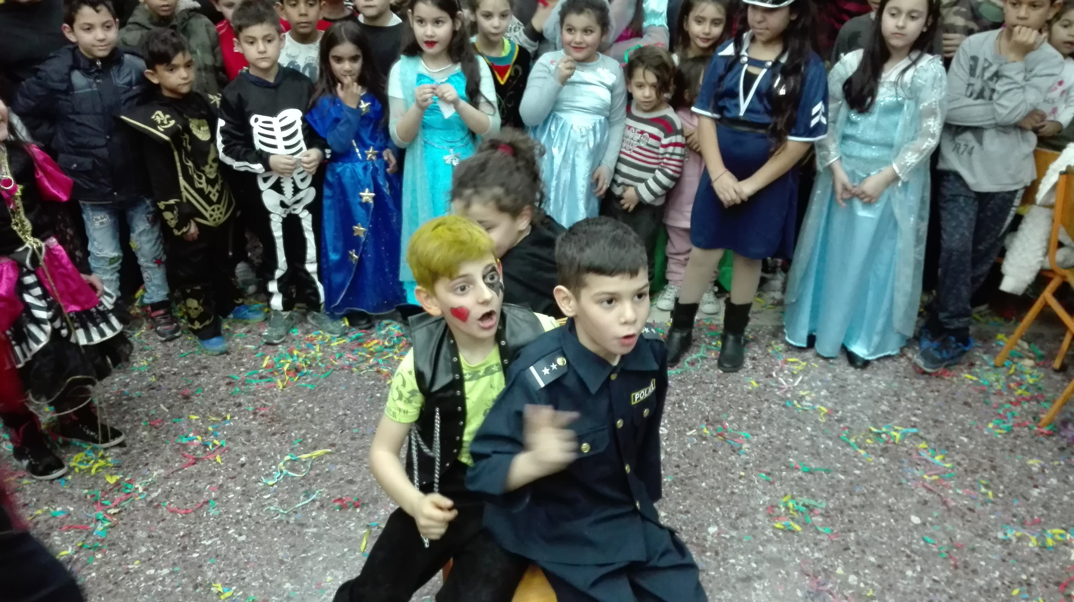
…like “Musical Chairs”

Slide 13
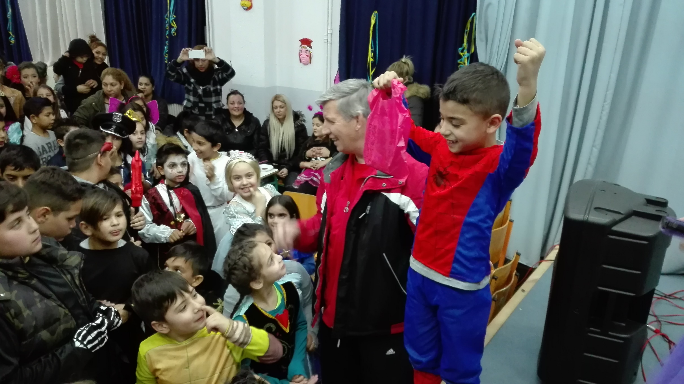
The winners took presents

Slide 14
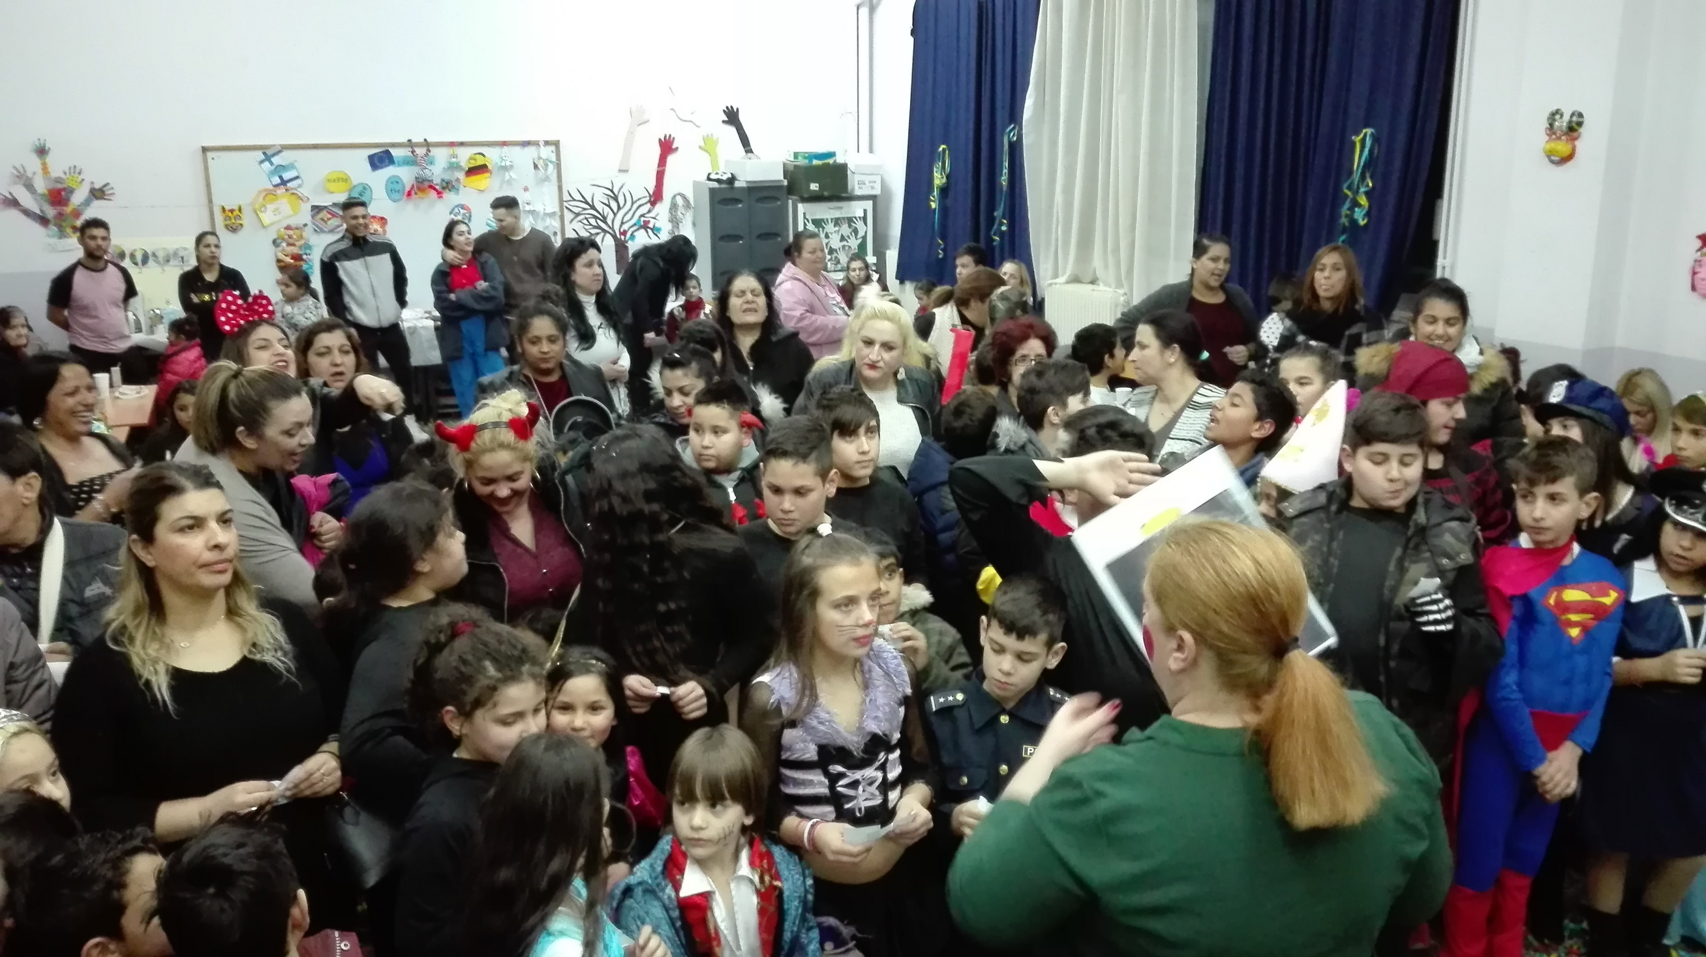
There were presents for all the children

Slide 15
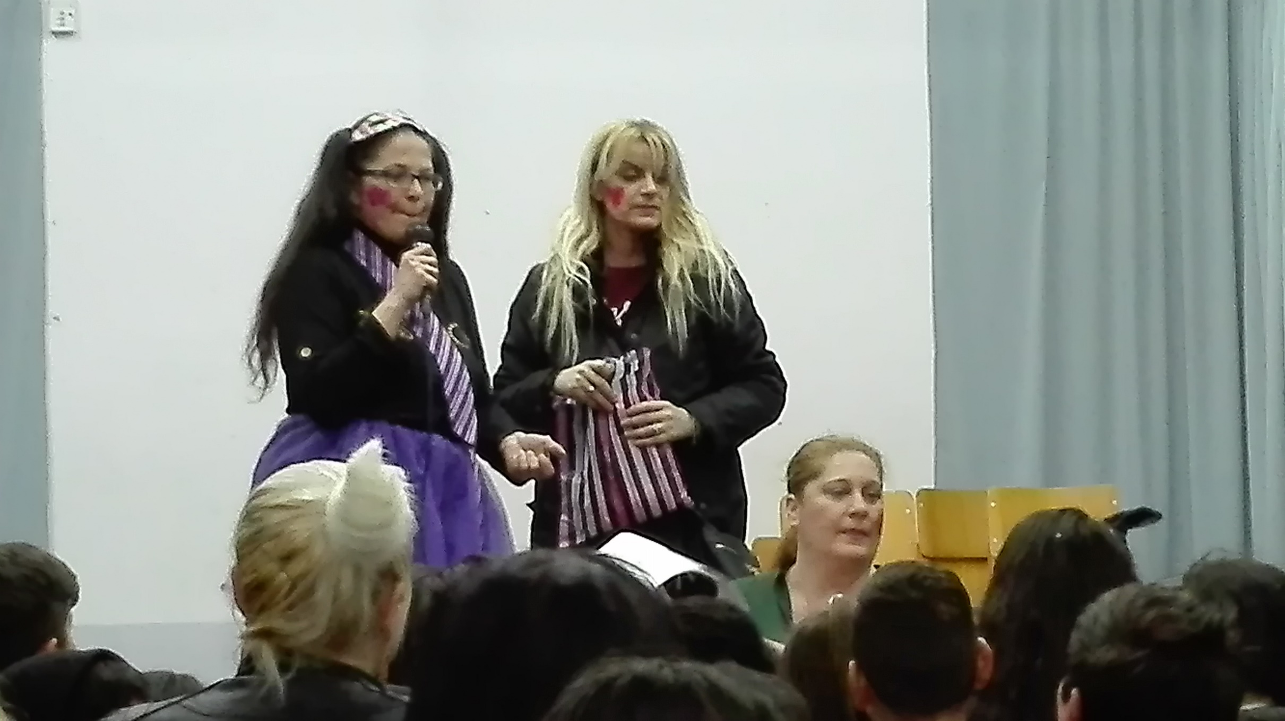
We thanked our parents for this wonderful party

