Slide 1
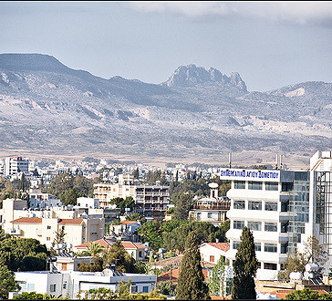
Our community
Ayios (Saint) Dometios

Slide 2
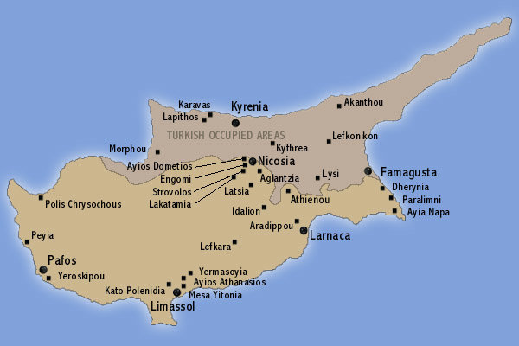
Location

Slide 3
City | Nicosia (capital)
Population | 12.456 (2011)
Area | 12 km²
Altitude | 160 m

Slide 4
Ayios Dometios is a suburb located west of the Cypriot capital Nicosia.
It has a population of 12,456 (2011 census) making it one of Cyprus' biggest municipalities. There is also a population of 2,314 within the area of Ayios Dometios under Turkish control.
Ayios Dometios became an independed municipality in 1986.
It’s only 3 km from the center of Nicosia.

Slide 5
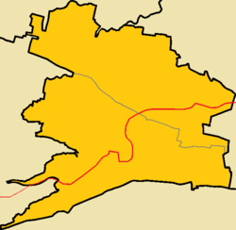
Ayios Dometios is divided into the civil parishes or neighbourhoods of St. George and St. Paul.
Saint Paul
Saint George

Slide 6
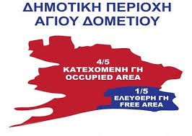
After the turkish invasion of 1974, the biggest part of Ayios Dometios is in occupied area.

Slide 7
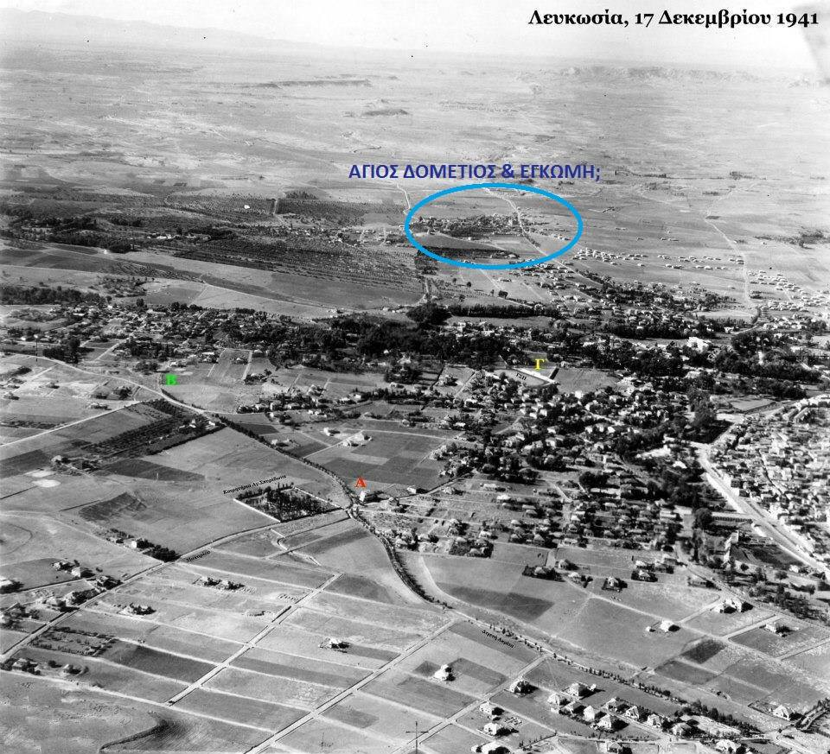
History
Ayios Dometios, has existed since ancient times as a small village, located 4 kilometres west of Nicosia.
Mention of Ayios Dometios comes from as early as the Franks era (Lusignan Period 1191–1489).

Slide 8
Our community is named after St. Dometios of Persia who originated from Persia in the 4th century AD and who became Christian later in his life. He lived in a cave in Mesopotamia and converted many people into Christianity. He died around 362 μ.Χ.
The name

Slide 9
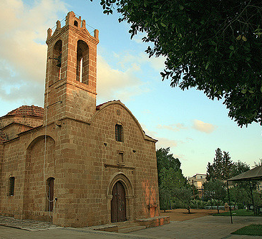
Ayios Dometios is currently home of three Christian-Orthodox churches. The church of Ayios Dometios was built in the 17th century and is dedicated to the Saint Dometios. It's built on a small hill overlooking the old part of town and is one of the town's main attractions.
The churches

Slide 10
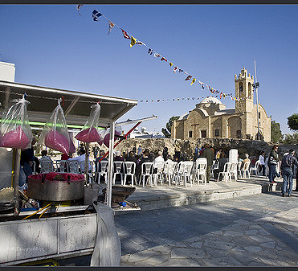
A fair in the church of Saint Dometios

Slide 11
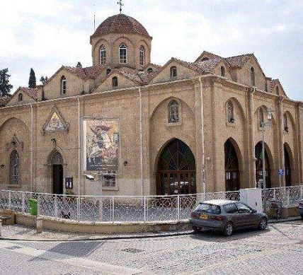
The church of Saint George It is situated in the center of the community. It is made of stone and it was built in 1902.

Slide 12
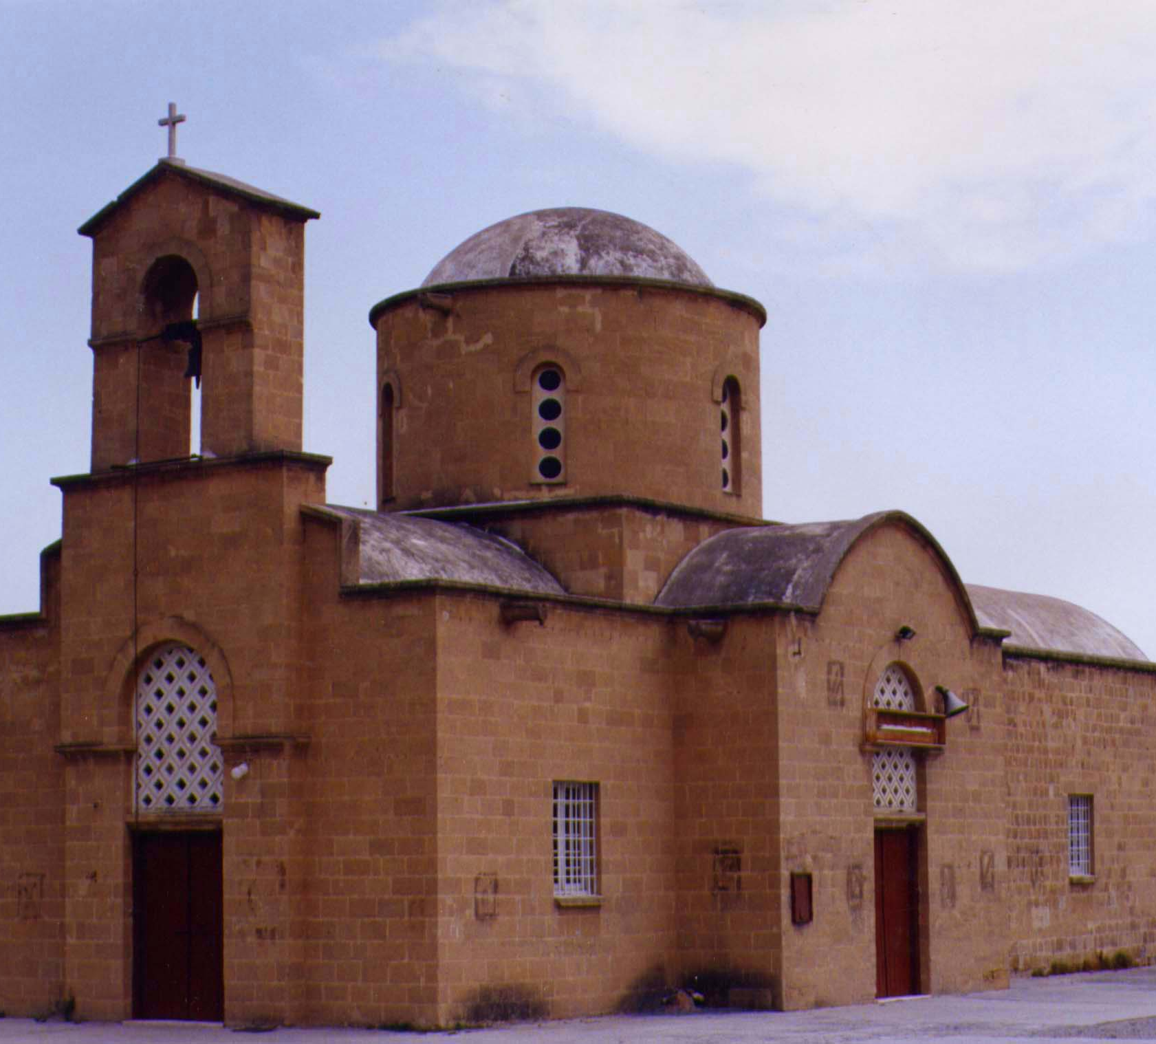
The old church of Saint Paul
The old church of St. Paul is a domed basilica, made of stone. This church was built in 1805, by Dragomanos of Cyprus, Hatzigiorgiakis Kornesios.

Slide 13
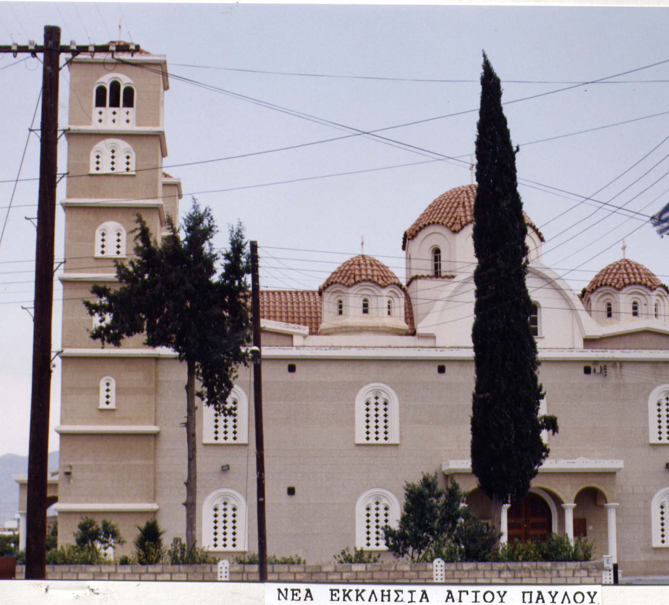
The new church of Saint Paul
It was built in 1985, following a need for a larger church.
The church was build in honor of Apostle Paul and is of Byzantine style.

Slide 14
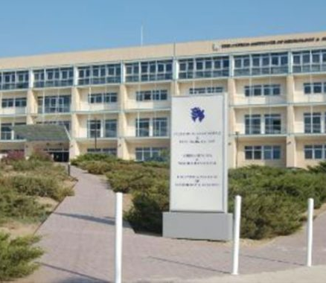
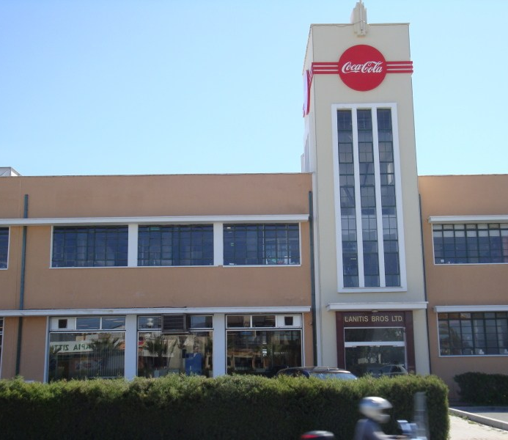
Interesting sites
The Cyprus Institute of Neurology and Genetics is located in Ayios Dhometios on the Kolokassides roundabout.
The island's Coca-Cola factory is located in Ayios Dhometios, on the edge of the Engomi industrial area. Lanitis juices and milk products are also produced in the factories compound.
Ayios Dhometios has four parks. The Missing in Action park, which is dedicated to the Ayios Dometios residents that went missing during the Turkish Invasion and are still missing and is located opposite the Coca-Cola factory, the Ayios Dometios park which is located near the checkpoint into the occupied area, the Ayios Pavlos park which is near the Junior High and the newest built park which is dedicated to the National Guard, and is also near the Junior High.

Slide 15
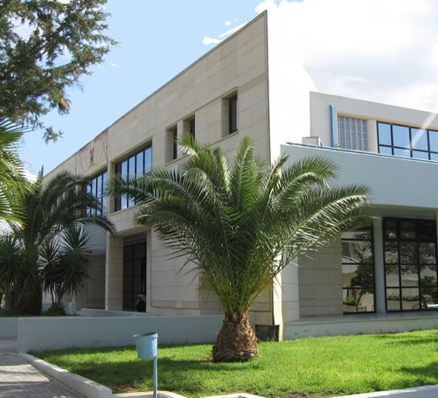
The town hall of Ayios Dometios

Slide 16
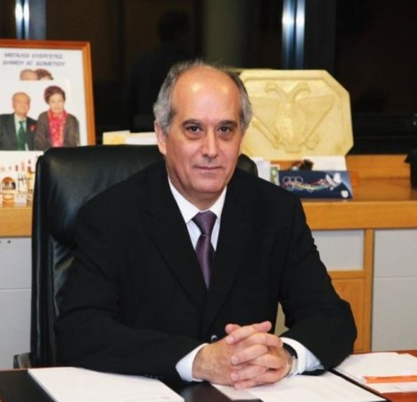
The mayor is elected directly by the people in mayor elections that take place every five years. This is the current mayor, dr Costas Petrou

Slide 17
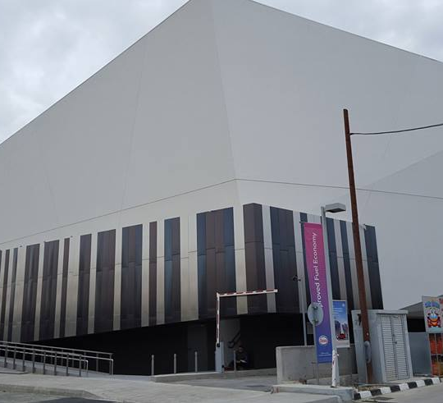
The Indoor Stadium

Slide 18
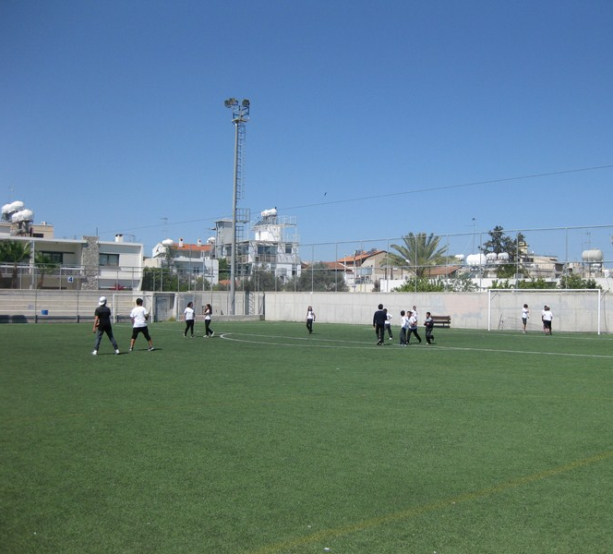
The Οutdoor Stadium

Slide 19
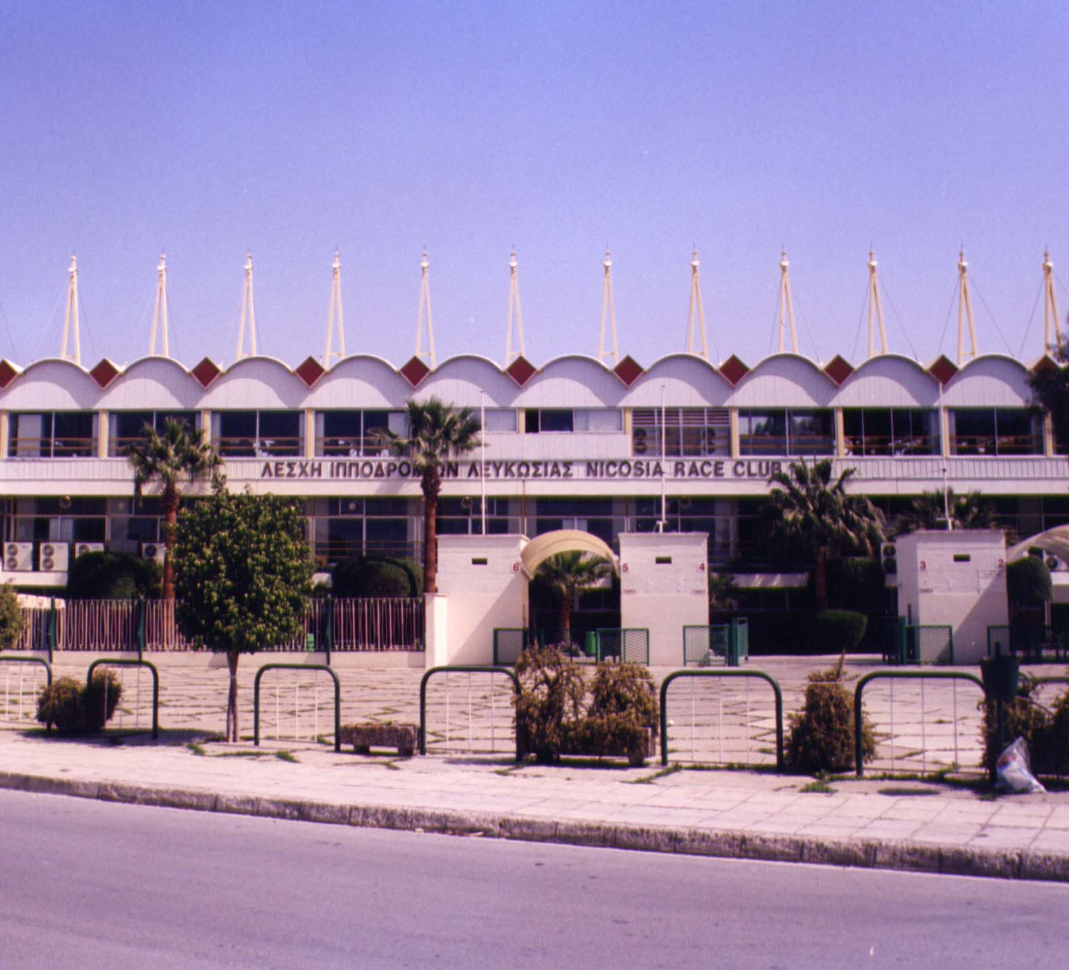
Nicosia’s Racing Club The Nicosia Race Club is the only organization in Cyprus authorized to organize horse races. It is based in Ayios Dometios since 1940.

Slide 20
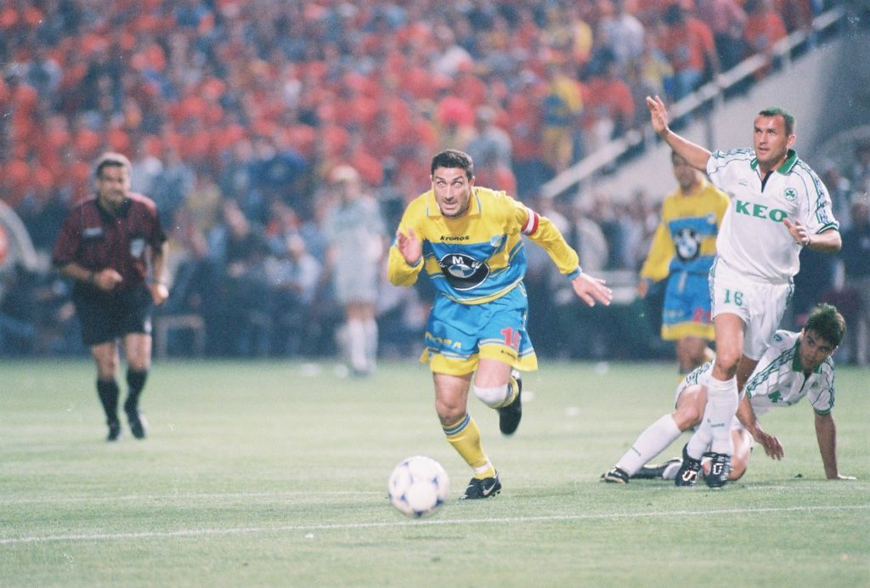
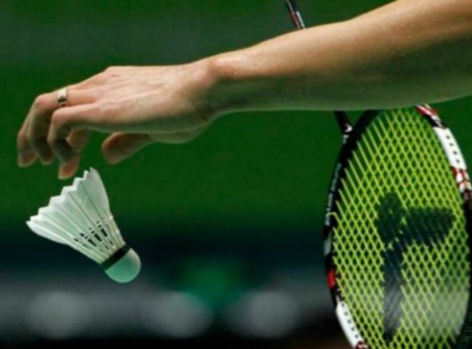
athletes
Ayios Dhometios has a long tradition in sporting events. Some of the countries best athletes originate from the community’s many sporting clubs. George Anastasiades, current captain of the National Basketball Team, Christos Stylianides, all time legend of Cyprus basketball and Yiannos Ioannou, former captain of the National Football Team all come from Ayios Dometios. Dometia and Maria Ioannou, the country's two best female Badminton athletes also live in Ayios Dometios.

Slide 21
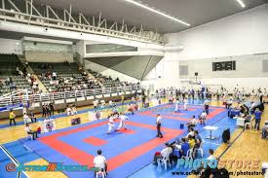
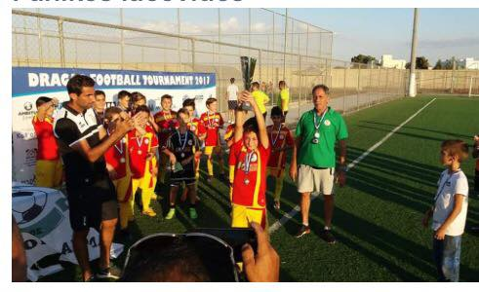
Teams and sports
ENAD Ayios Dhometios
ENAD was created in 1937 and is one of Nicosia's leading Basketball clubs.
Mavrommatis Ayios Pavlos
A handball and table tennis club, Mavrommatis has a good appearance in those above sports.
EAS Ayios Dhometios
Cyprus' major sport is football and Ayios Dometios has a team in that sport also. EAS plays in the amateur ranks of the Nicosia league. EAS' cycling team is also one of the countries elite.

Slide 22
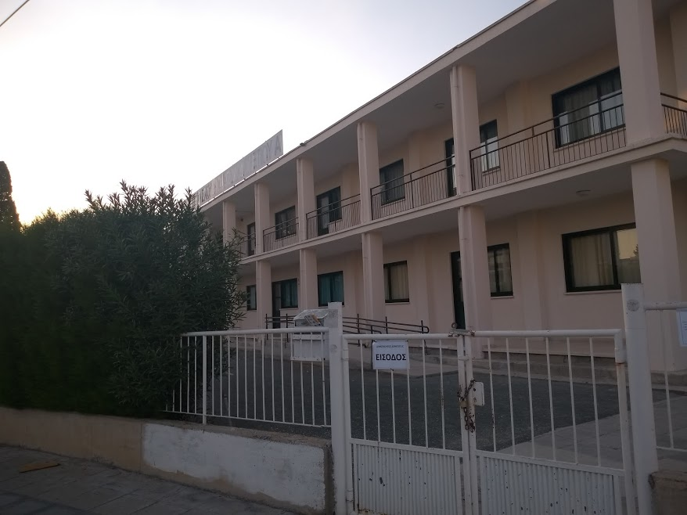
Education
Ayios Dometios І
In 1926 the first mixed elementary school began operating in Ayios Dometios.
The 1st Public Kindergarten shares the same building facilities.

Slide 23
Ayios Dometios ІІ
It started its operation with the independence of Cyprus. It worked for the first time with 338 children and 9 teachers.
The 2nd Public Kindergarten shares the same building facilities.

Slide 24
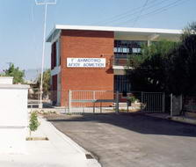
Ayios Dometios ІІІ, our school
It began its operation in 1960-1961. During the period of the Turkish invasion, the school building suffered great damages from guns and munitions and was closed for one year. After its reopening, men of the Peace Force patrolled the courtyard of the school. The school yard borders the buffer zone.
The 3rd Public Kindergarten shares the same building facilities.

Slide 25
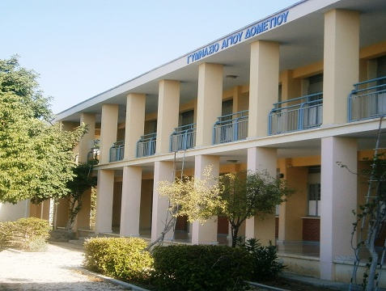
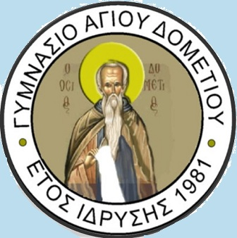
Ayios Dometios Junior High School
It began its operation in the school year 1981-1982, at the location of Ayios Dometios ІІІІ Elementary School. A new building for the junior high was being built and was ready in June 1974, but the Turkish troops took control of the new building.

Slide 26
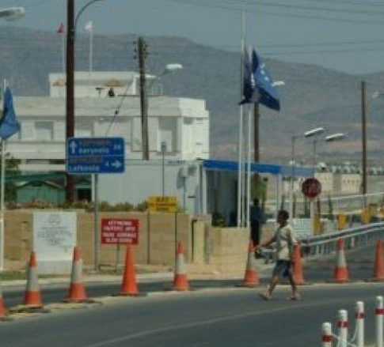
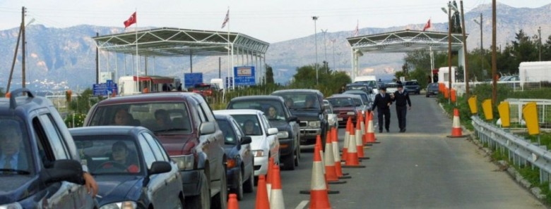
Since 2003 and the opening of the border, Ayios Dometios is the site of the island’s most important checkpoint in Cyprus, through which thousands of Greek Cypriots and Turkish Cypriots pass over the line every day.
The checkpoint

Slide 27
Services of the municipality
Office of public service
Secretary
Technical services
Financial services
Health services
Cultural and Social services

Slide 28
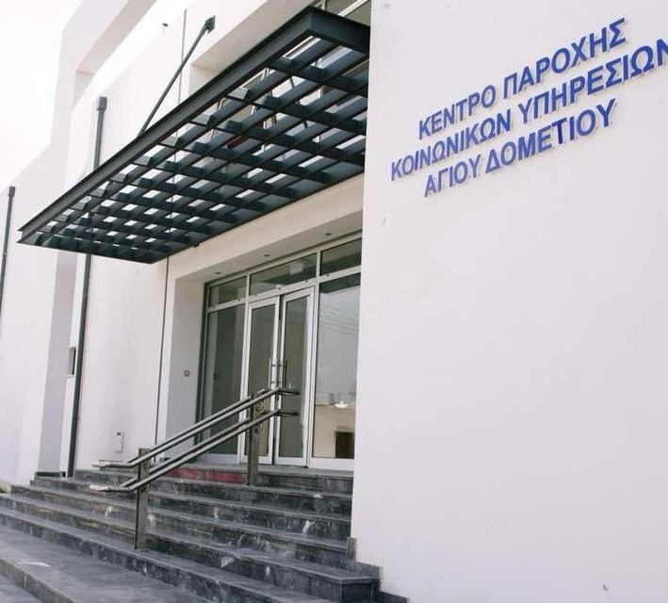
Social services center
It was launched in September 2005. The center operates the program "Daily Care for the Elderly (Adult Center)" and "Children's Club".

Slide 29
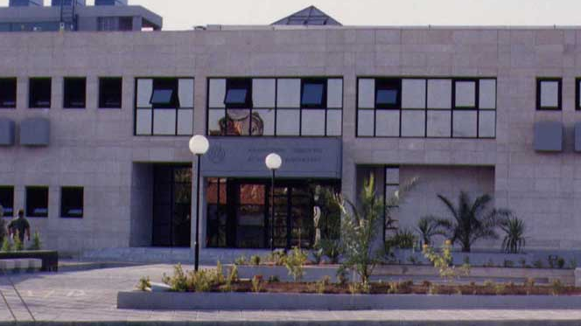
municipal library
The library is housed in the town hall and it functions as reading and lending library.

