Slide 1

3-step support system
Sanna Alalauri 2018

Slide 2
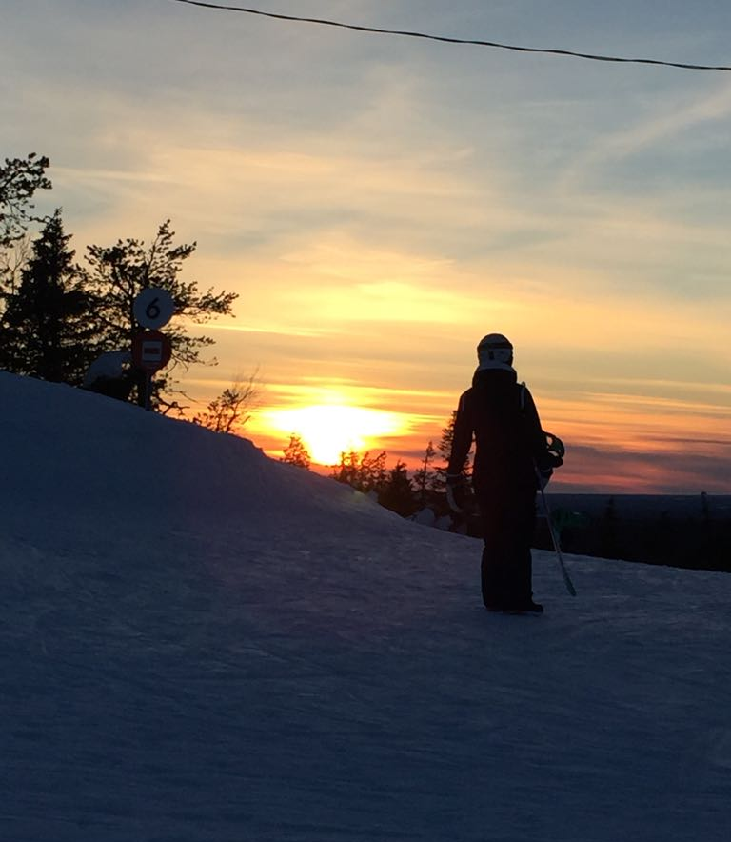
1. General support
All students are in general support.
General support contains:
- teacher's aid
- assistant's aid
- special education teacher's aid
- support education and differentiation
- pupil is studying in a big/ general teaching class.

Slide 3
When a pupil needs more support
Learning disabilities
Adhd/ add
Asperger syndrome
Disability
Challenging behavior
Poor school motivation

Slide 4
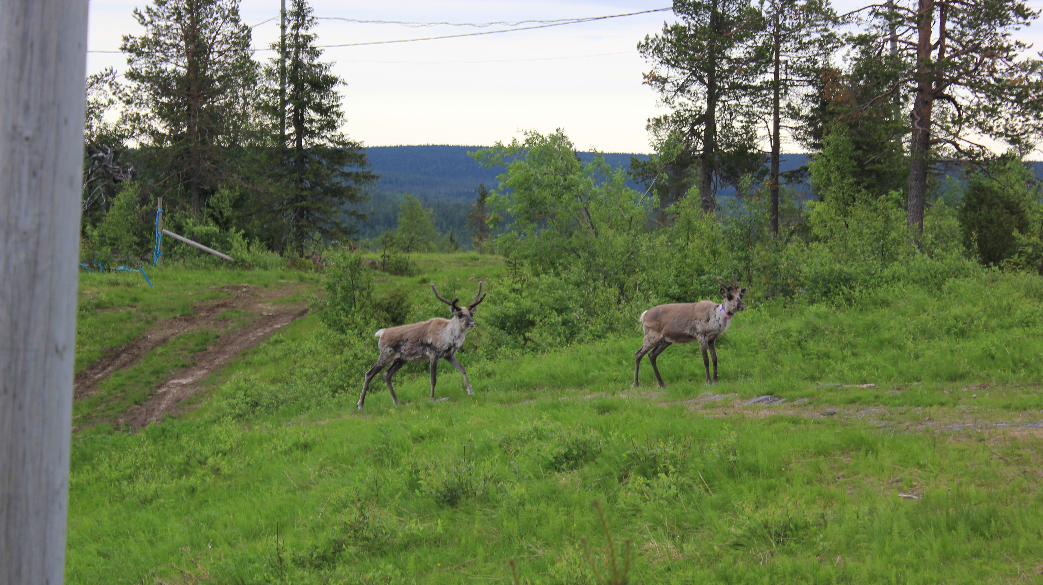
Pedagogical evaluation
If the pupil needs more support the, teacher and special education teacher co-operate with the pupil and parents and make a document called pedagogical evaluation
P.E. contains information about:
- the pupil's strengths and challenges
- what things help a pupil to learn
- what support resources could be used

Slide 5

Student welfare group
Principal or vice principal, special education teachers, school psychologist, school nurse and doctor
Sometimes there are visitors like therapists, other teachers and parents.
Organized and regular meetings once a month
Also when there's need for meeting
Preventive work
Decision making and consulting

Slide 6
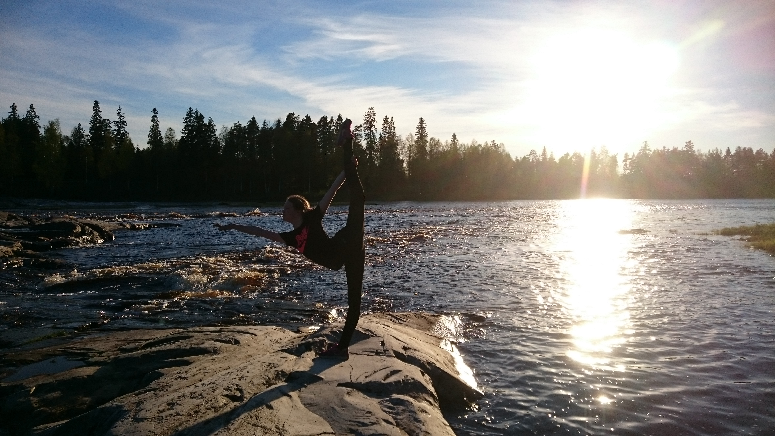
Intense support
After making pedagogical evaluation pupil can be moved to intense support, if needed.
Intense support contains:
- teacher's aid
- more support and help from assistant
and special education teacher
- support education and differentiation
- pupil can be studying in a small group for some subjects.
- pupil can have own goals, methods and learning tools

Slide 7

Learning plan
When a pupil moves to an intensive support, teachers co-operate with the pupil and parents and make a document called learning plan.
Learning plan includes:
- the pupil's strengths and challenges
- what things help a pupil to learn
- pupil's own goals
- what support resources could be used
- what learning materials are going to be used
- how the evaluation is going to be made

Slide 8

Pedagogical statement
If the pupil needs more support than intense support a teacher and a special education teacher co-operate with the pupil and parents and make a document called pedagogical statement
P.S. includes information about:
- the pupil's strengths and challenges
- what things help the pupil to learn
- what support resources have been used
- what learning tools have been used
- pupil's own emphasis areas or goals

Slide 9
Special support
After making pedagogical statement a pupil can be moved to special support, if needed.
Special support includes:
- more special teacher's aid
- more support and help from assistant
- support education and differentiation
- pupil is studying half or more classes in a small group
-> Skills and art subjects are studied in a big/general class
- pupil usually have own goals, methods and learning tools

Slide 10

Individual education plan, IEP
When a pupil moves special support, teachers co-operate with the pupil and parents and make a document IEP.
IEP includes:
- the pupil's strengths and challenges
- what things help a pupil to learn
- pupil's own goals
- what support resources are being used
- what learning materials are being used
- therapies and other professional help
- how the evaluation is going to be made
IEP is checked at least twice a year

