Slide 1
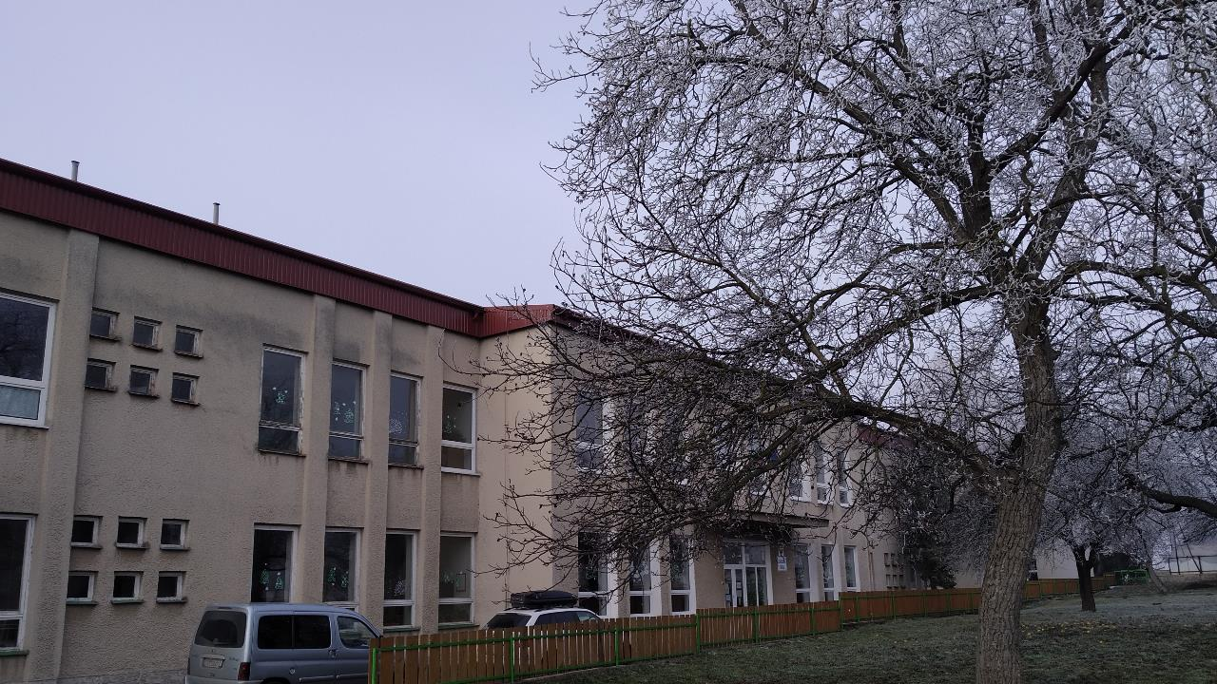
OUR SCHOOL
Základná Škola Trstené pri Hornáde

Slide 2
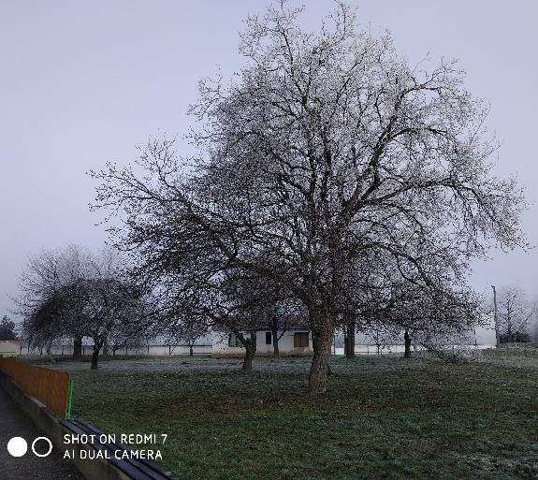
School Garden
Our school has got 2 gardens, the former is in front of the school and the latter is behind the school. In front of the school we´ve got a playground, fruit trees, benches on which we sit during a lunch break. Behind the school we have a small pond, plants, herbs and another fruit trees.

Slide 3
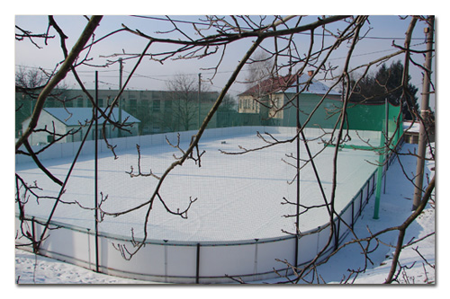
Multipurpose Playground
We also have a multipurpose playground
In fine weather we have physical education classes there
And during the winter we can skate and play ice hockey there

Slide 4
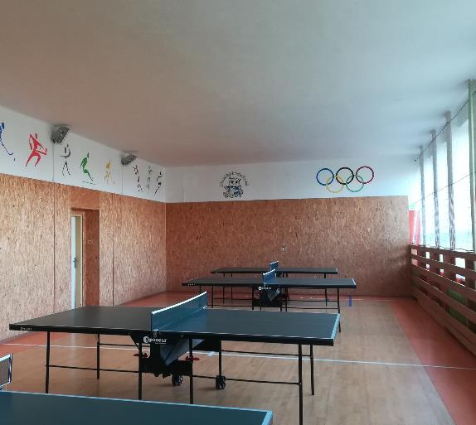
School Gym
It's a place where we can forget about learning ☺
It has undergone various changes from windows to floor replacement. We use it mainly for various sports such as: football, floorball and table tennis.

Slide 5
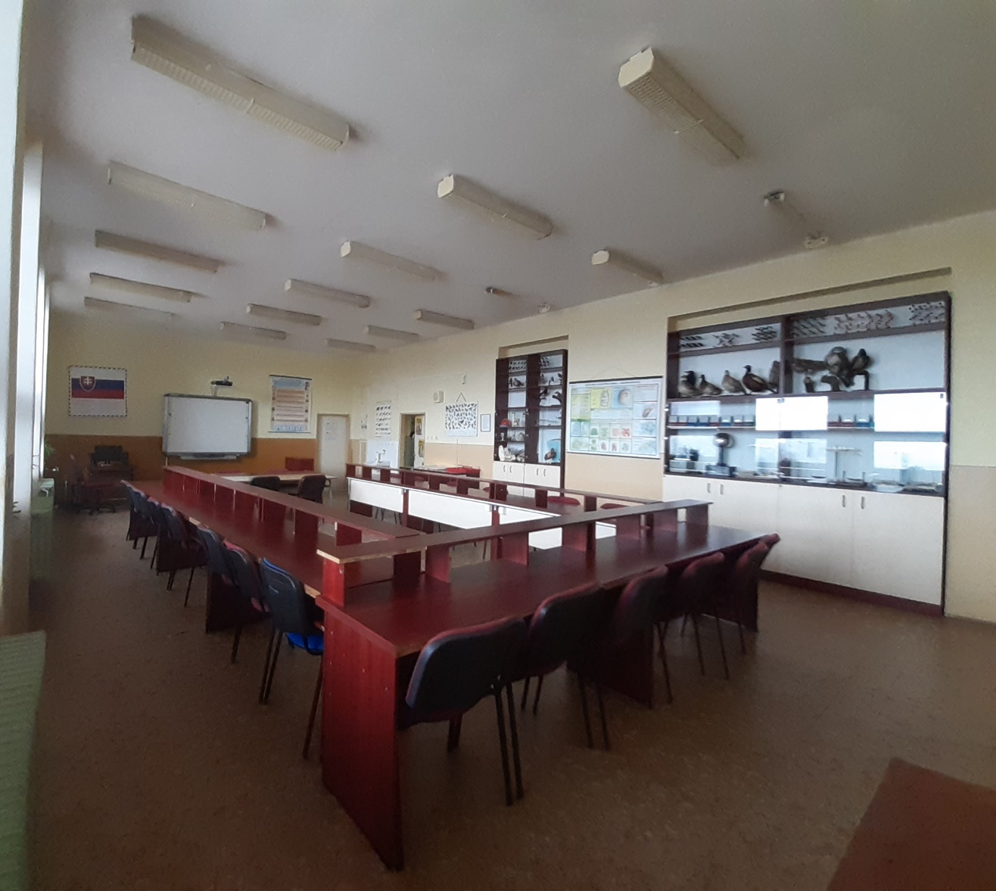
Special Class
Special Class we call this "Špeciálka„.
This classroom is for Science.
There is an interactive whiteboard too.

Slide 6
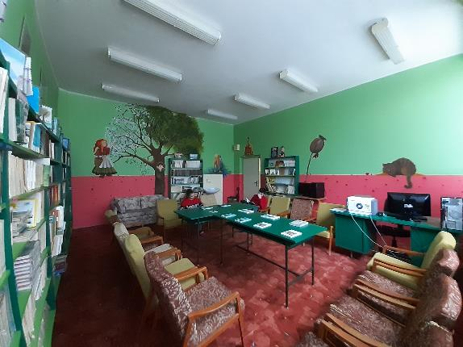
Library
Our school library is small but cozy. It is colorful and has got various fairy tale creatures on its walls. There are various books from children's to horror... If we want to borrow books, each of us must have a library card. Every year we have competition who reads more books.

Slide 7
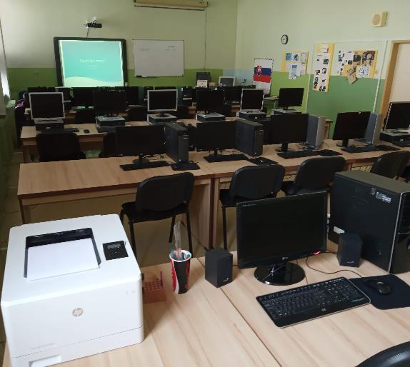
Computer classroom
We have a computer room at the school.
There are three rows with six computers in each.
There is an interactive whiteboard in the front.

Slide 8
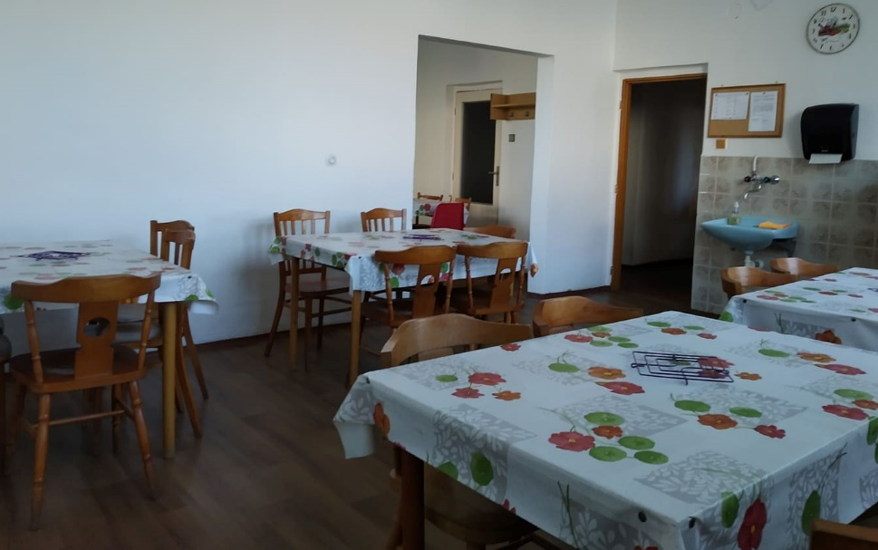
Cafeteria
Our cafeteria is part of the kinder garden right next to the school
For lunch we usually have soup and main meal
Most children and teachers go there
In the dinning room we have a weekly list of meal.

Slide 9
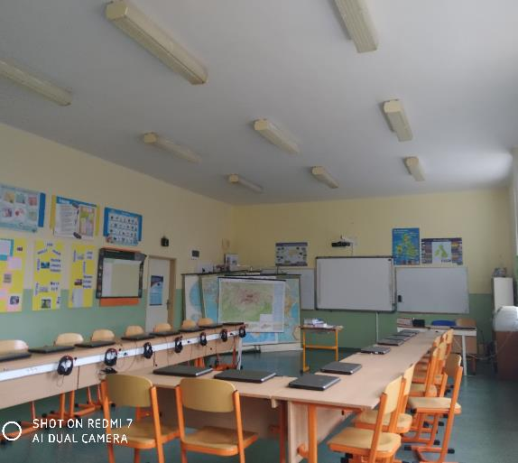
Launguage room
We call this class "jazykovka"
In this class we learn English and German language
In this room we have laptops

Slide 10
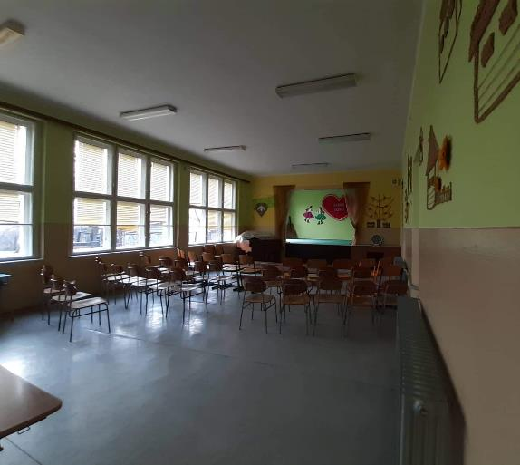
Clubroom
This class is called "Klubovňa"
In this class we attend theater shows.
After school you can join to „Musical school" where you can learn to play the Piano, Guitar...

Slide 11
School system
Kindergarten is from 3 to 6 years old
Elementary school is from 6 to 15 years old
Our marks are 1,2,3,4,5 - 1 is the best

Slide 12
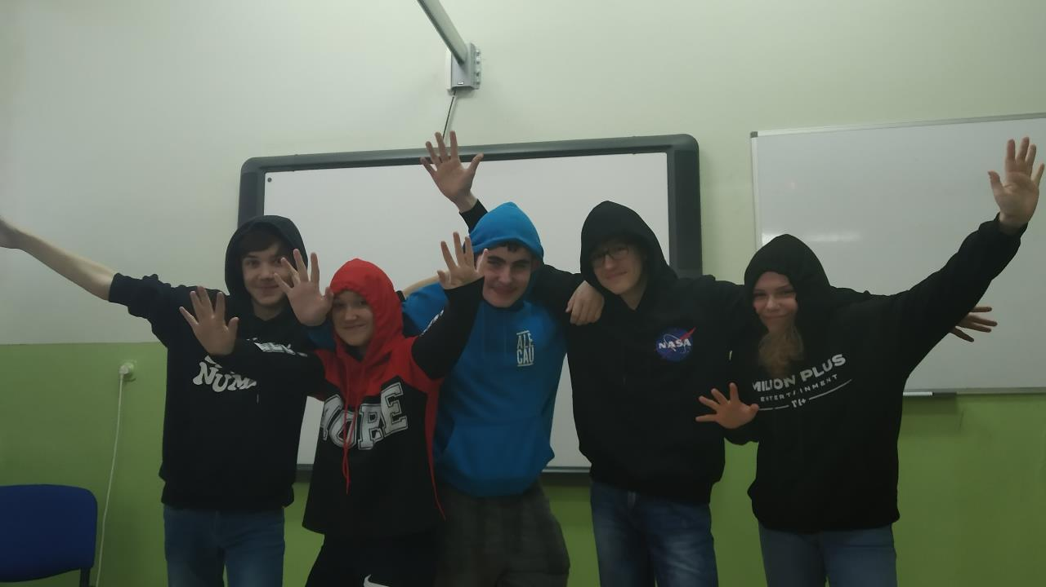
Thanks for your attention

