Slide 1
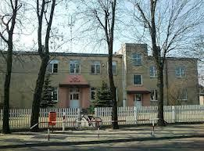
Primary School in Srock

Slide 2
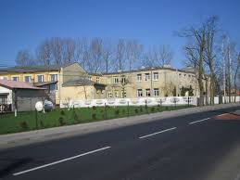
The school has the ground floor and the first floor.
On the ground floor, there are: a cloakroom, a canteen, a school office and a headteacher office, a teachers' room, a library and a gym. There are two classrooms and a kindergarden room, too.
On the first floor, there are: a computer room, a tuck shop and six classrooms.

Slide 3
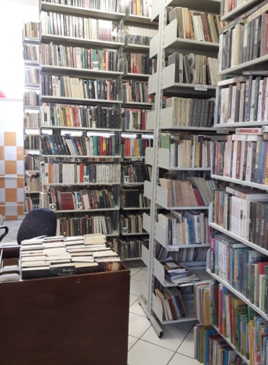
We have a big library, from which we can borrow books. Every student has own library card .

Slide 4
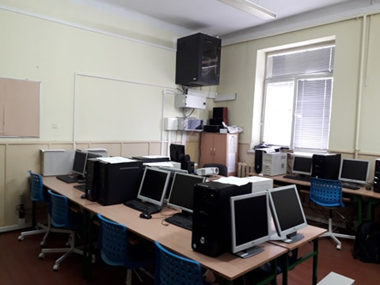
In my school there are special rooms for subjects like IT. To sum up, we have 16 classrooms. In computer room we have new computers, the Internet etc. Every of us has own place to work.

Slide 5
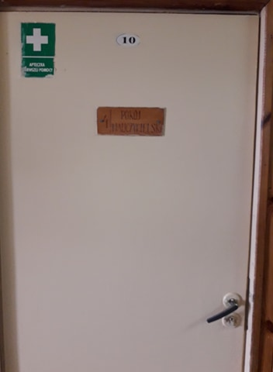
This is teachers room. It’s a place to recovery for teachers during breaks. Here are all registeries of every classes. It’s a place for discussion about our behaviour.

Slide 6
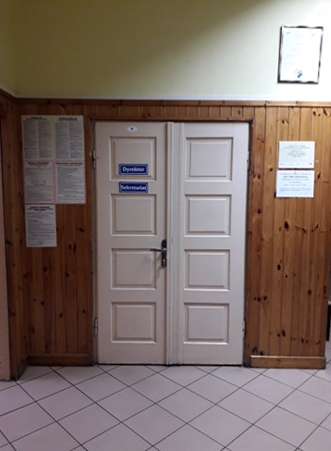
It’s our head teacher’s room and school office. If you have any problems with documents, come here!

Slide 7
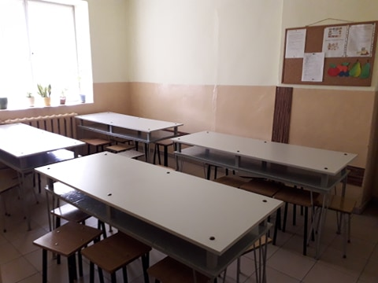
There is also a canteen. We eat our lunch here.

Slide 8
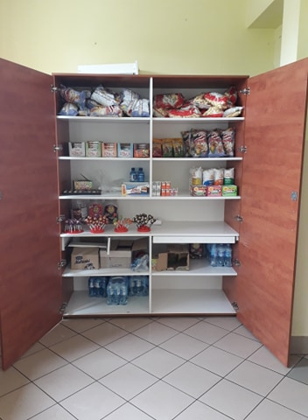
It’s our tuck shop. If you forget your luch box, you can buy here something to eat.

Slide 9
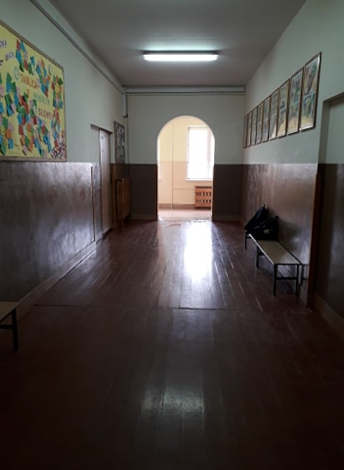
It’s our hall. The place where we spend breaks, meet with friends and rest.

Slide 10
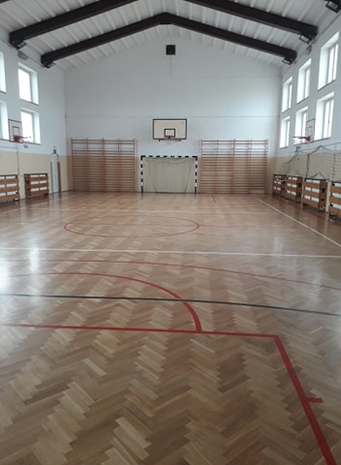
There is a big gym where we exercise during PE, have concerts and performances. PE is our favourite subject.

Slide 11
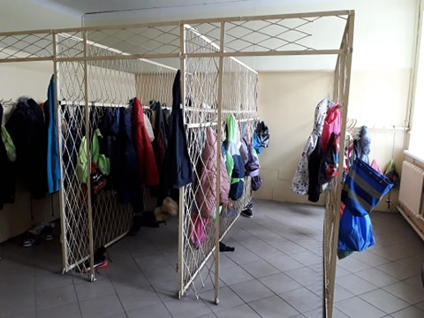
Cloakroom is a place to leave your shoes and jackets.

Slide 12
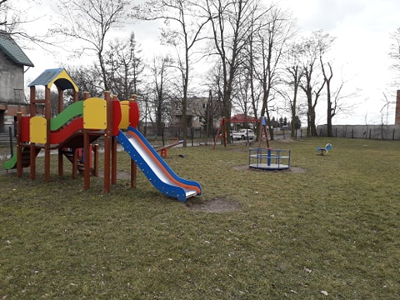
We have also a big playground where we spend our breaks when the weather is nice.

Slide 13
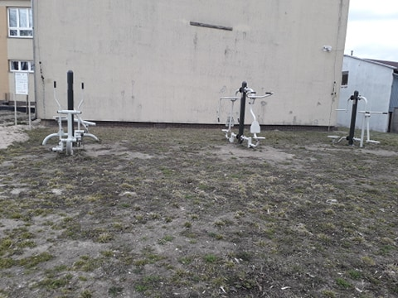
Outside we have also a gym. It’s a great place to workout.

Slide 14
We start primary school (Polish –szkoła podstawowa -8 years) when we are six years old, so when we are fifteen, we are in Year eight. Every year, there are two terms. After Year eight we go to secondary school. It lasts four or five years.
We get marks from 1 (the worst) to 6 (the best).

Slide 15
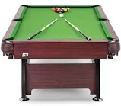
We go to school by the school bus, by car or an foot.
Our school starts at 8 o’clock. We’ve got 7 classes each day. Each lesson lasts 45 minutes. Between the lessons we’ve got 10 or 15 minutes break. We go home at 14:25. Sometimes we have additional activities like football, billiard or dancing.
We haven’t got uniforms.
BILLIARD TABLE

Slide 16
Thank you!
Class 7
From Srock

