Slide 1
Human rights
Swedish presentation of gender equality in Sweden

Slide 2
Equality in the name of law
The gender equality law
Make sure that men and women are equal on the labour market
Purpose - to increase womens terms and conditions in their working life
There are paragraphs about salery, recruitment and discrimination.
Includes rights about abortions, parental leave and access to child care.
Law of consent- sexual intercourse without consent from any part counts as rape/sexual assult

Slide 3
EDUCATION IN SWEDEN
Mandatory from ages 7 to 16
Free of charge
All children despite gender etc.
Equal educational standard all over Sweden
Women get higher education

Slide 4
Salary, income and labor market
Women earn only 90,2 procent of a mans salary…
and only 78 procent of a mans total income
4,3 procent more men work comparing to women
Notes:
Labor market:
4,3 procent morse men work comparing to women. Since the 70-sentery the differense betwen the number of working men and women has increast. Women more often work in the public sector and more often work part time then men while men more often are bosses. This despite the fact that women usually are fuder educated.

Slide 5
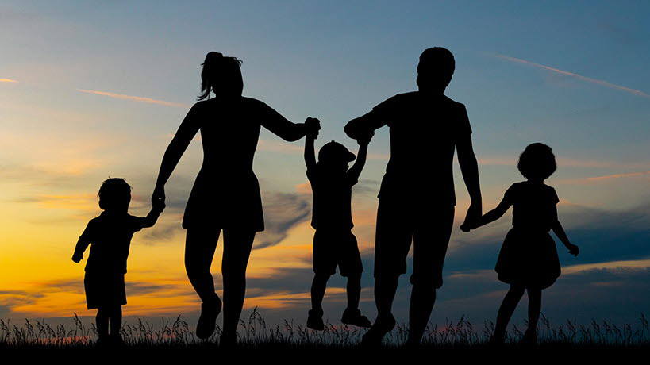
Parental Insurance: Swedens Parental Insurance and How It Works!
In 1974, financial compensation for both parents was introduced during parental leave, the right to keep work after parental leave and the abolition of joint taxation in households.
It was very unusual in the beginning for men to take that leave and in the first year only 0.5% of the parental benefit was taken by men.
The trend towards equally shared parental benefit is very slow. In 2020, 70% was taken out by women and 30% by men. In an attempt to get a more even distribution of parental leave, the government has made certain changes to the law on parental benefits.
1995 was the mother-father month, which means that one month is reserved for each parent. This increased over time and in 2002 it was two months reserved and finally in 2016 it was three months.

Slide 6
Equality in crimes
Statistics
Violence against women
1 out of 7 polices are women

Slide 7
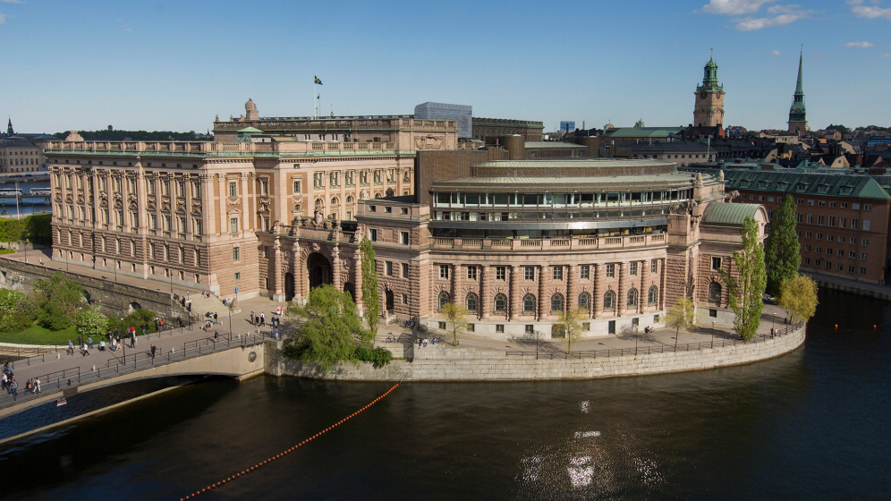
Influence and power
Parliament
In 2019, Sweden was in fifth place for parliament with the largest proportion of women, in 165 women out of 349 seats in parliament, about 47%
The Swedish Parliament has made a decision on an program for gender equality. The action program focuses on cultural issues such as treatment and attitudes
About 100 years arter women got the rights for voting, the first women in Sweden (Magdalena Andersson) has now become prime minister
The working group consists of representatives from all parliamentary parties and has an equal distribution. The program consists of five women and five men
The goal of Swedish gender equality policy is that women and men should have the same rights to shape society and their own lives.

Slide 8
Fi, JämO, gender equality
Feminist initiative (FI) is a politic party that will drives the question about feminism
FI is the political party that’s started talking about feminism and the questions around it
FI has about 14 000 members and about 57 percents of this members are women
Then we have something called jämställdhetsobudsmannen which is a administrative authority that has their focus on 4 laws
The first Gender equality law
The second law is about equal treatment of students
The third law is about ban of discrimination against children
The last law is ban against gender discrimination

