Slide 1
Erasmus+ week @ CJD
March 2022

Slide 2
Year 2 topic: Gender Equality

Slide 3
Welcome!
We’ve been looking forward to meet you!
We have a week of work ahead of us, in which we want to learn from each other and raise awareness to the topic of gender equality.
“No one can do everything, but everyone can do something, and together we can change the world.” (Teresa of Calcutta)

Slide 4
Teacher Team
Marisa
Mónica
Daniel
Rui
Márcia

Slide 5
Week Plan
Getting started
Tue
1
Going deeper
Wed
2
Sharing results
Thu
3
Bonding
Fri
4
Saying goodbye
Sat
5

Slide 6
Week Plan
 | Tue, 15 | Wed, 16 | Thu, 17 | Fri, 18
09.00-10.30 | Group activity | Working session | Working session | Outdoor activities
10.30-11.00 | Break | Break | Break
11.00-13.00 | Lectures | Working session | Working session
13.30-14.30 | Lunch | Lunch | Lunch
14.30-16.00 | Working session | Outdoor activities | Outdoor activities | Lunch
 | Outdoor activities |  | Outdoor activities | Free time + Dinner

Slide 7
Getting started
Tue,15th March

Slide 8
“Gender equality is more than a goal in itself. It is a precondition for meeting the challenge of reducing poverty, promoting sustainable development and building good governance”.
Kofi Annan
Former UN Secretary-General

Slide 9
Let’s move!
Stand in 2 rows facing each other
Pay attention to the quotes on the screen
If you agree with the quote, take two steps forward
If you disagree, take one step back

Slide 10
“Beauty is the wisdom of women. Wisdom is the beauty of men.”

Slide 12
“When a woman has scholarly inclinations, there is usually something wrong with her sexual organs.”

Slide 13
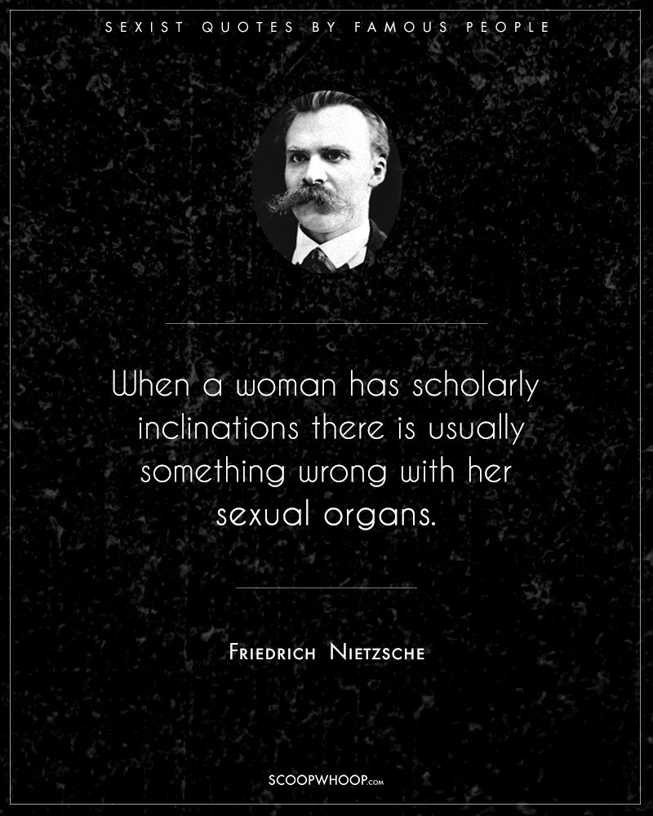

Slide 14
“Achieving gender equality requires the engagement of women and men, girls and boys. It is everyone’s responsibility.”

Slide 15
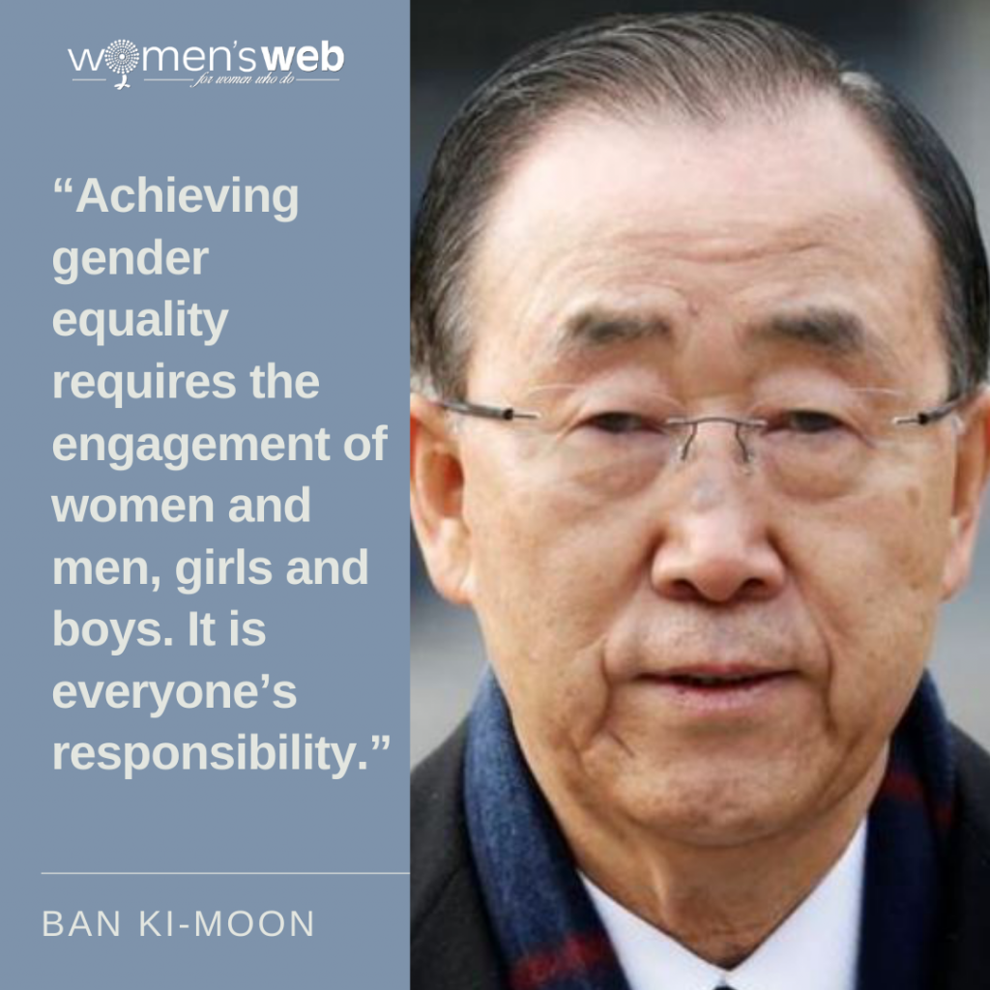

Slide 16
“Nature intended women to be our slaves. They are our property.”

Slide 18
“Freedom cannot be achieved unless women have been emancipated from all kinds of oppression.”

Slide 20
“A silent woman is a gift from God.”

Slide 22
“If women are expected to do the same work as men, we must teach them the same things.”

Slide 23
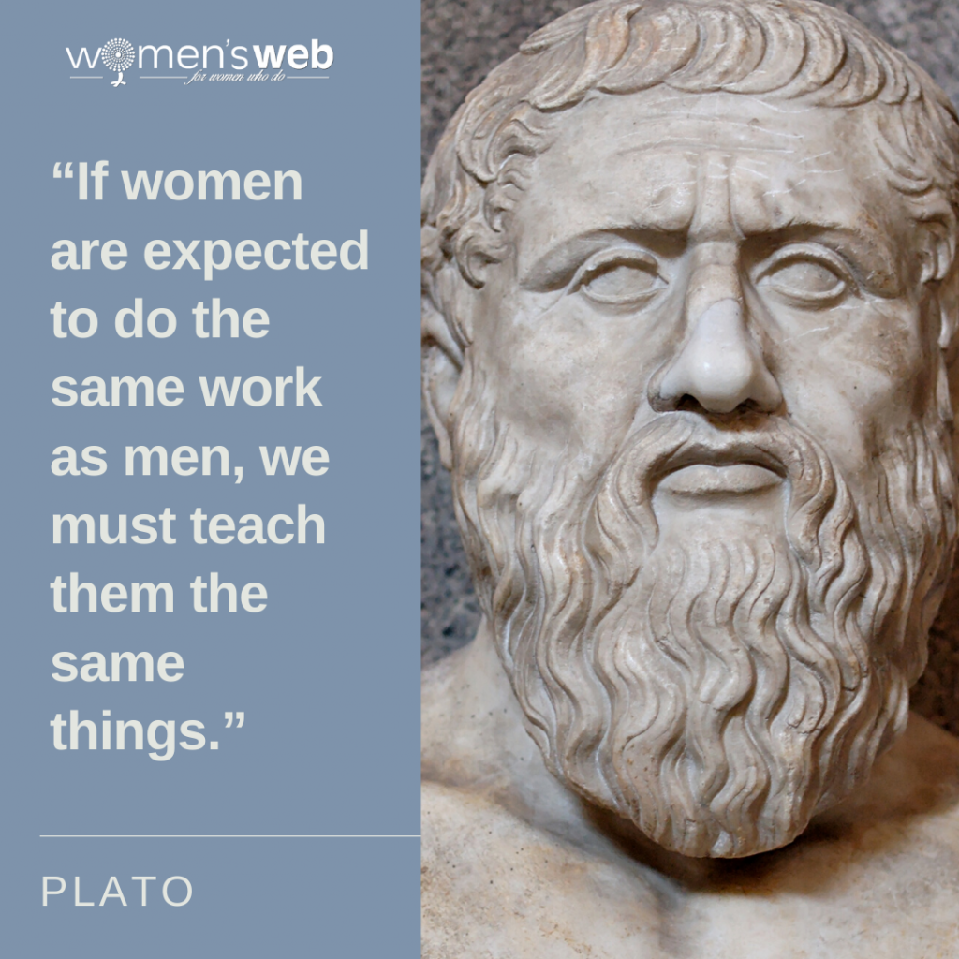

Slide 24
“Feminism encourages women to leave their husbands, kill their children, practice witchcraft, destroy capitalism and become lesbians.”

Slide 26
“No country can ever truly flourish if it stifles the potential of its women and deprives itself of the contribution of half of its citizens.”

Slide 27
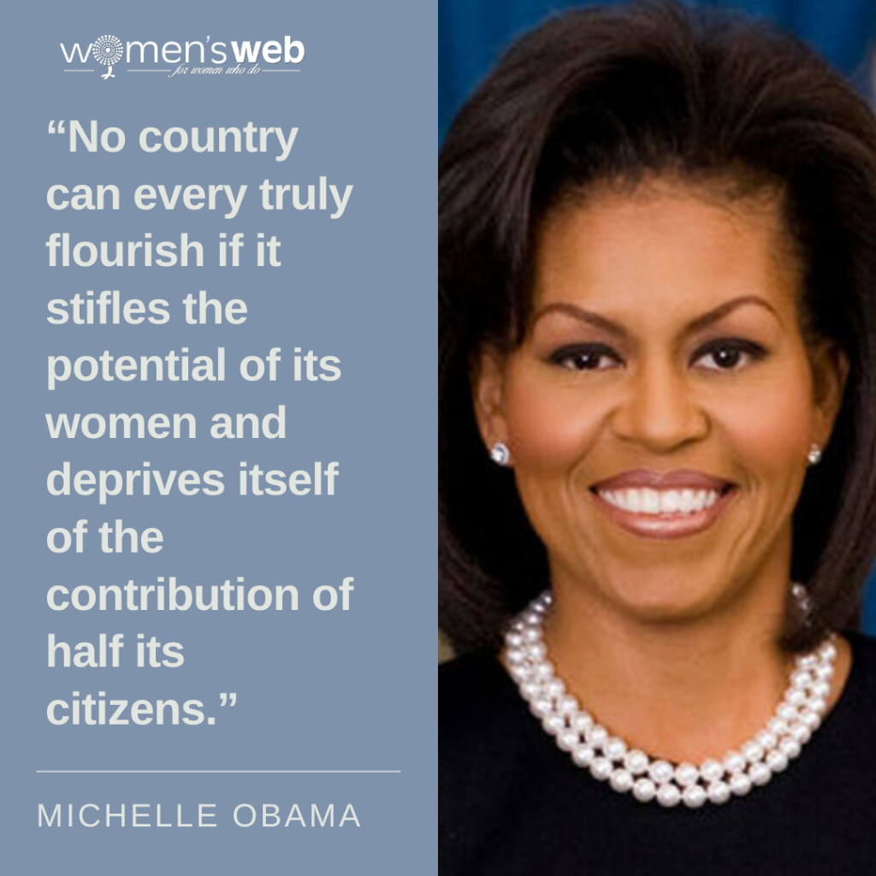

Slide 28
Let’s reflect!
Sit in a circle and think for a minute.
Which quote caught your attention the most? Why?

Slide 29
Lecture #1 Jorge Peixoto Freitas – Researcher at Porto University
Sex, Gender and Social Roles

Slide 30
Lecture #2 Francisco Ferraz – History Teacher at CJD
An historical look on
Gender Equality

Slide 31
Lecture #3 Patrícia Braga & Rita Monteiro – Sonae Arauco
Equal opportunities in the workplace: some initiatives and examples

Slide 32
Swedish Presentation
Gender equality in Sweden

Slide 33
Group work – Join in 10 groups #Gender Equality…
1 – at the workplace
2 – in politics
3 – inside the family
4 – in education
5 – in sports
6 – in culture
7 – inside a relationship
8 – in “men’s / women’s jobs”
9 – in economics
10 – in society

Slide 34
Group work
Linoit – Brainstorm your ideas on sticky notes
http://linoit.com/users/MonicaNeves/canvases/Gender%20Equality

Slide 35
Time starts now!
Timer

Slide 36
Share your group’s conclusions for today
https://www.classtools.net/random-name-picker/

Slide 37
Going deeper
Wed,16th March

Slide 38
Week Plan
 | Tue, 15 | Wed, 16 | Thu, 17 | Fri, 18
09.00-10.30 | Group activity | Working session | Working session | Outdoor activities
10.30-11.00 | Break | Break | Break
11.00-13.00 | Lectures | Working session | Working session
13.30-14.30 | Lunch | Lunch | Lunch
14.30-16.00 | Working session | Outdoor activities | Outdoor activities | Lunch
 | Outdoor activities |  | Outdoor activities | Free time + Dinner

Slide 39
Group work – Useful resources (EN)
iGEN – http://forumigen.cite.gov.pt/documentos/IGEN_2015_Report.pdf
CIG - Gender Equality in Portugal: Some numbers! (Nov 26th, 2021) https://drive.google.com/file/d/1HL5d7vj0MaIumZD6zdNju0KbFmjih5HJ/view?usp=sharing
APAV – https://apav.pt/apav_v3/index.php/en/apav/who-we-are
#HeForShe - https://www.heforshe.org/en
UNICEF - https://www.unicef.org/gender-equality
UN – https://www.un.org/en/global-issues/gender-equality
EU Report on Gender Equality 2021 - https://epws.org/eu-2021-report-on-gender-equality/
Council of Europe - https://www.coe.int/en/web/genderequality/gender-equality-commission
EIGE - https://eige.europa.eu/

Slide 40
Group work – Useful resources (PT)
Boletim Estatístico Igualdade de Género em Portugal – Boletim Estatístico 2021
Indicadores-Chave Igualdade de Género em Portugal – Indicadores Chave 2021
Fact-Sheet do Gender pay gap em Portugal
Várias fact-sheets no âmbito do poder e tomada de decisão
Destaques estatísticos sobre a igualdade de género em Portugal no contexto da EU
Source: https://www.cig.gov.pt/

Slide 41
Group work
Padlet – Post your work here

Slide 42
Sharing results
Thu,17th March

Slide 43
Week Plan
 | Tue, 15 | Wed, 16 | Thu, 17 | Fri, 18
09.00-10.30 | Group activity | Working session | Working session | Outdoor activities
10.30-11.00 | Break | Break | Break
11.00-13.00 | Lectures | Working session | Working session
13.30-14.30 | Lunch | Lunch | Lunch
14.30-16.00 | Working session | Outdoor activities | Outdoor activities | Lunch
 | Outdoor activities |  | Outdoor activities | Free time + Dinner

Slide 44
Inspiring ideas for your outcome
Why not creating…?
a handbook of good practices
a campaign on social media
a Ted talk in your school/community
a hymn
an app
…

Slide 45
Tools
Infographics, posters, presentations, videos
Comics and e-books
Surveys and quizzes
https://www.canva.com/
https://genial.ly/
https://biteable.com/
https://prezi.com/pt/
https://www.google.com/slides/about/
https://www.pixton.com/
https://bookcreator.com
https://kahoot.com/
https://quizizz.com/

Slide 46
Congratulations on being an active 21st century citizen!

