Slide 1
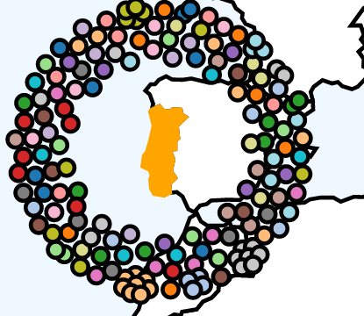
1. MIGRATION ORIGIN AND REASONS MIGRANTS vs. REFUGEES

Slide 2
REASONS WHY PEOPLE MIGRATE
There are many reasons why people migrate (people’s movement from one "usual place of residence" to another). They decide to leave their country because they want a better life, or they need to leave their country because they do not feel safe.
When someone migrates to a specific country in search of better life conditions, this is called pull factor.
On the other hand, when people flee from war, natural disasters, climate change or simply because they don’t feel accepted or are being persecuted, this is called pressure factor.

Slide 3
MIGRANTS vs. REFUGEES
Since the so called migration crisis identified in 2015 (due to the Syrian conflict) there was the need to clarify two concepts: migrants and refugees.
MIGRANTS – voluntary movement based on the purpose of improving their lives
REFUGEES – involuntary or forced movement which is a consequence of external factors (war, persecution, violence)
There is a fine line between both concepts as, if we think about it, both groups are forced to leave their lands somehow. In Portugal we have received many migrants that were forced to leave their countries for economic reasons. However, they are not associated with the designation “refugee” as they don’t fit the UN definition: persecution based on ethnicity, religion, nationality, social group or political opinions.

Slide 4
MIGRATION IN PORTUGAL
Portugal has always been a country with a close relation to migration. We have about 1 million people all over the world. The main reason for these people to leave has been the pursuit of better living conditions and new opportunities.
However, we also welcome people from all around the world. And the people that arrive at our country are also looking for a new chance to have a good life. Nowadays there are many young people arriving in Portugal to study and a lot of old people to enjoy the good climate.

Slide 5
MIGRATION in NUMBERS… ORIGIN OF MIGRANTS
Currently there are about 770 000 migrants, almost twice the figures of 2015.
Brazil | 17%
Cape Verde | 14%
Ukraine | 9%
Angola | 8%
Guinea | 6%
United Kingdom | 6%
Romania | 5%
Spain | 5%
Moldova | 4%

Slide 6
MIGRATION in NUMBERS… REFUGEES
Relocation refers to the movement of refugees from one EU Member State to another. It is an intra-EU process, in which Member States help another Member State to cope with the pressure of hosting a relatively large refugee population by agreeing to receive a number of them.
Resettlement is defined by UNHCR as the selection and transfer of refugees from a country outside of the EU to an EU Member State.

Slide 7
2. REFUGEES HOSTING PROCESS

Slide 8
SPONTANEOUS REQUESTS
SEF (entity responsible for controlling the borders and entry of citizens)
CPR (Portuguese council for refugees)
CAR (temporary shelter centres)
If accepted, they get a temporary residence permit for 6 months (extendable)

Slide 9
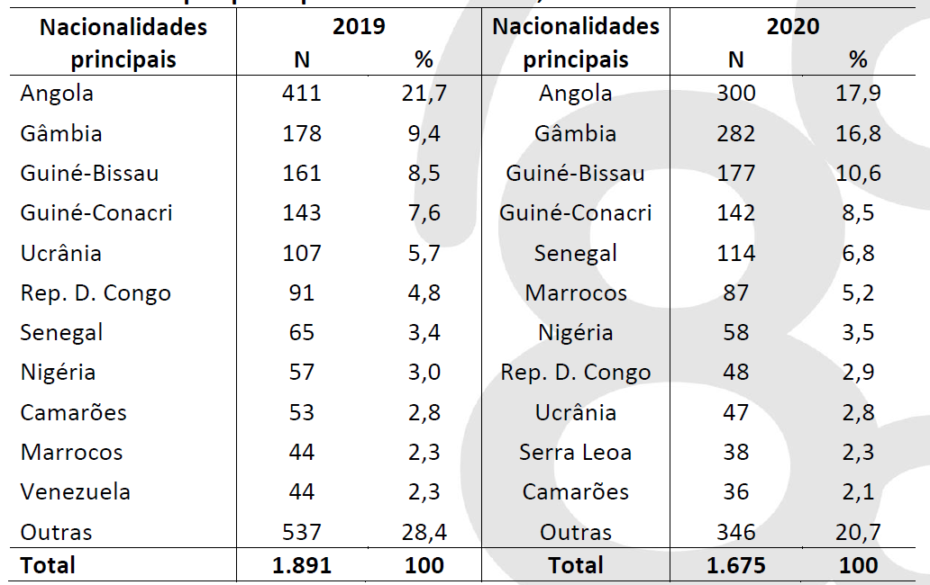
SPONTANEOUS REQUESTS - origin

Slide 10
EUROPEAN AGREEMENTS
ACM (High Commissioner for Migrations)
Several entities that work together: Conselho Português para os Refugiados - CPR, Plataforma de Apoio aos Refugiados - PAR, Cruz Vermelha Portuguesa - CVP, União das Misericórdias Portuguesas - UMP, Confederação Nacional das Instituições de Solidariedade - CNIS, and União das Mutualidades Portuguesas.
When arriving in Portugal, they have access to housing, social security, healthcare, Portuguese for Foreigners classes, education and training, and help finding a job. This program lasts 18 months.

