Slide 1
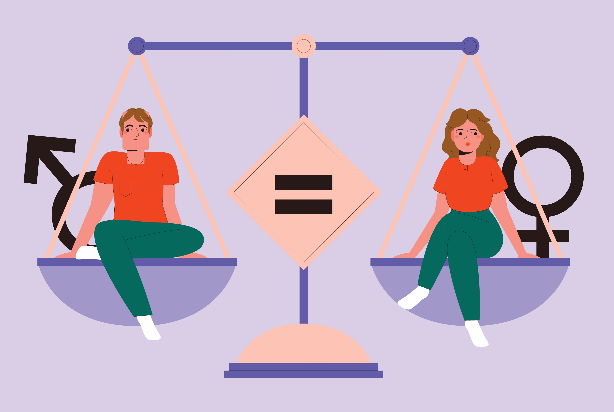
Gender Equality

Slide 2
GENDER EQUALITY IN RELATIONSHIPS

Slide 3
Notes:
Me too is a movement that started in 2017 when women mostly from show bussines in the United states started to share their storys about how they have experianced sexual abusment and simular things. Women from other places then also started to share their storys and it ended up as a big movement in many of the vesterns countrys, including sweden.

