Slide 1
Historical Bridges in Turkey
AHMET GİGİN
6TH GRADE LEVEL A
ACIBADEM COLLEGE

Slide 2
Clandras Bridge
Location: Uşak, Karahallı
Length: 24 metres
Age: 2500 years

Slide 3
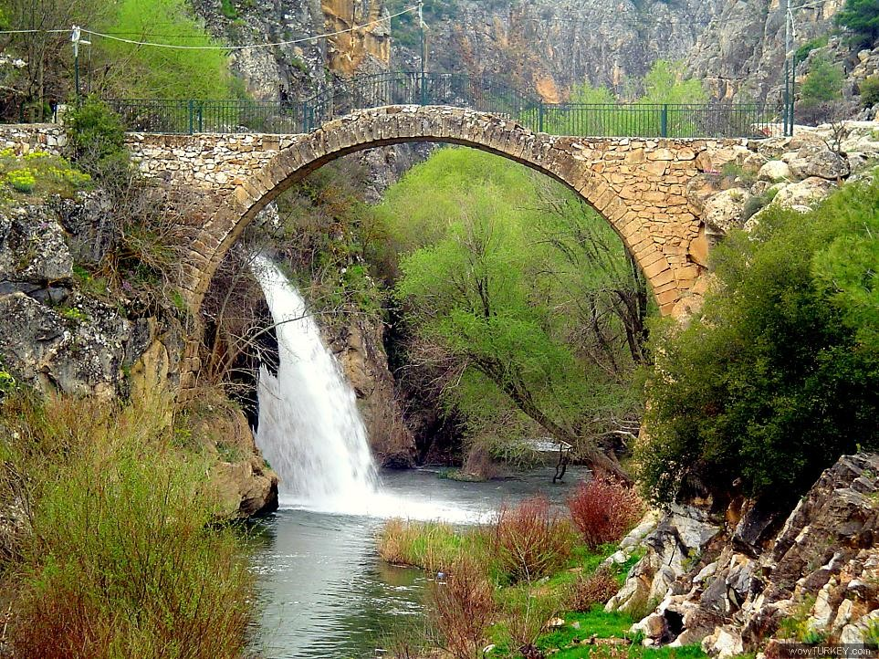

Slide 4
Mecidiye Bridge
Location: Edirne, Karaağaç
Lenght: 263 metres
Age: 168 years

Slide 5
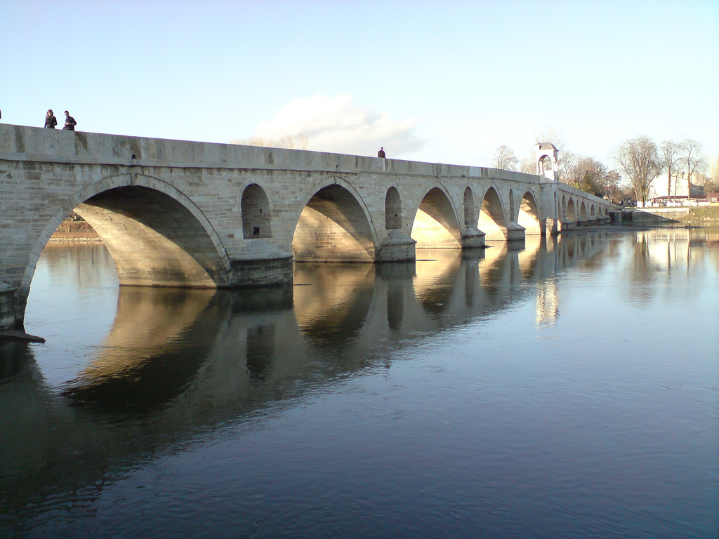

Slide 6
Babaeski Bridge
Location: Kırklareli, Babaeski
Lenght: 72 metres
Age: 381 years

Slide 7
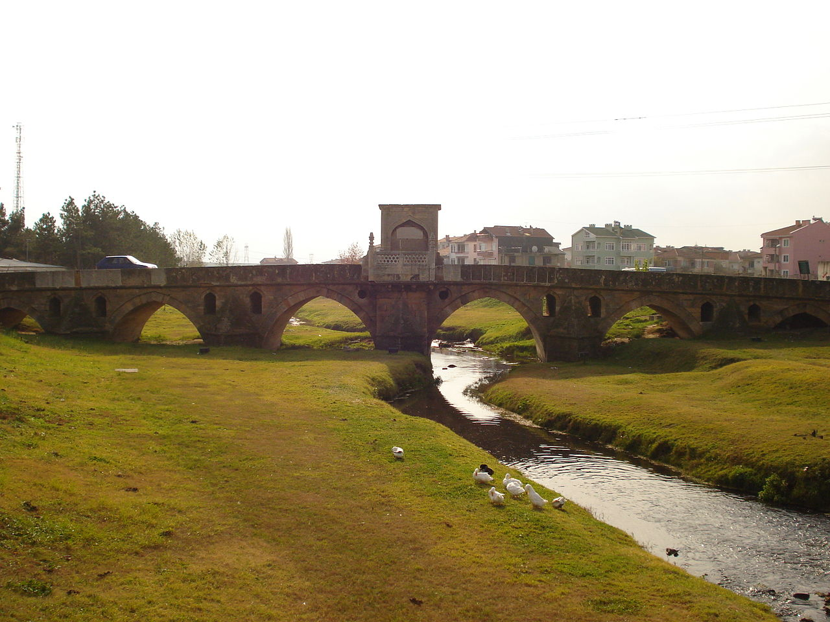

Slide 8
Irgandı Bridge
Location: Bursa, Gökdere
Lenght: ?
Age: 573 years

Slide 9
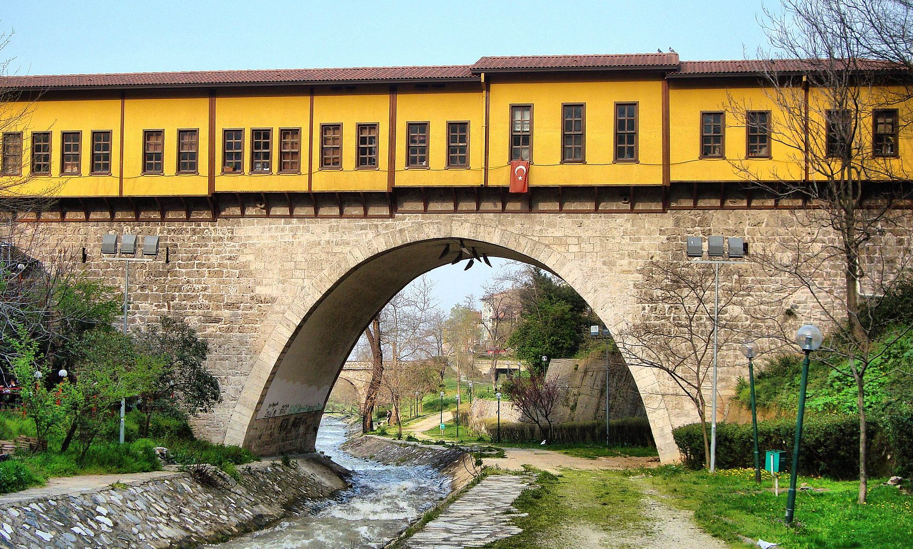

Slide 10
Cendere Bridge
Location: Adıyaman, Eskikale
Lenght: 120 metres
Age: 1804 - 1822

Slide 11
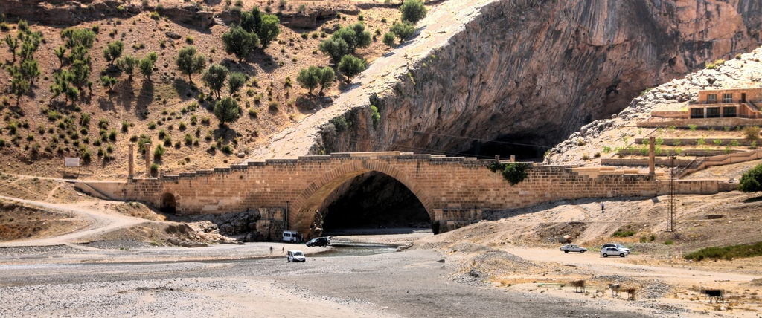

Slide 12
Kanuni Sultan Süleyman Bridge
Location: İstanbul, Büyükçekmece
Lenght: 636 metres
Age: 448 years

Slide 13
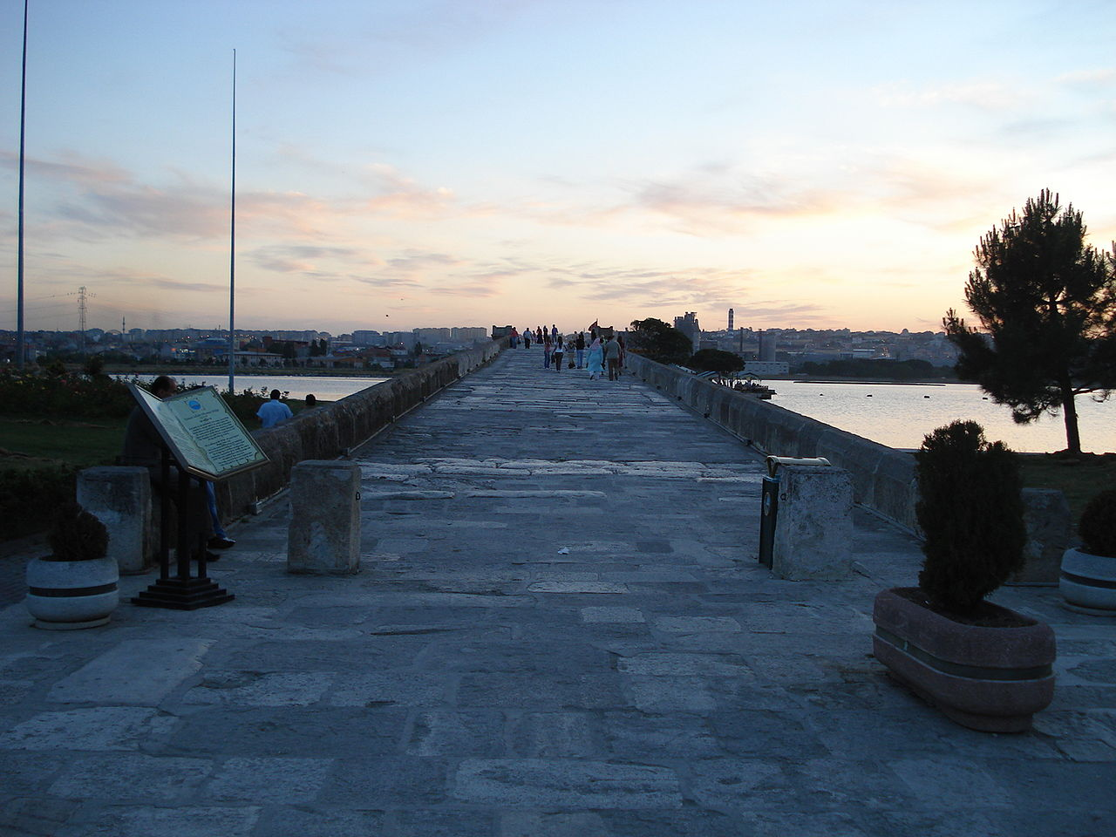

Slide 14
Demirköprü Bridge
Location: Adana, between Reşatbey and Sinanpaşa
Lenght: 530 metres
Age: 103 years

Slide 15
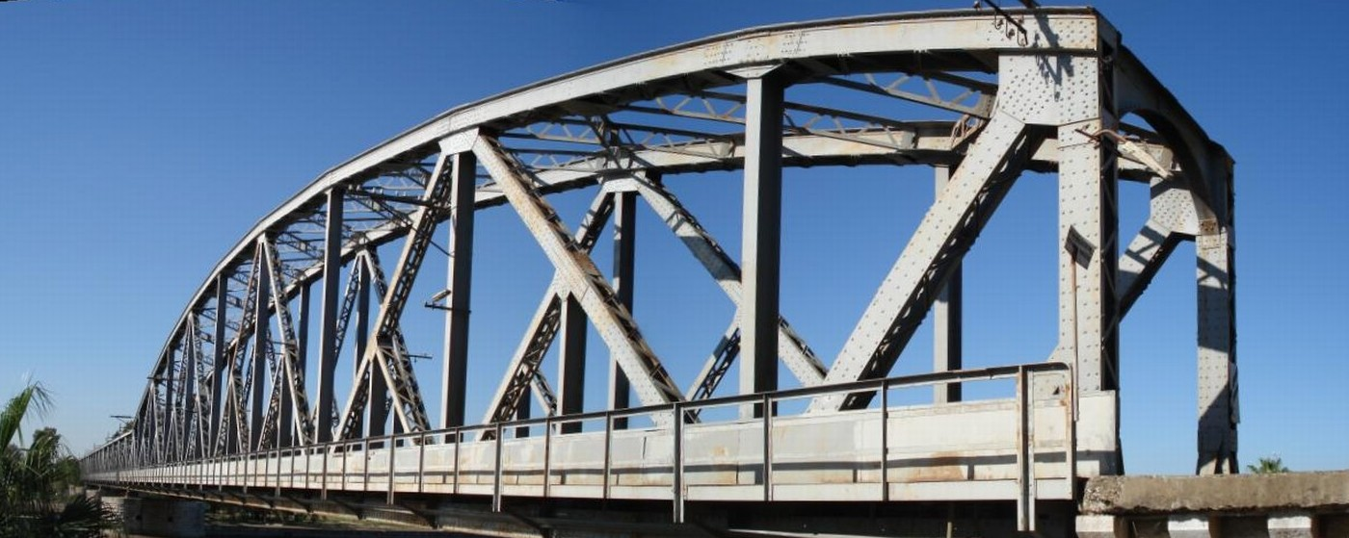

Slide 16
Misis Bridge
Location: Adana, Yüreğir
Lenght: ?
Construction Date: 4. Century

Slide 17
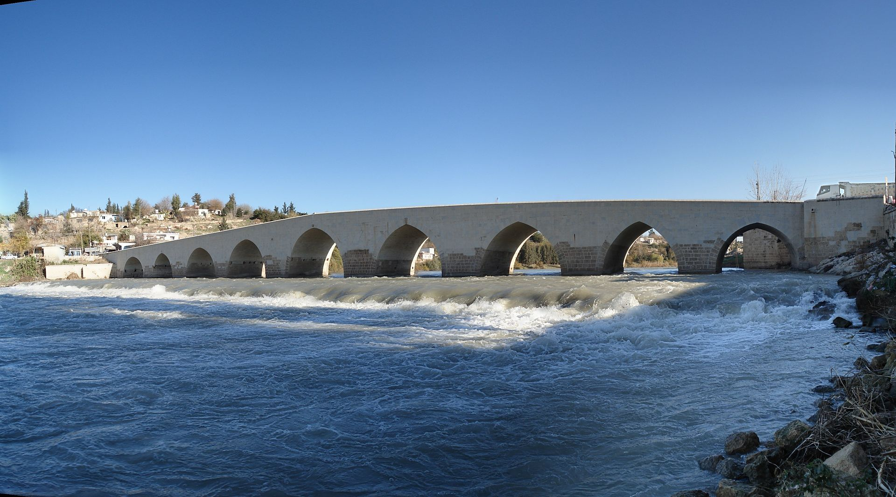

Slide 18
Varda Bridge
Location: Adana, Karaisalı
Lenght: 172 metres
Age: 103 years

Slide 19
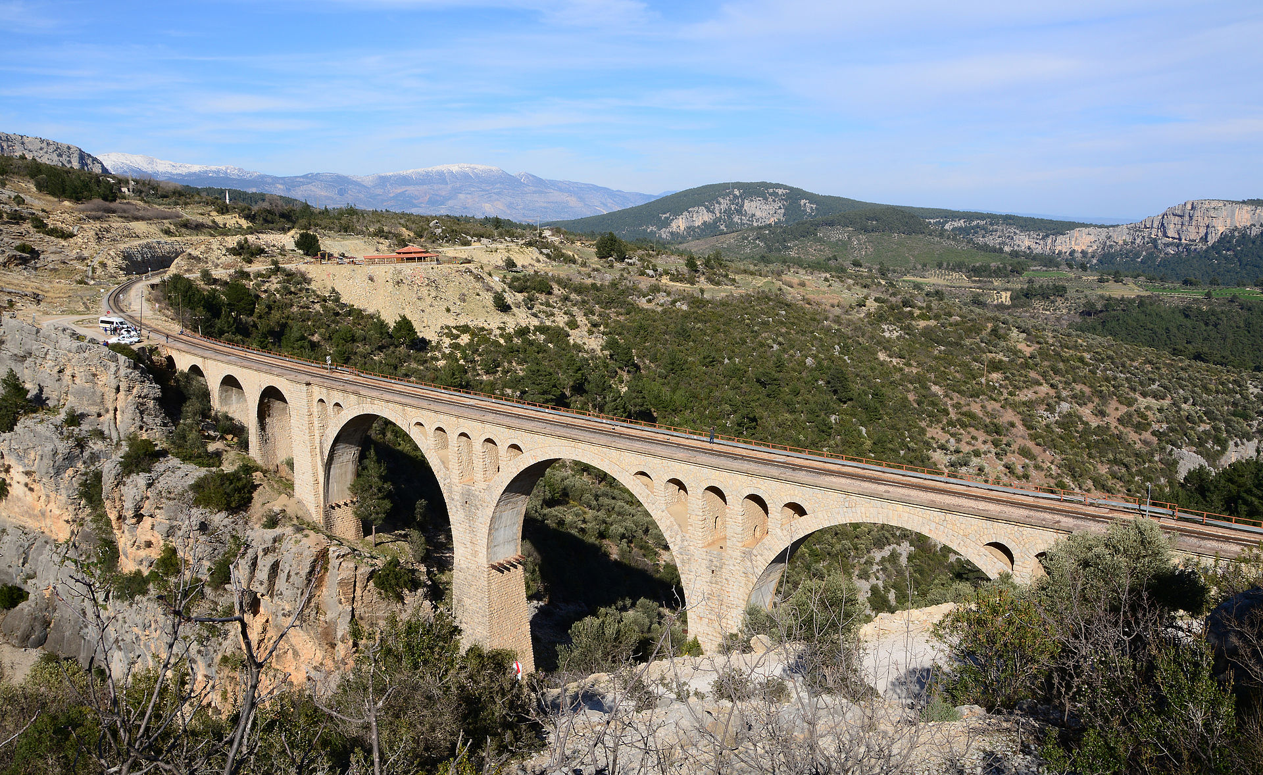

Slide 20
Taşköprü Bridge
Location: Adana, between Seyhan and Yüreğir
Lenght: 310 metres
Age: ?

Slide 21
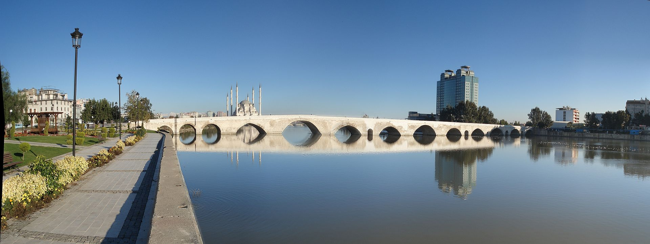

Slide 22
THE END

