Slide 1
Introducing migration
Migrants situation; Problems and solutions; examples of migration and integration; Broadening the mind through travel.

Slide 2
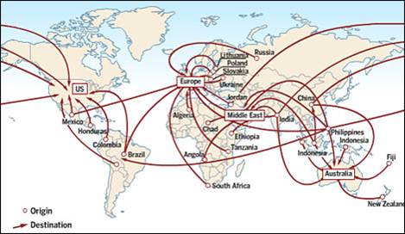
Circumstances that motivate migration
Migrations are displacements of human groups that move them away from their habitual residence
Search of a better life.
Political conflicts
The degradation of the environment
The professional drain
The labour and migratory policies of the countries of origin and destinations

Slide 3
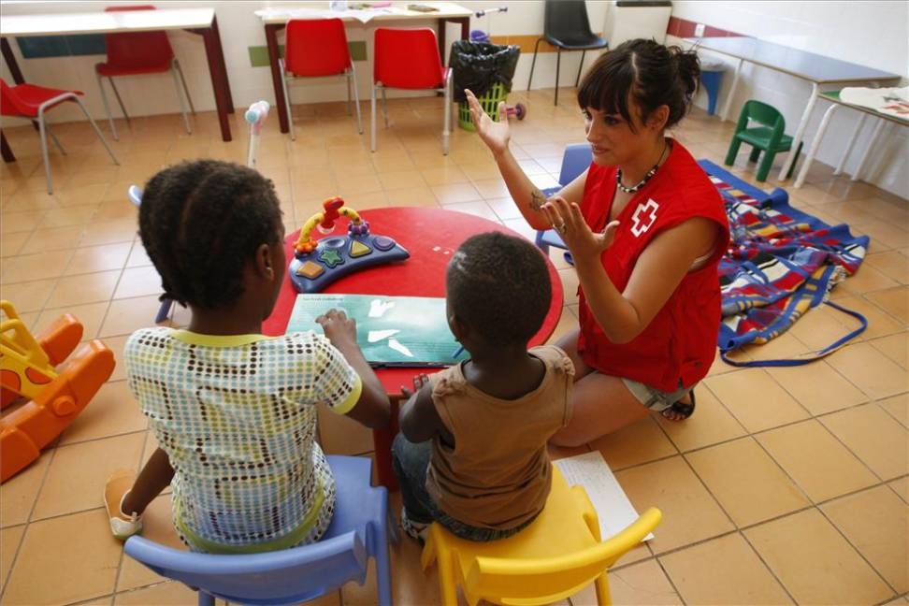
Integration of migrants in our city
This job is done by the Townhall of Córdoba:
Some integrations programs at local level are developed by the Townhall .
High rate of social and personal integration
Resources promotion and attention to immigrants actions.
Resources for an individualized attention:
Municipal intercultural mediation program
Municipal house of Welcome of Cordoba
Federation of Migrants Associations.
Different NGOs and foundations: Cordoba Acoge

Slide 4
Integration in our High School
People from eight different countries:
Morocco
Argentina
Moldova
UK
Cuba
Romania
Nigeria
Guinea
In our school, immigrant people are perfectly integrated thanks to the orientation department and our friendly character.

Slide 5
What do we know about immigrants’ problems?

Slide 6
Unknown surroundings
Inexistance of a “Safe net”
The need of somewhere to belong
Language barrier

Slide 7
Socioeconomic derivative problems
Job competition
Racism
Xenophobia

Slide 8
Examples of emigration and integration

Slide 9
Example of emigration (1)
Azahara del Rosal Garrido (26 years) (Tourism)
Why did she emigrate?
Learn German.
Now, back to Spain.
At least two languages.

Slide 10
Example of emigration (1)
Azahara del Rosal (26 years) (Tourism)
Her experience:
Nuremberg-Munich-Spain
What was the most difficult thing of living there?
Make new friends, but she has now a good level of German.

Slide 11
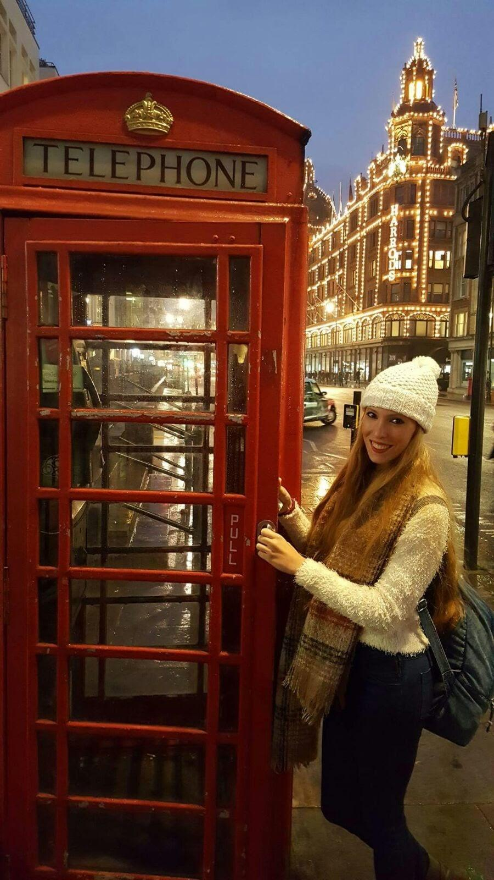
Example of emigration (2)
Myriam Jiménez García (25 years) (Nursing)
Why did she emigrate?
Make merits to work in Seville, to work in a public hospital.
2 years in Ireland.

Slide 12
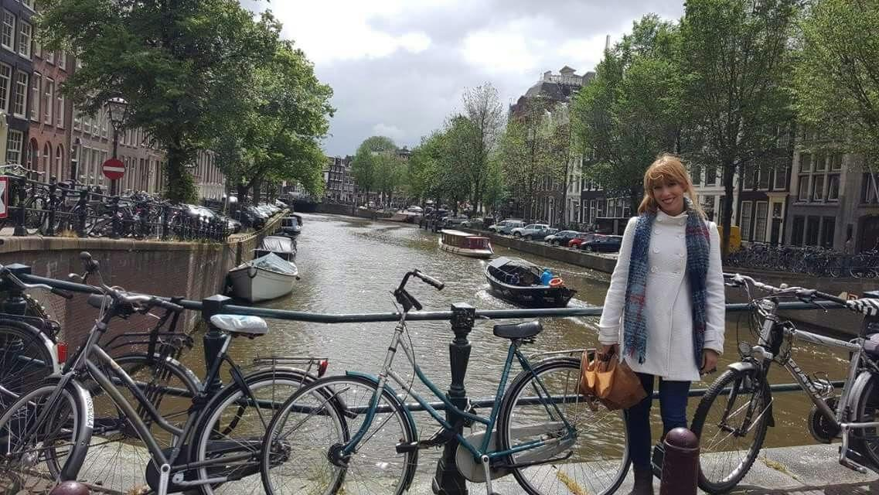
Example of emigration (2)
Myriam Jiménez García (25 years) (Nursing)
Her experience:
An interview, study English.
Good at work.
What was the most difficult thing of
living there?
Family, days, weather.

Slide 13
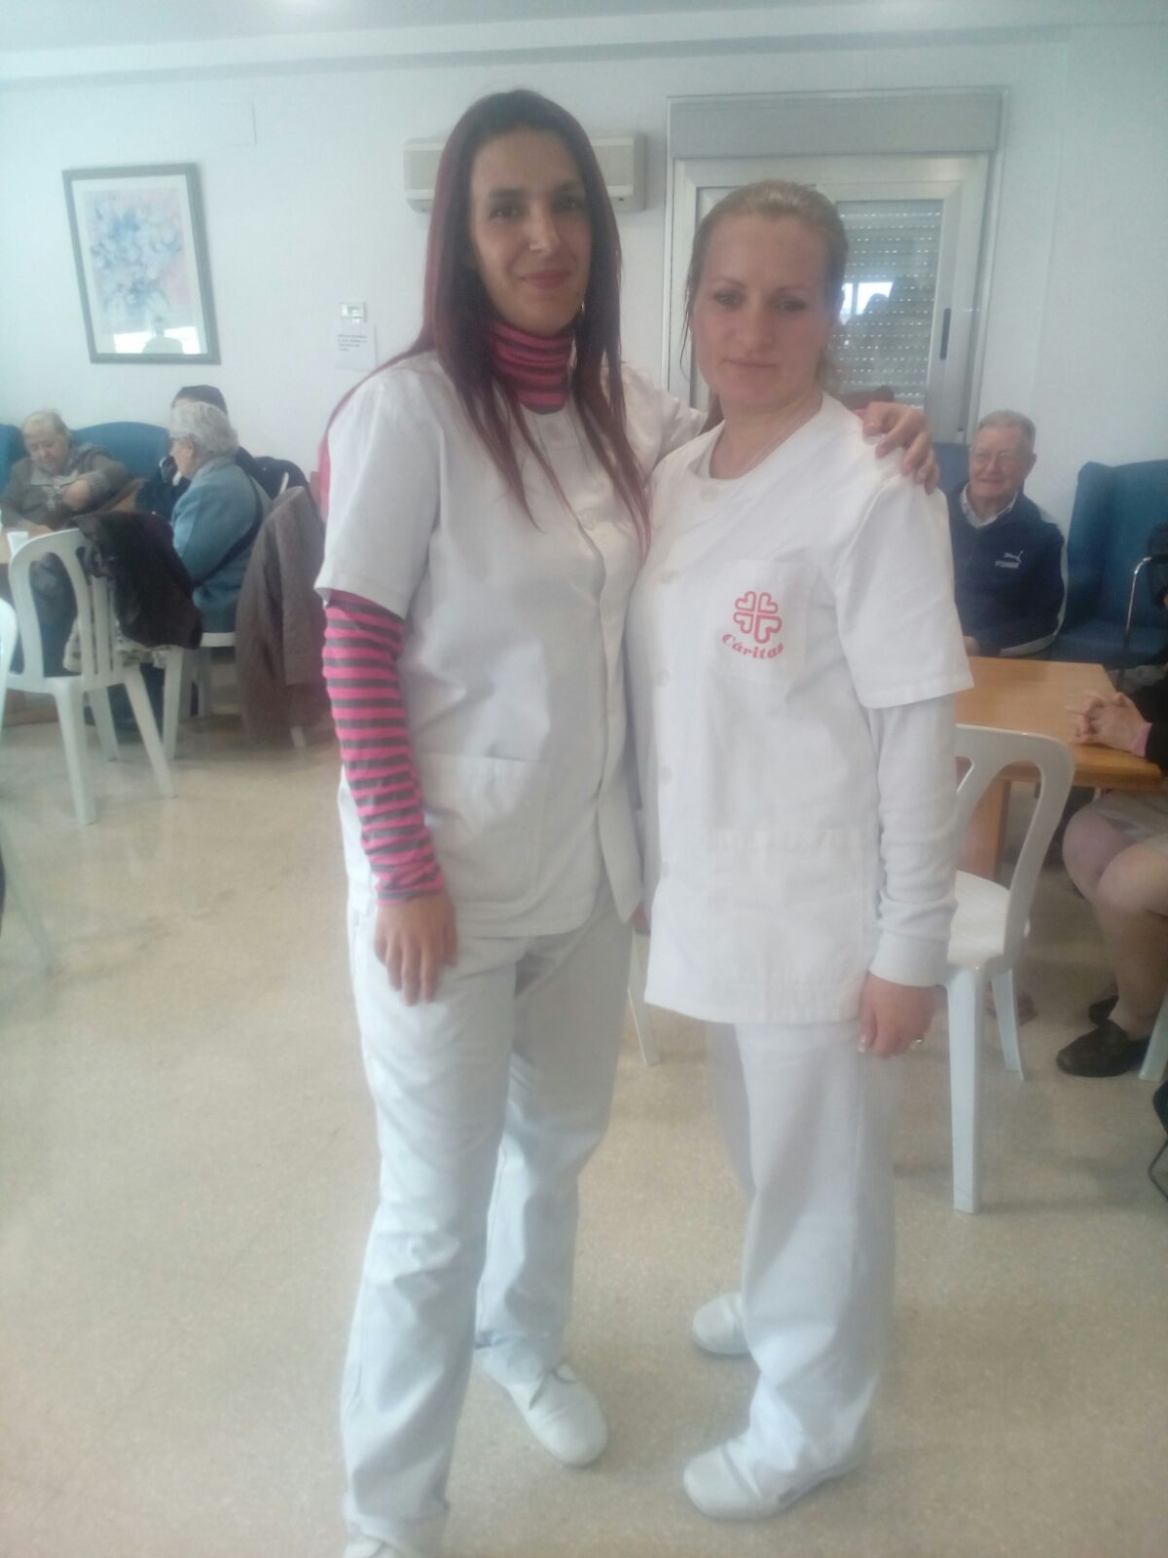
Example of immigration
Lydia (Romania, 37)
Why did she migrate?
She went to Spain during her holidays with some friends and after that travel she decided to settle down in Catalonia at first and then in Córdoba

Slide 14
Her experience:
-She got used to the way Spaniards speak and also to our kinds of food.
-Currently, Lydia is doing pretty well with her job and with her daughter.
What was the most difficult thing of living here?
-Family, food, way of talking.

Slide 15
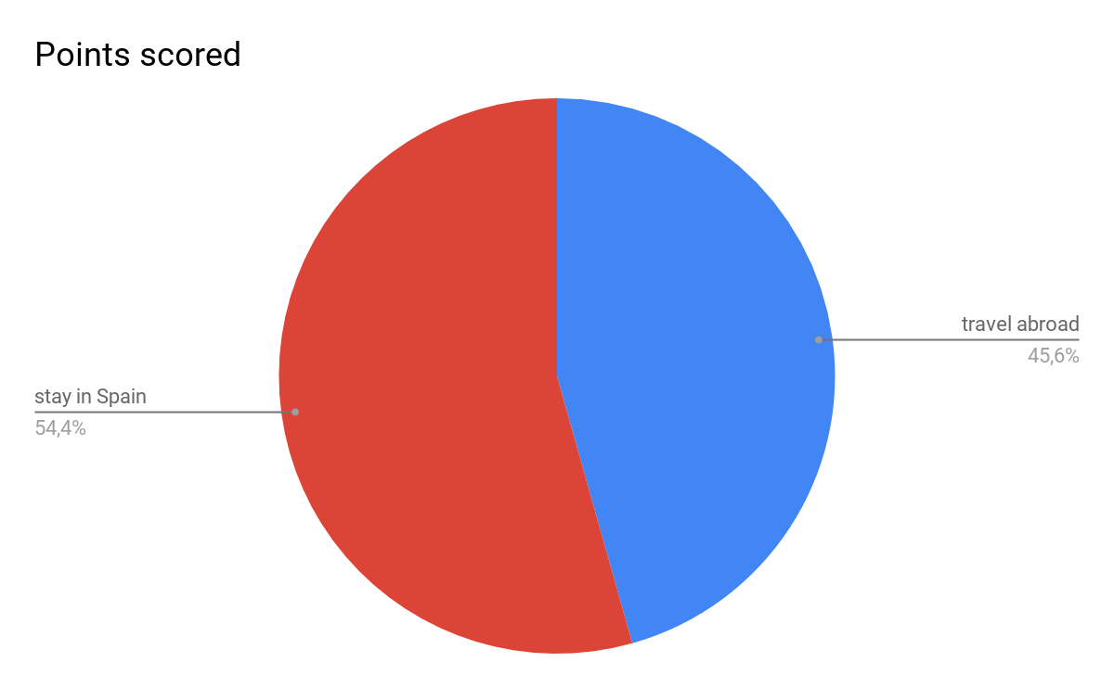
Travel abroad: impact
*45% Spanish teenagers would like to travel abroad
Causes:
-Unemployment (32.7%/ 20-24 years)
-Improvement /learning a language
-Advanced learning techniques

Slide 16
Example of migration (3)
Rodrigo Checa Lorite (18 years) (musician)
- First year in the Royal Academy of London.
*better musical educational system
* more job opportunities
*improve his English
*music is better valued

Slide 17
Advantages
-Cultural:
*Experience a different way of living
*Useful and priceless life learnings
-Developing independent lifestyle
-Broaden minds and dissipate prejudices

Slide 18
THANKS FOR YOUR ATTENTION

