Slide 1
MIGRATION IN FILMS/LITERATURE/ART - A UNIQUE WORLD
Gimnazija Tolmin, February 2020

Slide 2
Summary of the book „Lukec and his starling“
Acting out two short scenes
PPT presentation of photos
Reading a poem
Task for you

Slide 3
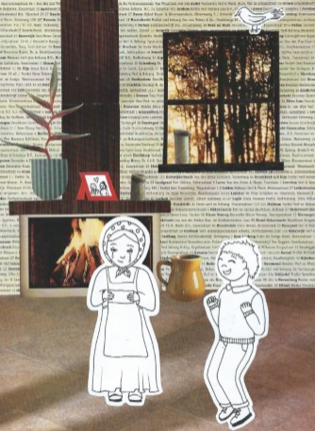
Lukec and his starling

Slide 7
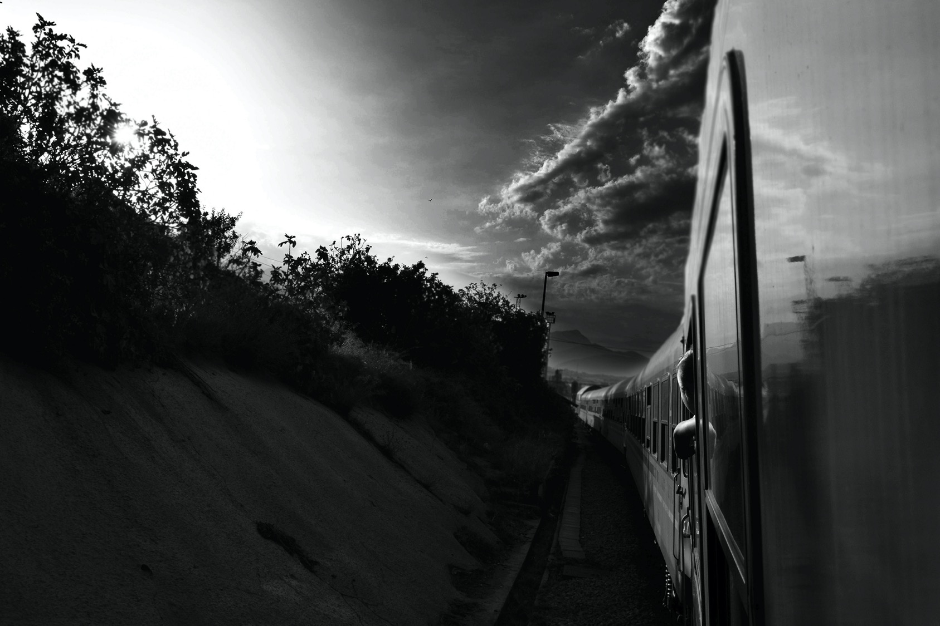
RUN AWAY
POVERTY
WAR

Slide 8
BARBED WIRE
WOUND
BLOOD

Slide 9
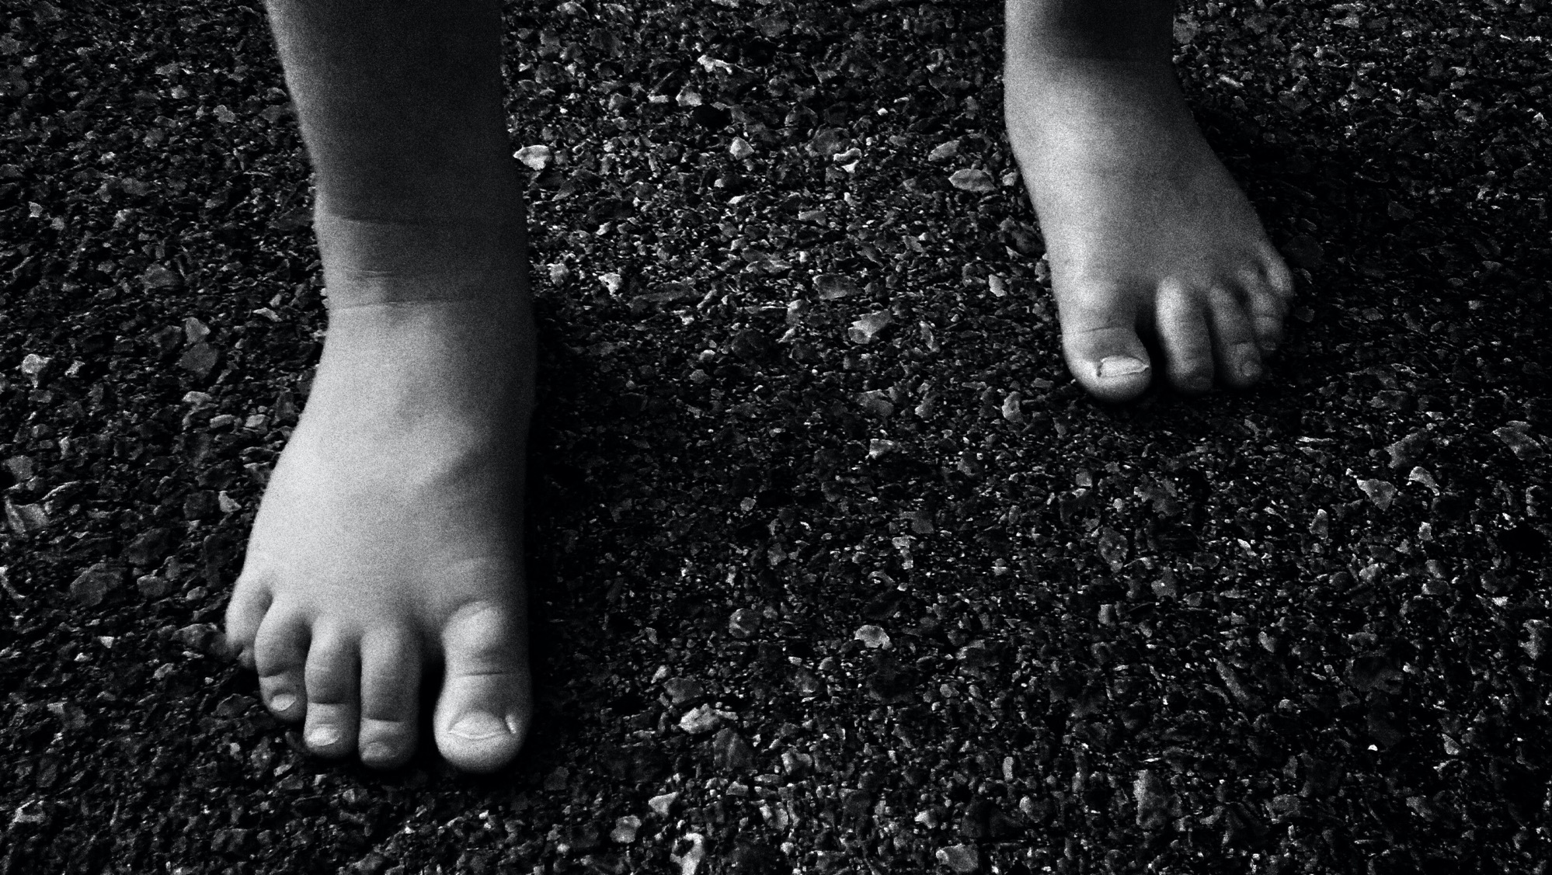
DESPERATION
REFUGEE CAMP
HELP

Slide 10
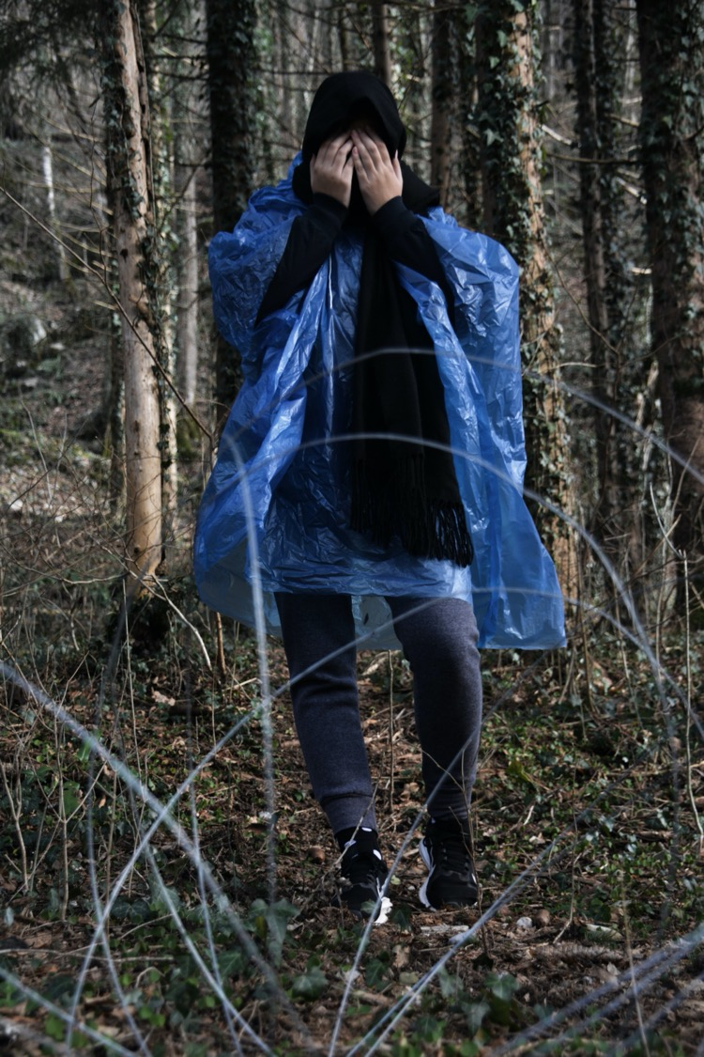
FEAR
COLD
HOPELESSNESS

Slide 11
BRIBERY
HOPE
LONELINESS

Slide 12
RUINS
SUSPENSE
ABANDONED PLACES

Slide 13
SHELTER
RAIN
DANGER

Slide 14
DISTRUST
HATE
HUNGER

Slide 15
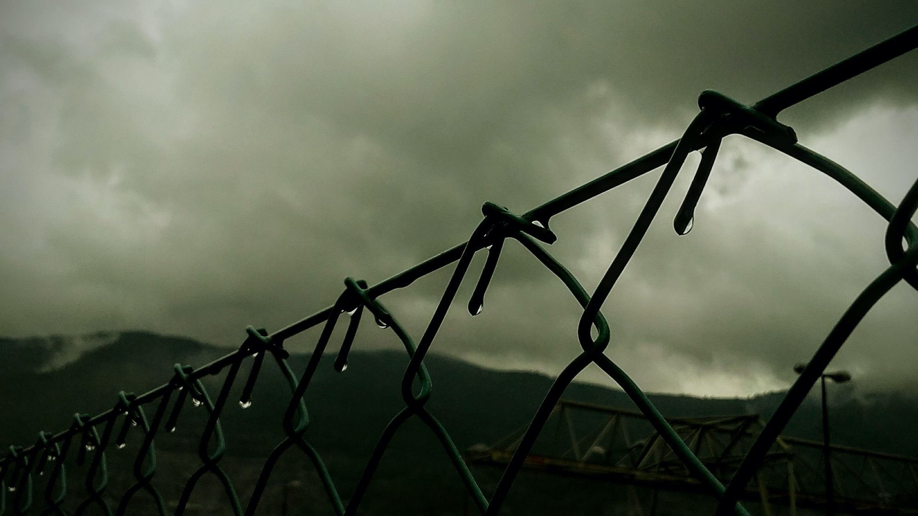
CAPITALISM
BARBED WIRE
GRIEF

Slide 16
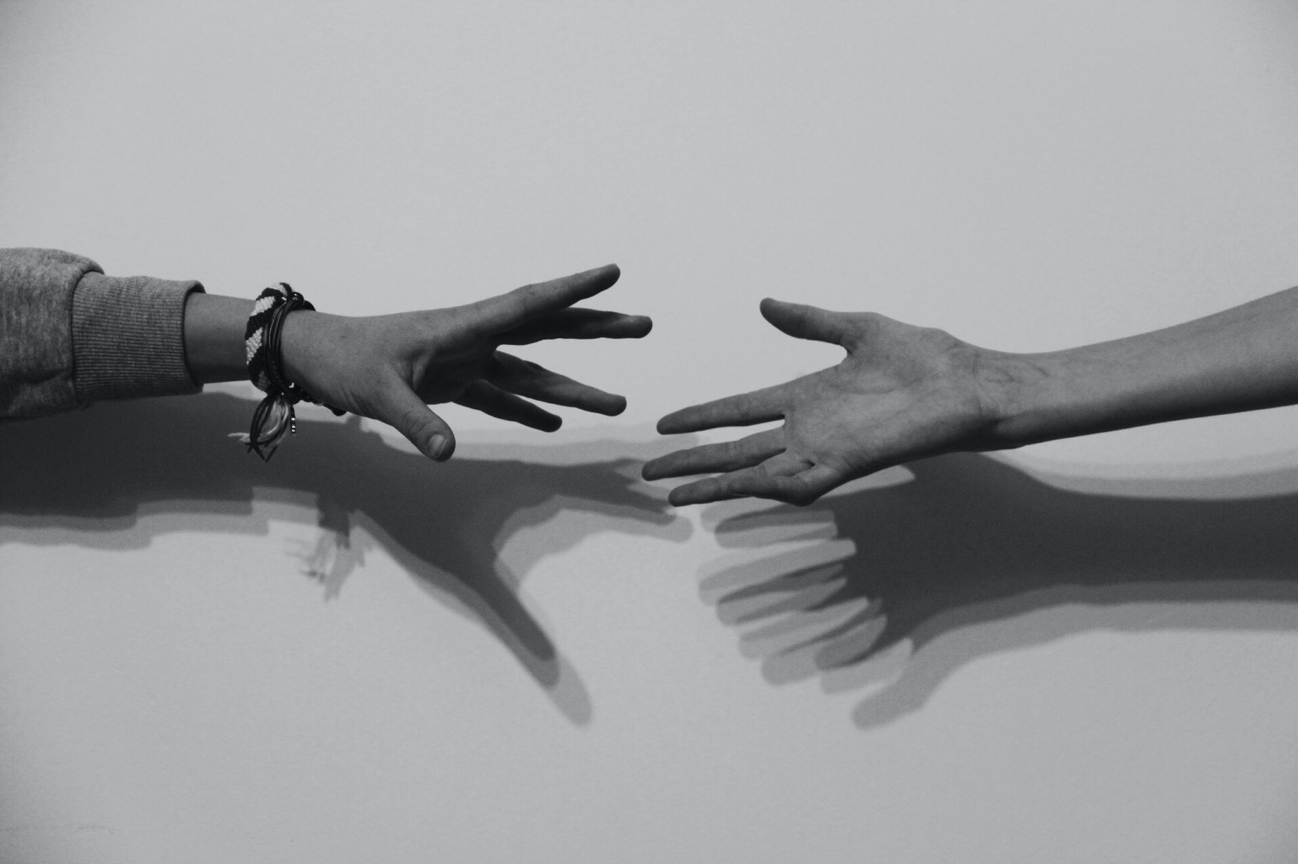
EMOTIONAL BOND
HOPE
POVERTY

Slide 17
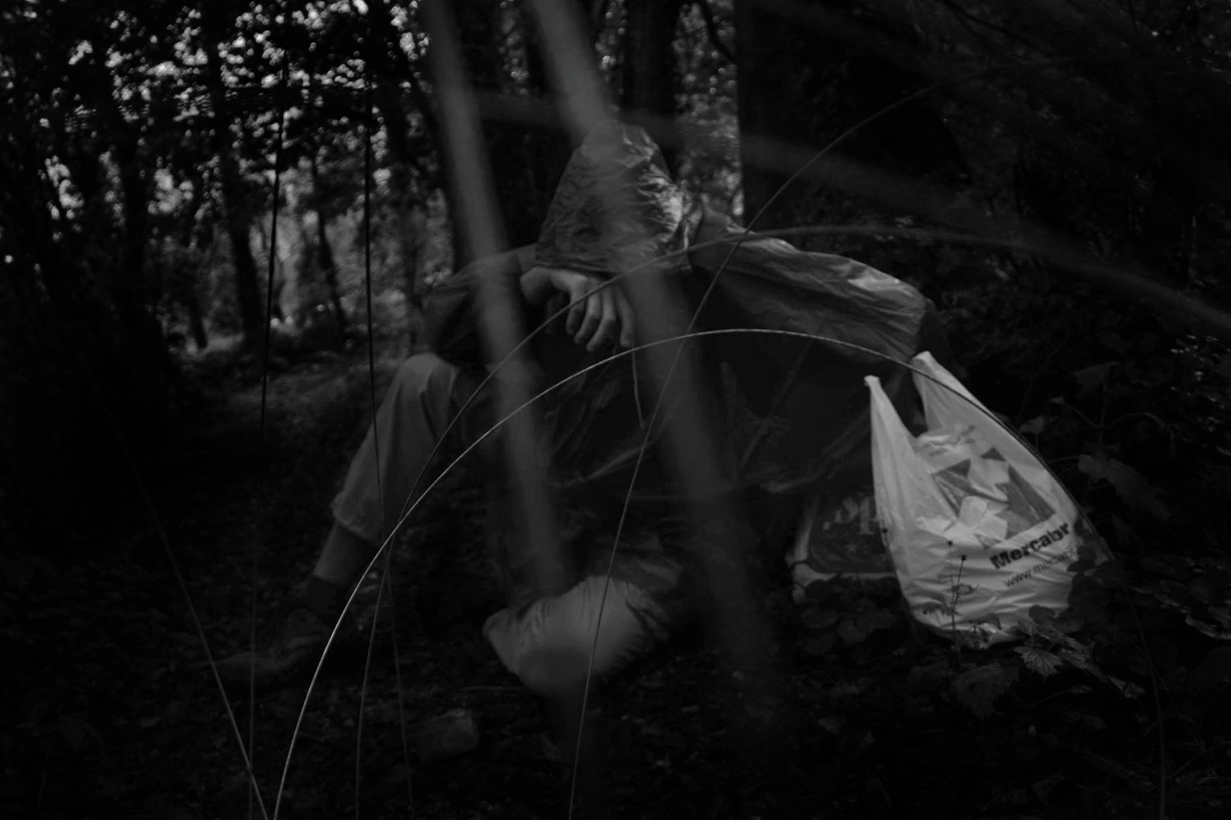
HELP
CANDLE
WAR

Slide 18
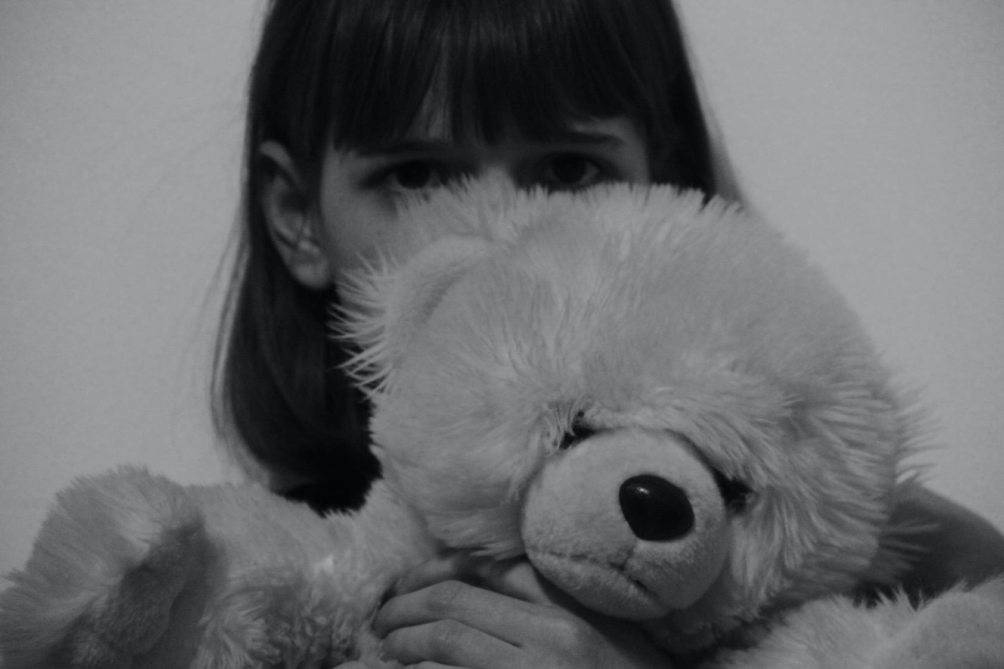
CHILDREN
TREASON
PREJUDICES

Slide 19
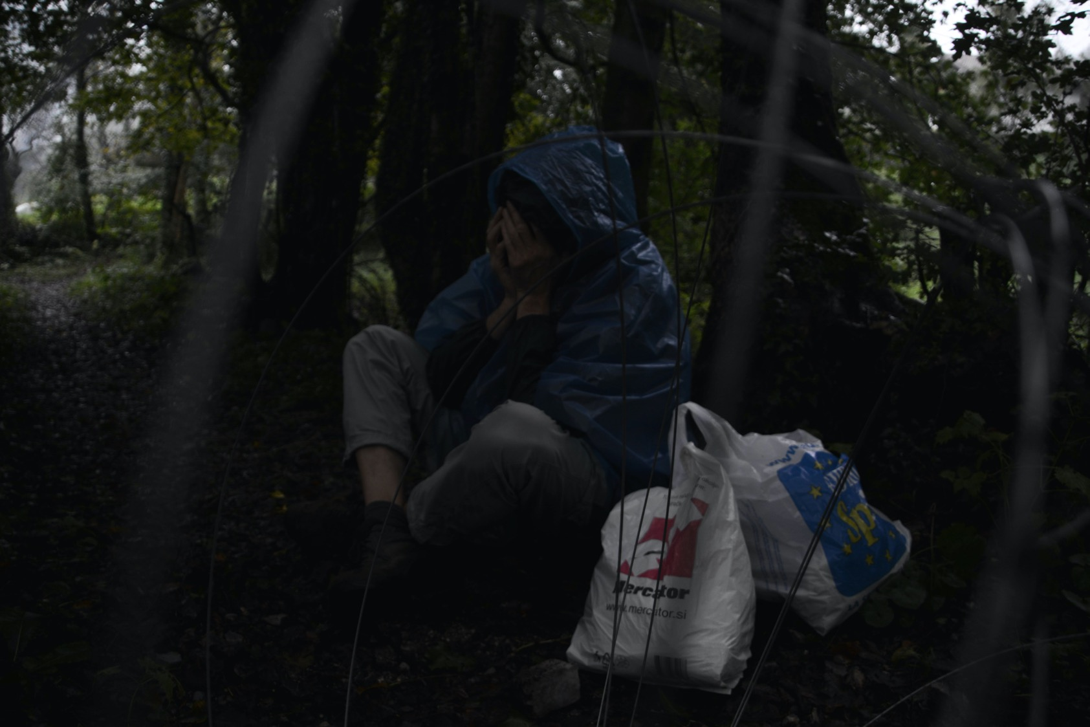
BAGS
SADNESS
DISCRIMINATION

Slide 20
THE DESIRE TO SUCCEED
HOPE
UNCERTAINTY

Slide 21
FOREST
EMIGRANT
RUN

Slide 22
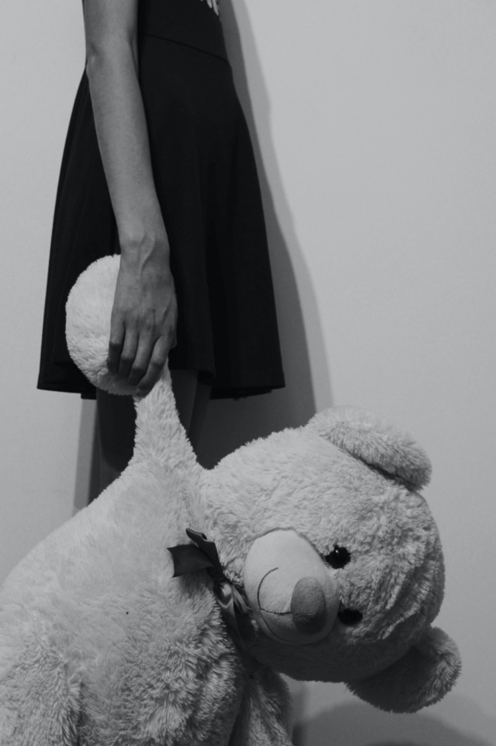
DESOLATION
REFUGEES
ANXIETY

Slide 23
UNTIDINESS
FLOWER
INTEGRATION

Slide 24
ROSE
BELIEF
PROMISE

Slide 25
A task for you
Also today the families are confronted with migration to foreign countries. Put yourself into a position of a peer who is currently experiencing it and present a story. Please keep in mind:
from where
to where
why and how
how he/she feels

Slide 26
https://www.fesliyanstudios.com/royalty-free-music/download/tears-wont-stop/231

Slide 27
Gimnazija Tolmin

