Slide 1
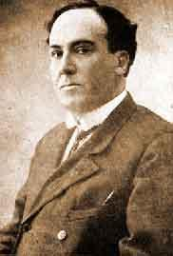
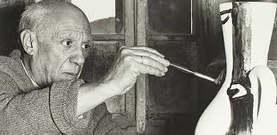
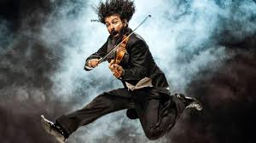
MIGRATION AND ART

Slide 2
INDEX
What has happened in our school since we met in Córdoba?
What are we going to focus on in this presentation?
Migration and art.
Conclusions.

Slide 3
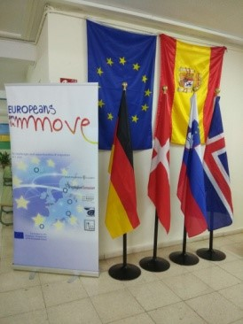
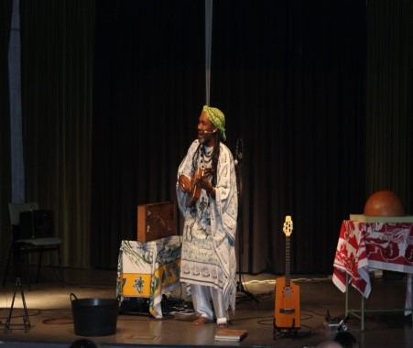
Kilema’s performance: A link between stories of success , migration and art.

Slide 4
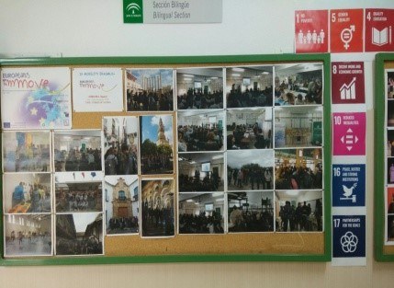
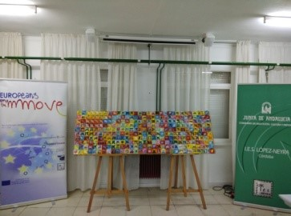
Dissemination of our project and products

Slide 5
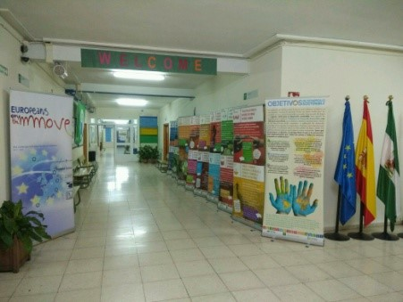
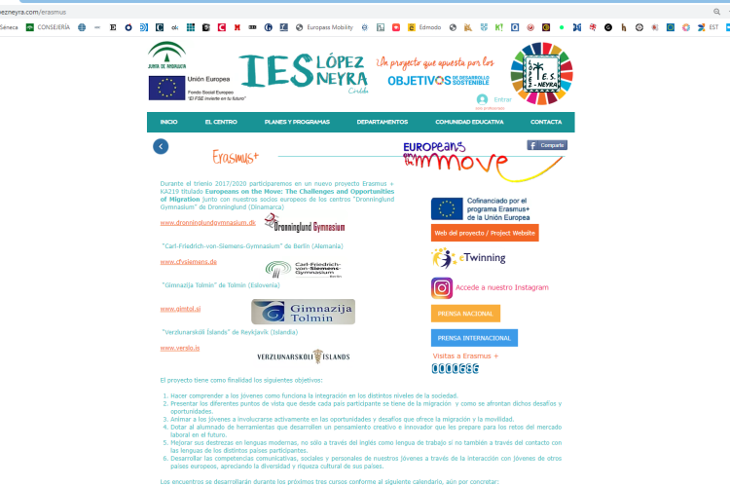
Campaign to promote the 2030 Agenda Global Goals
In the school corridors
In our web page

Slide 6
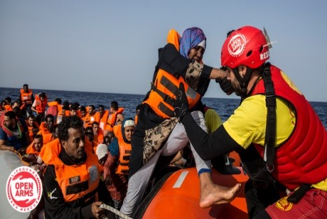
Solidarity week 2020:
Building bridges
01
02
Integrating migrants and raising money for NGO’s.
This year we are collaborating with OPEN ARMS.
03
They have saved hundreds of migrants in the Mediterranean sea

Slide 7
We want to :
Be able to criticise facts of our recent history.
Raise social conciousness about a current problem.
Engage the audience with our song.
01
02
03

Slide 8
MIGRATIONS AND ART
“El Guernica”
Ara Malikian
“As a way to denounce injustice in your homeland.”
“To help you survive and become a citizen of the world.”
1
3
Antonio Machado
Chambao
“To show you are the one who must create your own destiny.”
”To make visible the situation of illegal immigrants"
2
4

Slide 9
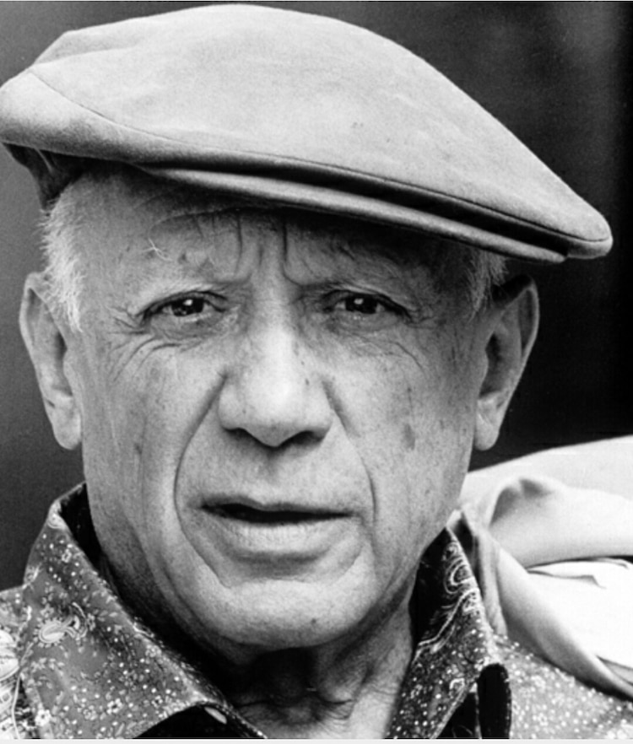
“EL GUERNICA” - PABLO PICASSO
1881
MÁLAGA
CIVIL
WAR
PABLO PICASSO
MONTMARTRE
SPANISH
PAINTER

Slide 10
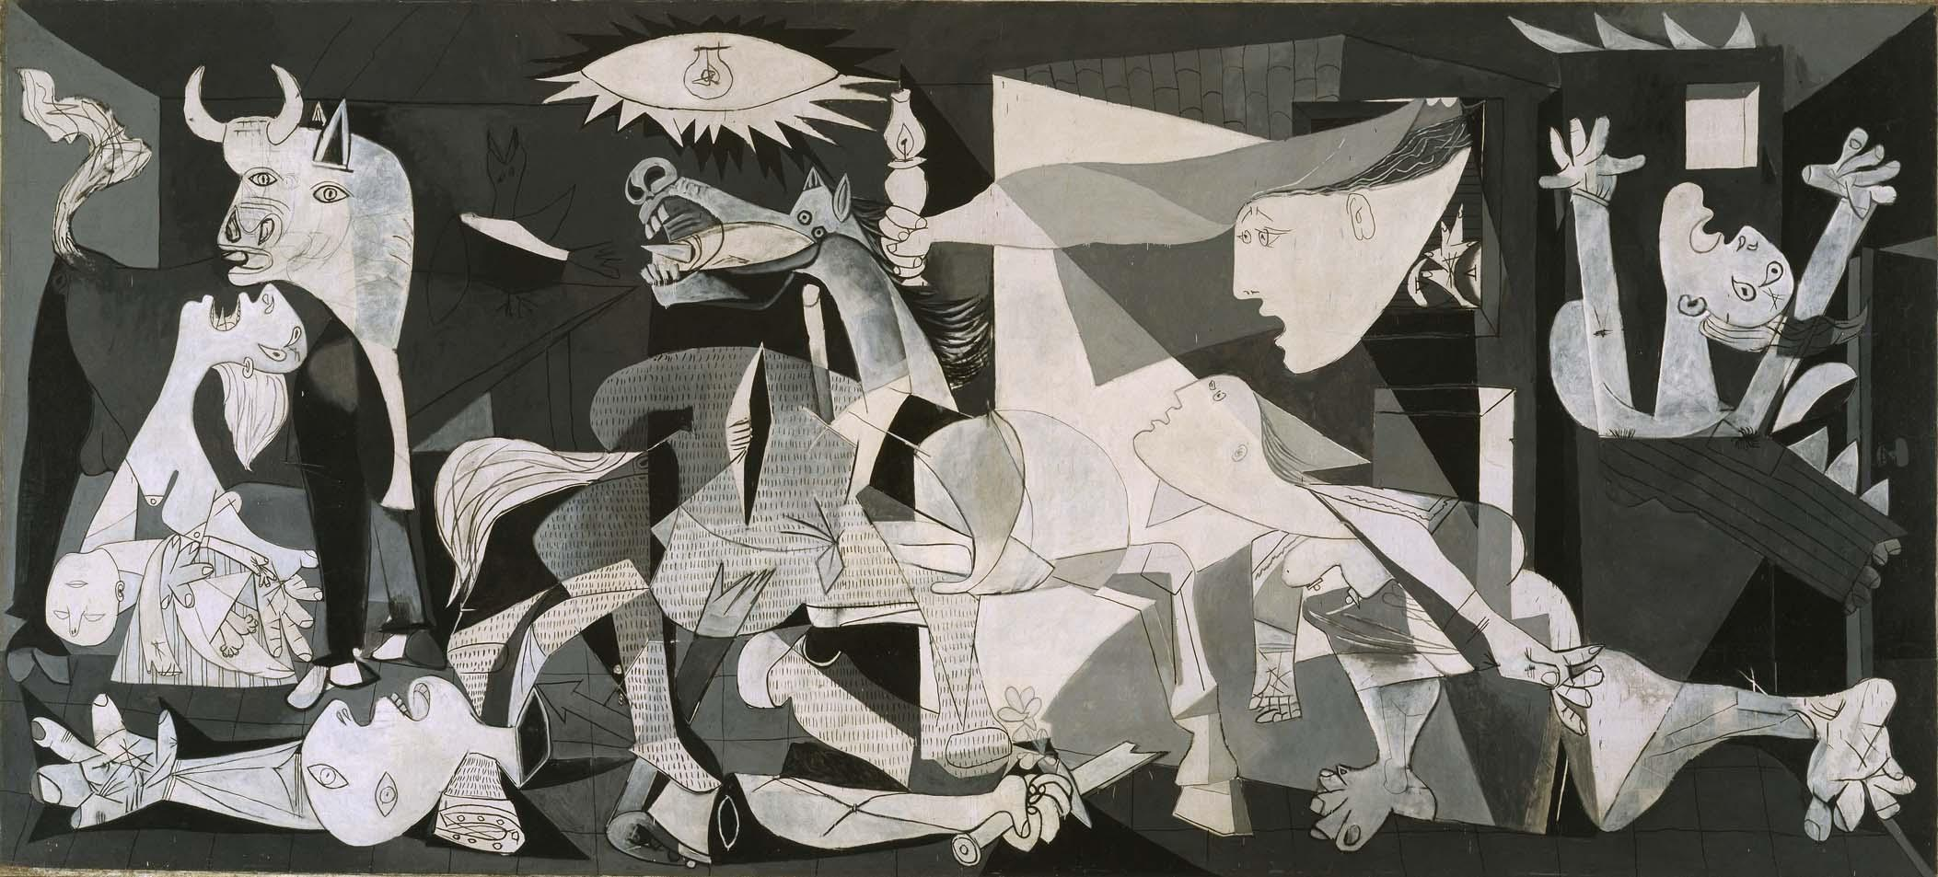
“EL GUERNICA” - PABLO PICASSO
1937 Nazi air raid, Guernica
“Art is a war instrument against the enemies”

Slide 11
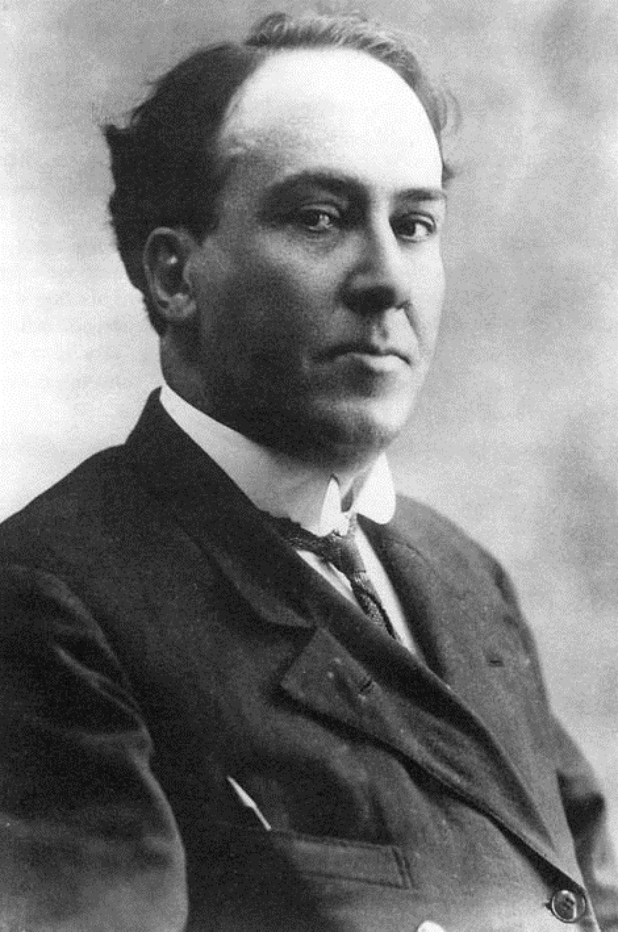
ANTONIO MACHADO
Seville, 1875
High school teacher
Spanish Civil War exile
Died France, 1939

Slide 12
POEM: “THE TRAVELLER”
The poet died far from home.
Shrouded by dust of a neighbouring land.
At his parting they heard him cry:
‘Traveller there’s no road
the road is your travelling…’
Step by step, line by line…
When the goldfinch can’t sing,
when the poet’s a wanderer,
when nothing aids our prayer.
‘Traveller there’s no road
the road is your travelling...’
Step by step, line by line.

Slide 13
POEM: “THE TRAVELLER”
Create our own destiny
Stop regretting
TO LEARN
TO
LIVE
TO EXPERIENCE
TO DISCOVER

Slide 14
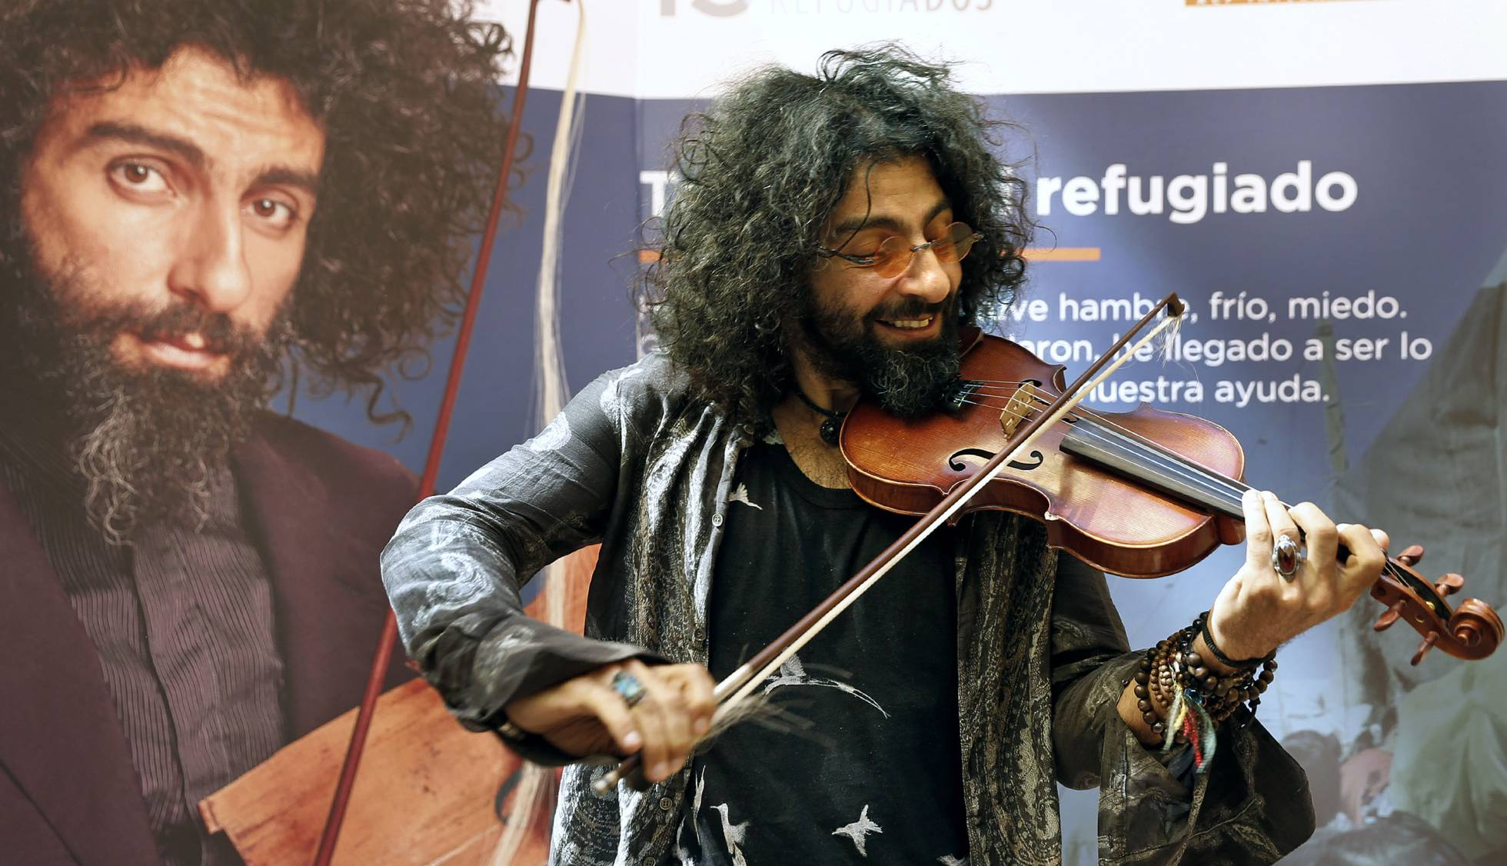
ARA MALIKIAN
Born in 1968, Armenian
Violinist from the age of 12
Lebanese War exile at 14 y/o
Lived as a refugee in Germany
Lives touring around the world

Slide 15
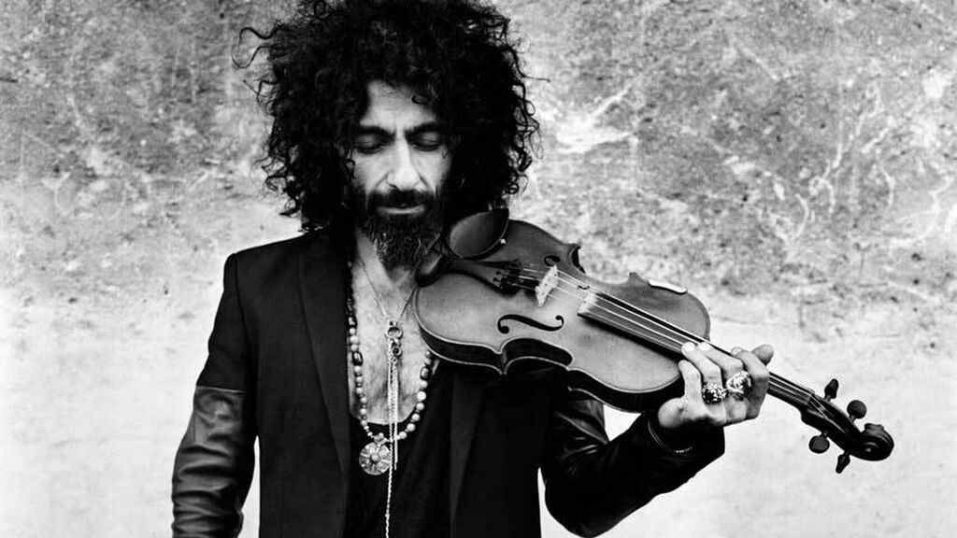
“A LIFE AMONG STRINGS”
https://aramalikian.com/ara-malikian-una-vida-entre-las-cuerdas/

Slide 16
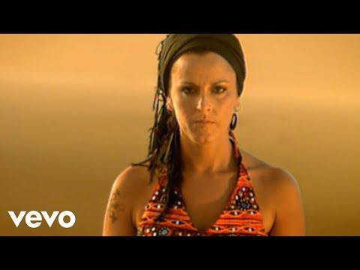
“Papeles mojados” by Chambao
-
LYRICS
Miles de sombras cada noche trae la marea, navegan cargaos de ilusiones que en la orilla se quedan.
Historias del día a día, historias de buena gente. Se juegan la vida cansados, con hambre y un frío que pela.
Ahogan sus penas con una candela,ponte tu en su lugar, el miedo que en sus ojos reflejan,la mar se echó a llorar.
Muchos no llegan, se hunden sus sueños papeles mojaos, papeles sin dueño.
La impotencia en su garganta con sabor a sal, una bocanada de aire le da otra oportunidad.
Tanta noticia me desespera, ponte tú en su lugar, el miedo que en sus ojos reflejan, la mar se echó a llorar.
Muchos no llegan, se hunden sus sueños papeles mojaos, papeles sin dueño.

Slide 17
Wet papers by Chambao
The tide brings every night thousands of shadows
They sail with deep and heartfelt hopes.
That in the banks are left.
Everyday stories
Good people stories
The risk their own lives, tired,
Starving and in a freezing cold.
They drown their sorrows with a bonfire
Put yourself in their place
Fear that their eyes reflect
The sea began to mourn
Many fail
Their dreams sink.
Wet papers, papers without owners
Fragile memories to drift
Tear the soul
Drenched through
Water drags them, hopeless
Powerlessness in their throats
Flavored salt
A breath of air
Given them another chance.
So much injustice exasperates me
Put yourself in their place
The fear that their eyes reflect
The sea began to mourn

Slide 18
CONCLUSIONS
Meaning of migration DIFFERENT PERSPECTIVES
Laws on migration A SHAME
History of migrationS WE ARE ALL MIGRANTS
Stories of success INDIVIDUAL & SOCIAL
Migration and art ART IS NECCESSARY

Slide 19
THANKS

