Slide 1
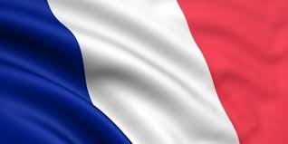
Bonjour
We are in France

Slide 2
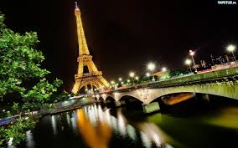
Geography
Paris is the capital of France

Slide 3
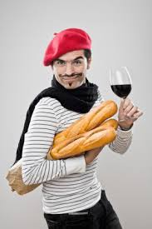
French people
Many Franch people wear beret.
Many franch men have got mustache.

Slide 4
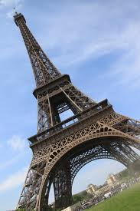
Famous buildings
The Eiffel Tower is the most
popular building in France

Slide 5
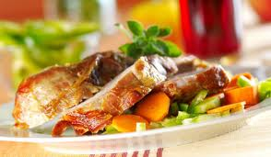
French food and drinks

Slide 6
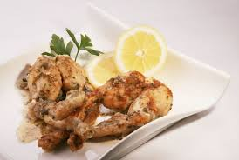
frog legs

Slide 7
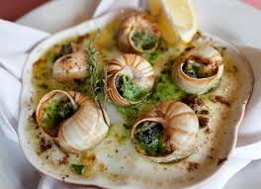
snails

Slide 8
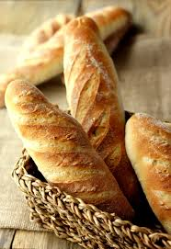
baguette

Slide 9
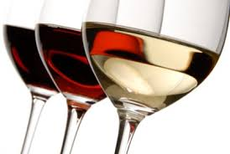
wine

Slide 10
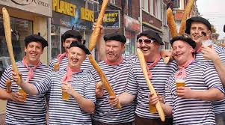
Thanks for your attention

